Slide 1
Measuring Mastery
Emily Zieno
Library Media Specialist, SCSD
10/26/16

Slide 2
Introduction
Library Media Specialist @ Clary Middle School, SCSD, 7 years
Creating Assessments, Collecting Data, Analyzing Data for Instructional Decisions, and Storing Data
Philosophy of role of LMS
Balance between providing good instruction and instilling a passion for reading

Slide 3
What is good instruction in the library?
Engaging lessons that focus on grade-level benchmark skills from the Empire State Information Fluency Continuum (IFC), using content from collaborating teacher/content area
Follow the I do/We do/You do model of teaching and learning
Differentiated based on data, specific needs of each student
Data is collected many times a year, in several different formats, for progress monitoring purposes and allows the LMS to analyze data to make decisions about how to effectively teach each student
Instruction looks different almost every day!

Slide 4
Creating assessments and collecting data
Multiple opportunities and formats of assessment
Tests
All students at Clary will take a library skills assessment 3 times a year (Sept/Oct, Jan/Feb, and May/June) using Castle Learning.
Student self-assessment
Pre and Post Project Self-Assessments
The post project assessment is part of the self-reflection process.
These pre and post project assessments are taken using pen and paper and results are stored in student folders.
Daily TOD’s (Ticket Out Door)
Authentic assessment
Within projects, assessment of skills as they naturally occur in the Stripling Model of Inquiry process.
Grades using rubrics, analyzing notes for a specific skill, etc.
Continuous formative assessment
Informal, while teaching mini-lessons

Slide 5
Other Useful Data
STAR Assessment
Use to determine lexile level for articles
Possible groupings for some skills
Miscellaneous
IEP
Behavior Plans
Learning Style information

Slide 6
What does a library skills assessment look like?
Created by LMS using Castle Learning
Combination of assessing ability to solve problems using actual grade level priority IFC benchmark skills AND assessing student’s confidence in his/her level of understanding or mastery of this skill
Both pieces of data are important to me
At times, there exists a disconnect between a student’s own recognition of mastery of a skill and the actual mastery of a skill.
This is important because if a student is not aware that a problem exists, I must address it with him/her.
Goal- Over a school year, students should show growth and mastery of each of the IFC priority benchmark skills.

Slide 7
Library Skills Assessment
Demonstrate Castle Learning test

Slide 8
What does the self-assessment look like?
Pre/Post project self-assessments AND daily TOD’s (Ticket Out Door)
Assessment of specific IFC benchmark skills being taught within the project and within each day
Asking for student to reflect on his/her ability level of each skill, using student friendly language
TOD
Students use shapes to correspond to : I don’t understand (I need a conference), I’m getting there (Please check in with me tomorrow), I understand (I’ll ask for help if I need it), or I’m an expert (I’m all good and can help someone else who is struggling)
Also asks for student explanation- Why did you choose this shape? Explain your thinking.
Pre/Post project self-assessment
Students circle one of the four options (expert/understand/getting there/don’t understand)
Comments section- used for teacher to express information (Pre- specific helpful feedback, Post- mastery)
Low risk opportunity for students to honestly communicate with me about their learning
LMS- look at these every day and, combined with other data, make decisions for next day instruction

Slide 9
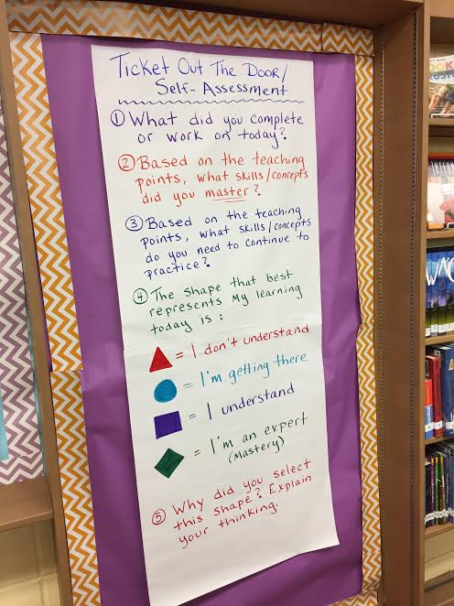

Slide 10
What does the authentic assessment look like?
Within each phase of the inquiry process, students will be demonstrating a benchmark skill, to be assessed while the project is underway
Set expectations and model what mastery of each skill looks like
Use rubrics where appropriate
Use student work- notes, graphic organizers, etc. to assess skills
Also use observation to assess skills
Authentic assessment data is recorded in the “Comments” section
Meaningful, specific feedback is always given in a timely manner

Slide 11
What does continuous formative assessment look like?
While teaching, various methods are used to gauge student understanding of material being taught
Methods of eliciting student feedback
Questioning
Silly things to elicit response (hands on head if you think… or hands on knees if you think…)
Thumbs up/ thumbs down
Dry erase boards or signal cards
Shapes on TOD
Observation
What do I see specific kids struggle with? What strengths do specific kids have?

Slide 12
What does the data look like?
Overall data
Whole group instruction
Helps me reflect on teaching practices/lessons
Do I need to reteach a specific skill? Present information a different way?
Individual data
Information for conferencing
Offering feedback
Create specific groupings, create specific activities based on data
Combination of ALL pieces of data that inform and drive instruction

Slide 13
More assessment?! Ugh…
Data driven instruction requires meaningful assessment in order to effectively:
Get to know my kids better!
Differentiate instruction
Create like groups or mixed groups that continually change
Pull small groups for re-teaching purposes
Conference with individual students
Creates a confidence with students- they know instructional choices are deliberate

Slide 14
Create/Collect/Analyze/Store Data
Create assessments? Check!
Collect data? Check!
Analyze data? Check!
Store data? … How do I do that?

Slide 15
Student Folders
Student work
Assessment results
Benchmark Tracking Sheet- list of all IFC benchmark skills for grade level
Skills are checked off when mastery has been achieved
By end of year, ALL skills should be checked off
Goal #1- Demonstrate mastery of each IFC priority benchmark skill
Goal #2- If students demonstrate mastery, then students must be challenged and instruction must reflect the need

Slide 16
Bulletin Board
Each grade level has listed all IFC priority benchmark skills, using the Stripling Model of Inquiry
Post additional signage when skill has been taught through a specific project
Visual for students – I have learned this skill
Visual for staff- LMS teaches the inquiry process with specific benchmark skills and is an educator

Slide 17
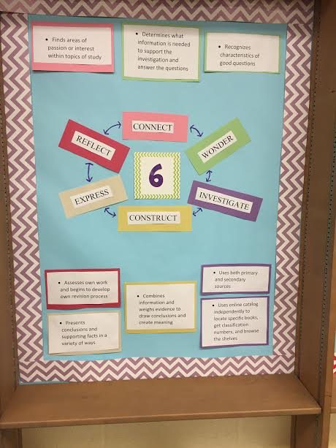

Slide 18
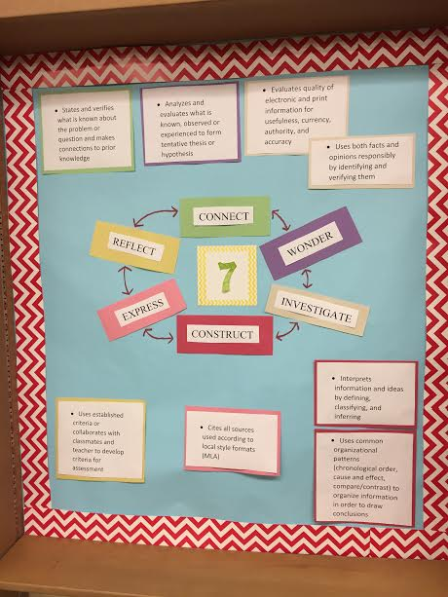

Slide 19
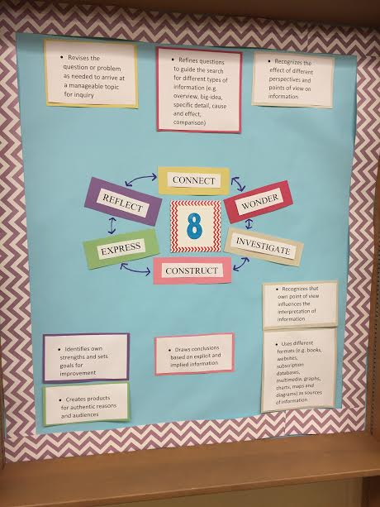

Slide 20
Real examples- Student perspective
Library skills assessment 3 times a year on Castle Learning
Every time I go to the library for a project, I take a pre/post project self-assessment of the benchmark skills being taught for that particular assignment. I fill out a ticket out the door every day, where I rate my learning, based on the skills being taught. I’m also assessed based on rubrics and teacher observation.
My student folder houses all of my work created in the library, as well as my benchmark tracking sheet, to keep records of the skills I have mastered.

Slide 21
Real examples- LMS perspective
LMS creates a library skills assessment on Castle Learning and administers to all 6-8 students through SS classes
LMS creates pre-assessment based on selected benchmark skills we will be working on (1 per each phase of the inquiry process)
LMS analyzes initial library skills assessment, pre-project self- assessment (and other miscellaneous data) to make some initial instructional decisions
Mini lessons throughout the project on each skill
Anchor charts with explicit processes and help, agenda/objectives/etc. posted
Typically, whole group instruction (I Do / We Do / You Do) then LMS pulls a small group to work with on particular skill while others are independently working OR student-led small groups AND/OR individual conferences and check-ins
Groupings continually change based on skill and task, using data (like or mixed)
Student leaders in the room based on skill we are working on (Tech Support group, Perfect Paraphrasers, etc.) selected to lead class while LMS works with small groups or individuals – specific procedures for this
Learning looks different for students at different times (students with highlighters reading a printed article, students online with headphones listening and reading to an article, students evaluating websites to find a reliable article, students with graphic organizers, etc.)
High expectations for all students- challenge and push themselves
Specific procedures for everything
Daily Ticket Out the Door AND student work produced that day gives LMS more data to analyze and flex plan for following day
LMS analyzes data from all 3 of the library skills assessments as a way to evaluate instructional piece of the library program

Slide 22
What Gets Differentiated?
Level and complexity of content
Pace
Scaffolds and Supports
Student Work
Activities
Differentiation applies to all students (students who struggle, students who need more challenge)
Examples: tiered instruction, centers, scaffolds, etc.

Slide 23
Positive Outcomes
For administrators
Instructional piece of the library program is very focused and strong
Evidence of teaching and learning happening in the library
For LMS/Students
Data has become a powerful communication tool between LMS and students
Student involvement = engagement, awareness and ownership of learning and work in the library
Portfolio of student work to show progress and growth
Instruction is differentiated/targeted and data driven, based on student needs
Data allows me to be more thoughtful and reflective of my teaching practices and lessons
Allows for meaningful vertical conversations- better transitions between schools

Slide 24
Bottom Line
Data = Opportunities
BUT, you have to not only create assessments and collect data
You also need to analyze it and base instructional decisions and strategies around it (and store it to track short-term project goals and long-term school career goals)
By doing this you are honoring each student as an individual learner and doing your very best to meet their needs!

Slide 25
Questions/ Comments/ Ideas
Contact information:
Emily Zieno
ezieno@scsd.us

