Slide 1
http://www.c3teachers.org
The Learning Commons and the C3 Framework for Social Studies

Slide 2
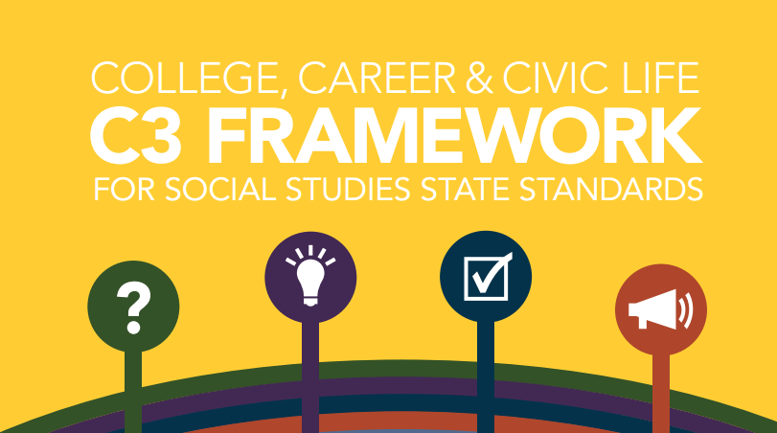
What is the C3 Framework
Notes:
The result of a three year state-led collaborative effort, between the Council of Chief State School Offices (Commissioners of Education) and the National Social Studies the College, Career, and Civic Life (C3) Framework for Social Studies State Standards was developed to serve two audiences: for states to upgrade their state social studies standards and for practitioners — local school districts, schools, teachers and curriculum writers — to strengthen their social studies programs. Its objectives are to: a) enhance the rigor of the social studies disciplines; b) build critical thinking, problem solving, and participatory skills to become engaged citizens; and c) align academic programs to the Common Core State Standards for English Language Arts and Literacy in History/Social Studies.

Slide 3
C3 Framework-who?
Council of chief State school Officers
National council for Social Studies
Key authors: S.G. Grant, Kathy Swan, John Lee, David Hicks

Slide 4
C3 Framework-why?
“The primary purpose of Social Studies is to help young people develop the ability to make informed decisions for the public good as citizens of a culturally diverse, democratic society in an interdependent world”. (adapted from the National Council for the Social Studies)

Slide 5
C3 Framework-why?
for states to upgrade their state social studies standards and
for practitioners — local school districts, schools, teachers and curriculum writers — to strengthen their social studies programs.

Slide 6
C3 Framework-why?
enhance the rigor of the social studies disciplines
build critical thinking, problem solving, and participatory skills to become engaged citizens
align academic programs to the Common Core State Standards for English Language Arts and Literacy in History/Social Studies

Slide 7
NYS Social Studies Framework
2011-Development began with a Content Advisory Panel
April 2014-New York State adopted the K-12 Social Studies Framework
September 2014-regulations change for Social Studies
October 2014-regulation change language
Field Memo published March 2015

Slide 8
INQUIRY at the focus
“The C3 Framework will focus primarily on Inquiry and concepts and will guide - not prescribe - the content necessary for a rigorous Social Studies program. The CCSSO recognizes the critical importance of content to the disciplines within social studies and supports individual state leadership in selecting the appropriate and relevant content.”
Notes:
C3 Framework; national collaborative work. Used by NYS in developing NY framework. SG Grant a C3 leader; leading work in creating inquiries adopted by NYS. Inquiry based teaching; student centered approach
The Inquiry Arc is integrated into the NYS Framework. The C3 is built on the foundation of an inquiry arc, “a set of interlocking and mutually reinforcing ideas that feature the four Dimensions of informed inquiry in social studies:
(1) Developing questions and planning inquiries;
(2) Applying disciplinary concepts and tools;
(3) Evaluating sources and using evidence; and
(4) Communicating conclusions and taking informed action” (p17).

Slide 9
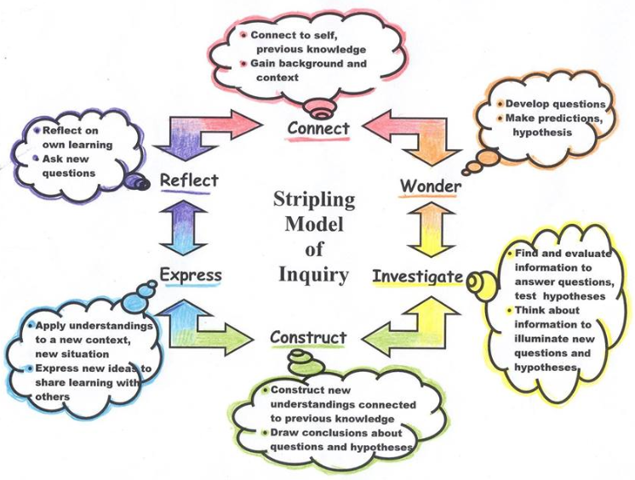
STRIPLING MODEL OF INQUIRY

Slide 10
C3 Inquiry Arc
C3 Inquiry Arc
Inquiry Arc
Dimension 1: Developing Questions and Planning Inquiries (connect)
Dimension 2: Applying Disciplinary Tools and Concepts (Civics, Economics, Geography, and History) (wonder/make predictions)
Dimension 3: Evaluating Sources and Using Evidence (investigate/construct)
Dimension 4: Communicating Conclusions and Taking Informed Action (express/reflect)
What is the C3 Framework?
Notes:
The dimensions of the Inquiry Arc as presented in the C3 Framework are:
Developing Questions and Planning Inquiries
Applying Disciplinary Tools and Concepts
Evaluating Sources and Using Evidence
Communicating Conclusion and Taking Informed Action

Slide 11
Inquiry Practices
Notes:
Inquiry practices that contribute to the literacy foundations in social studies
Highlight reading standard 1
Evidence is key, particularly in dimension 3 which focuses on developing claims using evidence and inferentially in developing questions answered with evidence in D1 or communicating conclusions with evidence in D4

Slide 12
NYS Social Studies Standards 1996
Standard 1: History of the United States and New York
Standard 2: World History
Standard 3: Geography
Standard 4: Economics
Standard 5: Civics, Citizenship, and Government

Slide 13
NYS Social Studies Practices
Gathering, Using and Interpreting Evidence
Chronological Reasoning and Causation
Comparison and Contextualization
Geographic Reasoning
Economics and Economic Systems
Civic Participation

Slide 14
Common Core Literacy Skills
Reading
Key Ideas and Details
Craft and Structure
Integration of Knowledge and Ideals
Range of Reading and Text Complexity
Writing
Text Types and Purpose
Production and Distribution of Writing
Range of Writing
Speaking and Listening
Comprehension and Collaboration
Presentation of Knowledge and Ideas

Slide 15
Key Ideas, Conceptual Understandings & Content Specifications
https://www.engageny.org/resource/new-york-state-k-12-social-studies-field-guide/file/114196

Slide 16
Social Studies Content Remains the Same

Slide 17
3 INSTRUCTIONAL SHIFTS
Focus on Conceptual Understanding
Foster Student Inquiry, Collaboration and Informed Action
Integrate Content and Skills Purposefully

Slide 18
Shift #1: Focus on Conceptual Understanding
From
To
Facts
Concepts and Content Knowledge
Breadth of Topics
Depth within Topics
Recall
Transfer and Connections
Notes:
inquiry learning focuses on students’ understanding and applying ideas to new contexts rather than simply knowing, doing rather than receiving (active instead of passive learning), and constructing new understandings rather than memorizing facts
All inquiry models require the same focus on conceptual understanding. This has many implications for classroom practice and lesson/unit design

Slide 19
Shift #2: Foster Student Inquiry, Collaboration, and Informed Action

Slide 20
Shift #3: Integrate Content and Skills Purposefully

Slide 21
IDM – Inquiry Design Model
IDM-a distinctive approach to creating curriculum and instructional materials that honors teachers’ knowledge and expertise.
Unique to the IDM is the “blueprint” template, a one page representation of the questions, tasks and sources that define an inquiry.

Slide 22
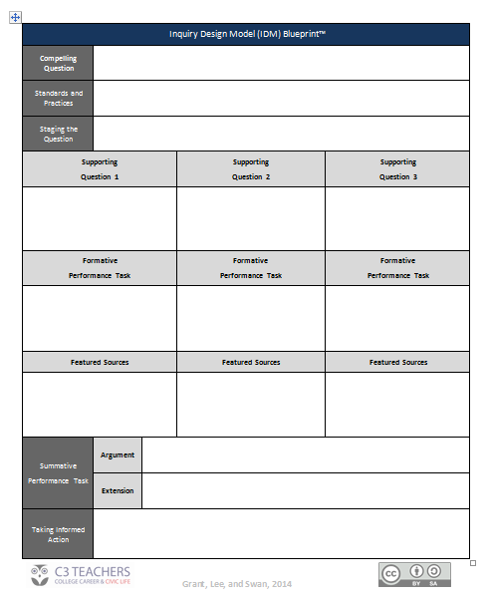

Slide 23
Inquiry Design Model Blueprint
Compelling question
Standards and Practices
Staging the question
Supporting question
Formative performance tasks
FEATURED SOURCES
Summative performance tasks
Taking informed action

Slide 24
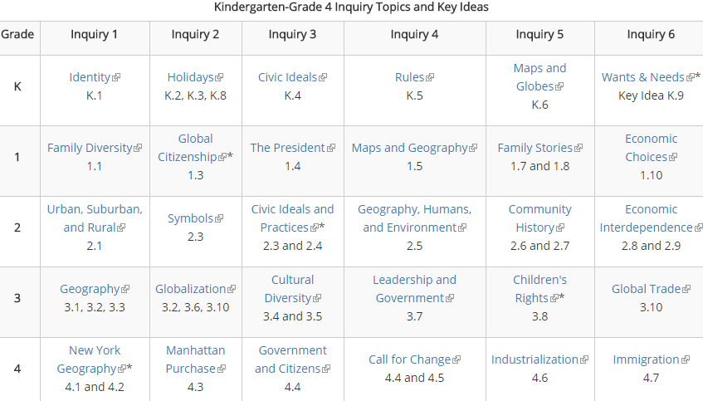
THE NYS TOOLKIT INQUIRIES
https://www.engageny.org/resource/new-york-state-k-12-social-studies-resource-toolkit-kindergarten-grade-4

Slide 25
C3 and the Learning Commons –Historical Thinking Skills
Gathering, Using and Interpreting Evidence
Chronological Reasoning and Causation
Comparison and Contextualization
Geographic Reasoning
Economics and Economic Systems
Civic Participation
The link to what we do as librarians is perfect. It is another golden opportunity…if we “choose to accept it”
https://www.youtube.com/watch?v=XAYhNHhxN0A
Notes:
The emphasis in Dimensions 2 and 3 ((2) Applying disciplinary concepts and tools;
(3) Evaluating sources and using evidence) mirrors the focus on skills in general and the vertical articulation of Social Studies practices

Slide 26
WHAT CAN LIBRARIANS DO?
Keep your ear to the ground
Check http://www.C3 teachers.org page often
Be part of the conversations in your building/district
Be the answer and help, your teachers need; they cannot create these inquiries without you.
Design easy access to pages/links of resources
They are unfamiliar with databases, Library of Congress, text sets, etc.
Be prepared to deliver professional learning on this.
Be the GO-TO person

Slide 27
FAMILIARIZE YOURSELF WITH:
Stanford History Education Group https://shed.Stanford.edu
Beyond the Bubble http://beyondthebubble.stanford.edu/
National Council for Social Studies http://www.socialstudies.org/
SCIM-C http://www.historicalinquiry.com
NYC libguide http://nycdoe.libguides.com/skills
ESIFC & SS Alignment http://inquiryk12.ischool.syr.edu/
Syracuse CSD http://www.ssmatters.com/
CQ & Library of Congress Primary Source Sets http://capregboces.libguides.com/ld.php?content_id=18438767
https://www.engageny.org/node/266/file/14666

Slide 28
The Empire State Information Fluency Continuum: An Inquiry Skills-Based Resource
https://www.engageny.org/resource/empire-state-information-fluency-continuum

Slide 29
