Slide 1
Teacher Evaluation
Using the Professional Practice Rubric

Slide 2
Review of the Race To The Top Initiatives

Slide 3
NYS Teaching Standards

Slide 4
Evaluation using the Professional Practice Rubric

Slide 5
Evaluation using the Professional Practice Rubric
In Cazenovia

Slide 6
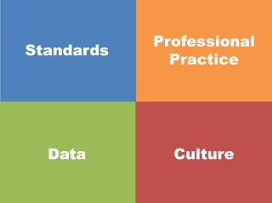
The Big Picture

Slide 7
Time out!
So, what do we know and not know but want to know?
Write one thing per sticky note and place on wall near appropriate sign.
Build in a break after you stick your notes.

Slide 8
NYS Teaching Standards

Slide 9
Imagine you are in the classroom of a highly effective teacher:
What would you see?
What would you hear?
What would the students be doing or saying?
Individually, write one idea per post-it note.
Notes:
NOTES

Slide 10
As a group, arrange the sticky notes in a way that makes sense, grouping similar ideas together.
Notes:
Need for a common languages. Even thought we had a convergent sense of what should be occurring in a classroom, we all have different descriptors and ways of talking about it

Slide 11
Draw the pie on chart paper.
Label the slices.
Now stick the sticky notes in the slice of the pie in which they belong
Standard 7
Professional Growth
Notes:
NOTES

Slide 12
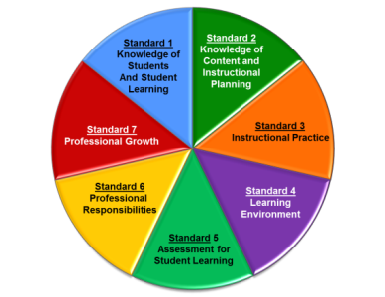
Standard 1: Knowledge of Students & Student Learning
Knowledge of child development
Knowledge of research…
Knowledge of diverse learning needs
Knowledge of individual students
Knowledge of economic, social
Knowledge of technological literacy…
Notes:
NOTES

Slide 13
Standard 2: Knowledge of Content & Instructional Planning
Knowledge of content…
Connect concepts across disciplines…
Uses a broad range of instructional strategies
Establishes goals & expectations
Designs instruction
Evaluate / utilize resources
Notes:
NOTES

Slide 14
Standard 3: Instructional Practice
Research-based practices
Communicates clearly…
High expectations…
Variety of instructional… to engage student
Engage students in multi-disciplinary skills
Monitor and assess progress
Notes:
NOTES

Slide 15
Standard 4: The Learning Environment
Creates a respectful, safe and supportive environment
Creates an intellectually stimulating environment
Manages the learning environment
Organize and utilize available resources (e.g. physical space, time, technology…)
Notes:
NOTES

Slide 16
Standard 5: Assessment for Student Learning
Range of assessment tools
Understand, analyze, use data for differentiation*
Communicates assessment system*
Reflect upon assessment system and adjust*
Prepare students for assessments
* - assessed through “multiple measures”
Notes:
NOTES

Slide 17
Standard 6: Professional Responsibilities
Upholds standards and policies
Collaborate with colleagues
Communicate & collaborate with families
Perform non-instructional duties
Complies with laws and polices
Notes:
NOTES

Slide 18
Standard 7: Professional Growth
Reflect on practice
Set goals for professional development
Communicate and collaborate to improve practice
Remain current in knowledge of content and pedagogy
Notes:
NOTES

Slide 19
Using the placemat for the NYSED Teaching Framework, re-sort your table’s post-it notes as appropriate to the standard, element and indicator
Notes:
NOTES

Slide 20
Knowledge of Students & Student Learning
Element 1.1 Demonstrate knowledge of child and adolescent development including cognitive, language, social, emotional, and physical developmental levels.
A) Describes developmental characteristics of students
Standards
Summary statements
Elements
Indicators
With rubrics
Notes:
20
NOTES

Slide 21
There are three priorities in the Teaching Standards
Engagement
Constructivism
21st Century Readiness
PRIORITIES
Notes:
NOTES

Slide 22
Engagement:
Cognitive
Zone of proximal development
Every student (ELLS, SWD, too)
ENGAGEMENT
Notes:
NOTES

Slide 23
Constructivism:
Making connections
Making meaning
Relate to world outside
Relate to personal future
CONSTRUCTIVISM
Notes:
NOTES

Slide 24
21C Readiness:
College
Career
Citizenship
Collaboration
Communication
Critical Thinking & Problem Solving
Creativity
21C READINESS
Notes:
NOTES

Slide 25
Video Observation
Observe what students are doing that shows evidence of engagement, constructing meaning, or 21C. Each triad member is responsible for one priority.
Collect evidence in a table, be prepared to share your evidence.
engagement
constructivism
21C
Notes:
Watch 10 minutes of a lesson. Use math “best deal” video? We have to make sure we chart these pieces of “evidence” for use later!!!

Slide 26
Video Observation
What did you observe in the video?
Evidence from the video
Notes:
We have to make sure we chart these pieces of “evidence” for use later!!!

Slide 27
In addition to the three priorities, other common themes of the Standards (and rubrics):
Upholds standards and policies
Equity
Cultural competence
High expectations
Developmental appropriateness
A focus on individuals, including those with special needs
Appropriate use of technology
Student assumption of responsibility
Notes:
NOTES

Slide 28
Learning by Adults and Learning by Children

Slide 29
Conditions for Learning
Reflect on something you recently learned.
How did you learn it?
How do you know?
What conditions help you learned it?

Slide 30
Conditions for Learning
Reflect on something you recently learned.
How did you learn it?
How do you know?
What conditions help you learned it?
It’s hard to learn on you own without any feedback…

Slide 31
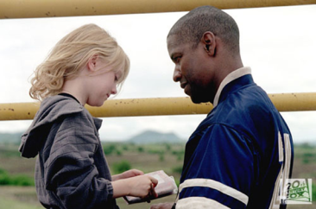
Effective Feedback
What were the qualities of the best feedback you have received?
What were the qualities of ineffective feedback?

Slide 32
Translating this to Evaluation…

Slide 33
Translating this to Evaluation… adds Accountability…

Slide 34
Translating this to Evaluation… adds Accountability… for Teachers and Evaluators

Slide 35
Highly Effective
Effective
Developing
Ineffective
Notes:
NOTES

Slide 36
Ineffective – Teaching shows evidence of not understanding the concepts underlying the component - may represent practice that is harmful - requires intervention
Developing – Teaching shows evidence of knowledge and skills related to teaching - but inconsistent performance
Notes:
NOTES

Slide 37
Effective - Teaching shows evidence of thorough knowledge of all aspects of the profession. Students are engaged in learning. This is successful, accomplished, professional, and effective teaching.
Highly Effective – Classroom functions as a community of learners with student assumption of responsibility for learning.
This
Is
our focus
Notes:
NOTES

Slide 38
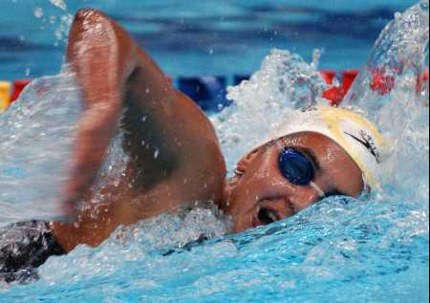
H
E
D
I
Notes:
NOTES

Slide 39
H
E
D
I
?
Notes:
NOTES

Slide 40
Teacher Evaluation
Using the Professional Practice Rubric
Day 2

Slide 41
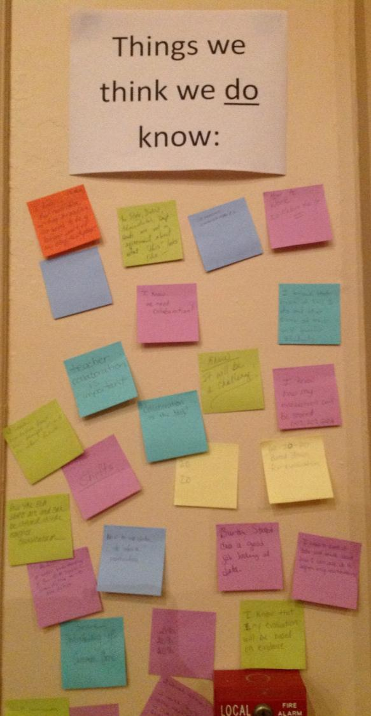
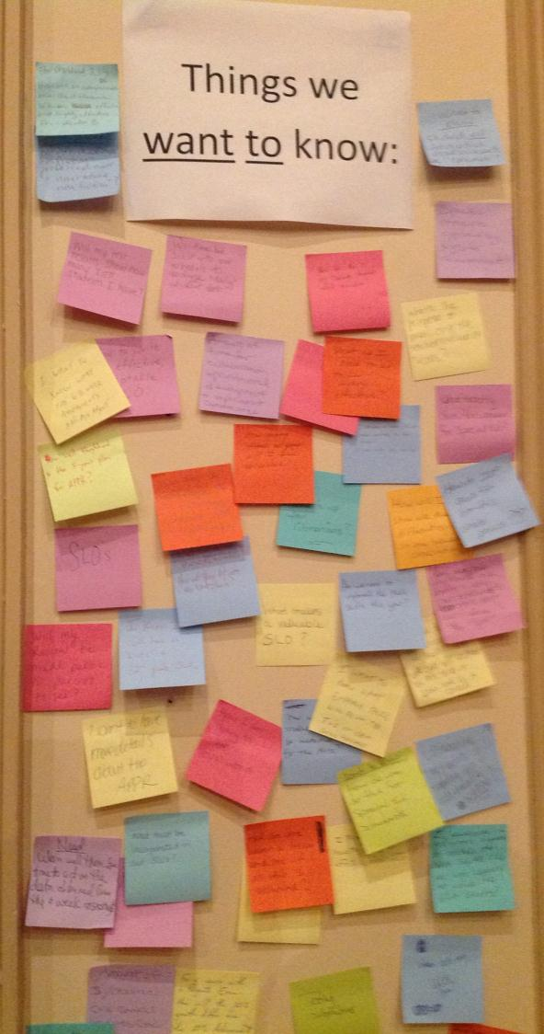

Slide 43
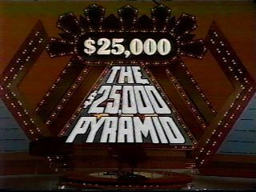
Review

Slide 44
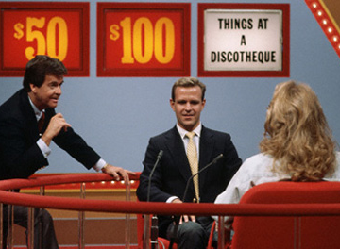
Review

Slide 45
$25K
$1000
$10K
$50
$100
$500

Slide 46
Standards

Slide 47
Data

Slide 48
Professional
Practice

Slide 49
Evidence

Slide 50
Engagement

Slide 51
Constructivism

Slide 52
21stC Readiness

Slide 53
Feedback

Slide 54
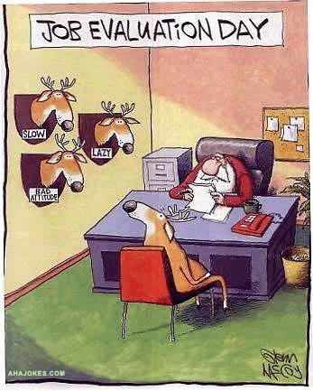
Notes:
NOTES

Slide 55
What’s wrong with teacher evaluation?
Why hasn’t it always resulted in professional growth?
What conditions support growth?
Notes:
NOTES

Slide 56
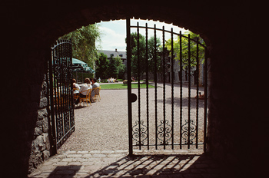
Three “Gates” for Effective Teacher Evaluation
Fairness
Reliability
Validity
Notes:
NOTES

Slide 57
Evidence is a factual reporting of events.
It may include teacher and student actions and/or behaviors.
It may also include artifacts prepared by the teacher, students, or others.
It is not clouded with personal opinion or biases.
It is selected using professional judgment by the observer and / or the teacher.
Notes:
Go back to the chart paper list of evidence from the watching of the fist video. Which ones are evidence and which are opinions.

Slide 58
Evidence v. opinion:
Back to yesterday’s video observation notes. Decide – is it evidence or opinion? Is it free from bias?
Notes:
NOTES

Slide 59
COLLECT DATA
(Evidence)
SORT TO
ALIGN
WITH YOUR
FRAMEWORK
Interpret:
Clarify
Conclusions
NO!
Impact on learning…
Support needed…
Notes:
NOTES

Slide 60
Video Observation
Observe what students are doing that shows evidence of elements of NYS Teaching Standard 3 (Instruction).
Try to collect some evidence as you watch.
Notes:
History Class from SNL (Seinfeld)

Slide 61
Video Observation
Talk with your neighbor about the evidence you collected this classroom observation.
Notes:
History Class from SNL (Seinfeld)

Slide 62
Evaluation using the Professional Practice Rubric

Slide 63
A first look at a rubric:
Read the descriptors for Element III.4 of the rubric
Underline any references to the three priorities
Notes:
NOTES

Slide 64
Cognitive Engagement
“Effective” = students must be cognitively engaged
“Highly Effective” = cognition, meta-cognition, and student ownership of their learning
Constructivist Learning
Effective and Highly Effective practice must have evidence of learning experiences designed to facilitate students’ construction of knowledge.
21st Century Skills
Effective and Highly Effective practice must plan for and have evidence of application of college career-readiness skills and dispositions
64
Notes:
NOTES

Slide 65
A second look at a rubric:
Read the descriptors for Element III.4 of the rubric
Highlight the verbs / phrases that distinguish the differences among the levels of performance
Notes:
NOTES

Slide 66
An even closer look at the rubric:
Analyze your assigned element from the rubric (from Standard 3.1 – 3.6)
On the left side of the chart paper, summarize your element
On the right side of your chart paper, describe what the students might be doing in the classroom that exemplifies that element
element summary
what students do
Notes:
NOTES

Slide 67
Gallery walk of the elements 3.1 – 3.6:
Docent at posters, answering questions only!
Carry two sticky notes with you: one with something you expected to see, one for something that surprised you
Place two notes on charts at the end of gallery
Something you expected to see
One thing that surprised you
Notes:
NOTES

Slide 68
So how is this going to work, here?
Contextualizing to Cazenovia
Picture how the year will work

Slide 69
Cazenovia’s System

Slide 70
Mapping Out the Year
Beginning of the Year Meeting
Ongoing evidence collection and growth-producing feedback
Some formal observations?????
End of the Year Meeting
Summative Evaluation

Slide 71
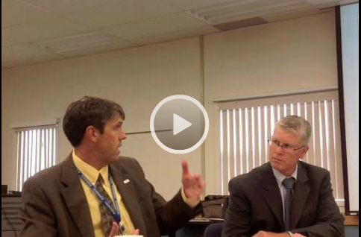
Mapping Out the Year
Beginning of the Year Meeting
Getting to know your kids
Plans for the year
SLO
Evaluator support

Slide 72
Mapping Out the Year
Beginning of the Year Meeting
What did you notice?
Is this different from current practice?
What were the teacher’s responsibilities?
What were the lead evaluator's responsibilities?
What are you going to need to be ready for this meeting?

Slide 73
Mapping Out the Year
Ongoing Evidence Collection
Formal observations
Mini observations
Artifact submission
With growth-producing feedback!
Teacher and administrator responsibility!

Slide 74
Mapping Out the Year
End of the Year Meeting
SLOs and LATS
Evidence Compared to the rubric
Professional reflection and look forward

Slide 75
Next Steps
Student Learning Objectives (SLOs)
Local Achievement Target (LAT)
Think about your evidence collection process(teachers and administrators)
CCLS units
Common Assessments
Try to keep a positive attitude!

Slide 76
Questions?

