Slide 1
Cazenovia Central School District
Annual Professional Performance Review
2012-2013

Slide 2
Committee Work
The Goal: Design an evaluation system that improves instructional practice and student learning.
Committee Continuing to Meet
Committee Membership
Teachers
Pupil Personnel Professionals
Administrators
Parents

Slide 3
20 + 20 + 60 =100
20%
Student Growth
60%
Multiple Measures
20%
Student Achievement

Slide 4
20 + 20 + 60 =100
20 points
SLOs
20%
Student Growth
20 points
LAT
60%
Multiple Measures
20%
Student Achievement
20 pts
Formal
20 pts
minis
20 points
Stds 5, 6, 7

Slide 5
20 + 20 + 60 =100
20 points
SLOs
20 points
LAT
20 pts
Formal
20 pts
minis
20 points
Stds 5, 6, 7

Slide 6
60 Points for Multiple Measures
Evidence collected throughout the school year
Teacher submits evidence
Administrator collects evidence from observation
Three to six mini-observations (at least six for probationary teachers)
One formal observation (including pre and post-conference)
20 pts
Formal
20 pts
minis
20 points
Stds 5, 6, 7

Slide 7
60 Points for Multiple Measures
Collected evidence gets sorted according to the 7 NYS Teaching Standards
20 Points from formal observation
20 points from mini-observations
20 points from Standards 5,6,7
Collected evidence is compared to the NYSUT Professional Practice Rubric
20 pts
Formal
20 pts
minis
20 points
Stds 5, 6, 7

Slide 8
60 Points for Multiple Measures
20 pts
Formal
20 pts
minis
20 points
Stds 5, 6, 7
20 pts
Formal
20 pts
minis
20 points
Stds 5, 6, 7

Slide 9
60 Points for Multiple Measures
Levels on the rubric come from the collected or submitted evidence
20 pts
Formal
20 pts
minis
20 points
Stds 5, 6, 7
 | I | D | E | H
1.1a | Hdjkfh jewklqfj fkwfj jgklrgj rjgk gh rlkgh klgh kjtr fjlafja itugj | Hdjkfh jewklqfj fkwfj jgklrgj rjgk gh rlkgh klgh kjtr fjlafja itugj | Hdjkfh jewklqfj fkwfj jgklrgj rjgk gh rlkgh klgh kjtr fjlafja itugj | Hdjkfh jewklqfj fkwfj jgklrgj rjgk gh rlkgh klgh kjtr fjlafja itugj
1.1b | Hdjkfh jewklqfj fkwfj jgklrgj rjgk gh rlkgh klgh kjtr fjlafja itugj | Hdjkfh jewklqfj fkwfj jgklrgj rjgk gh rlkgh klgh kjtr fjlafja itugj | Hdjkfh jewklqfj fkwfj jgklrgj rjgk gh rlkgh klgh kjtr fjlafja itugj | Hdjkfh jewklqfj fkwfj jgklrgj rjgk gh rlkgh klgh kjtr fjlafja itugj
1.1c | Hdjkfh jewklqfj fkwfj jgklrgj rjgk gh rlkgh klgh kjtr fjlafja itugj | Hdjkfh jewklqfj fkwfj jgklrgj rjgk gh rlkgh klgh kjtr fjlafja itugj | Hdjkfh jewklqfj fkwfj jgklrgj rjgk gh rlkgh klgh kjtr fjlafja itugj | Hdjkfh jewklqfj fkwfj jgklrgj rjgk gh rlkgh klgh kjtr fjlafja itugj
1.1d | Hdjkfh jewklqfj fkwfj jgklrgj rjgk gh rlkgh klgh kjtr fjlafja itugj | Hdjkfh jewklqfj fkwfj jgklrgj rjgk gh rlkgh klgh kjtr fjlafja itugj | Hdjkfh jewklqfj fkwfj jgklrgj rjgk gh rlkgh klgh kjtr fjlafja itugj | Hdjkfh jewklqfj fkwfj jgklrgj rjgk gh rlkgh klgh kjtr fjlafja itugj
4
3
4
2

Slide 10
60 Points for Multiple Measures
Overall rubric score gets translated to 60 points via conversion chart
20 pts
Formal
20 pts
minis
20 points
Stds 5, 6, 7

Slide 11
20 Points for Student Growth
State provides these points for 4-8 ELA and math teachers
Everyone else must make a Student Learning Objective to figures these points our for ourselves
20 points
SLOs
20 points
LAT

Slide 12
20 Points for Student Growth
Student Learning Objective is a process the state has prescribed
Set goals for the most important learning
Based on where your kids are starting the year
Common teachers will collaborate on measures
20 points
SLOs
20 points
LAT

Slide 13
INGREDIENTS

Slide 14
INGREDIENTS

Slide 15
20 Points for Local Achievement (LATs)
A lot like the SLOs
Same basic process and format
Teacher(s) identify the LAT course
Can’t be exactly the same as the SLO used for State Growth 20%
Could use different assessment
20 points
SLOs
20 points
LAT

Slide 16
20 + 20 + 60 =100
20 points
SLOs
20%
Student Growth
20 points
LAT
60%
Multiple Measures
20%
Student Achievement
20 pts
Formal
20 pts
minis
20 points
Stds 5, 6, 7

Slide 17
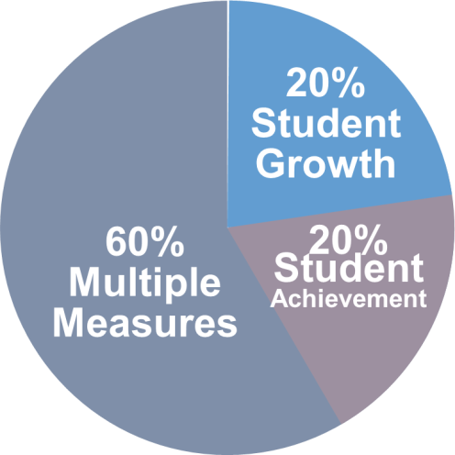
Annual Summative Evaluation
20 + 20 + 60 = Annual Summative Score for each teacher
HEDI (91-100, 75-90, 65-74, 0-64)
Final score by the end of the year (unless waiting for state’s 20%)
Appeals process
If “developing” or “ ineffective,” will have improvement plan for following year

Slide 18
A Year at a Glance
Beginning of the year meeting between teacher and Lead Evaluator
Set Student Learning Objectives (SLOs)
Baseline information about students and plans for the year
Mini-observations
Formal observation
End of the year meeting between teacher and Lead Evaluator
Review SLOs and LAT
Compare evidence to rubric
Summative evaluation

Slide 19
Odds and Ends
Timely Provision of Feedback
Evaluator Training
Training for Teachers

Slide 20
Odds and Ends
Timely Provision of Feedback
Evaluator Training
Training for Teachers
This is new to everyone
It is a work in progress
WE have to make it about growth-producing feedback and continuous improvement

Slide 21
Odds and Ends
Timely Provision of Feedback
Evaluator Training
Training for Teachers
This is new to everyone
It is a work in progress
WE have to make it about growth-producing feedback and continuous improvement

