Slide 1
OCM BOCES
APPR Regulations
“revised” February 2012 (pending NYS budget)

Slide 2
APPR
NOTE: New guidance will not be out until a budget is passed.
20%
Student Growth
60%
Multiple Measures
20%
Student Achievement

Slide 3
APPR
Growth over time
Knowledge of Students & Student Learning
Compared to Expected Growth
Knowledge of Content & Instructional Planning
Some Variables Considered
20%
Student Growth
SLOs Required
Instructional Practice
60%
Multiple Measures
Moment in time or growth
Learning Environment
20%
Student Achievement
Could be school-
wide measure
Assessment for Student Learning
Local or Purchased
Professional Responsibilities and Collaboration
Some Variables Considered
SLOs Optional
Professional Growth

Slide 4
Overall Differences
Agreement
Limits on terminating probationary teachers and principals
Subcomponent scores provided by last day of school; summative by September 1st
Demonstrate transparency and availability of each level to teachers and principals
Appeals must be timely and expeditious
Submit plans to SED for approval
SED will monitor scores (similar schools)
HEDI points (91-100, 75-90, 65-74, 0-64) need to be set up for each of the three components at beginning of the year

Slide 5
Agreement
Growth over time
Changes:
Compared to Expected Growth
HEDI point ranges (which can matter when setting SLO Gs)
Some more options mentioned
Score distribution monitored by SED
Some Variables Considered
20%
Student Growth
SLOs Required
60%
Multiple Measures

Slide 6
Agreement
Changes:
HEDI point ranges (which can matter when setting SLO LAs)
Some more options mentioned
Score distribution monitored by SED
3rd Party Assessment List (under revision, has been “taken down” for now)
20%
Student Growth
60%
Multiple Measures
Moment in time or growth
20%
Student Achievement
Could be school-
wide measure
Local or Purchased
Some Variables Considered
SLOs Optional

Slide 7
Agreement
Changes:
Knowledge of Students & Student Learning
At least 31 points based on observations (out of the total 60)
At least one observation unannounced (of the multiple observations)
Score distribution monitored by SED
Knowledge of Content & Instructional Planning
Instructional Practice
60%
Multiple Measures
Learning Environment
Assessment for Student Learning
Professional Responsibilities and Collaboration
Professional Growth

Slide 8
APPR
Rubrics:
Knowledge of Students & Student Learning
In our BOCES, one of these three being used:
FFT 2007 (ASCD)
FFT 2011 (Teachscape)
Professional Practice (NYSUT & NYSED)
Knowledge of Content & Instructional Planning
Instructional Practice
60%
Multiple Measures
Learning Environment
Assessment for Student Learning
Professional Responsibilities and Collaboration
Professional Growth

Slide 9
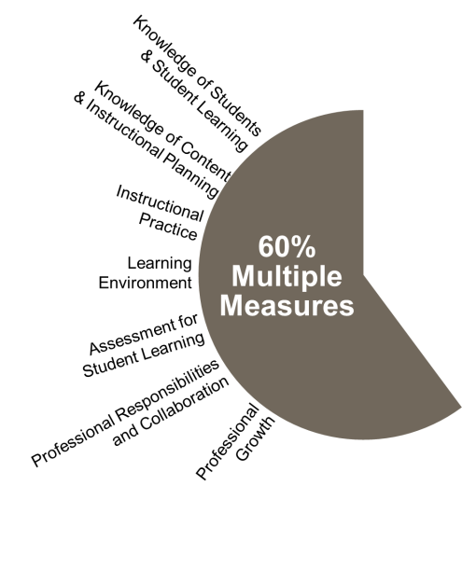
Points:
APPR
31-60 points
<29 points
Based on multiple observations
Use an approved rubric
Outside, impartial observation
Peer observation
Student feedback
Parent feedback
Other evidence of student development and performance (lesson plans, portfolios, other artifacts)

Slide 10
Points:
APPR
Could all be from the rubric
60 points

Slide 11
Points:
APPR
From the rubric from multiple observations
>31 points
From the list of other possibilities, would need system of point determination
<29 points

Slide 12
OCM BOCES
APPR Regulations
“revised” February 2012 (pending NYS budget)

