Slide 1
Oasys TRAINING COLLECTING & SUBMITTING EVIDENCE

Slide 2
APPR
Growth over time
Knowledge of Students & Student Learning
Compared to Expected Growth
Knowledge of Content & Instructional Planning
Some Variables Considered
20%
Student Growth
SLOs Required
Instructional Practice
60%
Multiple Measures
Moment in time or growth
Learning Environment
20%
Student Achievement
Could be school-
wide measure
Assessment for Student Learning
Local or Purchased
Professional Responsibilities and Collaboration
Some Variables Considered
SLOs Optional
Professional Growth

Slide 3
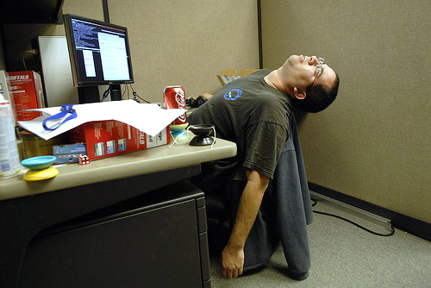
COLLECTING EVIDENCE
10-15 Minute MINI-OBSERVATIONS (minimum of 3 & unannounced)
Non-tenured: one extended mini observation (1 hour approx.)
Evaluator collects evidence

Slide 4
COLLECTING EVIDENCE
Evaluator sorts evidence into OASYS & sends invitation to teacher to meet within two days to discuss, clarify & interpret data
Teacher completes mini-observation feedback form on OASYS to guide conversation at conference
Evaluator adds comments onto mini-observation form & finalizes – teacher may add artifacts to form too.

Slide 5
SUBMITTING EVIDENCE
Sign on to My Learning Plan.com
username: email address
password:
Select My Evaluations
Select Artifact Files
Select Add Artifact
Enter Name
Enter Description (type in your description)

Slide 6
Choose: My Evaluations

Slide 7
Choose: Artifact Files

Slide 8
Choose: Artifact Files

Slide 9
Choose: Fill in fields/choose rubric

Slide 10
Choose: Select the file to upload

Slide 11
Choose: Save!

