Slide 1
NYS Initiatives for Teaching and Learning An overview of the Six instructional shifts: NYS P-12 Common core Learning standards for ELA & literacy
CNY Affiliate of NYS ASCD
December 7, 2011
OCM BOCES Network Team Facilitators
Auddie Mastroleo
Renee Burnett

Slide 2
EngageNY
http://engageny.org/

Slide 3
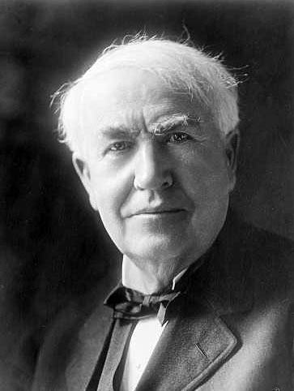
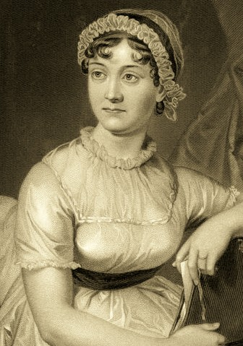
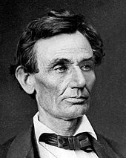
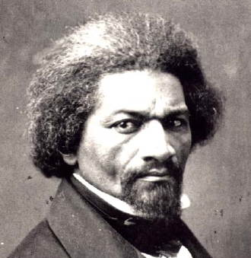
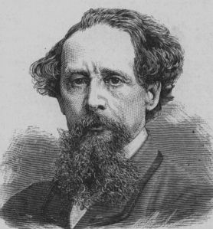
Who are they and what do they have in common?
Notes:
Who are they? Jane Austen, Thomas Edison, Charles Dickens, Frederick Douglass, Abraham Lincoln
What do they have in common? Largely self-educated through reading

Slide 4
Common Core Shifts ELA & Content Literacy
Balancing Informational & Literary Texts (Grades PK-5)
Knowledge in the Disciplines (Grades 6-12)
Staircase of Complexity
Text-based Answers
Writing from Sources
Academic Vocabulary
Notes:
Use Common Core Shifts ELA/Literacy: Planner in conjunction. Participants read through the expanded explanations of the shifts. Encourage discussion around the language used & what these shifts might mean in individual schools/districts.

Slide 5
Balancing Informational & Literary Texts
SHIFT 1
Grades
PK-5
Range of Text Types
Literature = Stories, Dramas, Poetry
Informational = Literary Nonfiction, Historical, Scientific, & Technical Texts
12th grade
8th grade
50% fiction 50% nonfiction
40% fiction 60% nonfiction
20% fiction 80% nonfiction
Increase in teaching and learning with non-fiction text
4th grade
Notes:
This shift is intended to prepare our students for the demands and the reality of college and career expectations for reading (and essentially writing). A reminder of a balance between narrative non-fiction and non-narrative non-fiction needs to be made in order to capture the essence of the type of non-fiction reading emphasized in the CCLS.
Teachers will need to evaluate the make-up of their classroom libraries/teaching materials to determine if there are sufficient resources available to them to make this shift. School librarians will need to be consulted as a resource to support teachers and to ensure library selections reflect this shift as well.

Slide 6
Knowledge in the disciplines
SHIFT 2
Grades
6-12
Reading & Writing Literacy Standards
Depending on text rather than referring to it
Think sophisticated non-fiction
Complement, not replace content standards
Read a president’s speech & write a response
Read scientific papers & write an analysis
Analyze and evaluate texts within disciplines
Gain knowledge from texts that convey complex information through diagrams, charts, evidence, & illustrations
Expectation of rigorous domain specific literacy instruction outside of ELA
Notes:
Conscious effort to weave/embed content area literacy into the Standards to ensure that literacy instruction is shared across the disciplines & not the sole responsibility of the ELA teacher. Students are expected to read and write with competency within specific disciplines and content teachers are expected to provide these experiences with equal rigor i.e., provide models of quality reading and writing examples specific to a domain; examine structures inherent to domain specific reading and writing tasks; multiple opportunities for practicing domain specific reading and writing tasks, etc. Teachers would be wise to engage in collaborative efforts to find common ground in supporting literacy instruction school-wide (an example might be developing a common writing rubric from which all students and teachers would gauge progress.)

Slide 7
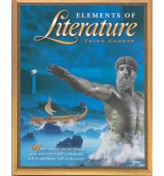
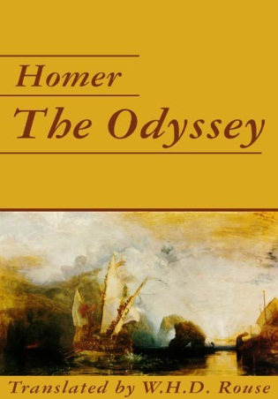
Pre-CCLS
Core Text
SHIFT 1
Balancing Informational and Literary Texts
SHIFT 2
Building Knowledge in the Disciplines
Notes:
Pre-CCLS: A unit of study might be based on one core fictional text and exhibit an inclusive focus on just the one text (i.e., Class, for the next few weeks, we will be reading and studying The Odyssey). Outside (other) text references are brief in nature and not included in the original unit plans, often offered as on-the-spot examples to help further explain, support, or identify the sole work being studied.

Slide 8
Post-CCLS
Core Texts
SHIFT 1
Balancing Informational and Literary Texts
SHIFT 2
Building Knowledge in the Disciplines
Paired Texts: The Hero’s Journey
Notes:
Post-CCLS: A unit utilizing paired texts of both fiction and nonfiction are given (fairly) equal billing in the study of a larger, key theme (the hero’s journey as opposed to The Odyssey). This balance of texts provides students with practice reading different text structures as well as opportunities to learn about the subject matter in the discipline (The Hero with the Thousand Faces provides a detailed history of the hero’s journey via a comprehensive analysis of myths throughout the ages). Note the balance here of a narrative non-fiction text (The Lost City of Z) with a non-narrative non-fiction text (The Hero with a Thousand Faces).

Slide 9
Staircase of complexity
SHIFT 3
Increase in text complexity at each grade level
Qualitative
Quantitative
Reader & Task
Levels of meaning
Word length
Motivation
Structure
Clarity of language
Knowledge demands
Sentence length
Text cohesion
Knowledge
Experience
Expectation of proficiency and independence in reading grade level text
Appendix B:
Text Exemplars and Sample Performance Tasks
Notes:
Steady decline in K-12 reading difficulty and sophistication of text for several decades (see Appendix A for research on this as well as further explanation of the three components used to determine text complexity). College and workplace reading demands have held steady or increased, creating a gap which hinders students’ ability to read at or above grade level and with little to no assistance

Slide 10
Pre-ccls
SHIFT 3
Staircase of Complexity
Refusal of the Call
Often when the call [to adventure] is given, the future hero refuses to heed it. This may be from a sense of duty or obligation, fear, insecurity, a sense of inadequacy, or any of a range of reasons that work to hold the person in his or her current circumstances.
Notes:
Pre-CCLS: This might be a typical text-book explanation for one piece of the hero’s journey. The text is not particularly demanding in terms of understanding the concept, but could be a precursor to helping students understand a more complex explanation of the hero’s journey.

Slide 11
Post-ccls
SHIFT 3
Staircase of Complexity
Refusal of the Call
Often in actual life, and not infrequently in the myths and popular tales, we encounter the dull case of the call unanswered; for it is always possible to turn the ear to other interests. Refusal of the summons converts the adventure into its negative. Walled in boredom, hard work, or "culture," the subject loses the power of significant affirmative action and becomes a victim to be saved. His flowering world becomes a wasteland of dry stones and his life feels meaningless—even though, like King Minos, he may through titanic effort succeed in building an empire of renown. Whatever house he builds, it will be a house of death: a labyrinth of cyclopean walls to hide from him his Minotaur. All he can do is create new problems for himself and await the gradual approach
of his disintegration.
Excerpt from The Hero with a Thousand Faces
Notes:
Post-CCLS: When confronted with the increased demands of text complexity required by the CCLS, one can quickly see the difference in what students would need to understand reading this as to what they needed to understand the text in the previous slide. Excerpted from the core text The Hero of a Thousand Faces, this text requires a skill set that includes figurative language, visual imagery, inferencing, prior knowledge of well-known myths, vocabulary usage, etc. that were not as evident or prevalent in the previous slide. The richness of this passage encourages the reader to linger and closely examine the author’s message.

Slide 12
Text-based answers
SHIFT 4
Questions tied directly to the text, but extend beyond the literal
Students must cite text to support answers
Personal opinions, experiences, and connections to the text are minimized in favor of what the text actually says or doesn’t say
Evidence-based questions are purposefully planned & direct students to closely examine the text
Notes:
Text-based answers (student focus) can be flipped to “text-dependent questions” or “evidence-based questions” (teacher focus). The development of questions can no longer be on the fly or an after-thought of instruction. Quality, thoughtful questions require purposeful planning and consideration for where they will lead students in their learning. Text-dependent questions by nature will require students to make multiple forays into the text, examining specific passages, sentences, and words, driving the need for close reading to determine what the author is expressing through the text. Questions that require students to not attend to the text are discouraged. Connections students make to the text should always lead them back to the actual text in question.

Slide 13
Pre-ccls
SHIFT 4
Text-based Answers
Question:
What reasons might a hero use to refuse the call to adventure?
Refusal of the Call
Often when the call [to adventure] is given, the future hero refuses to heed it. This may be from a sense of duty or obligation, fear, insecurity, a sense of inadequacy, or any of a range of reasons that work to hold the person in his or her current circumstances.
Notes:
Pre-CCLS: Students would not necessarily need to read a specific text in order to answer this question. Currently posed, students’ answers could be based on prior knowledge and experiences with the concepts of “mythology” and “hero”. The CCLS requires students to base answers upon what a text says or doesn’t say. Personal connections and prior knowledge are acceptable as long as the text under study remains the focus of their analysis.
However, this is an evidence-based question (meaning that students could answer it using the passage provided), but it requires minimal thinking on the students’ behalf and can be answered by “skimming the text”. This question enables students to engage in “amateur interactions” with the text. The bigger question is what will students have learned as a result of answering this question.

Slide 14
Post-ccls
SHIFT 4
Text-based Answers
Question:
What fate awaits the (future) hero who refuses the call to adventure?
Cite specific examples from the text to support your answer.
Refusal of the Call
Often in actual life, and not infrequently in the myths and popular tales, we encounter the dull case of the call unanswered; for it is always possible to turn the ear to other interests. Refusal of the summons converts the adventure into its negative. Walled in boredom, hard work, or "culture," the subject loses the power of significant affirmative action and becomes a victim to be saved. His flowering world becomes a wasteland of dry stones and his life feels meaningless—even though, like King Minos, he may through titanic effort succeed in building an empire of renown. Whatever house he builds, it will be a house of death: a labyrinth of cyclopean walls to hide from him his Minotaur. All he can do is create new problems for himself and await the gradual approach
of his disintegration.
Excerpt from The Hero with a Thousand Faces
Notes:
Post-CCLS: Questions are planned with the text in mind, requiring students to go beyond the literal to more in-depth analysis of the text under discussion while building knowledge in the content (author’s craft in using symbolism & explanation of the complex story structure of the hero’s journey). Students must cite specific references and examples from the text, but can still build meaning for themselves by considering the text through the lens of introspection.
This question requires students to closely examine the author’s message and to cite evidence from the text under study.
Text-based question/answer for Slide 22: What fate awaits the (future) hero who refuses the call to adventure? Use specific examples from the text to support your answer. Posed in this manner, a student would have to first determine the negative impact & then isolate examples to support their answer.

Slide 15
Writing from sources
SHIFT 5
Three Text Types
Argument
Supporting a claim with sound reasoning and relevant evidence
Informational/Explanatory Writing
Increase subject knowledge
Explain a process
Enhance comprehension
Narrative Writing
Conveys experience i.e. fictional stories, memoirs, anecdotes, autobiographies
Argumentative writing is especially prominent in the CCLS
Appendix C:
Samples of Student Writing
Notes:
Writing from sources can be directly connected to text-based answers in that students will need to examine texts closely in order to respond in writing to those texts. The CCLS support three specific writing genres (although others are not specified, there is room for teacher discretion on the inclusion of relevant writing tasks) with Argument taking center stage. There is a heavy emphasis on students being able to construct sound arguments across the disciplines using multiple sources, relevant evidence, and balanced analyses. Writing tasks should range from short on-demand prompts to longer research-type writing assignments.

Slide 16
Pre-CCLS
Write about a time you had to make a difficult decision. Describe the situation and the heroic qualities you exhibited.
SHIFT 5
Writing from Sources
Notes:
Pre-CCLS: This writing prompt requires no text association for the students in order to answer. The new CCLS requires proficient and rigorous analysis of texts in writing.
With the emphasis on close reading of text and students’ ability to respond to those texts, writing tasks or prompts will need to reflect this change. Students will be required to use the text flexibly to not only support arguments, but to inform as well. Narrative writings are still required, but take on a less prominent role in the CCLS as students progress through the grades.

Slide 17
Post-CCLS
Modern writers often enhance their story through the use of literary allusions. Grann compares Fawcett’s Nina to Odysseus’ Penelope. Analyze and evaluate the effectiveness of Grann’s choice in making this comparison. In your essay, be sure to:
Describe the call to adventure for both Percy Fawcett and Odysseus.
Compare and contrast the impact of answering this call on those closest to the heroes.
Support your analysis using specific evidence from the two works listed above.
SHIFT 5
Writing from Sources
Notes:
Post-CCLS: The writing prompt for this unit requires students to demonstrate their understanding of the hero’s journey by specifically referring to the texts studied. Students need to rely on the texts studied and what the authors of those texts intended in their meaning and use details from those texts to support their analysis.
With the emphasis on close reading of text and students’ ability to respond to those texts, writing tasks or prompts will need to reflect this change. Students will be required to use the text flexibly to not only support arguments, but to inform as well. Narrative writings are still required, but take on a less prominent role in the CCLS as students progress through the grades.

Slide 18
Academic vocabulary
SHIFT 6
Tier One Words
Words of everyday speech
Tier Two Words
Not specific to any one academic area
Generally not well-defined by context or explicitly defined within a text
Wide applicability to many types of reading
Tier Three Words
Domain specific
Low-frequency
Often explicitly defined
Heavily scaffolded
Ramp up instruction of Tier Two words
Notes:
Vocabulary is one area of instruction where the research is clear on what students need in order to be successful readers and writers. Explicit instruction of Tier 2 and Tier 3 words is crucial for students to engage fully with grade level text. Tier 2 words are emphasized in the CCLS for direct instruction for the reasons defined in the slide. They are the gateway for many of the complex texts students will be required to access proficiently and independently. An example of a Tier Two word might be “determined”. This word has high-utility across content areas, not specific to one domain, and is generally not defined in context. An example of a Tier Three word might be “mass production”. This word is domain specific (SS), will most likely be defined within the context of the course content or heavily scaffolded via pictures, graphs, bolded within the text, or defined within a glossary.

Slide 19
Pre-CCLS
Archetype
Epic Poetry
Mythology
Odyssey
SHIFT 6
Academic Vocabulary
Tier 3
Notes:
Pre-CCLS: Vocabulary selections for The Odyssey would focus specifically on Tier 3 words with little to no direct instruction of Tier 2 words.
Tier 3 (domain specific) vocabulary are often well-supported instructionally as they are the key concepts and/or terms students need to access the content. Hence, class time is dedicated to the direct instruction of such words. Due to other factors (mostly a lack of time and uncertainty of which words to select), many Tier 2 words (those non-domain specific words, not well-defined through context) are not adequately identified for direct instruction. Students, therefore, are left to figure these words out on their own often minimizing their understanding of the text.

Slide 20
Post-CCLS
Tier 3 Words
Archetype
Epic Poetry
Mythology
Odyssey
Tier 2 Words
Summons
Affirmative
Titanic
Disintegration
SHIFT 6
Academic Vocabulary
Notes:
Post-CCLS: Continuing with the Hero’s Journey unit, an increase in attention to the direct instruction of Tier 2 words (in addition to Tier 3 words) is expected.
With a shift in the text expectations, so too comes a shift in the vocabulary instruction students must receive. Text selections from primary sources or authentic texts often do not demonstrate a level of text cohesion one might find in a heavily scaffolded textbook. As a result, equal attention to those words exhibiting the characteristics of Tier 2 Words is required so that students can better access i.e., understand and attend to the increased demands of the text.

Slide 21
The six shifts in action K-5 Staying on topic within a grade and across grades: How to build knowledge systematically in english language arts k-5
The Human Body

Slide 22
Pre-CCLS
Core Text
SHIFT 1
Balancing Informational and Literary Texts
SHIFT 2
Building Knowledge in the Disciplines
The Human Body
Notes:
Pre-CCLS: Unit of study based on the human body may use a variety of texts. What texts do you use to teach this topic?

Slide 23
Post-CCLS
Core Texts
SHIFT 1
Balancing Informational and Literary Texts
SHIFT 2
Building Knowledge in the Disciplines
Kindergarten
First Grade
Second-Third Grade
Paired Texts:
The Human Body
Fourth-Fifth Grade
Notes:
Post-CCLS: Here we see a sampling of texts of varying complexity which can be used and paired with other texts for this unit

Slide 24
Pre-ccls
SHIFT 3
Staircase of Complexity
Thank you for hands and feet
that keep a beat,
for ears that hear,
and eyes that see.
Thank you for each bendy knee.
Notes:
Pre-CCLS: Again, consider the text you currently use. The text here is poetic in nature. Although perfectly appropriate for our elementary students, the CCLS demand the introduction of non-fiction prose and text structures beginning in Kindergarten. In order to provide a balance of having fun with words and language (lyrical, poetic, silly) to foster a love for reading, the CCLS would require we pair this type of text with a non-fiction counterpart.

Slide 25
POST-ccls
SHIFT 3
Staircase of Complexity
When you eat fresh fruits and vegetables and protein foods like meat, milk, and beans you are giving your body the things it needs to grow.
Notes:
Post-CCLS: In addition to the fictional selections used to teach about the human body, a non-fiction text such as My Amazing Body is used to build content knowledge. Note the difference in the how the text is structured with the previous slide.

Slide 26
Post-ccls
SHIFT 3
Staircase of Complexity
General information about the body
High picture-text relationship
Read-aloud
Presents specific parts of the body and their functions
Sidebars containing information
Read-aloud or read individually
Information is specific to nutrition and how it impacts the body
Layers of text formats and facts
Read Individually
In-depth exploration of nutrition
Chapter book, table of contents, glossary, index, etc.
Read individually
Kindergarten
1st Grade
2nd-3rd Grade
4th-5th Grade
Notes:
In addition to the differences in the actual words in the text, here is a list of the variations in text structure between the texts.

Slide 27
Pre-ccls
SHIFT 4
Text-based Answers
Can you name three healthy foods?
Why does your body need food?
What are three ways that food helps your body?
Why is it important to maintain a healthy diet?
Kindergarten
1st Grade
2nd-3rd Grade
4th-5th Grade
Notes:
Pre-CCLS: Students would not necessarily need to read a specific text in order to answer these questions. Currently posed, students’ answers would be based on prior knowledge and experiences. The CCLS requires students to base answers upon what a text says or doesn’t say. Personal connections and prior knowledge are acceptable as long as the text under study remains the focus of their analysis.

Slide 28
Post-ccls
SHIFT 4
Text-based Answers
From the text, why is it important to eat healthy foods?
Using the food pyramid in the text, what are some foods you may eat a lot of? What are some foods you should eat a little of?
We have learned that food keeps you alive, healthy, and strong. Give evidence from the text that shows two ways that this happens.
What reasons and evidence does the author provide in the text to argue the importance of a healthy diet?
Kindergarten
1st Grade
2nd-3rd Grade
4th-5th Grade
Notes:
HO: Standards-Questions Reference Chart
Post-CCLS: Questions are planned with the text in mind, requiring students to go beyond the literal to more in-depth analysis of the text under discussion while building knowledge in the content. Questions are explicitly written from the standards.

Slide 29
Pre-CCLS
What are your favorite foods?
SHIFT 5
Writing from Sources
Notes:
Pre-CCLS: This writing prompt requires no text association for the students in order to answer. The new CCLS requires proficient and rigorous analysis of texts in writing.
With the emphasis on close reading of text and students’ ability to respond to those texts, writing tasks or prompts will need to reflect this change. Students will be required to use the text flexibly to not only support arguments, but to inform as well. Narrative writings are still required, but take on a less prominent role in the CCLS as students progress through the grades.

Slide 30
Post-ccls
Using My Amazing Body, tell why the author thinks our bodies are amazing.
Why do you think it’s important to eat healthy foods? Use evidence from the text to support your answer.
Describe the relationship between proper nutrition and a healthy lifestyle. Use evidence from the text to explain how the information found within it contributes to an understanding of overall health.
Using details from the text, describe how your body uses the food you eat.
SHIFT 5
Writing from Sources
Kindergarten
1st Grade
2nd-3rd Grade
4th-5th Grade
Notes:
Post-CCLS: The writing prompt for this unit requires students to demonstrate their understanding of nutrition as described in the text.
With the emphasis on close reading of text and students’ ability to respond to those texts, writing tasks or prompts will need to reflect this change. Students will be required to use the text flexibly to not only support arguments, but to inform as well. Narrative writings are still required, but take on a less prominent role in the CCLS as students progress through the grades.

Slide 31
Pre-CCLS
vitamins
stomach
digestion
calories
SHIFT 6
Academic Vocabulary
Tier 3
Notes:
Pre-CCLS: Vocabulary selections for the human body would focus specifically on Tier 3 words with little to no direct instruction of Tier 2 words.
Tier 3 (domain specific) vocabulary are often well-supported instructionally as they are the key concepts and/or terms students need to access the content. Hence, class time is dedicated to the direct instruction of such words. Due to other factors (mostly a lack of time and uncertainty of which words to select), many Tier 2 words (those non-domain specific words, not well-defined through context) are not adequately identified for direct instruction. Students, therefore, are left to figure these words out on their own often minimizing their understanding of the text.

Slide 32
Post-CCLS
Tier 3 Words
vitamins
stomach
digestion
calories
Tier 2 Words
energy
detect
supply
manufacture
SHIFT 6
Academic Vocabulary
Notes:
Post-CCLS: Continuing with the human body unit, an increase in attention to the direct instruction of Tier 2 words (in addition to Tier 3 words) is expected.
With a shift in the text expectations, so too comes a shift in the vocabulary instruction students must receive. Text selections from primary sources or authentic texts often do not demonstrate a level of text cohesion one might find in a heavily scaffolded textbook. As a result, equal attention to those words exhibiting the characteristics of Tier 2 Words is required so that students can better access i.e., understand and attend to the increased demands of the text.

Slide 33
Readiness Guide
What can we do now to prepare for these shifts?
Awareness
Building Common Knowledge
Connections
Connecting the 6 Shifts to Current Practice
Integration
Using the CCLS in the Design of Classroom Curriculum, Instruction and Assessment

Slide 34
Contact information
Thank
you!
Thank
you!
rburnett@ocmboces.org
Thank
you!
amastroleo@ocmboces.org

