Slide 1
Formative/Interim assessments
OCM BOCES
NETWORK
TEAM
Notes:
Data Driven Instruction is one-third of the Race to the Top initiatives. This PowerPoint addresses one aspect of DDI: common interim assessments.

Slide 2
Interim Assessments and DDI
Interim Assessment Design and Implementation
Understand the relationship of common interim assessments and Data Driven Instruction (DDI) as part of Race to the Top
A calendar of an interim assessment schedule
Understand and engage in the 5 Step process for creating an interim assessment
One completed interim assessment for your course
Outcomes
Notes:
Participants will have an understanding of how common interim assessments support the implementation of the CCLS and provide a pathway for assessing student growth in a course of study.
Assume participants have:
Prioritized the standards in order to select the most important learning of their course for SLO development, however slides for this process are hidden and embedded into the Power Point if needed

Slide 3
The Work
of
New York

Slide 4
Professional
Practice
Standards
Data
Culture

Slide 5
Standards-based, revised, upgraded, realigned units
Professional
Practice
Data
Culture

Slide 6
Standards-based, revised, upgraded, realigned units
Professional
Practice
Common formative/
interim assessments
Culture

Slide 7
Standards-based, revised, upgraded, realigned units
APPR, including SLOs
Common formative/
interim assessments
Culture

Slide 8
Standards-based, revised, upgraded, realigned units
APPR, including SLOs
Common formative/
interim assessments
Meaningful collaboration on the right work

Slide 9
Professional
Practice
Standards
Data
Culture

Slide 10
Data

Slide 11
It’s always been here…

Slide 12
ITBS
Report Cards
Unit Tests
State Tests
Letters
Performance
Quizzes
Terra Nova
Attendance
Reports
Samples
Notebook
Regents
Inventories
Essay
Anecdotal
Performance
Unit Tests
Scores
Logs
Homework
Pictures
Journals
Posttest
RCT
Rubrics
Conferences
Pretest
PET
Checklists
Interview

Slide 13
It’s not really the data

Slide 14
It is
about
what we
do about
data

Slide 15
Common
Interim
Assessments

Slide 16
give the
test
make
the
test
analyze
the
work
do something about it

Slide 17
every
6-8
weeks

Slide 18
SLO
baseline
SLO
Summative Assessment
Formative Assessment
Formative Assessment
Formative Assessment
Formative Assessment
Formative Assessment
How does this all fit together?
After establishing the most important learning for your course with the SLO, periodically measure student progress toward that goal throughout the school year.
Notes:
The WHY slide: after establishing the most important learning for your course with the SLO, periodically measure student progress toward that goal throughout the year with CFAs.
Formative Assessments serve as a map or GPS on the learning journey. They may be spaced out over the course of the school year so that students are formatively assessed at approximately 6-8 week intervals.

Slide 19
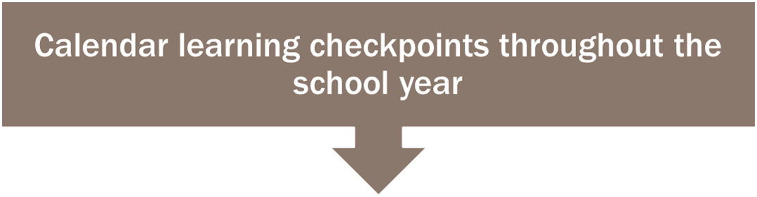
SLO
baseline
SLO
Summative Assessment
November 1
December 12
January 30
March 6
April 24
Calendar Learning Checkpoints
Notes:
The following dates have been selected as learning checkpoints for the interim assessments

Slide 20
Common
Formative
Interim
Assessment
Common
Formative
Interim
Assessment
Common
Formative
Interim
Assessment
September
June
UNIT
UNIT
UNIT
UNIT
UNIT
UNIT
SLO Baseline
Common
Formative
Interim
Assessment
Common
Formative
Interim
Assessment
SLO Summative
Notes:
Here is another slide that illustrates the big picture of how the SLO acts as bookends to the instruction over the course of the year. As instruction ensues, so does periodic learning check points that assess students progress toward the year end summative learning goals.

Slide 21
Common
Formative
Interim
Assessment
Common
Formative
Interim
Assessment
Common
Formative
Interim
Assessment
September
June
UNIT
UNIT
UNIT
UNIT
UNIT
UNIT
SLO Baseline
Common
Formative
Interim
Assessment
Common
Formative
Interim
Assessment
SLO Summative
Notes:
These Common Formative Assessments are spaces out across the year at approximately every 6-8 weeks

Slide 22
Common
Formative
Interim
Assessment
Common
Formative
Interim
Assessment
Common
Formative
Interim
Assessment
September
June
UNIT
UNIT
UNIT
UNIT
UNIT
UNIT
SLO Baseline
Common
Formative
Interim
Assessment
Common
Formative
Interim
Assessment
SLO Summative
Notes:
These assessment are standards based and may not rely on the content specifically. They are not necessarily a summative assessment, but they are used formatively to assess students’ progress toward the larger year-end learning goals.

Slide 23

Build Shared Knowledge
Notes:
Let’s take a few moments to build shared knowledge around some key assessment information and vocabulary

Slide 24
Notes:
HO: “Data Driven Instruction Shifts”
Activity: Say Something – In small groups or pairs, teacher read one shift, stop, say something about the shift (a question, a comment, a connection, etc), and continue to read, stop, and say something for the remainder of the shifts.
Whole group debrief: What shifts do we already have in place? What shifts will be a stretch for us?

Slide 25
Setting the stage for common assessments
Build Shared Knowledge
Formative vs. Summative
What does common mean?
Putting it all together
Notes:
We are continuing to build shared knowledge with the differences between formative and summative assessment and the term “common.”

Slide 26
Setting the stage for common assessments
Formative vs. Summative

Slide 27
Formative (Assessment for Learning)
Check-up
Summative (Assessment of Learning)
Autopsy
Know Your Purpose
Notes:
Why is the assessment taking place? Formative or Summative in nature?
Who will use the information? Teachers, students, parents, administrators, state-level?
What will the information be used for? Diagnostic, Instructional, Ranking, District or Building decisions, State decisions?

Slide 28
An assessment is formative if it…
Occurs during the learning process
Identifies students experiencing difficulties
Results are used to help students continue to learn (informs instruction)
Informs teachers as to the effectiveness of instruction for current students
Informs students in regards to progress in becoming proficient (provides feedback)
Typically are NOT used to assign grades
Formative
vs.
Summative
Notes:
Here are some key characteristics of formative assessment.

Slide 29
Exit/Entrance Slips
Journals
Questioning
Discussions
Observations
Whiteboards
Examples of Informal Formative Assessments
Notes:
Some examples of INFORMAL formative assessment strategies

Slide 30
Setting the stage for common assessments
What does common mean?

Slide 31
An assessment is common if it…
Is developed collaboratively by teachers who teach the same grade level or content
Uses a common process for determining the criteria for quality work
Measures the same learning targets no matter the teacher
Administered systematically and timely to all students enrolled in a course or grade
Results are scored and analyzed collaboratively
Facilitates a systematic, collective response to struggling students
What does common mean?
Notes:
Key characteristics of the term common

Slide 32
In-the-moment
Formative
Balanced Assessment System
Provides a link between the two
Interim
Larger year-end goal
Summative
Notes:
Interim assessments provide the link between those short, informal classroom formative assessments and the more formal summative assessments.

Slide 33
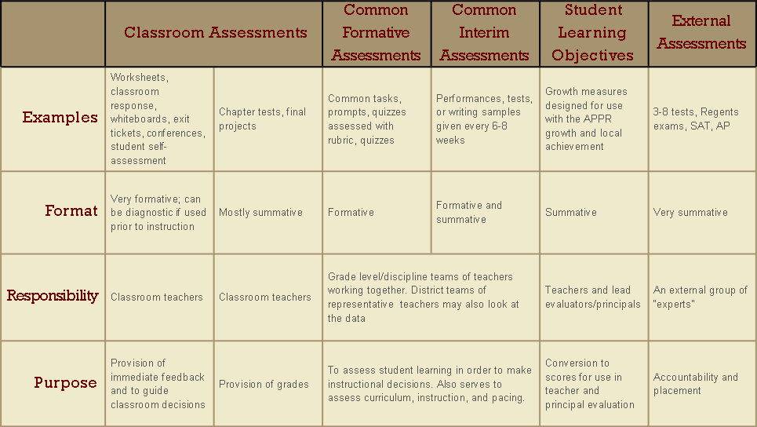
Balanced Assessment
Notes:
HO: “Balanced Assessment System”
The chart shows the variety of assessments we use, as well as the purpose of each. Here we see that Common Formative and Common Interim Assessments are similar, but Common Interim Assessments are regularly spaced out and calendared during the course of the school year. They can be used both formatively and summatively.

Slide 34
Begin with the end in mind
(Priority Standards)
Calendar learning checkpoints throughout the school year
Specify the learning targets at each learning checkpoint
Create the assessment
The steps in making common formative/
interim assessments
Notes:
There are four concrete steps that we can take in this whole process of beginning the data driven instructional process. We will walk through each of these steps.

Slide 35
Learning Checkpoints
Interim Assessment Learning Targets
I can identify the difference between primary and secondary sources
Interim Assessment
After reading the Preamble to the US Constitution and Words We Live By, by Linda Monk, please identify which text is a primary source and which is a secondary source. Use evidence from the text to explain how you know this. Identify purpose of each text. Use specific details from both texts to explain your answer.
I can identify the author’s intent and purpose in a text
I can quote and accurately paraphrase from a text
April 24
March 6
January 30
December 12
November 1
Priority Standard and Summative Learning Target
Cite specific textual evidence to support analysis of primary and secondary sources (RH.6-8.1)
I can quote reasons and proof from what I read to show my close reading of primary and secondary sources of information.
The steps in making common formative/
interim assessments
Notes:
This graphic inserts more specific information that was outlined in the previous slide. This information is examined further in the following slides.

Slide 36
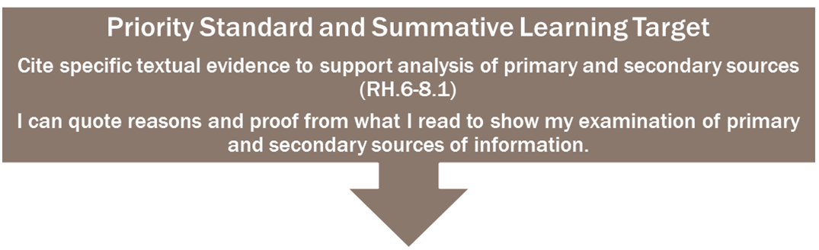
I can quote reasons and proof from what I read to show my close reading of primary and secondary sources of information.
Cite specific textual evidence to support analysis of primary and secondary sources.
Priority
Standard
RH.6-8.1.
Learning
Target
Notes:
HO: “History 7th Grade” folder for example and rubric
Remember that this is the standard we deemed as a priority standard. We unwrapped it and created a learning target by writing an “I can…” statement. The “I can…” statement that was written reflects the learning for the summative, year-end goal. We can break this learning target down into smaller learning chunks that build over time to reach this larger year-end learning target. The following slide shows one way to break it down.

Slide 37
Learning Targets
I can quote reasons and proof from what I read to show my close reading of primary and secondary sources of information.
I can identify the difference between primary and secondary sources
I can identify the purpose of a text
I can quote and accurately paraphrase from a text
Notes:
Here is the summative, year-end learning target that we have been looking at. Now we can break this down into smaller learning chunks that can be assessed during the interim assessments. I may choose to assess one or more of these smaller learning targets in the interim assessment. The following slide shows one way to assess these smaller targets.

Slide 38
Decide HOw to assess
Determine your assessment strategy
Selected Response
Constructed and extended written response
Performance assessment
Notes:
Selected response includes items such Multiple Choice, T/F, and matching type questions.
Constructed/Extended written response items require students to provide their own answer to a question or prompt. Examples are short or long essay prompts. Graphic organizers are also considered to be an example of this type.
Performance assessments ask students to demonstrate their understanding of a learning target by performing in front of the teacher, who evaluates them against a rubric.
Each method is equally viable as an assessment strategy as long as the following points are considered:
Does the selected strategy accurately measure the intended learning target at the level of thinking it was taught?
Does the selected strategy provide timely turnaround of the information needed for teachers and students to determine next steps?
Does the selected strategy require the use of a rubric? Will that rubric be implemented consistently across teachers?

Slide 39
Designing Quality Assessments
Learning Target
Assessment Method
Notes:
It is important to have the learning target (I can statement) match the assessment method.

Slide 40
Develop the assessment plan
Design the Assessment
Measure what you’ve taught (identified learning targets)
Assess student learning at the cognitive level the information was taught
Notes:
Two major considerations when developing the assessment plan. Show example of the Assessment Planner map as a model.

Slide 41
Assessment methods
Method | Ideal for assessing | Examples | Scoring
Selected Response | Knowledge-level learning targets | Multiple Choice Fill-in-the-blank T/F Matching | Number or percent of points Rubric
Extended written response | Chunks of knowledge that interrelate & student reasoning | Essay Short Answer
Performance Assessment | Learning best achieved through observable actions (skills) (or the development of products | Playing an instrument Changing the oil in a car Conversing in a foreign language
Notes:
HO: “Assessment Methods”
There are three basic assessment methods. This chart provides examples of each method, what it best assesses, and how it can be scored.

Slide 42
Develop the assessment plan
How long does it have to be?
How many items do I need to accurately assess a learning target?
Triangulate
Notes:
Assessment experts often refer to “triangulation” of data sources to provide a more complete picture. Think about providing a minimum of three questions to determine students’ understanding of a learning target. If the thinking involves both knowledge and application, it is best practice to combine constructed response and selected response type items.
Consider, too, the turn-around time you’ll need to analyze the data as you determine the length of your assessment.

Slide 43
MAKE THE Assessment
Students will read The Preamble to the US Constitution and Words We live By, by Linda Monk. They will answer selected response questions and, in a short writing piece, they will answer the following:
Identify which text is a primary source and which is a secondary source.
Use evidence from the texts to explain how you know this.
Identify the purpose of each text.
Use specific details from both texts to explain your answer.
Notes:
Based on the smaller learning targets that were pulled out of the larger, year-end learning target, here is an example of an interim assessment (possibly given around the March date). The two texts selected reflect content from 7th grade history and are sample texts from Appendix B. The sample task for the two texts in Appendix B is the following:
“Students analyze the governmental structure of the United States and support their analysis by citing specific textual evidence from primary sources such as the Preamble and First Amendment of the U.S. Constitution as well as secondary sources such as Linda R. Monk’s Words We Live By: Your Annotated Guide to the Constitution. [RH.6–8.1]”
The interim assessment reflects a step in the learning path toward the sample task (if the sample task were to be considered a summative assessment for the end of the unit, for example).

Slide 44
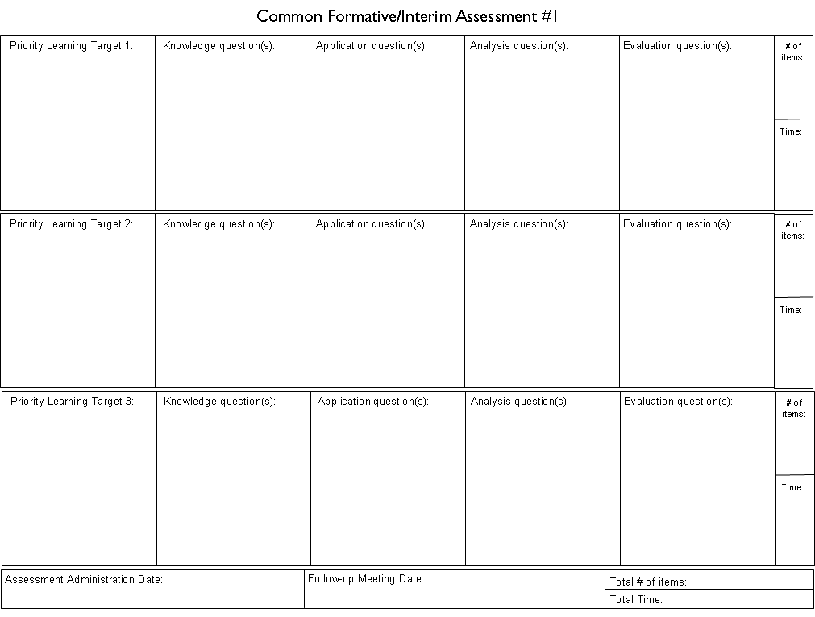
GETTING TO WORK…

Slide 45
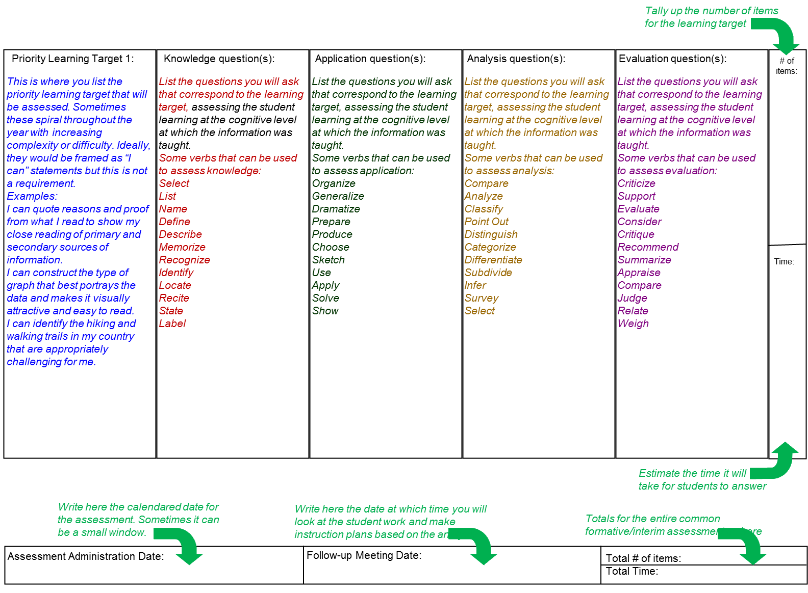
Lay out the learning targets
for ALL of the common formative/interim assessments and THEN make the actual assessments.

Slide 46
Find/make items that match the learning targets. You might not have all four types for each target, but “aim high” on Bloom’s

Slide 47
Keep a tally of your items and estimate the time. Think: GOLDILOCKS!

Slide 48
Your assessment totals go her. Think: GOLDILOCKS!

Slide 49
Calendar the COMMON assessment administration.

Slide 50
When will you meet to look at the student work AND make instructional plans based on your analysis?

Slide 52
READY! FIRE! AIM!
First: Lay out your targets for the year
Second: Make the first assessment (including calendaring the assessment(s) and scheduling the follow-up meeting)

Slide 53
Contact information
Patrick Shaw pshaw@ocmboces.org jeff craig jcraig@ocmboces.org
Thank You!

