Slide 1

School District Reorganization Research: What Do We Know,
Where Are the Research Gaps, and
What Should Be the Research Agenda?
William Duncombe, Professor of Public Administration
Education Finance and Accountability Program
The Maxwell School, Syracuse University
duncombe@maxwell.syr.edu
OCM BOCES
August 9, 2011

Slide 2
Introduction
School district consolidation is on the policy agenda in a number of states. Viewed as a way to save money during a financial crisis.
Some states, including New York, provide generous financial incentives for consolidation.
Yet research on the effects of consolidation on costs and student performance is limited.
Objective of this presentation is to review the evidence, discuss what we don’t know, and propose a research agenda for New York.

Slide 3
Organization
Putting New York into context
Pros and cons of consolidation
Research evidence
Major research gaps
Research agenda for New York

Slide 4
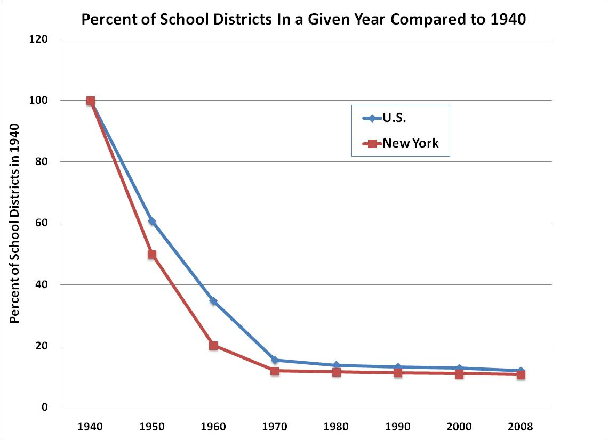

Slide 5
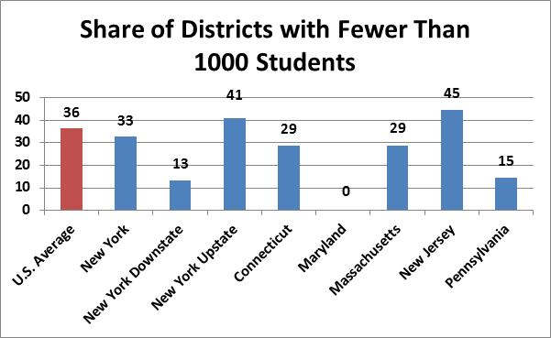
Enrollment in Median School District and
Share of Districts with Fewer Than 1000 Students
16902
Source: U.S. Census Bureau, Public Education Finances:2009.

Slide 6
Organization
Putting New York into context
Pros and cons of consolidation
Research evidence
Major research gaps
Research agenda for New York

Slide 7
Potential Cost Savings Due to Consolidation
Many administrative costs don’t increase significantly as enrollment increases.
More efficient size of physical plant, e.g., larger schools.
Greater specialization of teachers, especially in science and math.
Reduce number of very small classes.
Price discounts from greater volume.

Slide 8
Possible Negative Efficiency Effects from Consolidation
Higher transportation costs for district and longer travel time for students.
Teacher compensation may be higher-- set at highest level among merging districts.
Larger schools leads to lower staff motivation and productivity, student motivation, and parental involvement in large schools.

Slide 9
Organization
Putting New York into context
Pros and cons of consolidation
Research evidence
Major research gaps
Research agenda for New York

Slide 10
Types of Evidence
Case study evidence
Cost function estimates for school districts.
Program evaluations of actual school consolidations.
Studies of the effects of consolidation on property values

Slide 11
Case Study Research
There are a number of case studies of consolidations mostly from administrators or school board members involved in the process.
They provide valuable information of how to manage the process and the likely controversies and challenges.
However, relatively few involve comparisons to districts that didn’t consolidate or examine the impacts in the long-run on spending and student performance.

Slide 12
Case Study Research:
The Case of West Virginia
One of the most heavily cited case studies looks at closing of over 300 schools in 1990s in WV.
The state supposedly spending more than a $1 billion on the school consolidations.
  Lead to significantly longer student bus rides.
Promised benefits of consolidation didn’t materialize
  No reduction in district spending
  Little growth in advanced courses.

Slide 13
Cost Function Methodology
Cost functions are a statistical method which estimate the relationship between per pupil spending in a school district and enrollment controlling for differences in:
  Average student performance
  Average teacher salaries
  Average student characteristics (e.g., poverty)
  Efficiency control variables
Can be used to estimate “potential” cost reduction from larger school districts.

Slide 14
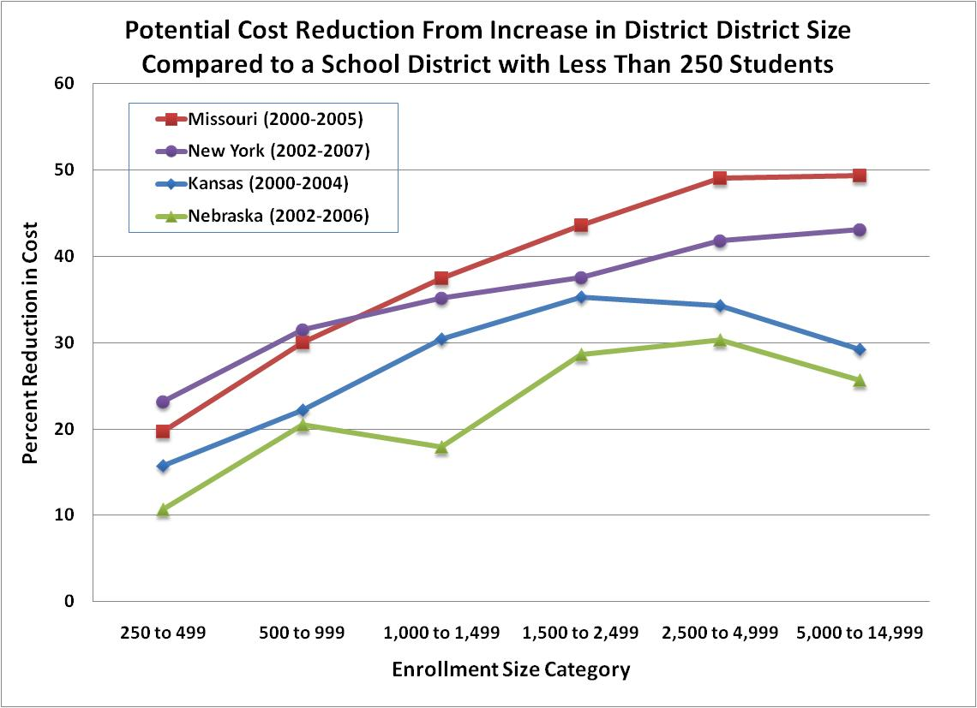
*Based on several cost function studies done by the author.

Slide 15
Summary of Evaluation Research
“In the 60 years between 1929 and 1989, consolidation reduced the number of school districts across the United States by 90 percent and the number of schools by 70 percent, yet during those years the number of students increased by 60 percent! The lack of pre-and post-consolidation studies means that we have no solid information about the accrual of benefits alleged to depend on school closures and consolidation.” (Howley, 1997, p. 25)

Slide 16
Evaluation of Consolidation in New York
We evaluated 12 pairs of districts consolidating between 1987 and 1995.
All are rural districts with enrollments between 250 and 2,000 students.
Evaluation was carried out using statistical analysis of a cost function.
A number of steps were taken to isolate effects of consolidation on costs.
Source: William Duncombe and John Yinger, 2007. “Does School Consolidation Cut Costs?” Education Finance and Policy. 2(4): 341-375.

Slide 17
Results of Evaluation
Simple comparison: Spending per pupil went up much faster in consolidating districts than non-consolidating districts due to significant increase in capital spending.
The potential long-run cost savings are quite large (over 40%) even in moderately sized districts (1,500 students).
However, in New York a significant portion of these savings are lost due to short-run increases in capital spending.

Slide 19
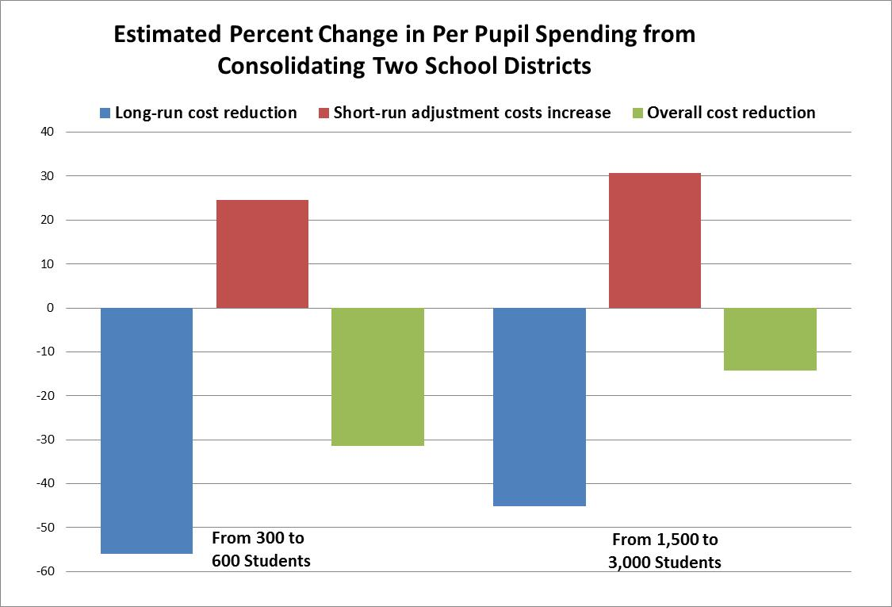

Slide 20
Evaluation of Consolidation in Iowa
Significant consolidations in Iowa (34) from 1992-1994 because of state financial incentives.
Evaluation done of impact of consolidation on spending per pupil, productivity, and dropout rate.
Findings: Consolidation is not associated with:
  Reduction in total spending or instructional spending per pupil.
  Improvement in productivity or decline in dropout rate.
Source: Nora Gordon and Brian Knight. 2008, “The Effects of School Consolidation on Educational Cost and Quality.” Public Finance Review. 36: 408-430.

Slide 21
Impact of Consolidation on Property Values in New York
Consolidation studies don’t reflect costs to parents and students from consolidation (e.g., increased travel time).
Changes in property values may reflect more complete picture of effects of consolidation
Consolidation resulted in large property value gains (25%) in very small districts but gains disappear by enrollment over 1,700 pupils.
Without consol. incentive, it increased property values only for districts under 1,000.
Source: Yue Hu and John Yinger. 2008. “The Impact of School District Consolidation on Housing Prices.” National Tax Journal 61(4): 609-634.

Slide 22
Organization
Putting New York into context
Pros and cons of consolidation
Research evidence
Major research gaps
Research agenda for New York

Slide 23
Why Have There Been So Few Evaluations of Consolidation?
State governments have not generally funded research on the results of school district reorganization.
The federal government and education foundations fund very little research on school finance and organization.
The result has been a lack of research on school organization and significant research gaps.

Slide 24
Research Gaps
Little research on state-imposed school district consolidation (e.g., Arkansas, Maine, Nebraska, West Virginia).
Research has involved either case studies or statistical analysis. Studies need both.
Very little research evaluating alternative organizational arrangements, such as shared services, regional organizations, or state provided services (e.g., state procurement).

Slide 25
Organization
Putting New York into context
Pros and cons of consolidation
Research evidence
Major research gaps
Research agenda for New York

Slide 26
Role of State Government in Improving Research
Provide technical assistance to districts considering consolidation. Small districts often don’t have capacity to do research themselves.
Support studies of past district consolidation. This research can help guide state policy.
Should build in an evaluation requirement into any legislation providing incentives for district consolidation.

Slide 27
Research Agenda for New York
Case studies of consolidations in last two decades to identify best practices and unanticipated problems.
Review of possible organizational arrangements and case studies of examples in other states.
Pilot studies by groups of districts to explore possible alternative organizations.
  Project teams should includes district officials, consolidation consultants, and academics.
  Require state funding if these studies are going to be both comprehensive and timely.

