Slide 1
Two Case Studies and Their Implications for State Policy
Mr. Alan D. Pole
Dr. William D. Silky
August 9, 2011

Slide 2
Case Study #1

Slide 3
Case Study #2

Slide 20
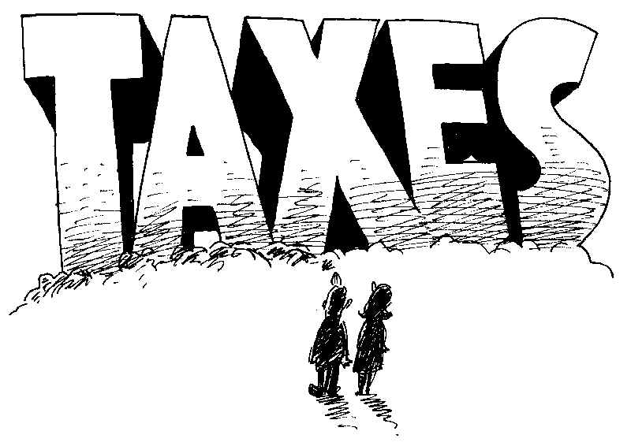

Slide 26
Policy Questions for Discussion
Should merger of school districts remain a local decision or should the state have the ability to force schools to merge?
Are three votes prior to districts actually merging really necessary?
Should the State Education Department require any district(s) that consider engaging in a merger study to undergo a per-merger study analysis?
In addition to incentives for districts to merge, should NYS also implement “disincentives” for those districts which choose not to merge but are targeted to do so?

Slide 27
Policy Questions for Discussion
Should BOCES aid be available to support school district merger studies?
Should the SED fund studies to develop various models (i.e., countywide school districts) of possible school district organization?
Should a differentiated incentive approach be implemented depending on the newly merged district’s characteristics?

Slide 28
Policy Questions for Discussion
Should a special category of additional transportation aid be available for newly merged districts since transportation costs always increase following a merger?
Is it reasonable to expect that all newly merged districts demonstrate achieving economies of scale at least five years after consolidation?
Should the state incentive program begin by supporting transition costs but then transition to incent districts to operate more efficiently?

