Slide 1
Principal Evaluator Training
Day 3
2014-2015

Slide 2
Agenda
Introductions
Objectives and Agenda Review
Research & Literature
From Session 1
Homework
Video Exercise
Summative Conferences

Slide 3
Back Again: 9 Components
New York State Teaching Standards and Leadership Standards
Evidence-based observation
Application and use of Student Growth Percentile and VA Growth Model data
Application and use of the State-approved teacher or principal rubrics
Application and use of any assessment tools used to evaluate teachers and principals

Slide 4
Back Again : 9 Components
Application and use of State-approved locally selected measures of student achievement
Use of the Statewide Instructional Reporting System
Scoring methodology used to evaluate teachers and principals
Specific considerations in evaluating teachers and principals of ELLs and students with disabilities

Slide 5
Back Again : 9+ Components
State-determined district-wide student growth goal setting process (Student Learning Objectives)
Effective supervisory visits and feedback
Soliciting structured feedback from constituent groups
Reviewing school documents, records, state accountability processes and other measures
Principal contribution to teacher effectiveness
Increasing the likelihood that it makes a difference

Slide 6
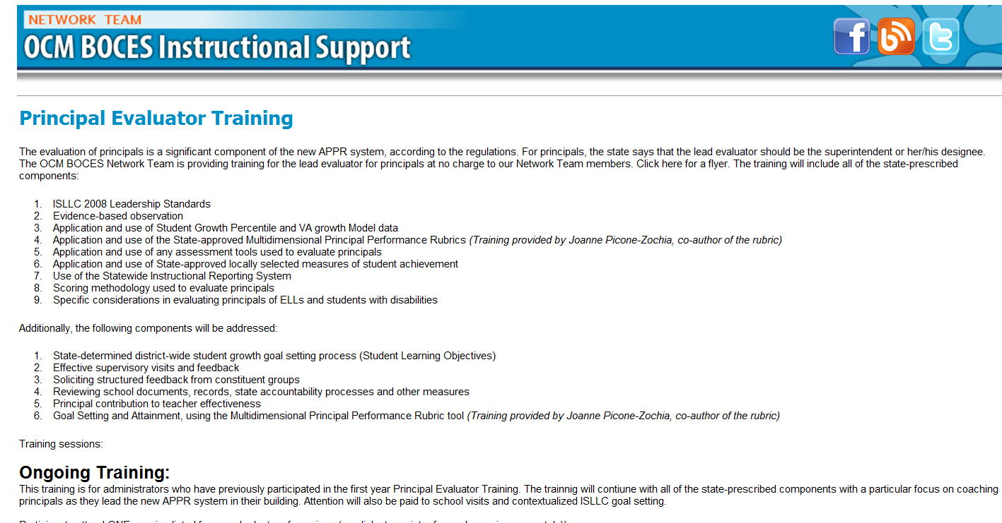
Resources Are Archived

Slide 7
Research & Literature

Slide 8
Article Read
Open folder.
Browse the collection.
Sort them by the level of interest to you.

Slide 9
Article Read - Continued
Relocate to a group of colleagues who are interested in the same article.
Read the article.
Prepare a summary – add to chart paper.
Identify implications for principal supervision – add to chart paper.

Slide 10
Article Read - Continued
Report out.

Slide 11
Going Along w/ a Principal Video Exercise

Slide 12
Going Along w/ a Principal
Were you able to accompany a principal through the observation and conference process?
How did it go?
What did you learn?
Implications on your practice?

Slide 13
Going Along w/ a Principal
Collect evidence from the classroom
Principal talks with the teacher
Supervisor talks with the principal

Slide 14
Going Along w/ a Principal
Collect evidence from the classroom
Principal talks with the teacher
Supervisor talks with the principal

Slide 15
Going Along w/ a Principal
Collect evidence from the classroom
Principal talks with the teacher
Supervisor talks with the principal

Slide 16
Going Along w/ a Principal
Collect evidence from the classroom
Principal talks with the teacher
Supervisor talks with the principal

Slide 17
3/4 Grade ELA Lesson
Students are “journalist trainees”
Working in groups
The goal was to recognize different text structures

Slide 18
Going Along w/ a Principal
Collect evidence from the classroom
Principal talks with the teacher
Supervisor talks with the principal

Slide 19
Watch the Conversation
v
Principal talks with the teacher
Take notes about the conversation

Slide 20
Conversation Debrief
Principal talks with the teacher
Debrief the conversation with a neighbor
What did the principal focus on?
What was her opening line?
What did she want the teacher to do in the future?
Where on the coaching continuum did the principal operate?

Slide 21
Conversation Debrief
Principal talks with the teacher
+
∆

Slide 22
Going Along w/ a Principal
Collect evidence from the classroom
Principal talks with the teacher
Supervisor talks with the principal

Slide 23
Plan Your Conversation
Supervisor talks with the principal
Plan your meeting with the principal
What will you want to focus on?
What will you start with?
Where on the coaching continuum will you intend to operate?

Slide 24
Watch the Conversation
v
Supervisor talks with the principal
Take notes about the conversation

Slide 25
Conversation Debrief
Supervisor talks with the principal
Debrief the conversation with a neighbor
What did the principal focus on?
What was her opening line?
What did she want the teacher to do in the future?
Where on the coaching continuum did the principal operate?

Slide 26
Conversation Debrief
Supervisor talks with the principal
+
∆

Slide 27
Summative Meetings with Teachers

Slide 28
Your Principals
How (and when) will you communicate to your principals what you want them to do with all of their teachers during end-of-the-year meetings?
Talk about your plans or your options at your table.

Slide 29
Summative Meetings with Principals

Slide 30
Reflect on Last Year
Look at the summative evaluation from last year.
What worked well? What didn’t work?
In what ways did it set the stage for this year?

Slide 31
Make Your Plan
When you meet with the principals…
What do you want all of your principals to hear?
What will your agenda or plan be?
How will you communicate this to your principals in advance?
How will you use this year to look ahead?

Slide 32
Reflect on Last Year
Look again at the summative evaluation from last year.
What’s your plan for the summative meeting with this principal, this year?

Slide 33
Principal Evaluator Training
2015-2016

Slide 34
Next Year
Next Year?
Three sessions?
After CSA or not?
Will we need a year one cohort?

Slide 35
Closure: Next Year
On note paper, write a quick letter to Jeff about what you would like to see included in or changed for
Principal Evaluator Training, NEXT YEAR.
Leave it at your table.
Dear Jeff:

Slide 36
Principal Evaluator Training
Day 3
2014-2015

