Slide 1

Principal Evaluator Training
Day 2
2015-2016

Slide 2
Agenda
Introductions
Objectives and Agenda Review
Research: Principal Characteristics
Time Out: §3012-d Planning
Forest or the Trees?
Making a “To-Do” List

Slide 3
Nine Required Components
3012-c
3012-d
New York State Teaching Standards and Leadership Standards
Evidence-based observation
Application and use of Student Growth Percentile and VA Growth Model data
Application and use of the State-approved teacher or principal rubrics
Application and use of any assessment tools used to evaluate teachers and principals
New York State Teaching Standards and Leadership Standards
Evidence-based observation
Application and use of Student Growth Percentile method
Application and use of the State-approved teacher or principal rubrics
Application of assessment tools the district employs

Slide 4
Nine Required Components
3012-c
3012-d
Application and use of State-approved locally selected measures of student achievement
Use of the Statewide Instructional Reporting System
Scoring methodology used to evaluate teachers and principals
Specific considerations in evaluating teachers and principals of ELLs and students with disabilities
Application and use of State-approved locally selected measures of student growth
Use of the Statewide Instructional Reporting System
Scoring methodology used by the state and the district
Specific considerations in evaluating teachers and principals of ELLs and students with disabilities

Slide 5
Back Again : 9+ Components
Effective supervisory visits and feedback
Principal contribution to teacher effectiveness
Increasing the likelihood that it makes a difference

Slide 6
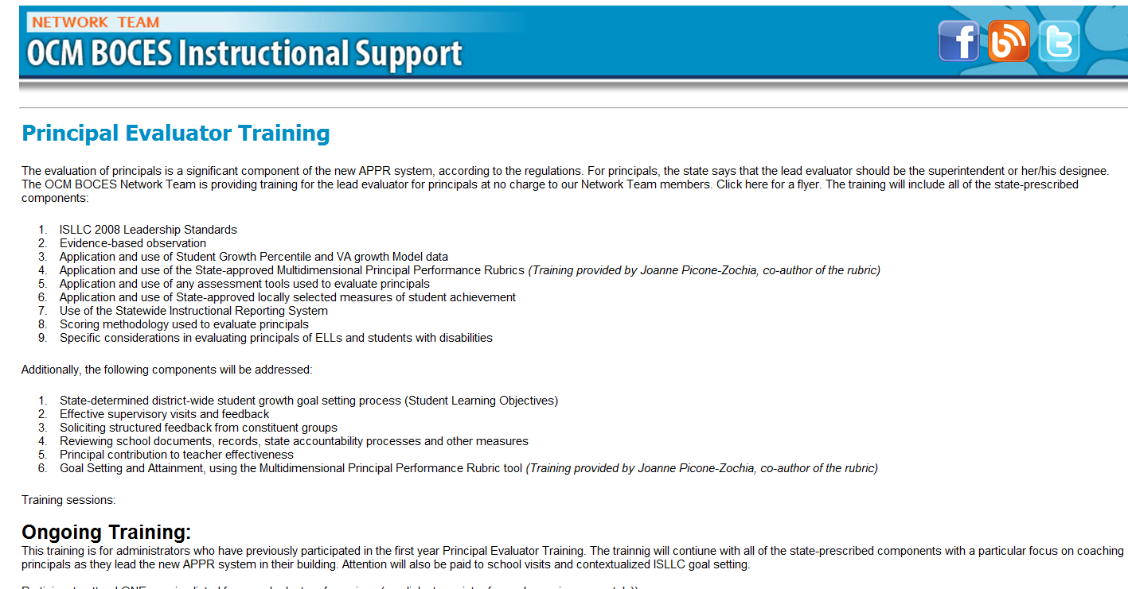
Resources Are Archived

Slide 7
Research & Literature Review

Slide 8
Principal Characteristics
  Osborne-Lampkin, L., Folsom, J. S., and Herrington, C. D. (2015). A systematic review of the relationships between principal characteristics and student achievement (REL 2016–091). Washington, DC: U.S. Department of Education, Institute of Education Sciences, National Center for Education Evaluation and Regional Assistance, Regional Educational Laboratory Southeast. Retrieved from http://ies.ed.gov/ncee/edlabs.

Slide 9
Principal Characteristics
What do you think this research showed?
Jot a few things down in the top box of the organizer
Discuss at your table
Notes:
This also serves as a good warm-up activity; do this rather than a separate warm-up.

Slide 10
Principal Characteristics
What do you think this research showed?
Jot a few things down in the top box of the organizer
Discuss at your table
Jot down what the research identified
Notes:
This also serves as a good warm-up activity; do this rather than a separate warm-up.

Slide 11
Principal Characteristics
Experience and student achievement:
9-17 years of teaching experience before administration better than <9 or >17
Overall years of experience in education has no relationship
Not clear that experience as assistant principal matters (a little, at first)
Some but not all studies show principal experience has an impact

Slide 12
Principal Characteristics
Principal Preparation programs:
Programs make a difference
Being based on ISLLC is better
Programs and certification does have a positive correlation

Slide 13
Principal Characteristics
Leadership behaviors with an impact on student learning:
Monitoring and providing feedback to teachers and students
Having a vison for learning
Providing support and participating in and PD to teachers (formal and informal)*
Using data to inform decisions
Notes:
*highest mean effect size

Slide 14
Principal Characteristics
Relationship factors:
High expectations of teachers and students
Emphasis on social capital*
Building community
Developing a rapport with teachers and students
Notes:
*Connect to Professional Capital session at Lead Evaluator Training

Slide 15
Principal Characteristics
Organizational management:
Does matter, in addition to instructional leadership

Slide 16
Principal Characteristics
What do you think this research showed?
Jot a few things down in the top box of the organizer
Discuss at your table
Jot down what the research identified
Compare the two lists
Notes:
This also serves as a good warm-up activity; do this rather than a separate warm-up.

Slide 17

Three-Minute Pause

Slide 18
School Visits
What Makes Them Good

Slide 19
School Visits
At your table, talk about a recent school visit you made that was a good one
What happened?
What made it good?

Slide 20
Time-Out:
§3012-d Planning and Sharing

Slide 21
Already “d”
Hear what the d-approved districts:
Other than the required SLOs, what are you using for assessments

Slide 22
“d” Changes
Break up in groups and discuss where you are in terms of “d” planning, whether it is the plan or the supplement:
“d” districts
Smaller
Medium
Larger
Notes:
15 minutes for the discussion

Slide 23
Forest or the Trees?

Slide 24
What We’ve Learned About Principal Evaluation
Principal evaluation systems lack depth and focus on the right things (Goldring, Xiu, Murphy, Elliott, Carson, & Porter, 2008; Seashore-Louis, et al., 2010; Mitgang, Gill, & Cummins, 2013)
Notes:
Ray Smith and Julie Smith: Evaluating Instructional Leadership: Recognized Practices for Success

Slide 25
What We’ve Learned About Principal Evaluation
Principals perceive performance evaluation as having limited usefulness in the areas of feedback, professional learning, or accountability to school improvement (Portin, Feldman, & Knapp, 2006)
Notes:
Ray Smith and Julie Smith: Evaluating Instructional Leadership: Recognized Practices for Success

Slide 26
What We’ve Learned About Principal Evaluation
Principal evaluation systems contain vague performance expectations and/or lack clear norms or performance standards (Goldring, Xiu, Murphy, Elliott, Carson, & Porter, 2008; Reeves, 2009)
Notes:
Ray Smith and Julie Smith: Evaluating Instructional Leadership: Recognized Practices for Success

Slide 27
What We’ve Learned About Principal Evaluation
Principal evaluation systems have not been implemented in ways that promote accurate judgments of principal effectiveness (Clifford & Ross, 2011; Davis, Kearney, Sanders, Thomas, & Leon, 2011)
Notes:
Ray Smith and Julie Smith: Evaluating Instructional Leadership: Recognized Practices for Success

Slide 28
What We’ve Learned About Principal Evaluation
Principal evaluation systems are typically one-size-fits all systems that don't differentiate for different school contexts (Clifford & Ross, 2011; Davis, Kearney, Sanders, Thomas, & Leon, 2011; Mitgang, Gill, & Cummins, 2013)
Notes:
Ray Smith and Julie Smith: Evaluating Instructional Leadership: Recognized Practices for Success

Slide 29
What We’ve Learned About Principal Evaluation
Principal evaluation systems have not been tested for critical psychometric properties and are not based on the latest research on principal leadership practices (Clifford, Menon, Gangi, Condon, & Hornung, 2012; Davis, Kearney, Sanders, Thomas, & Leon, 2011)
Notes:
Ray Smith and Julie Smith: Evaluating Instructional Leadership: Recognized Practices for Success

Slide 30
What We’ve Learned About Principal Evaluation
Principal evaluation systems are not unlike many other educational initiatives that are poorly implemented (Kimball, Milanowski, & McKinney, 2009)
Notes:
Ray Smith and Julie Smith: Evaluating Instructional Leadership: Recognized Practices for Success

Slide 31

What Are We Supposed to Do?
The Model Principal Supervisor Standards make some suggestions (eight, to be specific):
Standards
Dispositions
Actions

Slide 32

What Are We Supposed to Do?
Learning More:
Read 1 of the 8 Standards
Highlight important things
Move to “like” group
Compare highlights
Add “to-do” items to the poster
prepared for you
Report out

Slide 33
Three-Minute Pause

Slide 34
Next Session
April 13th: 12:00p - 3:00p
Agenda will include:
Updates
Research
Summative under “transition”
More

Slide 35
Principal Evaluator Training
Day 2
2015-2016

