Slide 1
Principal Evaluator Training
Day 2
2014-2015

Slide 2
Agenda
Introductions
Objectives and Agenda Review
Research & Literature
From Session 1
Homework
Video Exercise
Mid-Year Conferences

Slide 3
Back Again: 9 Components
New York State Teaching Standards and Leadership Standards
Evidence-based observation
Application and use of Student Growth Percentile and VA Growth Model data
Application and use of the State-approved teacher or principal rubrics
Application and use of any assessment tools used to evaluate teachers and principals

Slide 4
Back Again : 9 Components
Application and use of State-approved locally selected measures of student achievement
Use of the Statewide Instructional Reporting System
Scoring methodology used to evaluate teachers and principals
Specific considerations in evaluating teachers and principals of ELLs and students with disabilities

Slide 5
Back Again : 9+ Components
State-determined district-wide student growth goal setting process (Student Learning Objectives)
Effective supervisory visits and feedback
Soliciting structured feedback from constituent groups
Reviewing school documents, records, state accountability processes and other measures
Principal contribution to teacher effectiveness
Increasing the likelihood that it makes a difference

Slide 6
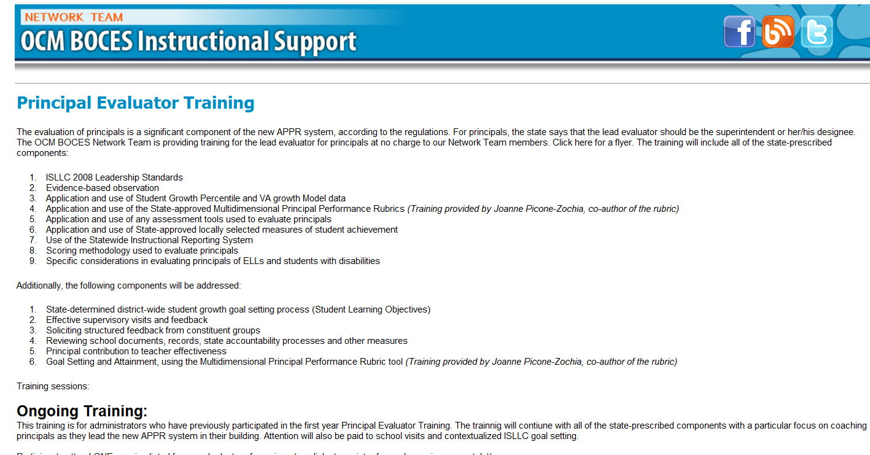
Resources Are Archived

Slide 7
Research & Literature

Slide 8
Standards for Evaluating Principals
Draft
Seven Standards

Slide 9
School principals are central to a system of instruction and accountability that requires them to ensure that each child is college and career ready upon graduation from high school and that each teacher effectively meets the diverse learning needs of his/her students on a daily basis.

Slide 10
Furthermore, school principals, along with their district leaders, are expected to lead the full implementation of new college and career ready standards, which will require the transformation of instruction, the use of new assessments, and the adoption and implementation of new educator evaluation and support systems.

Slide 11
In sum, today’s principals must engage stakeholders in continuous school improvement and support, which leverages the highest levels of student learning and the most impactful teacher instructional practices.

Slide 12
To achieve these new expectations, school principals need a system of support that includes highly effective preparation, induction, development coaching, professional learning, and evaluation programs which build and refine their instructional leadership capacity over their entire career.

Slide 13
Standards for Evaluating Principals
Pick up one of the standards at your table
Go to the sign in the room that corresponds to the one you picked
Discuss the standard:
Good? Bad? Missing?
Reconcile this with your other responsibilities…

Slide 14
From Session 1

Slide 15
Last time: Article Read
Article Read: Supervising Principals: How Superintendents
Can Improve Teaching and Learning in the Classroom
Homework: Accompany a principal on an observation cycle

Slide 16
Going Along w/ a Principal
Were you able to accompany a principal through the observation and conference process?
How did it go?
What did you learn?
Implications on your practice?

Slide 17
Going Along w/ a Principal Video Exercise

Slide 18
Going Along w/ a Principal
Collect evidence from the classroom
Principal talks with the teacher
Supervisor talks with the principal

Slide 19
Going Along w/ a Principal
Collect evidence from the classroom
Principal talks with the teacher
Supervisor talks with the principal

Slide 20
Going Along w/ a Principal
Collect evidence from the classroom
Principal talks with the teacher
Supervisor talks with the principal

Slide 21
Going Along w/ a Principal
Collect evidence from the classroom
Principal talks with the teacher
Supervisor talks with the principal

Slide 23
6th Grade Math Lesson
Review homework; one student at the interactive whiteboard
Model the comparison of unit price on cereal
Directions for group work
Students work in groups
Groups hand in their poster

Slide 24
Going Along w/ a Principal
Collect evidence from the classroom
Principal talks with the teacher
Supervisor talks with the principal

Slide 25
Watch the Conversation
v
Principal talks with the teacher
Take notes about the conversation

Slide 26
Conversation Debrief
Principal talks with the teacher
Debrief the conversation with a neighbor
What did the principal focus on?
What was her opening line?
What did she want the teacher to do in the future?
Where on the coaching continuum did the principal operate?

Slide 27
Conversation Debrief
Principal talks with the teacher
+
∆

Slide 28
Going Along w/ a Principal
Collect evidence from the classroom
Principal talks with the teacher
Supervisor talks with the principal

Slide 29
Plan Your Conversation
Supervisor talks with the principal
Plan your meeting with the principal
What will you want to focus on?
What will you start with?
Where on the coaching continuum will you intend to operate?

Slide 30
Watch the Conversation
v
Supervisor talks with the principal
Take notes about the conversation

Slide 31
Conversation Debrief
Supervisor talks with the principal
Debrief the conversation with a neighbor
What did the principal focus on?
What was her opening line?
What did she want the teacher to do in the future?
Where on the coaching continuum did the principal operate?

Slide 32
Conversation Debrief
Supervisor talks with the principal
+
∆

Slide 33
Mid-Year Meetings with Principals

Slide 34
Planning Meetings
Mid-Year Conference with Principals
A sample from another system

Slide 35
Planning Meetings
Mid-Year Conference with Principals
What are the things you typically discuss with principals at the mid-point?

Slide 36
Planning Meetings
Mid-Year Conference with Principals
Example of a organizer

Slide 37
Next Session
March 4th: 12:00p - 3:00p
Agenda will include:
Taking Stock of the year
Preparing for the end of the year

Slide 38
Principal Evaluator Training
Day 2
2014-2015

