Slide 1
Principal Evaluator Training
Day 2
2013-2014

Slide 2
Agenda
Introductions
Objectives and Agenda Review
Principal Evaluation: So far
Revised resources
Collect evidence from a “faculty meeting”
Debrief
Planning your next school visit

Slide 3
Back Again: 9 Components
New York State Teaching Standards and Leadership Standards
Evidence-based observation
Application and use of Student Growth Percentile and VA Growth Model data
Application and use of the State-approved teacher or principal rubrics
Application and use of any assessment tools used to evaluate teachers and principals

Slide 4
Back Again : 9 Components
Application and use of State-approved locally selected measures of student achievement
Use of the Statewide Instructional Reporting System
Scoring methodology used to evaluate teachers and principals
Specific considerations in evaluating teachers and principals of ELLs and students with disabilities

Slide 5
Back Again : 9+ Components
State-determined district-wide student growth goal setting process (Student Learning Objectives)
Effective supervisory visits and feedback
Soliciting structured feedback from constituent groups
Reviewing school documents, records, state accountability processes and other measures
Principal contribution to teacher effectiveness
Increasing the likelihood that it makes a difference

Slide 6
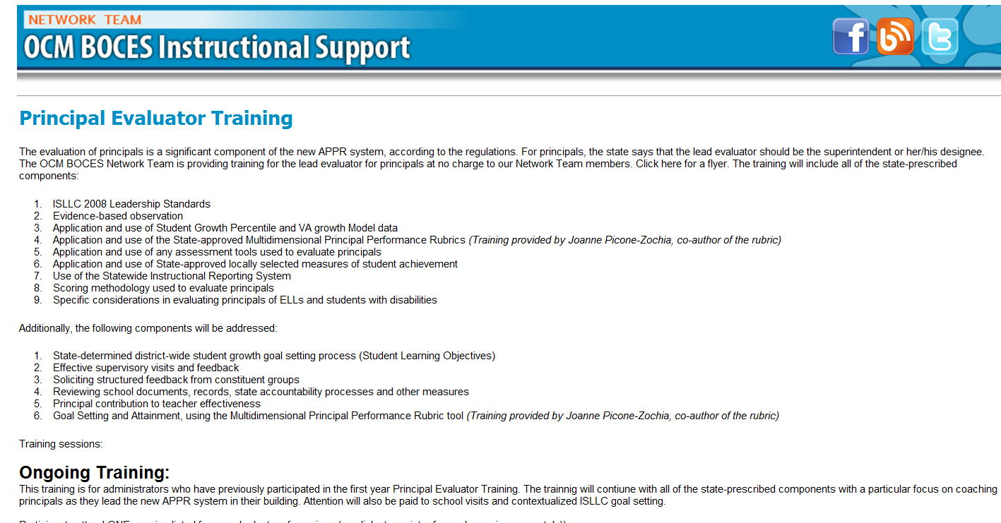
Resources Are Archived

Slide 7
Agenda
Introductions
Objectives and Agenda Review
Principal Evaluation: So far
Revised resources
Collect evidence from a “faculty meeting”
Debrief
Planning your next school visit

Slide 8
Principal Evaluation: So Far

Slide 9
Think of a Principal…
Pick out one of your principals:
Reflect on the supervision you have provided so far this year
Use the questions in the organizer to prompt your reflection

Slide 10
Table Conversation
At your table, talk about what you have down so far. Record your thinking on a piece of chart paper:
+
∆

Slide 11
Revised Tool Using the Supervisor’s Guide

Slide 12
Supervisor’s Guide
Previous version was checklist
Revised version has a place for recording the date instead of a √
date

Slide 13
Evidence Collection From a Faculty Meeting

Slide 14
Evidence Collection
Faculty Meeting Simulation
At your table, talk about the faculty meetings in your district
Participate in the simulation
Record evidence during the simulation

Slide 15
Faculty Meeting December 2013
Quixotic Bay Elementary School

Slide 16
Agenda
Announcements
Committee Reports
Mathematical Practices

Slide 17
Announcements
Additional parking
Revised Traffic Flow
PTA – teacher rep needed
Learn to Ski Program (help wanted)
Other?

Slide 18
Committee Reports
RtI Committee
Social Committee
Character Ed Committee
Health School Committee
District committee reports?

Slide 19
Mathematical Practices
Overview

Slide 20
Mathematical CCLS
Five critical areas:
Collaboration
Instruction
Content
Assessment
Intervention

Slide 21
Mathematical Practices
Describe what students should be doing while they learn mathematics.
Superior to content
Processes and proficiencies
Not a checklist

Slide 22
Mathematical Practice 1
Make sense of Problems and Persevere in Solving Them
Students make conjectures about the meaning of a solution and plan a solution pathway
Students try special cases or simpler forms to gain insight
Students monitor and evaluate their progress and discuss with others
Students understand multiple approaches and ask the question: “Does this solution make sense?”

Slide 23
Mathematical Practice 2
Reason Abstractly and Quantitatively
Students can decontextualize a problem by representing the problem symbolically for a solution
Students can contextualize a problem by attend to the meaning of the quantities in the problem
Students can create a coherent representation of the task or problem presented

Slide 24
Mathematical Practice 3
Construct Viable Arguments and Critique the Reasoning of Others
Students make conjectures and explore the truth of those conjectures
Students justify their conclusions and communicate them to others
Students compare the effectiveness of two plausible arguments
Students listen, read, and respond to the arguments of others for making sense and clarity

Slide 25
Mathematical Practice 4
Model with Mathematics
Students represent mathematical concepts by using such tools as diagrams, tables, charts, graphs, calculators, etc.
Students use symbols and tools to represent real-work solutions
Students routinely interpret their mathematical results in the context of the problem situation
Students are comfortable making assumptions and approximations to simply real-world situations and can test the assumptions

Slide 26
Mathematical Practice 5
Use Appropriate Tools Strategically
Students choose an appropriate tool for the problem or task
Students know the limits of each tool
Students detect tool-generated errors by estimating reasonable solutions without the tool
Students use tools to explore and deepen their discovery and understanding of concepts

Slide 27
Mathematical Practice 6
Attend to Precision
Students communicate precisely to others
Students use clear definitions of terms
Students express numerical answers with a degree of precision appropriate for he problem context
Students calculate accurately and efficiently
Students are careful about specifying units and labels

Slide 28
Mathematical Practice 7
Look For and Make Use of Structure
Students attention is drawn to the structure of mathematics as it occurs
Students are engaged in exploring numerical and visual patterns that reveal structure
Students can use strategies that shift the perspective of a solution

Slide 29
Mathematical Practice 8
Look For and Express Regularity in Repeated Reasoning
Students notice and discuss if their results are reasonable while solving the problem
Students notice and can articulate patterns in calculations that can be generalized to properties for formulae

Slide 30
Mathematical Practices
Activities

Slide 31
Mathematical Practices in Action
In your grade-level group, complete the organizer:
How is the practice important?
What does it look like at your level?
Indicate the relative importance: High, Medium, or Low
Use the resources at your table: Standards, placemat, etc.

Slide 32
Mathematical Practices in Action

Slide 33
Look-Fors

Slide 34
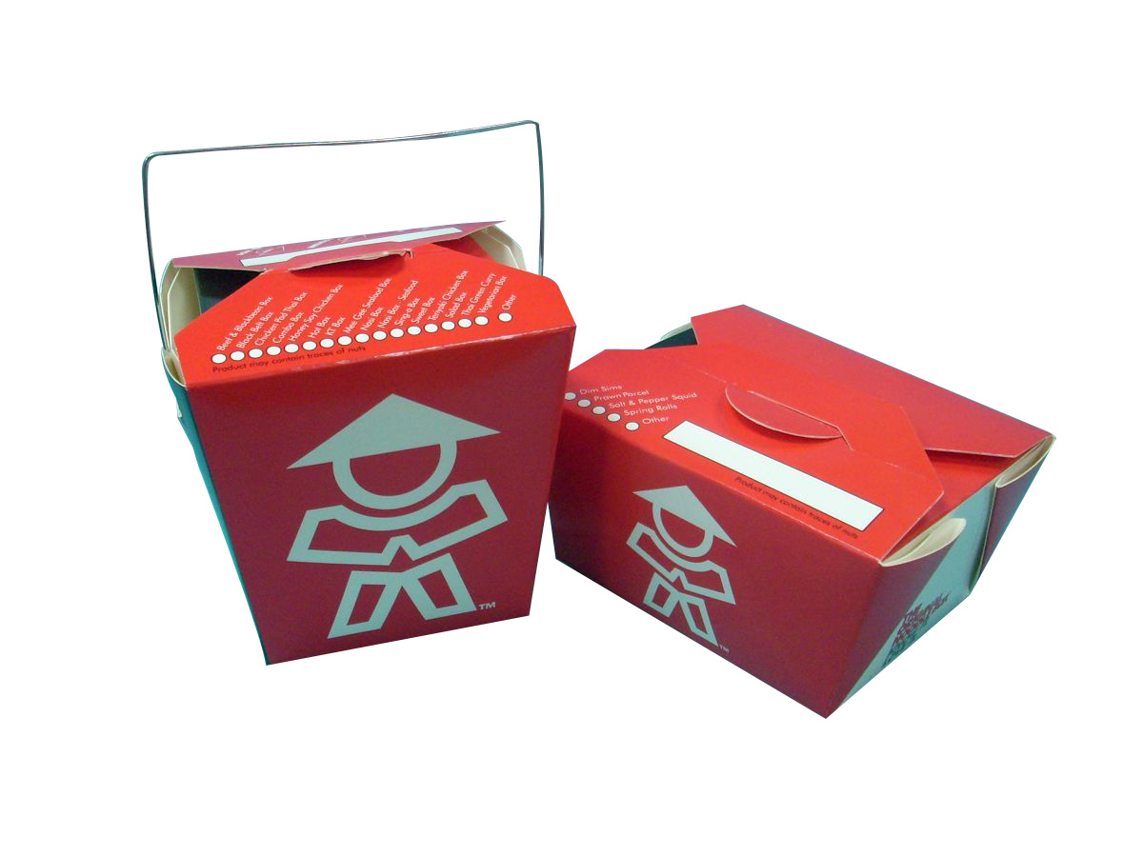
Closure
At as table, what is your “take-away” from this meeting?

Slide 35
Faculty Meeting December 2013
Quixotic Bay Elementary School

Slide 36
Evidence Collection
Clean up your own evidence
Talk about the evidence at your table:
What did you collect?
What did you not collect?
Implications?

Slide 37
Coaching Your Principal
Checking in from last time

Slide 38
Coaching
How would you coach this principal?

Slide 39
Support Your Local Principal
Checking in from last time

Slide 40
Principal Learning
What are you planning to…
Help your principal(s) with time management
Increase the inter-rater reliability and agreement among your lead evaluators
Help principals plan their faculty meetings
Help principals remain positive and be good leaders
Help principals with their learning

Slide 41
Principal Learning
What do you have done and what have you planned for your principals:
As a group?
Individually?

Slide 42
Tool School Visit Organizer

Slide 43
Planning Visits

Slide 44
Agenda
Introductions
Objectives and Agenda Review
Principal Evaluation: Different?
One Year Later
Coaching Principals
Collect evidence
Support your local principal

Slide 45
Next Session
March 26th: 12:00p - 3:00p
Henry Large Conference Room
Agenda will include:
Assessments as evidence
More about school visits
Preparing for the Summative

Slide 46
Principal Evaluator Training
Day 2
2013-2014

