Slide 1

Principal Evaluator Training
Day 1
2015-2016

Slide 2
Agenda
Introductions
Objectives and Agenda Review
Research
SED Update: Principal Scores
Negotiations
Questions
Support Your Local Principal

Slide 3
Nine Required Components
3012-c
3012-d
New York State Teaching Standards and Leadership Standards
Evidence-based observation
Application and use of Student Growth Percentile and VA Growth Model data
Application and use of the State-approved teacher or principal rubrics
Application and use of any assessment tools used to evaluate teachers and principals
New York State Teaching Standards and Leadership Standards
Evidence-based observation
Application and use of Student Growth Percentile method
Application and use of the State-approved teacher or principal rubrics
Application of assessment tools the district employs

Slide 4
Nine Required Components
3012-c
3012-d
Application and use of State-approved locally selected measures of student achievement
Use of the Statewide Instructional Reporting System
Scoring methodology used to evaluate teachers and principals
Specific considerations in evaluating teachers and principals of ELLs and students with disabilities
Application and use of State-approved locally selected measures of student growth
Use of the Statewide Instructional Reporting System
Scoring methodology used by the state and the district
Specific considerations in evaluating teachers and principals of ELLs and students with disabilities

Slide 5
Back Again : 9+ Components
State-determined district-wide student growth goal setting process (Student Learning Objectives)
Effective supervisory visits and feedback
Soliciting structured feedback from constituent groups
Reviewing school documents, records, state accountability processes and other measures
Principal contribution to teacher effectiveness
Increasing the likelihood that it makes a difference

Slide 6
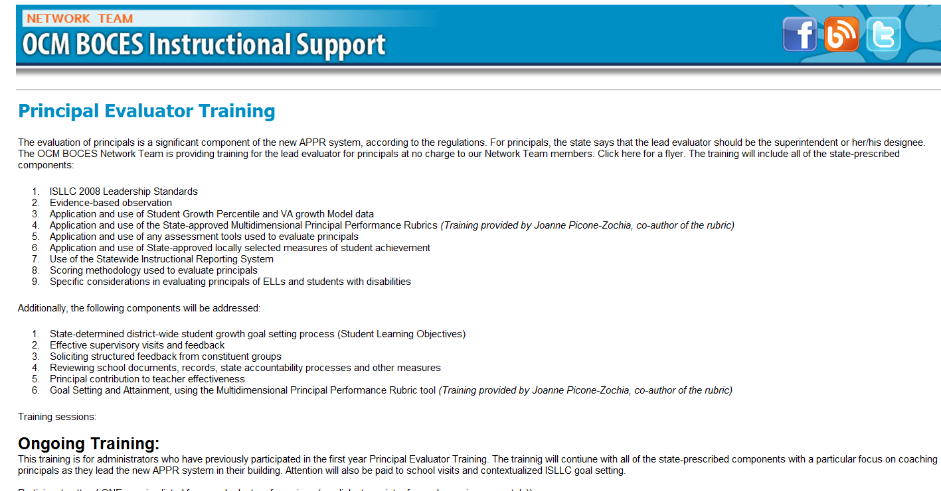
Resources Are Archived

Slide 7
Agenda
Introductions
Objectives and Agenda Review
Research
SED Update: Principal Scores
Negotiations
Questions
Support Your Local Principal

Slide 8
Opening Activity:
What Matters Most?

Slide 9
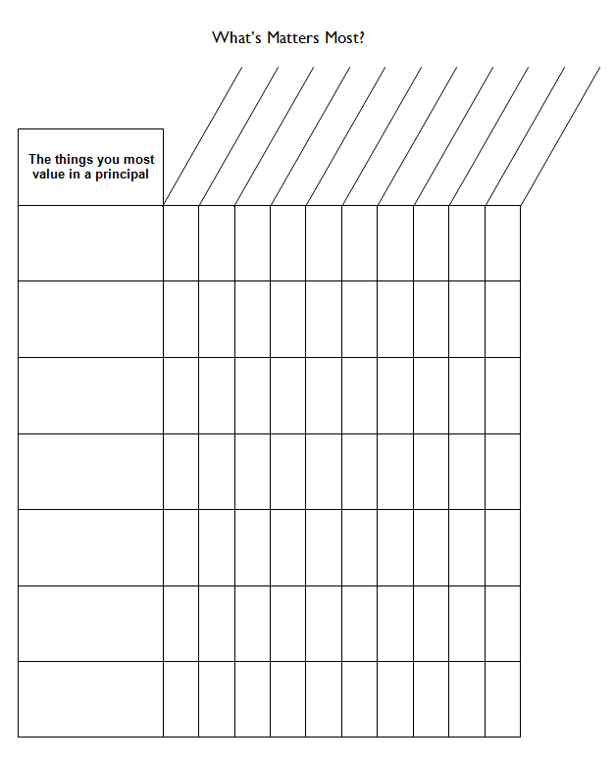
What Matters
On the organizer, list the things you most value in a principal.

Slide 10
Research & Literature Review

Slide 11
Who matters more?
TEACHER
PRINCIPAL
Notes:
The school principal as leader: guiding schools to better teaching and learning - The Wallace Foundation, January 2012.

Slide 12

Who matters more?
Notes:
The school principal as leader: guiding schools to better teaching and learning - The Wallace Foundation, January 2012.

Slide 13
Principal Conversations
  LeFevre, D. M. & Robinson, V. M. (2015) The interpersonal challenges of instructional leadership: Principals’ effectiveness in conversations about performance issues. Educational Administration Quarterly, 51(1), p. 58-95.

Slide 14
Principal Conversations
Three barriers to effective instructional leadership:
Administrative tasks distract from the core business of improving teaching and learning
Leaders inadequate knowledge about effective teaching and learning
Skill to help teachers improve

Slide 15
Principal Conversations
Three barriers to effective instructional leadership:
Administrative tasks distract from the core business of improving teaching and learning
Leaders inadequate knowledge about effective teaching and learning
Skill to help teachers improve

Slide 16
Principal Conversations
Principals and teacher performance issues:
The most common response to teacher incompetence has been to tolerate, protect and/or avoid
Conversations have avoided the truth
It’s hard to give negative feedback after years of double-talk and ceremonial congratulations
YET: Most teachers and administrators agree that the number of teachers who receive unsatisfactory evaluations is less than actual number of unsatisfactory teachers

Slide 17
Principal Conversations
Productive conversations depend on principal being able to (from least important to most):
Express a grounded point of view
Seek deeper understanding of the other’s point of view
Check for understanding
Help other to consider other point of view
Consider other points of view
Reach agreement about effective and integrative solutions

Slide 18
Principal Conversations
Productive conversations depend on principal being able to (from least important to most):
Express a grounded point of view
Seek deeper understanding of the other’s point of view
Check for understanding
Help other to consider other point of view
Consider other points of view
Reach agreement about effective and integrative solutions
True for any conversation… with teachers
and with parents…

Slide 19
Principal Conversations
Are there patterns in principals‘ difficult conversations (with parents, teachers, and both)?
Principals have modest skill level
More consistently closed conversations rather than open
Jump to solutions prior to through consideration (less inquiry)

Slide 20
Principal Conversations
Conclusion: The overall modest to low skill levels demonstrated [in the study] highlight the need to provide leaders with sustained, high-quality opportunities to learn how to effectively deal with difficult conversations
Some of this comes from Lead Evaluator Training, but more is needed. From where?

Slide 21
What Matters
On the organizer, list the things you most value in a principal.
Anything to add your MVP list?

Slide 22

Three-Minute Pause

Slide 23
SED Information:
Principal and Teacher Scores from the State

Slide 24
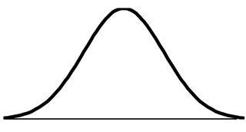
mean
Ineffective
Range (6.7%)
Highly Effective
Range (6.7%)
Developing
Range (9.2%)
Effective Range (77.4%)
SD = -1.5
SD = -1
SD = 0
SD = +1.5
SD = +2
6%
16%
50%
94%

Slide 25
SGPs to MGPs for Principals
To measure principal performance, we find the mean growth percentile (MGP) for all her students who were enrolled on BEDS day and assessment day. To find a principal’s mean growth percentile, take the average of SGPs in the school:
Step 1: 45+40+70+41 = 196
Step 2. 196/4 = 49.
Principal Jensen’s mean growth percentile (MGP) is 49, meaning on average her students performed as well or better than 49 percent of similar students.
Principal Jensen’s School
 | SGP | BEDS-Assessment Day Enrollment
Student Q | 45 | Yes
Student R | 40 | Yes
Student S | 70 | Yes
Student T | 60 | No
Student U | 41 | Yes
Same minimum sample size requirements (16 student scores) for principals as for teachers.

Slide 26
GREs for Principals
Simplified Illustrative Example
Principal’s score on this metric is 0.2. On average, students at this school are passing 0.2 Regents Exams more than similar students statewide. A zero represents average or effective results.
Student | Number of Regents Passed This Year For This Student | Number of Regents Passed This Year by Similar Students | Difference
Jessica | 1 | 1 | 0
Tyler | 2 | 2 | 0
Ashley | 1 | 2 | -1
Emily | 3 | 2 | 1
Jacob | 3 | 2 | 1
Total Difference (Sum of Differences) |  |  | 1
Average Difference (Total Difference/Number of Students) |  |  | 1/5 = .2
NOTE: 0 means student or school achieved the average (or “effective”) result compared to similar students statewide.

Slide 27
Distribution of HEDI Labels
State-Provided Teacher and Principal Scores
mean
Ineffective
Range (6.7%)
Highly Effective
Range (6.7%)
Developing
Range (9.2%)
Effective Range (77.4%)
SD = -1.5
SD = -1
SD = 0
SD = +1.5
SD = +2
6%
16%
50%
94%
Notes:
Note: The actual proportion of educators receiving each rating can vary slightly from the distribution in this chart, after the confidence ranges are applied. The final label is based both on what HEDI category an educator’s MGP falls in and the upper and lower limits of their confidence ranges.

Slide 28
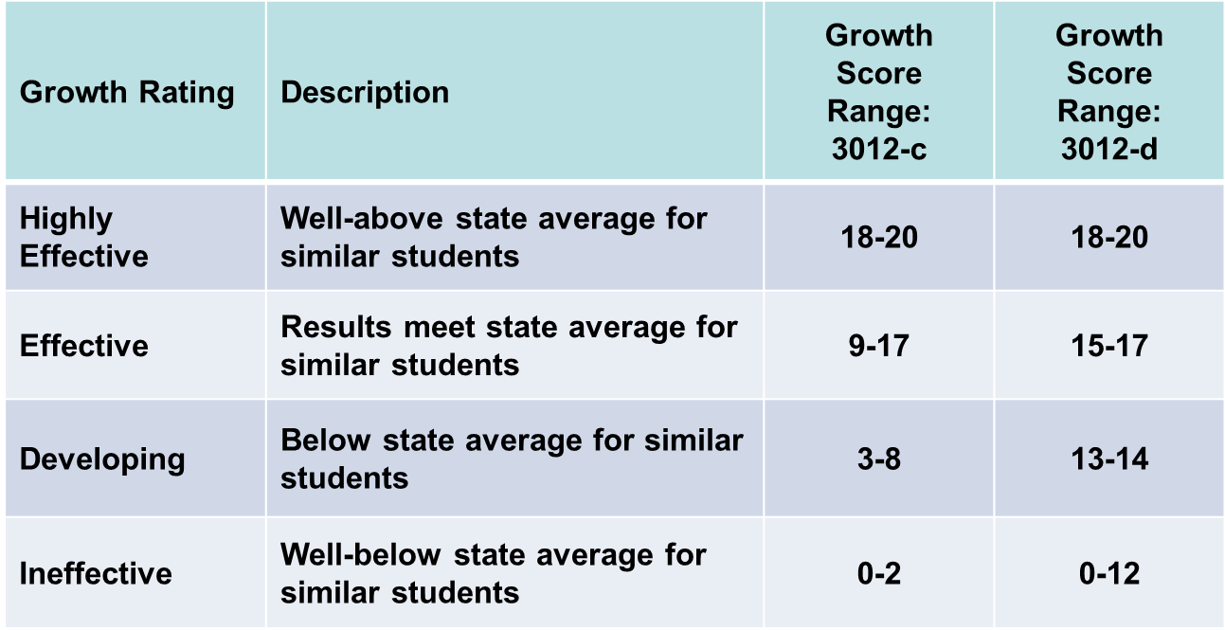
Assigning Points to HEDI Labels

Slide 29
mean
Assigning Points to HEDI Labels
Previous Distribution
0 1 2
3 4 5 6 7 8
9 10 11 12 13 14 15 16 17
18 19 20
Ineffective
Range (6.7%)
Highly Effective
Range (6.7%)
Developing
Range (9.2%)
Effective Range (77.4%)
SD = -1.5
SD = -1
SD = 0
SD = +1.5
SD = +2
6%
16%
50%
94%

Slide 30
mean
Assigning Points to HEDI Labels
Future Distribution
0 1 2 3 4 5 6 7 8 9 10 11 12
13 14
15 16 17
18 19 20
Ineffective
Range (6.7%)
Highly Effective
Range (6.7%)
Developing
Range (9.2%)
Effective Range (77.4%)
SD = -1.5
SD = -1
SD = 0
SD = +1.5
SD = +2
6%
16%
50%
94%

Slide 31
§3012-c to § 3012-d Scoring Bands
 | 3012-c Bands |  | 3012-d Bands
HEDI Points | Min MGP | Max MGP | Min MGP | Max MGP
0 | 9 | 28 | 9 | 22
1 | 29 | 31 | 23 | 24
2 | 32 | 35 | 25 | 25
3 | 28 | 35 | 26 | 26
4 | 36 | 36 | 27 | 27
5 | 37 | 37 | 28 | 28
6 | 38 | 38 | 29 | 29
7 | 39 | 39 | 30 | 30
8 | 40 | 41 | 31 | 31
9 | 36 | 43 | 32 | 32
10 | 44 | 45 | 33 | 33
11 | 46 | 48 | 34 | 34
12 | 49 | 50 | 35 | 35
13 | 51 | 52 | 28 | 37
14 | 53 | 55 | 38 | 41
15 | 56 | 57 | 36 | 48
16 | 58 | 60 | 49 | 55
17 | 61 | 69 | 56 | 69
18 | 67 | 68 | 67 | 68
19 | 69 | 72 | 69 | 72
20 | 73 | 97 | 73 | 97
KEY | Description
Ineffective | Well-below state average for similar students
Developing | Below state average for similar students
Effective | Results meet state average for similar students
Highly Effective | Well-above state average for similar students
*For illustrative purposes only. 3012-d scoring bands were not in place for most teachers during 2014-15. The minimum and maximum MGPs associated with each point range may change in future years based on the MGPs of teachers statewide.

Slide 32
Three-Minute Pause

Slide 33
SED Information:
Principal and Teacher Scores from the State

Slide 34
Details to Work Out
Number site visits
Independent Evaluator or not
Whether to use a supplemental measure
Scoring ranges
Those other details…

Slide 35
Tool
School Visits

Slide 36
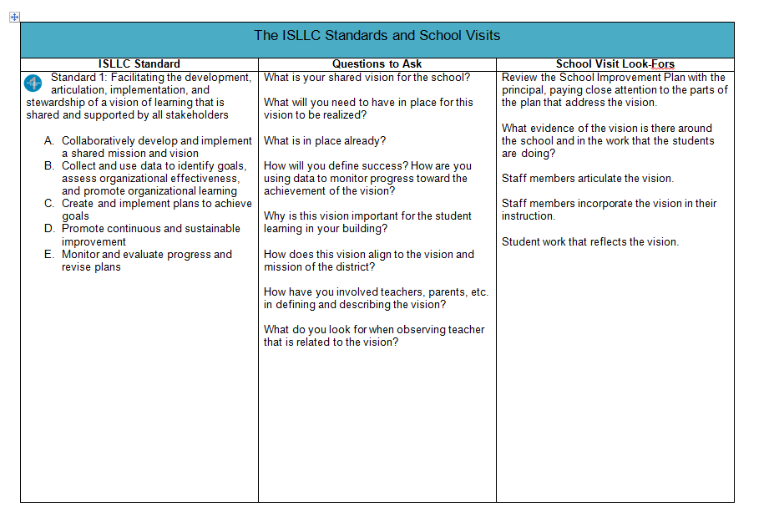
Questions and Visits
What questions do you ask when you meet with your principal? When you go on a school visit?

Slide 37
Questions and Visits
Each person at your table groups should pick a different page to review.
After all have been examined, take turns, in order, to review them.
What questions and “look-fors”
would you add?

Slide 38
What Matters
On the organizer, list the things you most value in a principal.
Anything to add your MVP list?

Slide 39
What Matters
Now list your principals across the top

Slide 40
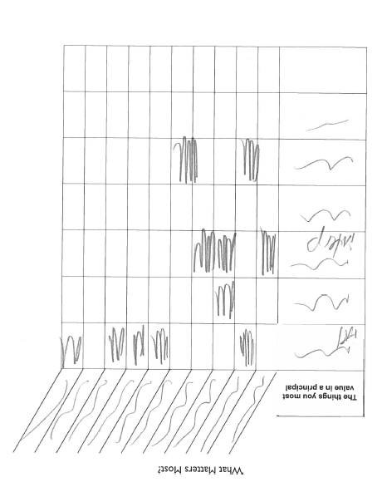
What Matters
Shade in the areas when you can recall EXPLICITLY addressing the valuable quality with the principals
you’ve identified.
Look at your “heat map”

Slide 41
Support Your Local Principal

Slide 42
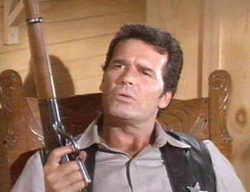
Principal Learning
Principals report that while they are attempting to create conditions to support learning for others, their own learning is not well supported.
Notes:
This is a repeat from last year, based on the fact that principals reported their learning continued to be a low priority.
From “Rethinking Principal Evaluation: A New Paradigm Informed by Research and Practice,” p. 9.

Slide 43
Principal Learning
What are you planning to…
Help your principal(s) with time management
Increase the inter-rater reliability and agreement among your lead evaluators
Help principals plan their faculty meetings
Help principals remain positive and be good leaders
Help principals with their learning
Helping principals with their conversations

Slide 44
Three-Minute Pause

Slide 45
Compliance

Slide 46


Slide 47
Next Session
February 10th: 12:00p - 3:00p
Agenda will include:
Updates
Research
Feedback
More

Slide 48
Principal Evaluator Training
Day 1
2015-2016

