Slide 1

Principal Evaluator Training
Day 1
2014-2015

Slide 2
Agenda
Introductions
Objectives and Agenda Review
Messaging
Research & Literature
Article Read
Planning Visits (and HW)
Artifact Review
Support your local principal

Slide 3
Back Again: 9 Components
New York State Teaching Standards and Leadership Standards
Evidence-based observation
Application and use of Student Growth Percentile and VA Growth Model data
Application and use of the State-approved teacher or principal rubrics
Application and use of any assessment tools used to evaluate teachers and principals

Slide 4
Back Again : 9 Components
Application and use of State-approved locally selected measures of student achievement
Use of the Statewide Instructional Reporting System
Scoring methodology used to evaluate teachers and principals
Specific considerations in evaluating teachers and principals of ELLs and students with disabilities

Slide 5
Back Again : 9+ Components
State-determined district-wide student growth goal setting process (Student Learning Objectives)
Effective supervisory visits and feedback
Soliciting structured feedback from constituent groups
Reviewing school documents, records, state accountability processes and other measures
Principal contribution to teacher effectiveness
Increasing the likelihood that it makes a difference

Slide 6
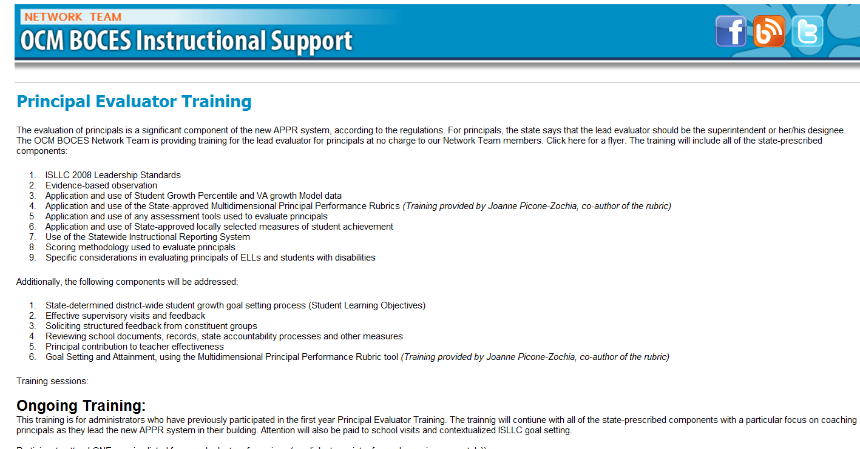
Resources Are Archived

Slide 7
Agenda
Introductions
Objectives and Agenda Review
Messaging
Research & Literature
Article Read
Planning Visits (and HW)
Artifact Review
Support your local principal

Slide 8
Research & Literature Review

Slide 9





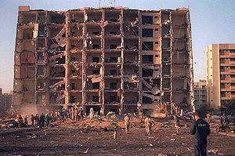

ISLLC 2014
First version in 1996
Modest revisions in 2008
So, approximately 20 years old

Slide 10
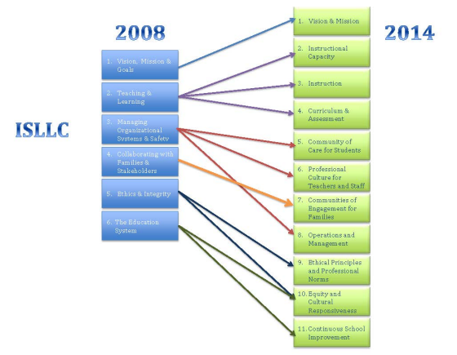
ISLLC 2014

Slide 11
Central Office
A shared vision of principals as instructional leaders
A system of support for developing principals as instructional leaders
Making it possible for principals to be instructional leaders

Slide 12

Fullan’s Three Keys
Leading Learning
Being a District and System Player
Becoming a Change Agent

Slide 13
Who matters more?
TEACHER
PRINCIPAL
Notes:
The school principal as leader: guiding schools to better teaching and learning - The Wallace Foundation, January 2012.

Slide 14
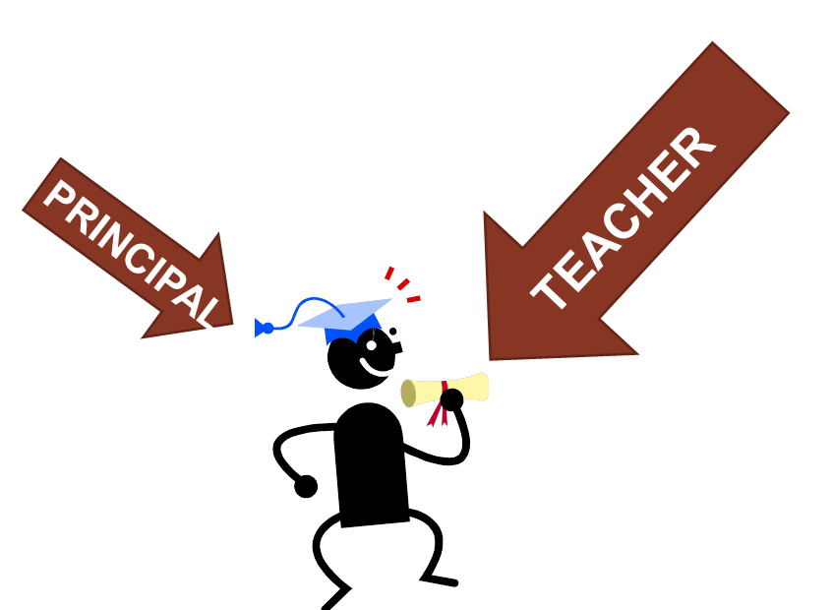
Who matters more?
Notes:
The school principal as leader: guiding schools to better teaching and learning - The Wallace Foundation, January 2012.

Slide 15
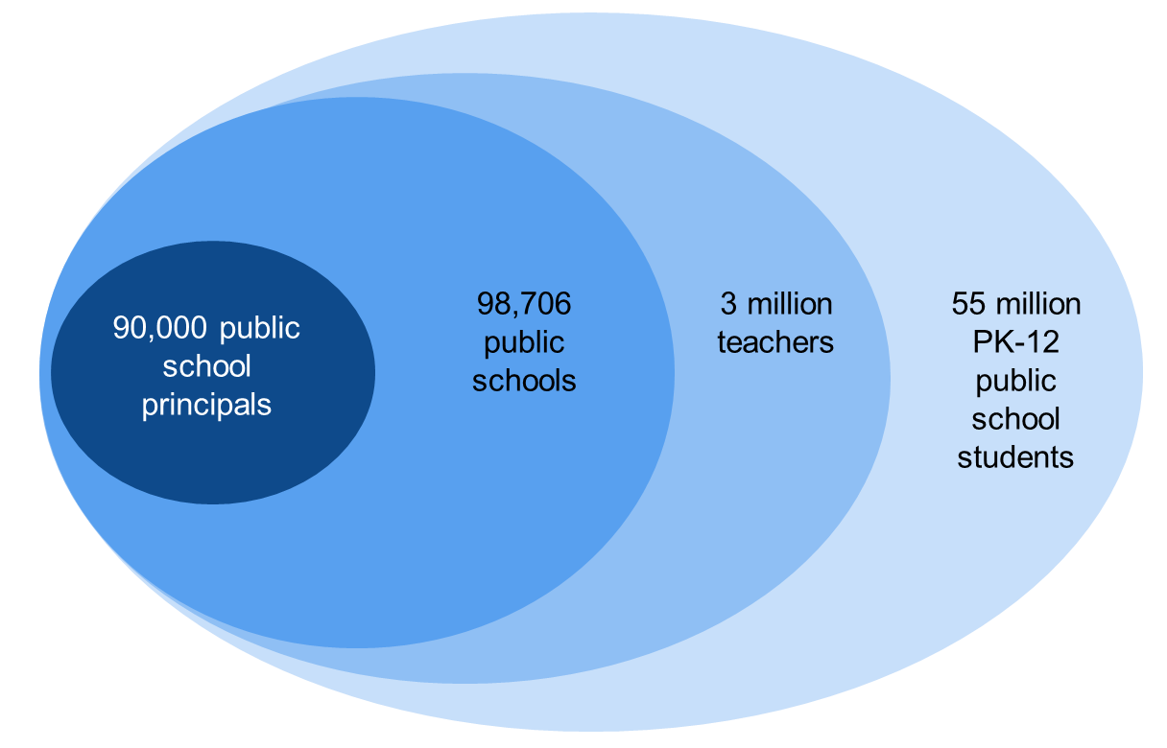
Literature Update (AIR)
  The “ripple effect” model:
Notes:
U.S. Census, 2011; Battle & Gruber, 2010; Gates et al., 2002

Slide 16
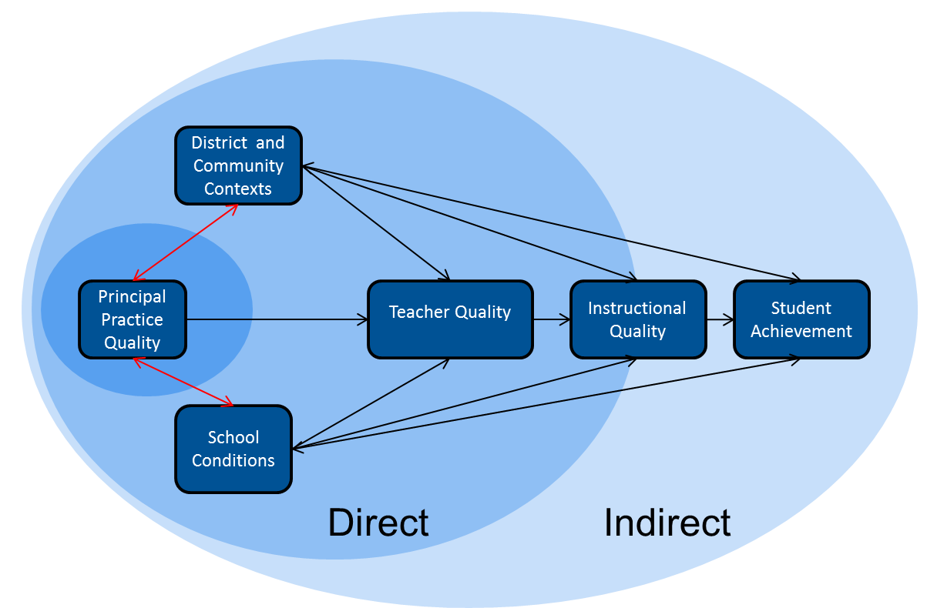
Literature Update (AIR)
  The “ripple effect” model:
Notes:
U.S. Census, 2011; Battle & Gruber, 2010; Gates et al., 2002

Slide 17
Beginning of the Year

Slide 18
Messages
What are the three most important things for your principals this year?
  __________
  __________
  __________
How do they know?

Slide 19
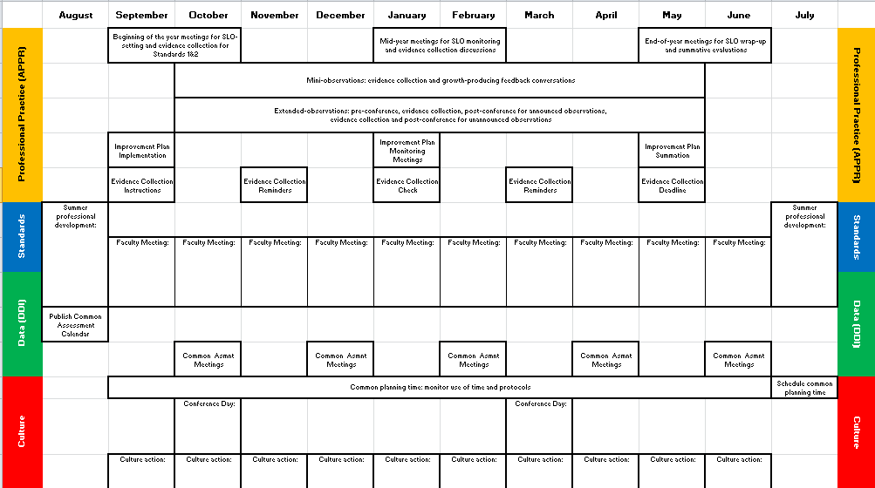
A Year in the Life
Notes:
NOTES

Slide 20
Supervising Principals: How Superintendents Can Improve Teaching and Learning in the Classroom

Slide 21
Article Read
Divide up article (four sections)
Go to corner of room
Read section; discuss
Return to table; report out
SO WHAT?

Slide 22
Tool
School Visit Organizer

Slide 23
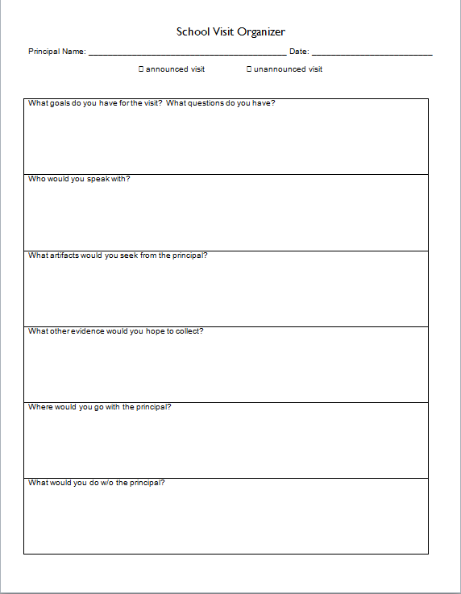
Planning Visits

Slide 24
Homework
Accompany a principal on an observation
Pre
Evidence Collection
Post

Slide 25
Homework
Accompany a principal on an observation
Driving Forces >>>
<<<Restraining Forces

Slide 26
Looking at Some Evidence

Slide 27
Evidence Review
Let’s watch a principal providing feedback to a teacher.
How did the principal do?
How would you coach the principal?

Slide 28
Evidence Review
Let’s watch another principal providing feedback to a teacher.
How did the principal do?
How would you coach the principal?

Slide 29
It’s Not Too Late
Contextualized Goal-Setting

Slide 30
Contextualized Goal Setting
Review the process. How does it work?
Look at the examples (see folder).
It’s not too late

Slide 31
Support Your Local Principal

Slide 32
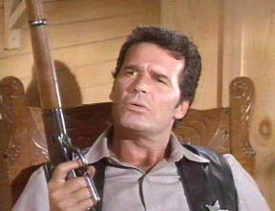
Principal Learning
Principals report that while they are attempting to create conditions to support learning for others, their own learning is not well supported.
Notes:
This is a repeat from last year, based on the fact that principals reported their learning continued to be a low priority.
From “Rethinking Principal Evaluation: A New Paradigm Informed by Research and Practice,” p. 9.

Slide 33
Principal Learning
Do you think the statement from principals is a fair generalization?
Do you expect your principals to get better?
Would your principal(s) agree?
If so, how would she/he know?
Notes:
Table discussions, start allow 5-7 minutes. The point is not to necessarily resolve these questions but to get people thinking about this.

Slide 34
Principal Learning
What are you planning to…
Help your principal(s) with time management
Increase the inter-rater reliability and agreement among your lead evaluators
Help principals plan their faculty meetings
Help principals remain positive and be good leaders
Help principals with their learning

Slide 35
Next Session
December 10th: 12:00p - 3:00p
Agenda will include:
Evidence
Giving principals feedback about giving teachers feedback
More productive school visits

Slide 36
Principal Evaluator Training
Day 1
2014-2015

