Slide 1

Principal Evaluator Training
Day 1
2013-2014

Slide 2
Agenda
Introductions
Objectives and Agenda Review
Principal Evaluation: Different?
One Year Later
Coaching Principals
Collect evidence
Support your local principal

Slide 3
Back Again: 9 Components
New York State Teaching Standards and Leadership Standards
Evidence-based observation
Application and use of Student Growth Percentile and VA Growth Model data
Application and use of the State-approved teacher or principal rubrics
Application and use of any assessment tools used to evaluate teachers and principals

Slide 4
Back Again : 9 Components
Application and use of State-approved locally selected measures of student achievement
Use of the Statewide Instructional Reporting System
Scoring methodology used to evaluate teachers and principals
Specific considerations in evaluating teachers and principals of ELLs and students with disabilities

Slide 5
Back Again : 9+ Components
State-determined district-wide student growth goal setting process (Student Learning Objectives)
Effective supervisory visits and feedback
Soliciting structured feedback from constituent groups
Reviewing school documents, records, state accountability processes and other measures
Principal contribution to teacher effectiveness
Increasing the likelihood that it makes a difference

Slide 6
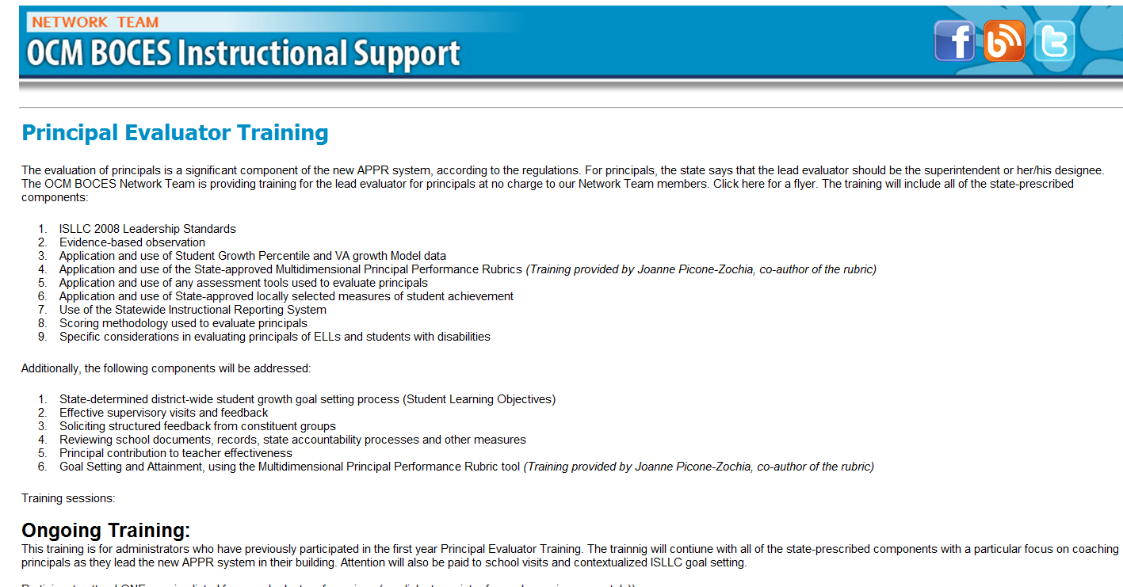
Resources Are Archived

Slide 7
Agenda
Introductions
Objectives and Agenda Review
Principal Evaluation: Different?
One Year Later
Collect evidence
Coaching Principals
Support your local principal

Slide 8
Looking Back at Last Year

Slide 9
How Different Was It?
How different was your evaluation of principals from the way you used to do it?
How “honest, “frank,” and specific was the feedback you provided your principals?
Would your principals say that their evaluation helped them to be a better principal?

Slide 10

Notes:
Poll Title: How different was your principal evaluation process from the way you used to do it?
http://www.polleverywhere.com/multiple_choice_polls/sIfcRpswXNBvZWn

Slide 11
Notes:
Poll Title: How much more "honest" or "frank" and specific was the feedback you provided your principals?
http://www.polleverywhere.com/multiple_choice_polls/hcN6lgYiA3qi7qq

Slide 12
Notes:
Poll Title: What would your principals say about the impact of their evaluation?
http://www.polleverywhere.com/multiple_choice_polls/kbrZsNikXkdtZIA

Slide 13
Who matters more?
TEACHER
PRINCIPAL
Notes:
The school principal as leader: guiding schools to better teaching and learning - The Wallace Foundation, January 2012.

Slide 14

Who matters more?
Notes:
The school principal as leader: guiding schools to better teaching and learning - The Wallace Foundation, January 2012.

Slide 15
Who matters more?
D
A
C
E
B
Notes:
The school principal as leader: guiding schools to better teaching and learning - The Wallace Foundation, January 2012.

Slide 16
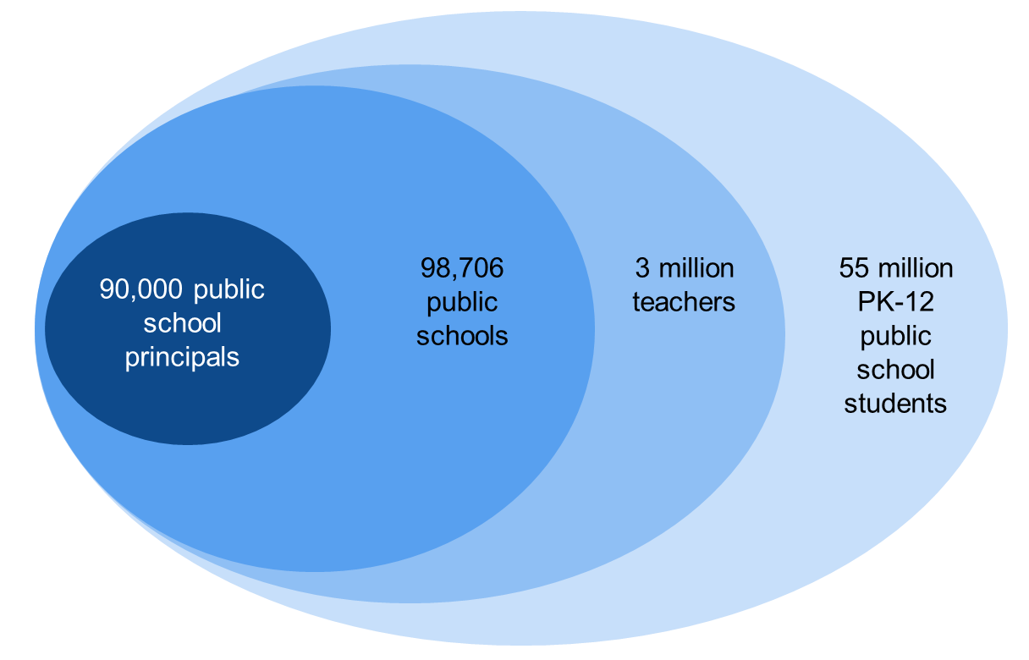
Literature Update (AIR)
  The “ripple effect” model:
Notes:
U.S. Census, 2011; Battle & Gruber, 2010; Gates et al., 2002

Slide 17
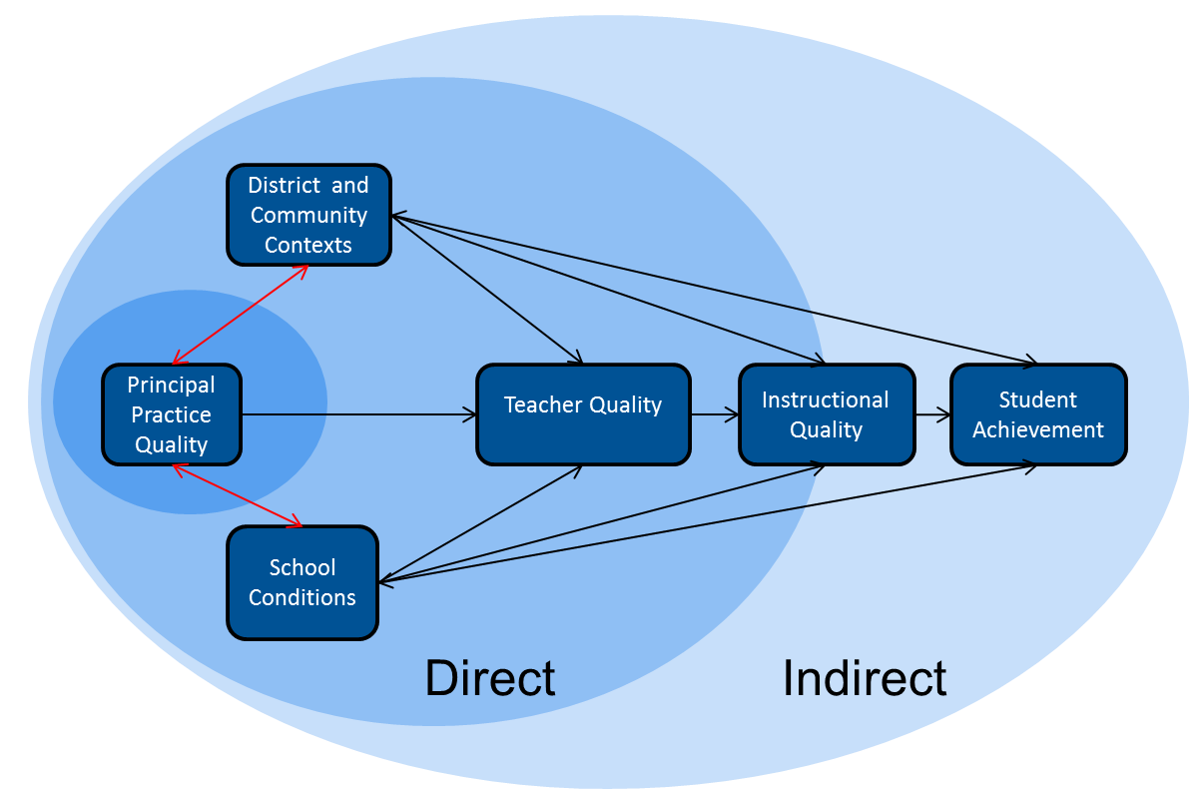
Literature Update (AIR)
  The “ripple effect” model:
Notes:
U.S. Census, 2011; Battle & Gruber, 2010; Gates et al., 2002

Slide 18
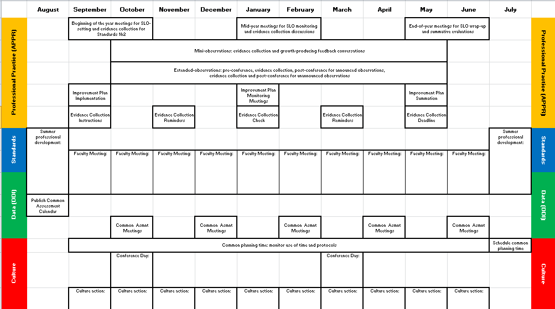
An updated Year in the Life
Notes:
NOTES

Slide 19
Tool
Using the Supervisor’s Guide

Slide 20
Supervisor’s Guide
Go through the checklist and review the things you did last year.
When done, talk about which things were easier to do and which were more difficult or problematic.
Discuss the evidence you collected along the way.

Slide 21
Supervisor’s Guide
What is missing that should be added?

Slide 22
Tool
School Visit Organizer

Slide 23
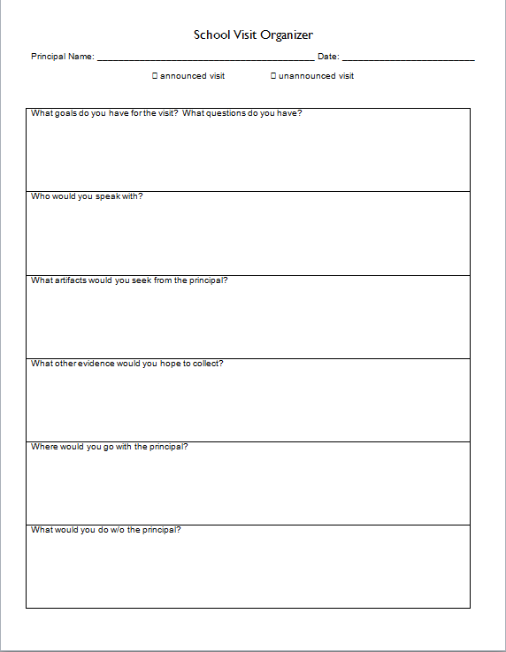
Planning Visits

Slide 24
Another Tool
Contextualized Goal-Setting

Slide 25
Contextualized Evidence Collection
This remains a way to provide “focus” to your evaluation process
This employs the ISLLC Standards as intended
This might actually improve the implementation of an initiative

Slide 26
Coaching Your Principal

Slide 27
Coaching Literature
Read some of the synthesis of the coaching literature in the context of principal evaluation.
Everyone reads intro
Each person reads about one competency
Discuss, in turn

Slide 28
Coaching Rubric
Take a look at the rubric that accompanies the model described in the literature synthesis.
Look it over
Think about how you did last year
Talk about the rubric at your table; what does the rubric “say” to the principal evaluator?

Slide 29
Looking at Some Evidence

Slide 30
Evidence Review
Let’s watch a principal providing feedback to a teacher.
How did the principal do?
How would you coach the principal?

Slide 31
Evidence Review
Let’s watch another principal providing feedback to a teacher.
How did the principal do?
How would you coach the principal?

Slide 32
Support Your Local Principal

Slide 33
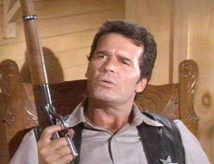
Principal Learning
Principals report that while they are attempting to create conditions to support learning for others, their own learning is not well supported.
Notes:
This is a repeat from last year, based on the fact that principals reported their learning continued to be a low priority.
From “Rethinking Principal Evaluation: A New Paradigm Informed by Research and Practice,” p. 9.

Slide 34
Principal Learning
Do you think the statement from principals is a fair generalization?
Do you expect your principals to get better?
Would your principal(s) agree?
If so, how would she/he know?
Notes:
Table discussions, start allow 5-7 minutes. The point is not to necessarily resolve these questions but to get people thinking about this.

Slide 35
Principal Learning
What are you planning to…
Help your principal(s) with time management
Increase the inter-rater reliability and agreement among your lead evaluators
Help principals plan their faculty meetings
Help principals remain positive and be good leaders
Help principals with their learning

Slide 36
Principal Learning
What do you have planned for your principals:
As a group?
Individually?

Slide 37
Agenda
Introductions
Objectives and Agenda Review
Principal Evaluation: Different?
One Year Later
Coaching Principals
Collect evidence
Support your local principal

Slide 38
Next Session
December 18th: 12:00p - 3:00p
Rodax 8 Large Conference Room
Agenda will include:
Evidence from a “Faculty Meeting”
Assessments as evidence
More productive school visits

Slide 39
Principal Evaluator Training
Day 1
2013-2014

