Slide 1
Faculty Meeting December 2013
Quixotic Bay Elementary School

Slide 2
Agenda
Announcements
Committee Reports
Mathematical Practices

Slide 3
Announcements
Additional parking
Revised Traffic Flow
PTA – teacher rep needed
Learn to Ski Program (help wanted)
Other?

Slide 4
Committee Reports
RtI Committee
Social Committee
Character Ed Committee
Health School Committee
District committee reports?

Slide 5
Mathematical Practices
Overview

Slide 6
Mathematical CCLS
Five critical areas:
Collaboration
Instruction
Content
Assessment
Intervention

Slide 7
Mathematical Practices
Describe what students should be doing while they learn mathematics.
Superior to content
Processes and proficiencies
Not a checklist

Slide 8
Mathematical Practice 1
Make sense of Problems and Persevere in Solving Them
Students make conjectures about the meaning of a solution and plan a solution pathway
Students try special cases or simpler forms to gain insight
Students monitor and evaluate their progress and discuss with others
Students understand multiple approaches and ask the question: “Does this solution make sense?”

Slide 9
Mathematical Practice 2
Reason Abstractly and Quantitatively
Students can decontextualize a problem by representing the problem symbolically for a solution
Students can contextualize a problem by attend to the meaning of the quantities in the problem
Students can create a coherent representation of the task or problem presented

Slide 10
Mathematical Practice 3
Construct Viable Arguments and Critique the Reasoning of Others
Students make conjectures and explore the truth of those conjectures
Students justify their conclusions and communicate them to others
Students compare the effectiveness of two plausible arguments
Students listen, read, and respond to the arguments of others for making sense and clarity

Slide 11
Mathematical Practice 4
Model with Mathematics
Students represent mathematical concepts by using such tools as diagrams, tables, charts, graphs, calculators, etc.
Students use symbols and tools to represent real-work solutions
Students routinely interpret their mathematical results in the context of the problem situation
Students are comfortable making assumptions and approximations to simply real-world situations and can test the assumptions

Slide 12
Mathematical Practice 5
Use Appropriate Tools Strategically
Students choose an appropriate tool for the problem or task
Students know the limits of each tool
Students detect tool-generated errors by estimating reasonable solutions without the tool
Students use tools to explore and deepen their discovery and understanding of concepts

Slide 13
Mathematical Practice 6
Attend to Precision
Students communicate precisely to others
Students use clear definitions of terms
Students express numerical answers with a degree of precision appropriate for he problem context
Students calculate accurately and efficiently
Students are careful about specifying units and labels

Slide 14
Mathematical Practice 7
Look For and Make Use of Structure
Students attention is drawn to the structure of mathematics as it occurs
Students are engaged in exploring numerical and visual patterns that reveal structure
Students can use strategies that shift the perspective of a solution

Slide 15
Mathematical Practice 8
Look For and Express Regularity in Repeated Reasoning
Students notice and discuss if their results are reasonable while solving the problem
Students notice and can articulate patterns in calculations that can be generalized to properties for formulae

Slide 16
Mathematical Practices
Activities

Slide 17
Mathematical Practices in Action
In your grade-level group, complete the organizer:
How is the practice important?
What does it look like at your level?
Indicate the relative importance: High, Medium, or Low
Use the resources at your table: Standards, placemats, etc.

Slide 18
Mathematical Practices in Action

Slide 19
Look-Fors

Slide 20
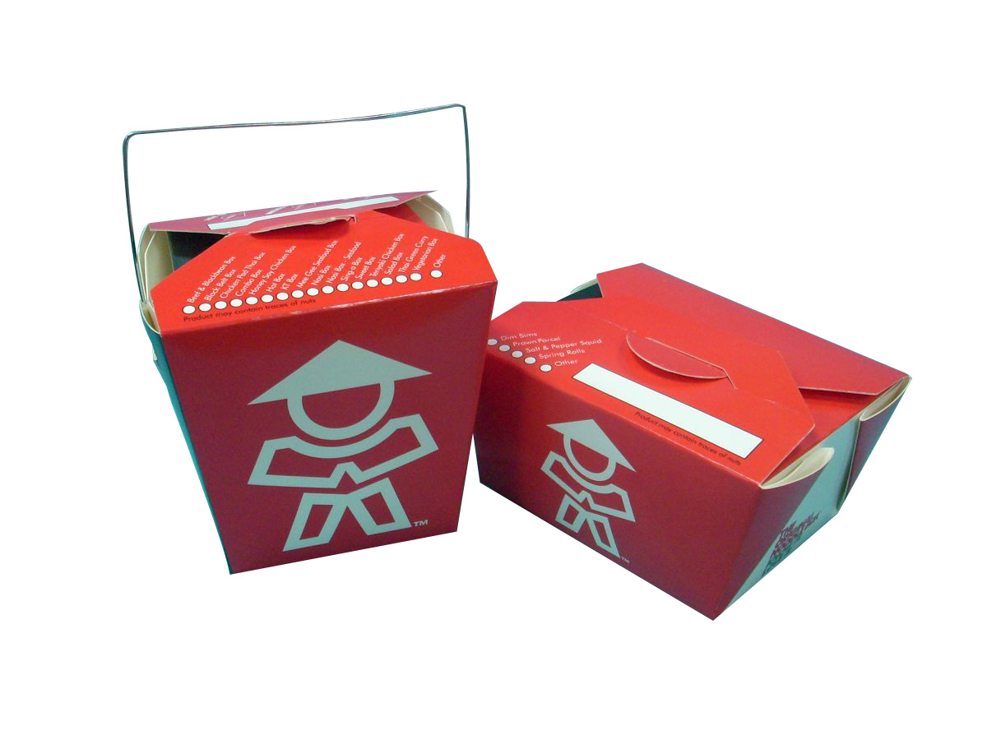
Closure
At as table, what is your “take-away” from this meeting?

Slide 21
Faculty Meeting December 2013
Quixotic Bay Elementary School

