Slide 1
Specific Considerations in Evaluating Teachers of ELLs
Adam Bauchner
Mid-State Regional Bilingual Education Resource Network
Notes:
How many of you have ELLs in your building?
How many of you supervise ESL teachers?
How many of you supervise other teachers of ELLs?
How many of you, when you were teachers, were ESL teachers?
How many of you were teachers of English Language Learners?
How many of you are served by an itinerant ESL teach?
One ESL teachers for the building?
Multiple ESL teachers in a building?
Bilingual program? SIOP training?
For those of you with English Language Learners, raise your hands if in your school they are performing & achieving as well as their Native English Speaking peers?

Slide 2
Things can look very different in the world of ELLs.
Notes:
Some things look the same, but are different. Some things look different, but are the same.

Slide 3
This presentation aims to help you see.
Notes:
My goal in this presentation is to provide you some basic tool to distinguish between them. I will describe a basic framework for understanding best practice with ELLs. This includes understanding the students, the curriculum, and the instructional practice that research shows is best suited for increasing outcomes fro ELLs. Recognizing that the total evaluation process is complex and to some extent contact-bound, I want to help you learn how to see, hear, and talk about teaching English Language Learners.

Slide 4
Who are we looking at?
“ESL Teachers”
“Teachers of ELLs”
Second language acquisition
Cultural components
ESL standards, curriculum & assessment
Best instructional practice for ELLs
Training or experience with content areas?
Any teacher with ELLs
Any subject
Any grade level
Generalists & specialists
Training or experience with ELLs & SLA?
Notes:
These teachers rely on each other. Neither group can succeed without support from the other. Collaboration time has always been vital- the new APPR system underscores this. Please consider, do I need to change systems and schedules within my building to increase this collaboration? Do I need to change the culture in my building?

Slide 5
What do they all need to know about second language learners?
Notes:
Emergent Bilinguals: One thing we know: If we can successfully educate bilingual people, we are creating an amazing resource for our communities. Bilingualism pay off academically, cognitively, emotionally, socially, culturally, economically. The first step in succeeding with English Language Learners or Emergent Bilinguals is a deeply help conviction of the value of these students and all they bring and all their potential. Any teacher who sees them as deficient, as extra work, as a burden, cannot succeed.

Slide 6
5 Stages of Second Language Acquisition
Preproduction
Early Production
Speech Emergence
Intermediate Fluency
Advanced Fluency
Notes:
Stage I: Pre-production
up to 500 words in their receptive vocabulary, will repeat, will listen attentively and copy words from the board. respond to pictures and other visuals. Exhausting
Stage II: Early production
last up to six months, receptive and active vocabulary of about 1000 words, one- or two-word phrases, short memorized language chunks
Stage III: Speech emergence
vocabulary of about 3,000 words, simple phrases and sentences, ask simple questions, initiate short conversations with classmates.
BICS: Basic Interpersonal Communication Skills
CALP: Cognitive Academic Language Proficiency
Stage IV: Intermediate fluency
vocabulary of 6000 active words, more complex sentences when speaking and writing , will ask questions to clarify , able to work in grade level math and science classes with some teacher support, students will use strategies from their native language to learn content in English, writing at this stage will have many errors , time for teachers to focus on learning strategies
Stage V: Advanced Fluency
4-10 years, near-native, exited from ESL, need continued support

Slide 7
5 Stages of Second Language Acquisition
Affects:
Questioning strategies
Response expectations
Level of independence
Level of collaboration

Slide 8
So we need to ask:
“What are the language acquisition stages of your ELL students?
How is this lesson tailored to their levels?”
Notes:
Teachers of ELLs probably won’t be able to answer these questions without some training in SLA and consulting with ESL teachers

Slide 9
Best Curricular Practice:
Dual Objectives
Language Goals
Content Goals
Notes:
http://www.cal.org/siop/

Slide 10
Content Goals
Usually drawn from state standards for the content area
Recognized by verbs related to knowledge of the content area:
identify, analyze, rank, construct, graph, divide, solve, visualize, design.
Notes:
http://www.cal.org/siop/

Slide 11
Language Goals
Address the language needed to engage with the academic content, perform classroom tasks, and achieve the content objectives:
read, write, listen, list, tell, discuss, journal, record, persuade, debate, draft
Also key vocabulary, language functions, grammar or structures, and language learning strategies.
Notes:
http://www.cal.org/siop/

Slide 12
So we need to ask:
“What are the lesson’s content objectives and language objectives?
How did you determine these objectives?”
Notes:
Interdependence of teachers of ELLs & ESL teachers.

Slide 13
Best Instructional Practice for ELLs
Start with what the kids bring, know, are.
Culture
Language
Personal Experiences
Academic Experience
Notes:
Funds of Knowledge

Slide 14
Best Instructional Practice for ELLs
Provide lots of comprehensible input.
Speak slowly & clearly
Minimize idiom
Use gestures & visuals
Check comprehension frequently
Notes:
This is when people start to be concerned about pace & rigor for native English Speakers.
1. A lot of what is best practice for ELLs is best for any struggling student.
2. Yes, teachers need to differentiate so kids who can move faster & deeper have opportunities to do so, whether or not there are ELLs in the room.
3. Common Core: Pressure to slow down, build language & literacy, go deeper for higher order thinking skills. We can’t just race through any more.

Slide 15
Best Instructional Practice for ELLs
Provide lots of opportunity to use English.
Students speaking a lot
Affirm communicative ability
Correct with modeling
Check comprehension frequently
Notes:
The person who is doing the most learning is doing the most talk. See: “ESL Shadowing”

Slide 16
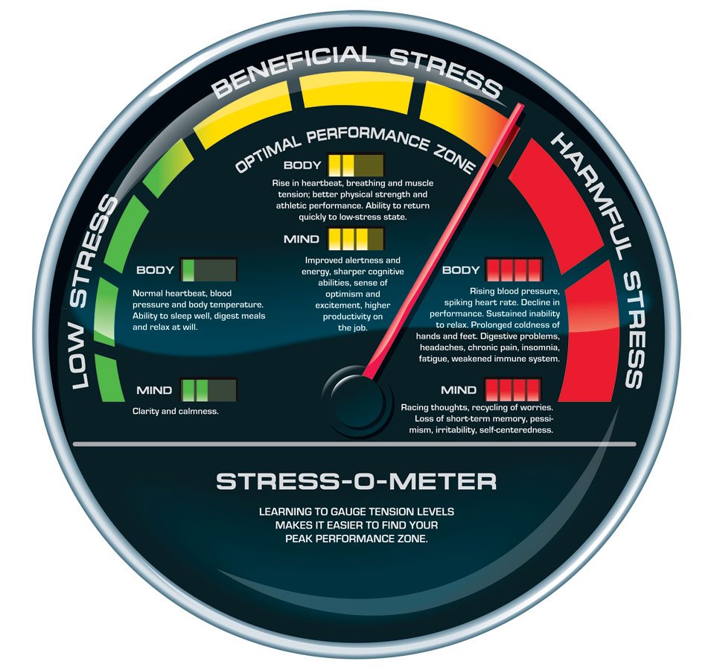
Best Instructional Practice for ELLs
Keep anxiety low.
Notes:
All students benefit from this. Brain research tells us, we just don’t learn as well when we’re stressed out. For students learning both content & language, the likelihood of stress is higher, and the penalty doubled.
Check comprehension frequently for corrective measures, to lower anxiety.

Slide 17
So we need to ask:
“What are your instructional strategies specific to ELLs?
How will you check ELL student comprehension and learning?”

Slide 18
Always Best Practice
Student engagement
Higher order thinking skills
Differentiation
Collaboration
Data-driven instruction
More …
Student engagement

Slide 19
So we need to ask:
“How does this lesson demonstrate great teaching and engaged learning?”

Slide 20
More Resources
http://rbern.ocmboces.org/
Click on left sidebar
“Lead Evaluator Training”
Many other resources on the RBERN site.

