Slide 1
Evaluation of
Special Education Teachers
Janel Payette
RSE TASC Coordinator, OCM BOCES
jpayette@ocmboces.org

Slide 2
General Education
Related Services
Consult Services
Co-Teaching
Resource Room
Special Class
Individual Education Program
Specially Designed Instruction
Access to Curriculum

Slide 3

The IEP-highly individualized, drives the work of the Special Education Teacher
The Golden Ticket to Accessing the General Education Curriculum for Students with Disabilities
Enables students with disabilities to access the general education curriculum
Provide specially designed individualized instruction to students with disabilities by supporting them in one or more domains of learning

Slide 4
Accomplished through the Delivery of Specially Designed Instruction
Adapting-Making changes matched to student need or condition
Content-Knowledge and skills that comprise the curriculum
Methodology-Actions by the teacher intended to produce or facilitate learning
Instructional Delivery-Teaching that results in access to, participation in and progress in the curriculum for students with disabilities

Slide 5
Specially Designed Instruction
Adapting
Content
Instructional Delivery
Methodology
Least Restrictive Environment
Co-Teaching
Access
Curriculum
Consult
Related Service
Gen Ed
Special Class
Resource

Slide 6
Student
Content
Instruction
General Questions
to Consider in the
Context of……..

Slide 7

Context of the Student
What are the student(s) IEP goals? What IEP will you be addressing?
How will you know that students were successful in moving toward mastery of their IEP goals?
What accommodations will student(s) be using based on the IEP?
How will you monitor student progress on IEP goals?

Slide 8

Context of the Content
How will you ensure that students with disabilities are working on content aligned with the content of their grade level peers?
What adaptations will you make to the content based on student(s) IEP?
How will you evaluate the effectiveness of those adaptations?

Slide 9

Context of Instruction-Methodology
What adaptations will you make in your methodology of instruction based on student(s)IEP?
What teaching strategies will you use that are specific to the students with disabilities in the classroom?
How will you evaluate the effectiveness of the teaching strategies?

Slide 10

Context of Instruction-Delivery
What adaptations will you make in the delivery of instruction based on student(s) IEP?
What learning strategies will you teach?
How will you teach those learning strategies?
How will you support students in generalizing strategies to other settings?

Slide 11
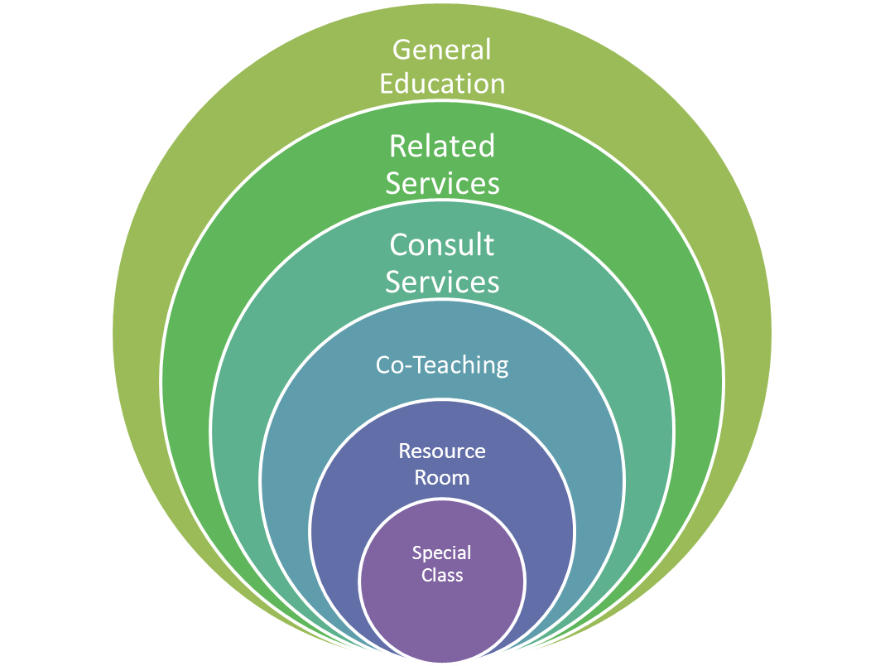
Continuum of Services for Students with Disabilities

Slide 12
Direct or Indirect Consult
Special education teacher provides services to adapt the content, methodology, or delivery of instruction to support SWD’s. General education teacher provides primary academic instruction
* Special Consideration-There are two models of consultant teaching
Direct Consult
  Special education teacher works directly with the SWD in general education class instruction
Indirect Consult
  Special education teacher assists the general education teacher
Questions to Consider…
Are teachers implementing their roles with fidelity?
Is there evidence of collaboration?

Slide 13
Integrated Co-Teaching
Instruction delivered jointly by two or more professionals for a diverse group of students with and with out disabilities
*Specials Consideration-Administrators should note a variety of co-teaching models during mini-observations
*Special Consideration-
Special education teacher needs to have a more in-depth knowledge of the content
Questions to consider..
What evidence is there of co-planning?
What types of co-teaching models are being used?
Are those models being implemented with fidelity?
How are the interactions between gen ed and sped teacher impacting the classroom climate?

Slide 14
Resource Room
Supplementing the regular or special classroom instruction of students with disabilities
*Special Consideration-Homework and content area text may be incorporated for independent practice, but homework should never be “the lesson”
Questions to consider….
What is the skill focus of the lesson?
How is the general education content being supported?
What evidence is there of collaboration and communication with stakeholders?

Slide 15
Special Class
Provides primary instruction to a group of students in a self-contained setting, separate from their non-disabled peers
*Special Considerations-
There are a variety of configurations based on intensity of student need:
  15:1 Specialized instruction
  12:1:1 Management needs interfere with Instructional process
  8:1:1 Intensive management needs
  6:1:1 Highly intensive management needs
  12:1 (3:1) Severe, multiple disabilities in Special Class
*Special Considerations-
The special education teacher is also responsible for teaching content
Questions to Consider..
Do students have access to the content?
How is the content being adapted to meet the ability levels of the student?
What types of materials are students using?
How are functional behavior plans and behavior intervention plans being developed and implemented?

Slide 16
Paraprofessionals-
What is the Role of the Paraprofessional?
Teaching Assistants
Teacher Aides
  •working with individual students or groups of students on special instructional projects;
  •providing the teacher with information about students which will assist the teacher in the development of appropriate learning and behavioral experiences;
  •assisting students in the use of available instructional resources and development of instructional materials;
  •assisting in the development of instructional materials;
  •assisting in providing testing accommodations;
  •assisting in related instructional work as required; and
  •assisting students with specific health related activities as appropriate.
•assisting in physical care tasks and health-related activities;
•assisting students with behavioral/management needs;
•assisting in the set up of equipment
•reading to and playing audio-visual materials for children in lower grades;
•assisting in proctoring and other tasks related to the administration of examinations;
•assisting in the correction of test papers, recording of grades, maintaining of files and preparing statistical reports;
•managing records, materials and equipment; and
•supervising students (e.g., watching students during recess, hall transitions, etc.).

Slide 17
Specially Designed Instruction
Adapting
Content
Instructional Delivery
Methodology
Least Restrictive Environment
Co-Teaching
Access
Curriculum
Consult
Related Service
Gen Ed
Special Class
Resource

