Slide 1



The Wisdom of Practice
Imagine you are in the classroom of a highly effective teacher:
  What would you see?
  What would you hear?
  What would the students be doing or saying?
Individually, write one idea per post-it note.
Notes:
NOTES

Slide 2
The Wisdom of Practice
As a table group, arrange the sticky notes in a way that makes sense, grouping similar ideas together.
Notes:
Need for a common languages. Even thought we had a convergent sense of what should be occurring in a classroom, we all have different descriptors and ways of talking about it

Slide 3
NYS Teaching Standards
Draw the pie on chart paper.
Label the slices.
Now stick the sticky notes in the slice of the pie in which they belong
Standard 7
Professional Growth
Notes:
NOTES

Slide 4
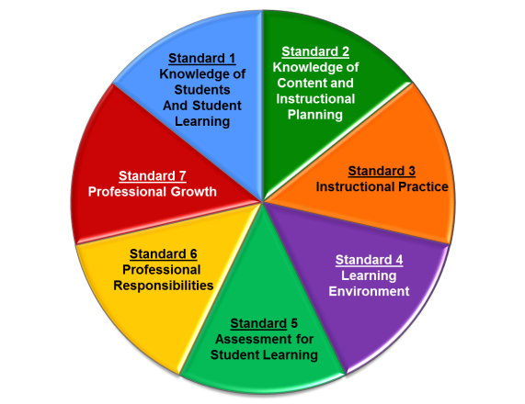
Planning & Preparation
Standard 1: Knowledge of Students & Student Learning
  Knowledge of child development
  Knowledge of research…
  Knowledge of diverse learning needs
  Knowledge of individual students
  Knowledge of economic, social
  Knowledge of technological literacy…
Notes:
NOTES

Slide 5
Planning & Preparation
Standard 2: Knowledge of Content & Instructional Planning
  Knowledge of content…
  Connect concepts across disciplines…
  Uses a broad range of instructional strategies
  Establishes goals & expectations
  Designs instruction
  Evaluate / utilize resources
Notes:
NOTES

Slide 6
Instruction
Standard 3: Instructional Practice
  Research-based practices
  Communicates clearly…
  High expectations…
  Variety of instructional… to engage student
  Engage students in multi-disciplinary skills
  Monitor and assess progress
Notes:
NOTES

Slide 7
Observation
Standard 4: The Learning Environment
  Creates a respectful, safe and supportive environment
  Creates an intellectually stimulating environment
  Manages the learning environment
  Organize and utilize available resources (e.g. physical space, time, technology…)
Notes:
NOTES

Slide 8
Observation
Standard 5: Assessment for Student Learning
  Range of assessment tools
  Understand, analyze, use data for differentiation*
  Communicates assessment system*
  Reflect upon assessment system and adjust*
  Prepare students for assessments
  * - assessed through “multiple measures”
Notes:
NOTES

Slide 9
Professional Responsibilities
Standard 6: Professional Responsibilities
  Upholds standards and policies
  Collaborate with colleagues
  Communicate & collaborate with families
  Perform non-instructional duties
  Complies with laws and polices
Notes:
NOTES

Slide 10
Professional Responsibilities
Standard 7: Professional Growth
  Reflect on practice
  Set goals for professional development
  Communicate and collaborate to improve practice
  Remain current in knowledge of content and pedagogy
Notes:
NOTES

Slide 11
NYS Teaching Standards
Using the placemat for the NYSED Teaching Framework, re-sort your table’s post-it notes as appropriate to the standard, element and indicator
Notes:
NOTES

Slide 12
NYS Teaching Standards
Knowledge of Students & Student Learning
Element 1.1 Demonstrate knowledge of child and adolescent development including cognitive, language, social, emotional, and physical developmental levels.
A) Describes developmental characteristics of students
Standards
Summary statements
Elements
Indicators
With rubrics
Notes:
12
NOTES

Slide 13
NYS Teaching Standards
Common Themes across the Elements
  Upholds standards and policies
  Equity
  Cultural competence
  High expectations
  Developmental appropriateness
  A focus on individuals, including those with special needs
  Appropriate use of technology
  Student assumption of responsibility
Notes:
NOTES

