Slide 1
OCM BOCES
Day 1 & 2
Lead
Evaluator
Training
Notes:
NOTES

Slide 2

Day One Agenda
Introductions
  Lee Carulli
  Jeff Craig
  Renee Burnett
  Network Team
Notes:
NOTES

Slide 3
Day One Agenda
Introductions
Objectives and Agenda Review
RTTT: The Big Picture
The Wisdom of Practice
  Common Language in Schools
Priorities in the Teaching Standards
  Engagement, Constructivism & 21C
Teacher Evaluation
  Rubric Organization
  Levels of Performance
  Elemental Perspective
  Observing a lesson
Closure
Notes:
NOTES

Slide 4
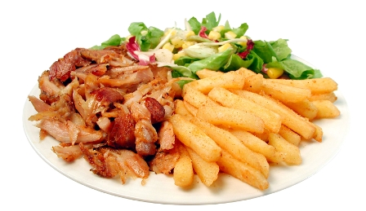
Introductions
What’s On Your Plate
Fill in your plate with all the professional and personal obligations, responsibilities, initiatives, and goals
At your table, share these (if you don’t know everyone, do introductions, too)
After everyone has shared, make a generalization(s) about “what’s on your plates”
Notes:
NOTES

Slide 5
Training Objectives
Understand the nature of learning for students and educators
Understand how a common language creates and supports professionalism and a culture for learning
Understanding the relationship between research and the rubric criteria
Understand the relationship between the NYSED Teaching Standards and the rubrics by which the teaching standards are assessed
Hone observation skills to focus
  Evidence Collection
  Alignment of evidence with Standards
Collaboration with colleagues
Notes:
NOTES

Slide 6
Objectives
What questions or ideas do the objectives bring to mind?
How will the objectives help you in your work?
What objectives would you like to add to the agenda?
Notes:
NOTES

Slide 7
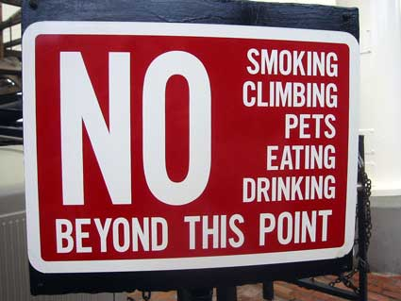
Ground Rules
No one in the room has all the answers; we all have regulatory questions and concerns we have to work out in our districts
Remember that we’re leaders
Improving teaching and learning is the point
The State has high standards for observers
when they observe teachers
Parking lot
Choose your attitude
Be present
Play
Make someone’s day
Notes:
NOTES

Slide 8
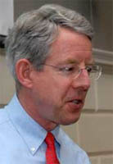
One Last Introduction
Meet Kim. What is he saying?

Slide 9

The Big Picture

Slide 10

The Big Picture

Slide 11
The Big Picture
Standards

Slide 12
The Big Picture
CCLS

Slide 13
The Big Picture
Data
DDI
CCLS

Slide 14
The Big Picture
DDI
CCLS

Slide 15
The Big Picture
Practice
DDI
CCLS

Slide 16
The Big Picture
DDI
CCLS
APPR

Slide 17
The Big Picture
DDI
CCLS
APPR
Board of Ed

Slide 18

The Big Picture
DDI
Board of Ed
Superintendents
CCLS
APPR

Slide 19
The Big Picture
Principals
DDI
Board of Ed
Superintendents
CCLS
APPR

Slide 20
The Big Picture
Teachers
Principals
DDI
Board of Ed
Superintendents
CCLS
APPR

Slide 21
Introductions
What’s On Your Plate
Notes:
NOTES

Slide 22
Introductions
What’s On Your Plate
Notes:
NOTES

Slide 23
Introductions
But how is it adding too much to our plates to…
Notes:
NOTES

Slide 24
Introductions
Be clear about what we expect children to learn…
Notes:
NOTES

Slide 25
Introductions
Use assessment and data to nurture and guide achievement…
Notes:
NOTES

Slide 26
Introductions
Try to become a better teacher or leader…
Notes:
NOTES

Slide 27
Introductions
Are we adding to our plates or is this the way we should be doing business?
Notes:
NOTES

Slide 28
Introductions
Sometimes school can feel like a jungle…
Notes:
NOTES

Slide 29


The Wisdom of Practice
Imagine you are in the classroom of a highly effective teacher:
  What would you see?
  What would you hear?
  What would the students be doing or saying?
Individually, write one idea per post-it note.
Notes:
NOTES

Slide 30
The Wisdom of Practice
As a table group, arrange the sticky notes in a way that makes sense, grouping similar ideas together.
Notes:
Need for a common languages. Even thought we had a convergent sense of what should be occurring in a classroom, we all have different descriptors and ways of talking about it

Slide 31
NYS Teaching Standards
Draw the pie on chart paper.
Label the slices.
Now stick the sticky notes in the slice of the pie in which they belong
Standard 7
Professional Growth
Notes:
NOTES

Slide 32
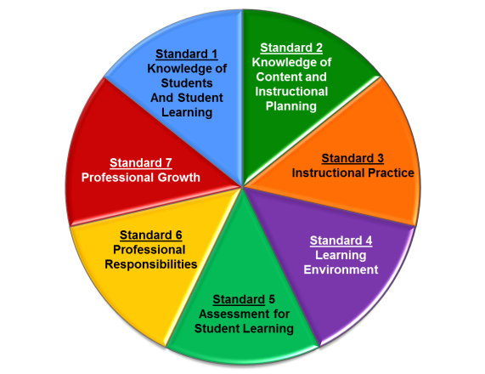
Planning & Preparation
Standard 1: Knowledge of Students & Student Learning
  Knowledge of child development
  Knowledge of research…
  Knowledge of diverse learning needs
  Knowledge of individual students
  Knowledge of economic, social
  Knowledge of technological literacy…
Notes:
NOTES

Slide 33
Planning & Preparation
Standard 2: Knowledge of Content & Instructional Planning
  Knowledge of content…
  Connect concepts across disciplines…
  Uses a broad range of instructional strategies
  Establishes goals & expectations
  Designs instruction
  Evaluate / utilize resources
Notes:
NOTES

Slide 34
Instruction
Standard 3: Instructional Practice
  Research-based practices
  Communicates clearly…
  High expectations…
  Variety of instructional… to engage student
  Engage students in multi-disciplinary skills
  Monitor and assess progress
Notes:
NOTES

Slide 35
Observation
Standard 4: The Learning Environment
  Creates a respectful, safe and supportive environment
  Creates an intellectually stimulating environment
  Manages the learning environment
  Organize and utilize available resources (e.g. physical space, time, technology…)
Notes:
NOTES

Slide 36
Observation
Standard 5: Assessment for Student Learning
  Range of assessment tools
  Understand, analyze, use data for differentiation*
  Communicates assessment system*
  Reflect upon assessment system and adjust*
  Prepare students for assessments
  * - assessed through “multiple measures”
Notes:
NOTES

Slide 37
Professional Responsibilities
Standard 6: Professional Responsibilities
  Upholds standards and policies
  Collaborate with colleagues
  Communicate & collaborate with families
  Perform non-instructional duties
  Complies with laws and polices
Notes:
NOTES

Slide 38
Professional Responsibilities
Standard 7: Professional Growth
  Reflect on practice
  Set goals for professional development
  Communicate and collaborate to improve practice
  Remain current in knowledge of content and pedagogy
Notes:
NOTES

Slide 39
NYS Teaching Standards
Using the placemat for the NYSED Teaching Framework, re-sort your table’s post-it notes as appropriate to the standard, element and indicator
Notes:
NOTES

Slide 40
NYS Teaching Standards
Knowledge of Students & Student Learning
Element 1.1 Demonstrate knowledge of child and adolescent development including cognitive, language, social, emotional, and physical developmental levels.
A) Describes developmental characteristics of students
Standards
Summary statements
Elements
Indicators
With rubrics
Notes:
40
NOTES

Slide 41
NYS Teaching Standards
Common Themes across the Elements
  Upholds standards and policies
  Equity
  Cultural competence
  High expectations
  Developmental appropriateness
  A focus on individuals, including those with special needs
  Appropriate use of technology
  Student assumption of responsibility
Notes:
NOTES

Slide 42

NYS Teaching Standards
Think about this activity; discuss in your table group:
Would you do this activity with teachers?
All of them or just your 4-8?
What would it accomplish?
Notes:
NOTES

Slide 43

The Priorities
There are three priorities in the Teaching Standards
Engagement
Constructivism
21st Century
Readiness
PRIORITIES
Notes:
NOTES

Slide 44
The Priorities
Engagement:
Cognitive
Zone of proximal development
Every student (ELLS, SWD, too)
ENGAGEMENT
Notes:
NOTES

Slide 45
The Priorities
Constructivism:
Making connections
Making meaning
Relate to world outside
Relate to personal future
CONSTRUCTIVISM
Notes:
NOTES

Slide 46
The Priorities
21C Readiness:
College
Career
Citizenship
Collaboration
Communication
Critical Thinking & Problem Solving
Creativity
21C READINESS
Notes:
NOTES

Slide 47
NYS Teaching Standards
Discuss what these concepts look like in the classroom and how you would know if students are cognitively engaged.
In table groups go back to your sticky notes. Look them over. On any of your sticky notes that reflect and (or all) of the priorities, stick a colored dot on it.
Notes:
NOTES

Slide 48
Video Observation
Observe what students are doing that shows evidence of engagement, constructing meaning, or 21C. Each triad member is responsible for one priority.
Collect evidence in a table, be prepared to share your evidence.
engagement
constructivism
21C
Notes:
We have to make sure we chart these pieces of “evidence” for use later!!!

Slide 49
Video Observation
What did you observe in the video?
Evidence from the video
Notes:
We have to make sure we chart these pieces of “evidence” for use later!!!

Slide 50
NYS Teaching Standards
A first look at a rubric:
Read the descriptors for Element III.4 of the rubric
Underline any references to the three priorities
Notes:
NOTES

Slide 51

Levels of Performance
Highly Effective
Effective
Developing
Ineffective
Notes:
NOTES

Slide 52
Levels of Performance
Ineffective – Teaching shows evidence of not understanding the concepts underlying the component - may represent practice that is harmful - requires intervention
Developing – Teaching shows evidence of knowledge and skills related to teaching - but inconsistent performance
Notes:
NOTES

Slide 53
Levels of Performance
Effective - Teaching shows evidence of thorough knowledge of all aspects of the profession. Students are engaged in learning. This is successful, accomplished, professional, and effective teaching.
Highly Effective – Classroom functions as a community of learners with student assumption of responsibility for learning.
Notes:
NOTES

Slide 54
The Priorities
Cognitive Engagement
  “Effective” = students must be cognitively engaged
  “Highly Effective” = cognition, meta-cognition, and student ownership of their learning
Constructivist Learning
  Effective and Highly Effective practice must have evidence of learning experiences designed to facilitate students’ construction of knowledge.
21st Century Skills
  Effective and Highly Effective practice must plan for and have evidence of application of college career-readiness skills and dispositions
54
Notes:
NOTES

Slide 55

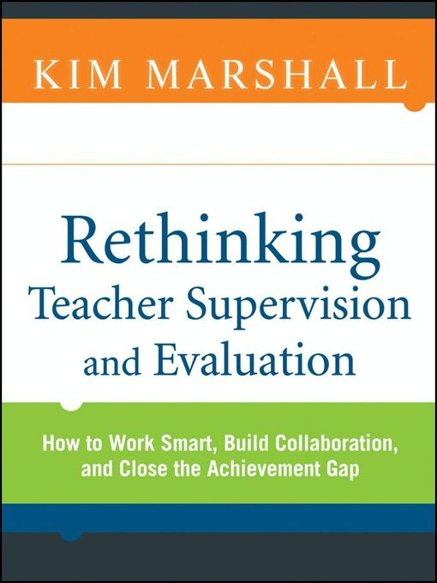
Teacher Evaluation
Introducing the course companion.
Which chapter
description most
intrigues you?
Chapter preview
INTRODUCTION (p. xiii)

Slide 56
Levels of Performance
Research about levels & student achievement
Teachers have substantial effect on student achievement
Significant correlation between FFT based evaluation and student achievement (NYSUT rubrics based on FFT)
Evaluation using the FFT found:
  Unsatisfactory and Basic: students had lower gains than expected
  Proficient: students made expected gains
  Distinguished: students made positive, and greater than expected gains
http://papers.ssrn.com/sol3/papers.cfm?abstract_ id= 1565963
Notes:
NOTES

Slide 57
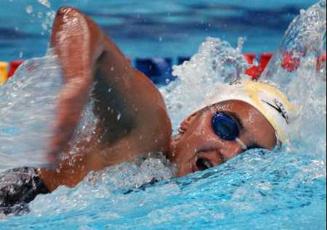
Levels of Performance
H
E
D
I
Notes:
NOTES

Slide 58
Levels of Performance
H
E
D
I
?
Notes:
NOTES

Slide 59
NYS Teaching Standards
A second look at a rubric:
Read the descriptors for Element III.4 of the rubric
Highlight the verbs / phrases that distinguish the differences among the levels of performance
Notes:
NOTES

Slide 60
NYS Teaching Standards
An even closer look at the rubric:
Analyze your assigned element from the rubric (from Standard 3.1 – 3.6 or Standard 5.1)
On the left side of the chart paper, summarize your element
On the right side of your chart paper, describe what the students might be doing in the classroom that exemplifies that element
element summary
what students do
Notes:
NOTES

Slide 61

NYS Teaching Standards
Gallery walk of the elements 3.1 – 3.6 and 5.1:
Docent at posters, answering questions only!
Carry two sticky notes with you: one with something you expected to see, one for something that surprised you
Place two notes on charts at the end of gallery
Something you expected to see
One thing that surprised you
Notes:
NOTES

Slide 62
Turning it Around
The priorities of the framework are critically important to understanding the rubrics and the assessment of teaching practice. How might you respond to the following questions/statements (discuss at table):
  “We don’t have a lot of technology in our district so I don’t think we can hold teachers responsible for 21st Century skills.”
  “We have embraced direct instruction in our district so we can’t expect teachers to be highly effective because direct instruction doesn’t allow for students to take control of the classroom.”
  “How can students be cognitively engaged in something like PE?”
  “I don’t think these rubrics will work for all teachers.”
Notes:
NOTES

Slide 63
Management
The Learning Map
Notes:
NOTES

Slide 64

Shifts
What shifts have to occur…
In teachers’ thinking?
In teachers’ actions?
Notes:
NOTES

Slide 65
Shifts
What shifts have to occur…
In principals’ thinking?
In principals’ actions?
Notes:
NOTES

Slide 66
Shifts
What shifts have to occur…
In the culture of the district?
In the culture of the school?
Notes:
NOTES

Slide 67
Day One Agenda
Introductions
Objectives and Agenda Review
RTTT: The Big Picture
The Wisdom of Practice
  Common Language in Schools
Priorities in the Teaching Standards
  Engagement, Constructivism & 21C
Teacher Evaluation
  Rubric Organization
  Levels of Performance
  Elemental Perspective
  Observing a lesson
Closure
Notes:
NOTES

Slide 68
Closure
Questions
Visiting the Parking Lot
+/∆
+
∆
Notes:
NOTES

Slide 69
Day Two Agenda
Reconvene and regroup
Objectives and Agenda Review
Focusing on the learners
Teacher Evaluation
  The nature of evaluation
  Growth Producing feedback
  Evidence
  Bias
Collecting Some Evidence
Culture
Closure
Notes:
NOTES

Slide 70
The Priorities
There are three priorities in the Teaching Standards
Engagement
Constructivism
21st Century
Readiness
PRIORITIES
Notes:
NOTES

Slide 71
Turning It Around
In your role as a leader you will be expected to be an instructional expert and to be able to recognize the priorities of the Teaching Standards and rubric in every classroom.
With a partner, choose one of the classroom contexts on the worksheet and describe the specific examples of what you would actually see and hear in the classrooms described.
Be prepared to share your work
Notes:
NOTES

Slide 72
Turning It Around
The setting: 5th grade blended physical education class (includes APE). Two teachers. Twenty-five students.
Examples of what would be seen and heard:
  Cognitive engagement:
  Constructivism:
  21st Century Readiness:

Slide 73
Turning It Around
The setting: 5th grade blended physical education class. Two teachers.
Examples of what would be seen and heard:
  Cognitive engagement: students talking to each other about the health and social benefits of walking. They refer to a rubric for walking. They look at maps of County Parks highlighting the walking trails with different color highlighters depending on the difficulty of the walk and whether it is wheelchair accessible.
  Constructivism:
  21st Century Readiness:

Slide 74
Turning It Around
The setting: 5th grade blended physical education class. Two teachers.
Examples of what would be seen and heard:
  Cognitive engagement:
  Constructivism: Student partners are making plans for how much walking they should be doing according to their fitness gram and goals. They prepare a chart that they will use to record the walks they take during the next month.
  21st Century Readiness:

Slide 75
Turning It Around
The setting: 5th grade blended physical education class. Two teachers.
Examples of what would be seen and heard:
  Cognitive engagement:
  Constructivism:
  21st Century Readiness: health literacy, meaningful collaboration, discuss the impact of unhealthy lifestyles on society

Slide 76
Turning It Around
The setting: 2nd grade literacy block (inclusion class). Twenty-four students. Two teachers. Eight students with IEPs.
Examples of what would be seen and heard:
  Cognitive engagement
  Constructivism
  21st Century Readiness

Slide 77
Turning It Around
The setting: 10th grade living environment class. Thirty-three students in the class. 14 ELLs and 6 SWD.
Examples of what would be seen and heard:
  Cognitive engagement
  Constructivism
  21st Century Readiness

Slide 78
Turning It Around
The setting: 7th grade accelerated math class. Thirty-three students in the class. Four were not recommended by placement process but parent insistence resulted in their being included on a trial basis.
Examples of what would be seen and heard:
  Cognitive engagement
  Constructivism
  21st Century Readiness

Slide 79
NYS Teaching Standards
Think about this activity; discuss in your table group:
Would you do this activity with teachers?
All of them or just your 4-8?
What would it accomplish?
Notes:
NOTES

Slide 80
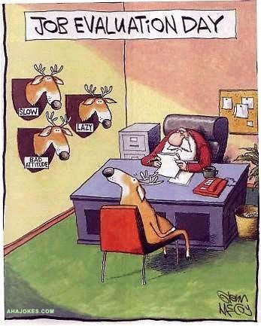
Teacher Evaluation
Notes:
NOTES

Slide 81
Teacher Evaluation
What are the purposes of evaluation?
Quality Assurance
Professional Learning
Improving teacher quality
Other
Other
Notes:
NOTES

Slide 82
Teacher Evaluation
What’s wrong with teacher evaluation?
Why we need a new approach
CHAPTER 2 (p. 19)
Notes:
Have to get away from the dog and pony show element of this. Many teachers expect evaluators to stay for their whole specially prepared lesson. Have to move away from this to multiple observations not all of full-length.

Slide 83
Teacher Evaluation
What’s wrong with teacher evaluation?
Why hasn’t it traditionally resulted in professional growth?
Notes:
NOTES

Slide 84
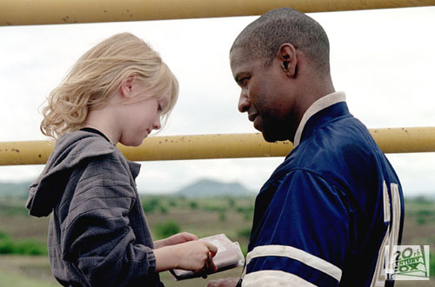
Teacher Evaluation
What’s wrong with teacher evaluation?
Why hasn’t it traditionally resulted in professional growth?
What conditions support growth?
Notes:
NOTES

Slide 85

Teacher Evaluation
Three “Gates” for Effective Teacher Evaluation
Fairness
Reliability
Validity
Notes:
NOTES

Slide 86
Teacher Evaluation
Basis for evaluation
Plan for gathering data
Processes and procedures for gathering information about quality of work
End result
Student progress
Quality of work (based on NYS Teaching Standards)
Procedures for gathering information about student progress
Career ladder
Compensation
Determination of employment
Direction for professional growth
Student learning
Teacher rating
State Assessment
Benchmark assessments
Common assessments
Teacher-made assessments
Notes:
NOTES

Slide 87
Teacher Evaluation
Basis for observation– Knowledge of the criteria
Plan for gathering data – Fidelity to process and procedures
End result –
Quality of the product
Observers must understand the Criteria
Observers must be able to identify appropriate data (evidence) to paint an accurate picture of educators’ work
Observer must understand the process including it’s intent or purpose.
Observer must follow process with fidelity, engaging the educator in discussion along the way
Observer must maintain consistency and fairness from educator to educator
Observer must align evidence to appropriate component
Observer must level evidence accurately
Observer must have sufficient evidence to support rating
Observer must have skill in engaging educator in conversation around level and direction for future
Observers must have a focus on constructing meaning through cognitive engagement
Notes:
NOTES

Slide 88
Teacher Evaluation
Effective teacher evaluation research identifies six best practices:
Annual Processes
Clear, rigorous expectations
Multiple measures
Multiple ratings
Regular feedback
Significance
http://www.tntp.org/index.php/publications/issue-analysis/teacher-evaluation-2.0/
88
Notes:
NOTES

Slide 89
Turning It Around
Discuss the following:
  Why is it important to understand the 3 “gates” and best practices in educator evaluation (fairness, reliability, validity)?
  How will you present this information to teachers who have different experiences with evaluation?
Notes:
NOTES

Slide 90

Evidence
Evidence is a factual reporting of events.
  It may include teacher and student actions and/or behaviors.
  It may also include artifacts prepared by the teacher, students, or others.
  It is not clouded with personal opinion or biases.
  It is selected using professional judgment by the observer and / or the teacher.
Notes:
Go back to the chart paper list of evidence from the watching of the fist video. Which ones are evidence and which are opinions.

Slide 91

Evidence
Types of Observation Evidence
Verbatim scripting of teacher or student comments: “Bring your white boards, markers and erasers to the carpet and sit on your square.”
Non-evaluative statements of observed teacher or student behavior: Teacher presented the content from the front of room.
Numeric information about time, student participation, resource use, etc.: [9:14 – 9:29] Warm-up. 8 of 22 Ss finished at 9:20, sat still until 9:29
An observed aspect of the environment: Desks were arranged in groups of four with room to walk between each group.
Notes:
NOTES

Slide 92

Evidence
Evidence v. opinion:
Back to yesterday’s video observation notes (on chart paper). Decide – is it evidence or opinion?
Notes:
NOTES

Slide 93
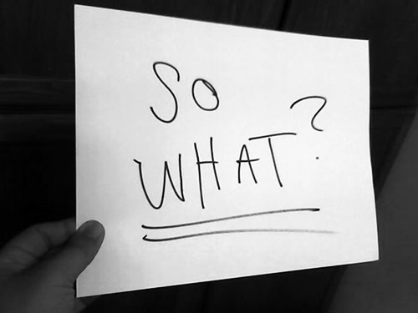
Evidence
Why is this important?
We are human beings and we bring with our own lenses and experience and biases.
There’s no chance at fairness, reliability and validity unless we can observe things similarly, from classroom to classroom and school to school and district to district
Notes:
NOTES

Slide 94
Bias
Definition of bias (and we all have biases):
Attaching positive or negative meaning to elements in our environment based on personal or societal influences that shape our thinking.
A biased judgment is based on outside influences and is not necessarily related to a teacher’s effectiveness.
  Example: “Mrs. T does so much for the school, she is an excellent teacher. “
  The actual classroom evidence may not support the rating of the teacher as “excellent.”
Notes:
NOTES

Slide 95

Bias
Bias in an Educational Setting
Imagine that you are the parent of a school age child. You are walking down the hall of your child’s school while classes are in session. The doors to several rooms are open and you have the opportunity to look in on teachers.
What would cause you to think favorably about what you saw and what would cause you to think negatively?
Notes:
NOTES

Slide 96
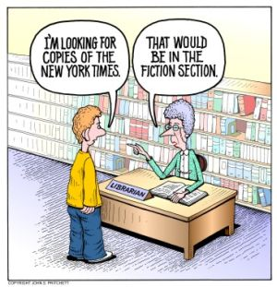
Bias
Other Threats to Observer Accuracy
Assessor bias
Leniency
Central Tendency
“Halo” or “Horns”
Effect
Notes:
NOTES

Slide 97
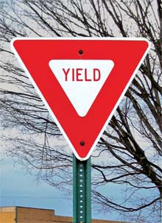
Bias
Reflection:
As your reflect upon your individual and group responses to these activities, make your own personal list of biases to be aware of when you assess teaching performance.
List your biases around the yield sign to remind you not to yield to them when evaluating performance.
Determine if the bias leads you to assign
a higher or lower rating when evaluating
teacher performance.
Notes:
NOTES

Slide 98
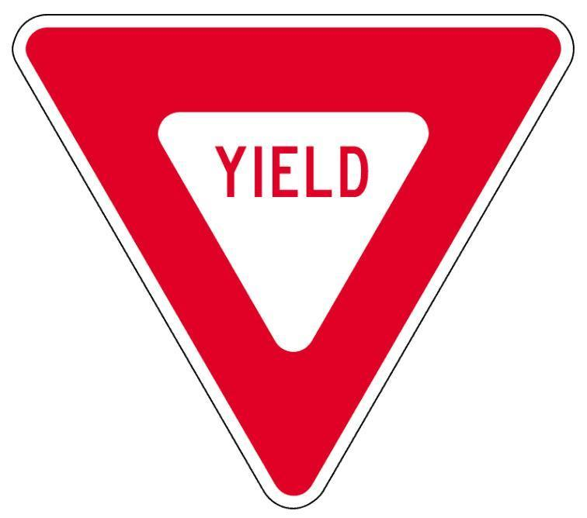
Bias
Notes:
NOTES

Slide 99
Teacher Evaluation
Meet the author, Kim Marshall:
Do his experiences
remind you of anything?
Not Focusing on Learning (p. 13)

Slide 100
The Evidence Cycle
COLLECT
DATA
(Evidence)
SORT TO
ALIGN
WITH YOUR
FRAMEWORK
Interpret:
Clarify
Conclusions
NO!
Impact on learning…
Support needed…
Notes:
NOTES

Slide 101
Evidence Collection
Remember the Priorities
  Cognitive Engagement
  Constructivist Learning
  21st Century Skills
Review the Standards/Rubrics
  What type of evidence must you collect to assess the priorities of the rubrics?
Be ready to collect the evidence
  Electronically
  iPad? Laptop? Handheld?
  Template or open-ended?
  Placemat?
Notes:
NOTES

Slide 102
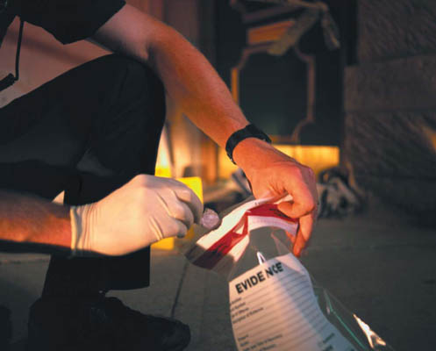
Video Observation
Observe what students are doing that shows evidence of elements of NYS Teaching Standard 3 (Instruction).
Collect evidence as you watch, ideally electronically.

Slide 103

Evidence Collection
Use the self-check questions to review your evidence collection
  Have I recorded only facts?
  Is my evidence relevant to the criteria being examined?
  Whenever possible, have I quantified words such as few, some, and most?
  Have I used quotation marks when quoting a teacher or student?
  Does my selection or documentation of evidence indicate any personal or professional preferences?
  Have I included any opinion (in the guise of fact)?
Notes:
NOTES

Slide 104
Culture
The Complexity of Teaching
“After 30 years of doing such work, I have concluded that classroom teaching … is perhaps the most complex, most challenging, and most demanding, subtle, nuanced, and frightening activity that our species has ever invented. ..The only time a physician could possibly encounter a situation of comparable complexity would be in the emergency room of a hospital during or after a natural disaster.”
Lee Shulman, The Wisdom of Practice
Notes:
NOTES

Slide 105
Culture
A Culture of Professional Inquiry
  Professional learning never ends.
  It is every teacher’s responsibility to engage in professional development.
  Teaching is so complex that it is never done perfectly.
  Every educator can always become more skilled. Making a commitment to do so is part of the essential work of teaching.
Charlotte Danielson
The Handbook for Enhancing Professional Practice
Notes:
NOTES

Slide 106
Culture
A Culture of Professional Inquiry Should:
Infuse a school’s practices related to professional development;
Be reflected in the school’s practices surrounding mentoring and teacher evaluation; and
Regard mentoring and evaluation as ongoing learning.
Charlotte Danielson
The Handbook for Enhancing Professional Practice
Notes:
NOTES

Slide 107
Culture
“Teacher evaluation can be an opportunity for genuine professional learning. When organized around clearly established and accepted standards of practice, teacher evaluation offers an opportunity for educators to reflect seriously on their practice, and promote learning.”
Charlotte Danielson
The Handbook for Enhancing Professional Practice
Notes:
NOTES

Slide 108
Culture
Discuss the content of the previous 4 slides with your colleagues.
  What cultural and structural conditions must be in place to create and sustain a climate of professional inquiry?
  In what ways does the type of questions observers ask of teachers promote – or inhibit – such a climate?
  What might be the impacts of a transition to a new system be on your existing culture?
Notes:
NOTES

Slide 109
Shifts
What shifts have to occur…
In teachers’ thinking?
In teachers’ actions?
Notes:
NOTES

Slide 110
Shifts
What shifts have to occur…
In principals’ thinking?
In principals’ actions?
Notes:
NOTES

Slide 111
Shifts
What shifts have to occur…
In the culture of the district?
In the culture of the school?
Notes:
NOTES

Slide 112

Shifts
Don’t let perfect be the enemy of good.
Notes:
NOTES

Slide 113
Day Two Agenda
Reconvene and regroup
Objectives and Agenda Review
Focusing on the learners
Teacher Evaluation
  The nature of evaluation
  Growth Producing feedback
  Evidence
  Bias
Collecting Some Evidence
Culture
Closure
Notes:
NOTES

Slide 114
Objectives
Goals for the year:
Training in the nine prescribed components
Making it “manageable”
½ sessions (how will this work?)
Leading & Learning in CNY piggy-back
Notes:
NOTES

Slide 115
Closure
Questions
Visiting the Parking Lot
+/∆
+
∆
Notes:
NOTES

Slide 116
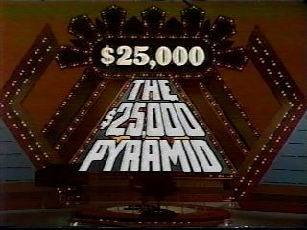
Review

Slide 117
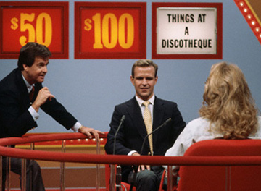
Review

Slide 118
$25K
$1000
$10K
$50
$100
$500

Slide 119
Standards

Slide 120
Data

Slide 121
Professional
Practice

Slide 122
Engagement

Slide 123
Constructivism

Slide 124
21stC Readiness

Slide 125
Go!

