Slide 1
OCM BOCES Day 8
Lead
Evaluator
Training
Notes:
NOTES

Slide 2
Taking Care of Business
April’s session has been cancelled due to the change in calendar. Look for an email with your “independent study” directions.
Clarifying sign-up for half days:
As each one approaches we will email you with a link so you can tell us which one is better for you
The link will also be at the website
MyLearningPlan is not flexible in this way
Remember how listservs work

Slide 3
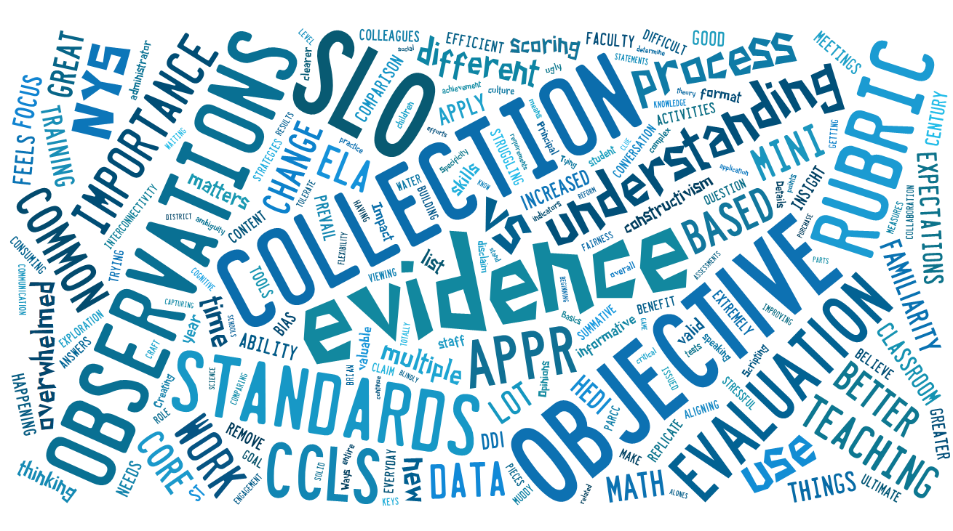
3 Things We’ve Learned

Slide 4
2 Things More To Learn

Slide 5
1 Thing We’ll Do

Slide 6
Day Eight Agenda
Lead Evaluator Training continues…
RTTT Road Map
Data Driven Instruction
Considerations when ELLs
Considerations when SWDs
Updating the Regs and SLOs
A Principal’s “Race To The Top” Map
Evidence Collection
Evidence Sorting Submission

Slide 7
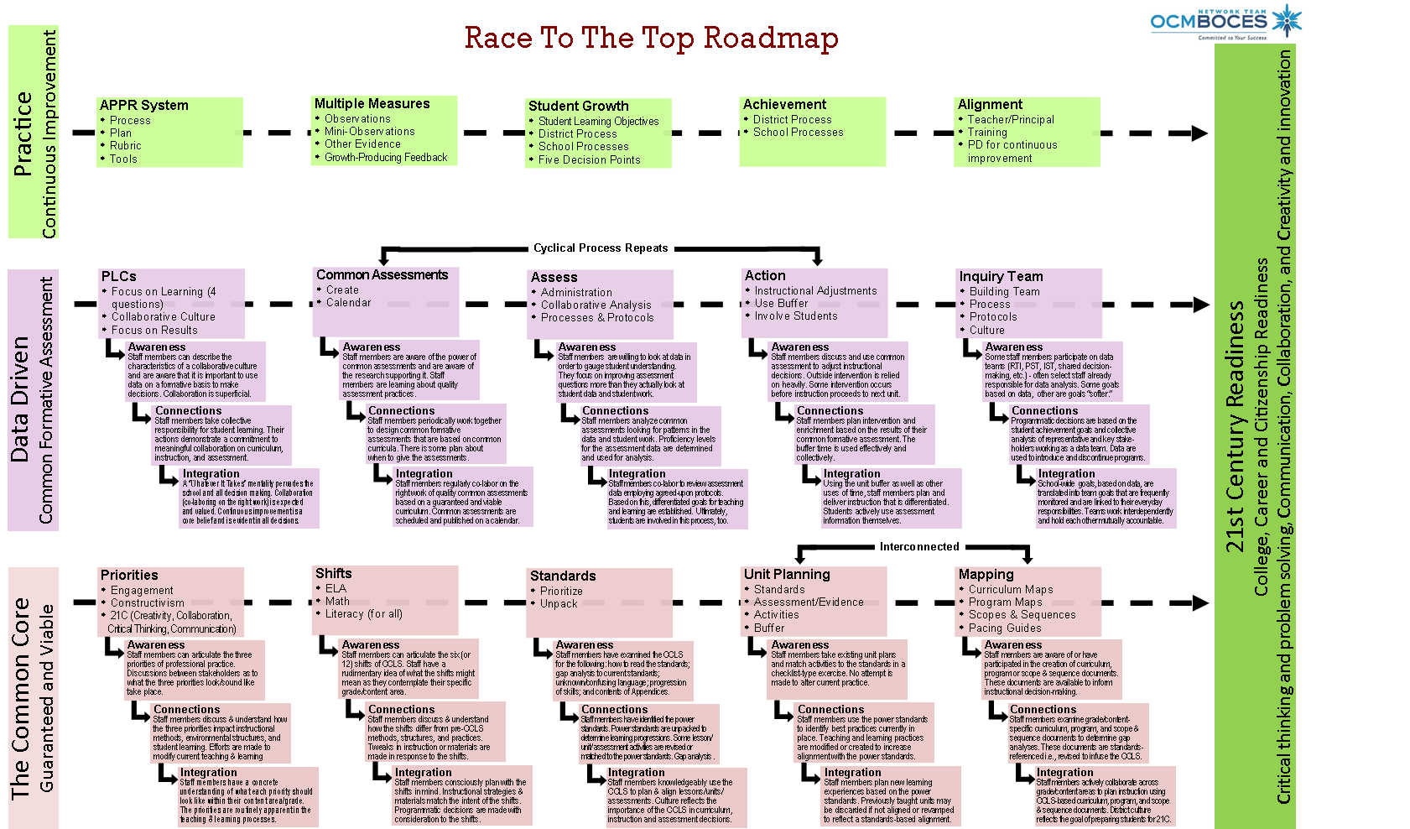
Connections
Race To The Top Road Map
Notes:
NOTES

Slide 8
Connections
Race To The Top Road Map
Where are you now?
Notes:
NOTES

Slide 9
Data Driven Instruction
Six Shifts of DDI
 |  | Shifts in Data Driven Instruction
Shift 1 | Data belongs with teachers working collaboratively | Collaboration of teachers is expected and valued. Teachers work together and take collective responsibility for student learning. Sufficient time for meaningful collaboration is built into every schedule. Protocols are in place to guide data inquiry processes.
Shift 2 | Emphasis on formative assessment | A balanced assessment system uses classroom assessments, common formative assessments, common interim assessments, and summative assessments to paint a balanced picture of student progress. Unlike summative assessments, formative assessments take on a more prominent role in the balanced assessment system due to the quality and immediacy of the data collected. To reflect this importance, common assessments are calendared, administered, scored, and analyzed collaboratively.
Shift 3 | Assess what is important | A guaranteed and viable curriculum is provided to all students and drives the assessment system. Teachers clearly identify, communicate, and assess the knowledge, skills, and dispositions that are the priority for each unit and course.
Shift 4 | Take meaningful action | Rather than waiting on summative data, teachers quickly respond to the data gathered from formative and interim assessments. It is this careful examination of student work that creates the foundation for all current and future curriculum, program, and instructional decisions.
Shift 5 | A commitment to continuous improvement | The status quo can never be an option. All educators must constantly search for better ways to achieve mutual goals and increase achievement for all students. All programs, policies, and practices are continually assessed on their contribution to student learning.
Shift 6 | Commitment to student involvement | The power of formative assessments are only truly recognized when students are included as users of the data. Therefore, students must play an integral role in the assessment process. Students must be able to assess and monitor their own progress in order to set individual goals for learning.

Slide 10
Data Driven Instruction
Six Shifts of DDI
 |  | Shifts in Data Driven Instruction
Shift 1 | Data belongs with teachers working collaboratively | Collaboration of teachers is expected and valued. Teachers work together and take collective responsibility for student learning. Sufficient time for meaningful collaboration is built into every schedule. Protocols are in place to guide data inquiry processes.
Shift 2 | Emphasis on formative assessment | A balanced assessment system uses classroom assessments, common formative assessments, common interim assessments, and summative assessments to paint a balanced picture of student progress. Unlike summative assessments, formative assessments take on a more prominent role in the balanced assessment system due to the quality and immediacy of the data collected. To reflect this importance, common assessments are calendared, administered, scored, and analyzed collaboratively.
Shift 3 | Assess what is important | A guaranteed and viable curriculum is provided to all students and drives the assessment system. Teachers clearly identify, communicate, and assess the knowledge, skills, and dispositions that are the priority for each unit and course.
Shift 4 | Take meaningful action | Rather than waiting on summative data, teachers quickly respond to the data gathered from formative and interim assessments. It is this careful examination of student work that creates the foundation for all current and future curriculum, program, and instructional decisions.
Shift 5 | A commitment to continuous improvement | The status quo can never be an option. All educators must constantly search for better ways to achieve mutual goals and increase achievement for all students. All programs, policies, and practices are continually assessed on their contribution to student learning.
Shift 6 | Commitment to student involvement | The power of formative assessments are only truly recognized when students are included as users of the data. Therefore, students must play an integral role in the assessment process. Students must be able to assess and monitor their own progress in order to set individual goals for learning.
1) Data belongs with teachers working collaboratively

Slide 11
Data Driven Instruction
Six Shifts of DDI
 |  | Shifts in Data Driven Instruction
Shift 1 | Data belongs with teachers working collaboratively | Collaboration of teachers is expected and valued. Teachers work together and take collective responsibility for student learning. Sufficient time for meaningful collaboration is built into every schedule. Protocols are in place to guide data inquiry processes.
Shift 2 | Emphasis on formative assessment | A balanced assessment system uses classroom assessments, common formative assessments, common interim assessments, and summative assessments to paint a balanced picture of student progress. Unlike summative assessments, formative assessments take on a more prominent role in the balanced assessment system due to the quality and immediacy of the data collected. To reflect this importance, common assessments are calendared, administered, scored, and analyzed collaboratively.
Shift 3 | Assess what is important | A guaranteed and viable curriculum is provided to all students and drives the assessment system. Teachers clearly identify, communicate, and assess the knowledge, skills, and dispositions that are the priority for each unit and course.
Shift 4 | Take meaningful action | Rather than waiting on summative data, teachers quickly respond to the data gathered from formative and interim assessments. It is this careful examination of student work that creates the foundation for all current and future curriculum, program, and instructional decisions.
Shift 5 | A commitment to continuous improvement | The status quo can never be an option. All educators must constantly search for better ways to achieve mutual goals and increase achievement for all students. All programs, policies, and practices are continually assessed on their contribution to student learning.
Shift 6 | Commitment to student involvement | The power of formative assessments are only truly recognized when students are included as users of the data. Therefore, students must play an integral role in the assessment process. Students must be able to assess and monitor their own progress in order to set individual goals for learning.
2) Emphasis on formative assessment

Slide 12
Data Driven Instruction
Six Shifts of DDI
 |  | Shifts in Data Driven Instruction
Shift 1 | Data belongs with teachers working collaboratively | Collaboration of teachers is expected and valued. Teachers work together and take collective responsibility for student learning. Sufficient time for meaningful collaboration is built into every schedule. Protocols are in place to guide data inquiry processes.
Shift 2 | Emphasis on formative assessment | A balanced assessment system uses classroom assessments, common formative assessments, common interim assessments, and summative assessments to paint a balanced picture of student progress. Unlike summative assessments, formative assessments take on a more prominent role in the balanced assessment system due to the quality and immediacy of the data collected. To reflect this importance, common assessments are calendared, administered, scored, and analyzed collaboratively.
Shift 3 | Assess what is important | A guaranteed and viable curriculum is provided to all students and drives the assessment system. Teachers clearly identify, communicate, and assess the knowledge, skills, and dispositions that are the priority for each unit and course.
Shift 4 | Take meaningful action | Rather than waiting on summative data, teachers quickly respond to the data gathered from formative and interim assessments. It is this careful examination of student work that creates the foundation for all current and future curriculum, program, and instructional decisions.
Shift 5 | A commitment to continuous improvement | The status quo can never be an option. All educators must constantly search for better ways to achieve mutual goals and increase achievement for all students. All programs, policies, and practices are continually assessed on their contribution to student learning.
Shift 6 | Commitment to student involvement | The power of formative assessments are only truly recognized when students are included as users of the data. Therefore, students must play an integral role in the assessment process. Students must be able to assess and monitor their own progress in order to set individual goals for learning.
3) Assess what is important

Slide 13
Data Driven Instruction
Six Shifts of DDI
 |  | Shifts in Data Driven Instruction
Shift 1 | Data belongs with teachers working collaboratively | Collaboration of teachers is expected and valued. Teachers work together and take collective responsibility for student learning. Sufficient time for meaningful collaboration is built into every schedule. Protocols are in place to guide data inquiry processes.
Shift 2 | Emphasis on formative assessment | A balanced assessment system uses classroom assessments, common formative assessments, common interim assessments, and summative assessments to paint a balanced picture of student progress. Unlike summative assessments, formative assessments take on a more prominent role in the balanced assessment system due to the quality and immediacy of the data collected. To reflect this importance, common assessments are calendared, administered, scored, and analyzed collaboratively.
Shift 3 | Assess what is important | A guaranteed and viable curriculum is provided to all students and drives the assessment system. Teachers clearly identify, communicate, and assess the knowledge, skills, and dispositions that are the priority for each unit and course.
Shift 4 | Take meaningful action | Rather than waiting on summative data, teachers quickly respond to the data gathered from formative and interim assessments. It is this careful examination of student work that creates the foundation for all current and future curriculum, program, and instructional decisions.
Shift 5 | A commitment to continuous improvement | The status quo can never be an option. All educators must constantly search for better ways to achieve mutual goals and increase achievement for all students. All programs, policies, and practices are continually assessed on their contribution to student learning.
Shift 6 | Commitment to student involvement | The power of formative assessments are only truly recognized when students are included as users of the data. Therefore, students must play an integral role in the assessment process. Students must be able to assess and monitor their own progress in order to set individual goals for learning.
4) Take meaningful action

Slide 14
Data Driven Instruction
Six Shifts of DDI
 |  | Shifts in Data Driven Instruction
Shift 1 | Data belongs with teachers working collaboratively | Collaboration of teachers is expected and valued. Teachers work together and take collective responsibility for student learning. Sufficient time for meaningful collaboration is built into every schedule. Protocols are in place to guide data inquiry processes.
Shift 2 | Emphasis on formative assessment | A balanced assessment system uses classroom assessments, common formative assessments, common interim assessments, and summative assessments to paint a balanced picture of student progress. Unlike summative assessments, formative assessments take on a more prominent role in the balanced assessment system due to the quality and immediacy of the data collected. To reflect this importance, common assessments are calendared, administered, scored, and analyzed collaboratively.
Shift 3 | Assess what is important | A guaranteed and viable curriculum is provided to all students and drives the assessment system. Teachers clearly identify, communicate, and assess the knowledge, skills, and dispositions that are the priority for each unit and course.
Shift 4 | Take meaningful action | Rather than waiting on summative data, teachers quickly respond to the data gathered from formative and interim assessments. It is this careful examination of student work that creates the foundation for all current and future curriculum, program, and instructional decisions.
Shift 5 | A commitment to continuous improvement | The status quo can never be an option. All educators must constantly search for better ways to achieve mutual goals and increase achievement for all students. All programs, policies, and practices are continually assessed on their contribution to student learning.
Shift 6 | Commitment to student involvement | The power of formative assessments are only truly recognized when students are included as users of the data. Therefore, students must play an integral role in the assessment process. Students must be able to assess and monitor their own progress in order to set individual goals for learning.
5) A commitment to continuous improvement

Slide 15
Data Driven Instruction
Six Shifts of DDI
 |  | Shifts in Data Driven Instruction
Shift 1 | Data belongs with teachers working collaboratively | Collaboration of teachers is expected and valued. Teachers work together and take collective responsibility for student learning. Sufficient time for meaningful collaboration is built into every schedule. Protocols are in place to guide data inquiry processes.
Shift 2 | Emphasis on formative assessment | A balanced assessment system uses classroom assessments, common formative assessments, common interim assessments, and summative assessments to paint a balanced picture of student progress. Unlike summative assessments, formative assessments take on a more prominent role in the balanced assessment system due to the quality and immediacy of the data collected. To reflect this importance, common assessments are calendared, administered, scored, and analyzed collaboratively.
Shift 3 | Assess what is important | A guaranteed and viable curriculum is provided to all students and drives the assessment system. Teachers clearly identify, communicate, and assess the knowledge, skills, and dispositions that are the priority for each unit and course.
Shift 4 | Take meaningful action | Rather than waiting on summative data, teachers quickly respond to the data gathered from formative and interim assessments. It is this careful examination of student work that creates the foundation for all current and future curriculum, program, and instructional decisions.
Shift 5 | A commitment to continuous improvement | The status quo can never be an option. All educators must constantly search for better ways to achieve mutual goals and increase achievement for all students. All programs, policies, and practices are continually assessed on their contribution to student learning.
Shift 6 | Commitment to student involvement | The power of formative assessments are only truly recognized when students are included as users of the data. Therefore, students must play an integral role in the assessment process. Students must be able to assess and monitor their own progress in order to set individual goals for learning.
6) Commitment to student involvement

Slide 16
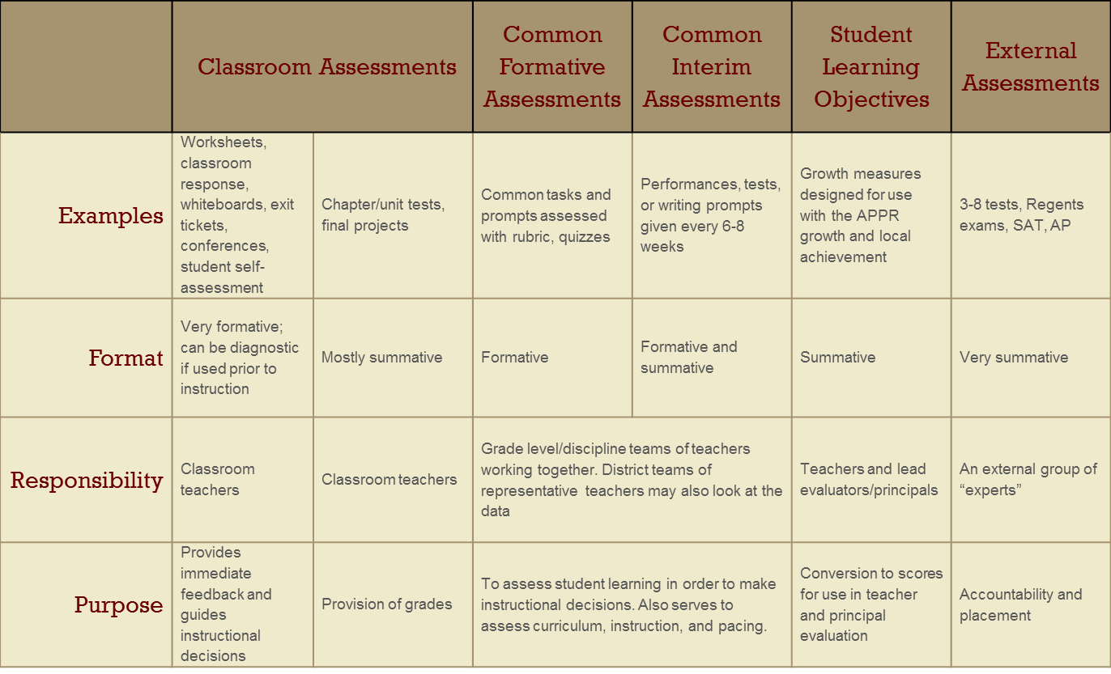
Data Driven Instruction
Balanced Assessment System

Slide 17
Data Driven Instruction
The Shifts and External Assessments

Slide 18
Data Driven Instruction
The Shifts and External Assessments

Slide 19
Data Driven Instruction
The Shifts and External Assessments

Slide 20
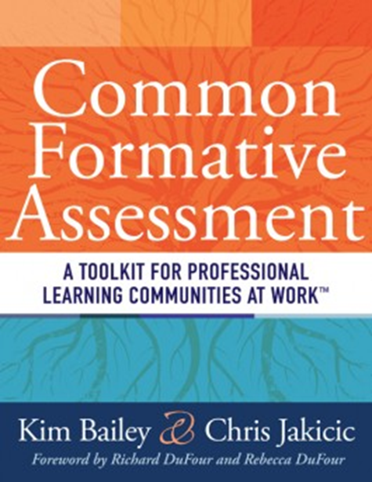
Data Driven Instruction
Introducing the “text book”

Slide 21
Data Driven Instruction
Introducing the “text book”
Intro to PLC
DuFour
Hattie
Deming

Slide 22
Data Driven Instruction
Introducing the “text book”
Intro to PLC

Slide 23
Data Driven Instruction
Introducing the “text book”
Intro to PLC

Slide 24
Data Driven Instruction
Introducing the “text book”
Assessment Overview
DuFour
Stiggins
Wiliam

Slide 25
Data Driven Instruction
Introducing the “text book”
What’s Most Important
Marzano
Ainsworth

Slide 26
Data Driven Instruction
Introducing the “text book”
Unpacking
Marzano
Wiggins
McTighe
Ainsworth

Slide 27
Data Driven Instruction
Introducing the “text book”
Assessment Design
Reeves
Ainsworth
Marzano
Stiggins
Popham

Slide 28
Data Driven Instruction
Introducing the “text book”
Unit Planning & Mapping
Covey
Wiggins
McTighe
p21

Slide 29
Data Driven Instruction
Introducing the “text book”
Data-Based Action
Schmoker
DuFour
Wellman
Lipton

Slide 30
Data Driven Instruction
Introducing the “text book”
Involving Students
Popham
Wiliam
Brookhart
Hattie

Slide 31
Data Driven Instruction
Introducing the “text book”
Sustaining the Effort
DuFour
Newmann
Deming

Slide 32
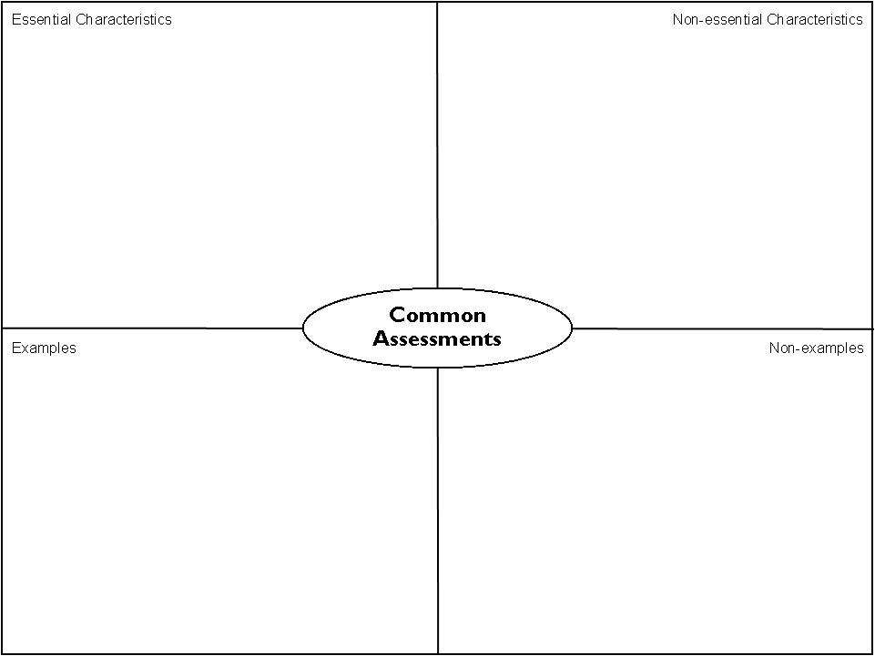
Data Driven Instruction
Introducing the “text book”
Directions
Individually, read pages 16-18
With your partner, complete the Frayer organizer for what you read

Slide 33
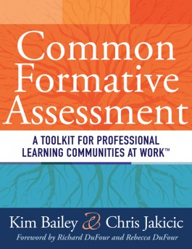
CCLS, DDI & Practice
About the “text book”
June 25th & 26th
Rodax 8
Limited to 100 educators
Teachers and leaders
w/ CNY Teacher Center
BOTH AUTHORS!

Slide 34
LE “Certification”
The Nine Required Components
New York State Teaching Standards and Leadership Standards
Evidence-based observation
Application and use of Student Growth Percentile and VA Growth Model data
Application and use of the State-approved teacher or principal rubrics
Application and use of any assessment tools used to evaluate teachers and principals
Notes:
NOTES

Slide 35
LE “Certification”
The Nine Required Components
Application and use of State-approved locally selected measures of student achievement
Use of the Statewide Instructional Reporting System
Scoring methodology used to evaluate teachers and principals
Specific considerations in evaluating teachers and principals of ELLs and students with disabilities
Notes:
NOTES

Slide 36
Evidence Collection

Slide 37
Evidence Collection
Evidence Collection
Cleaning it up (↑objectivity ↓subjectivity
Practice and process
Collecting some of your evidence for feedback
Notes:
NOTES

Slide 38
OCM BOCES
APPR Regulations
“revised” February 2012 (pending NYS budget)

Slide 39
APPR
NOTE: New guidance will not be out until a budget is passed.
20%
Student Growth
60%
Multiple Measures
20%
Student Achievement

Slide 40
APPR
Growth over time
Knowledge of Students & Student Learning
Compared to Expected Growth
Knowledge of Content & Instructional Planning
Some Variables Considered
20%
Student Growth
SLOs Required
Instructional Practice
60%
Multiple Measures
Moment in time or growth
Learning Environment
20%
Student Achievement
Could be school-
wide measure
Assessment for Student Learning
Local or Purchased
Professional Responsibilities and Collaboration
Some Variables Considered
SLOs Optional
Professional Growth

Slide 41
Overall Differences
Agreement
Does not impact district decisions with regard to probationary teachers and principals
Subcomponent scores provided by last day of school; summative by September 1st
Demonstrate transparency and availability of each level to teachers and principals
Appeals must be timely and expeditious
Submit plans to SED for approval by July 1st (but no penalty until January withhold aid action)
SED will monitor scores
HEDI points (91-100, 75-90, 65-74, 0-64) need to be set up for each of the three components at beginning of the year

Slide 42
Agreement
Growth over time
Changes:
Compared to Expected Growth
HEDI point ranges (which can matter when setting SLO Gs)
Some more options mentioned
Score distribution monitored by SED with the right to be inspect assessments in SLOs
3rd part assessments will not be required for any subjects (but are an option)
Some Variables Considered
20%
Student Growth
SLOs Required
60%
Multiple Measures

Slide 43
Agreement
Changes:
HEDI definitions (well-above, meet, below, well-below)
Could use different assessments in different schools if demonstrated comparability
Some more options mentioned, including state assessments in a different way
Score distribution monitored by SED
School-wide measures permitted
20%
Student Growth
60%
Multiple Measures
Moment in time or growth
20%
Student Achievement
Could be school-
wide measure
Local or Purchased
Some Variables Considered
SLOs Optional

Slide 44
Agreement
Changes:
Knowledge of Students & Student Learning
At least 31 points based on observations (out of the total 60)
At least one observation unannounced (of the multiple observations)
Score distribution monitored by SED
Feedback gathering from parents or students must use approved tool
Stand alone goals no longer permitted
Knowledge of Content & Instructional Planning
Instructional Practice
60%
Multiple Measures
Learning Environment
Assessment for Student Learning
Professional Responsibilities and Collaboration
Professional Growth

Slide 45
APPR
Rubrics:
Knowledge of Students & Student Learning
In our BOCES, one of these three being used (so far):
FFT 2007 (ASCD)
FFT 2011 (Teachscape)
Professional Practice (NYSUT & NYSED)
Knowledge of Content & Instructional Planning
Instructional Practice
60%
Multiple Measures
Learning Environment
Assessment for Student Learning
Professional Responsibilities and Collaboration
Professional Growth

Slide 46
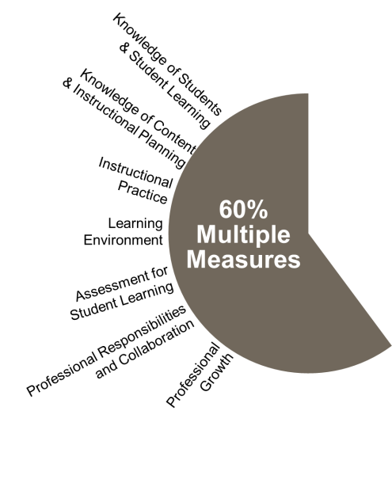
Points:
APPR
31-60 points
<29 points
Based on multiple observations
Use an approved rubric
Outside, impartial observation
Peer observation
Student feedback
Parent feedback
Other evidence of student development and performance (lesson plans, portfolios, other artifacts)

Slide 47
Points:
APPR
Could all be from the rubric
60 points

Slide 48
Points:
APPR
From the rubric from multiple observations
>31 points
From the list of other possibilities, would need system of point determination
<29 points

Slide 49
Rubrics:
APPR
FFT 2007
FFT 2011
NYS Practice
Four Domains
No cost to use rubrics
Can be used with 3rd party electronic systems
Four Domains
No cost to use rubrics
Can only be used with Teachscape electronic system
NYS Teaching Standards (7)
No cost to use rubrics
Can be used with 3rd party electronic systems

Slide 50
OCM BOCES
APPR Regulations
revised February 2012

Slide 51
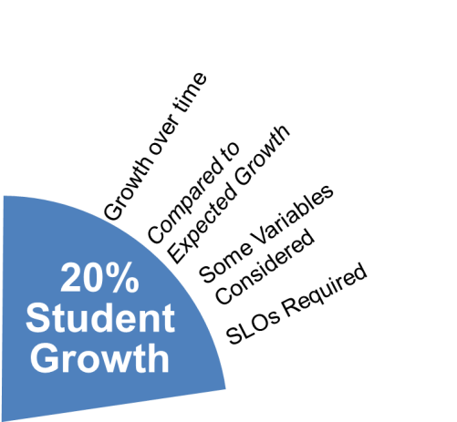
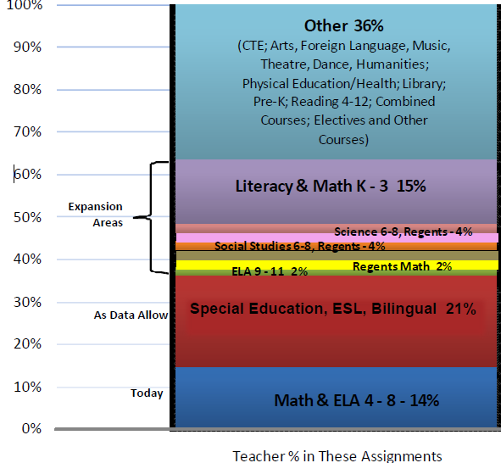
APPR
NO State-provided Growth Score; Use Student Learning Objectives
State-provided Growth Score

Slide 52
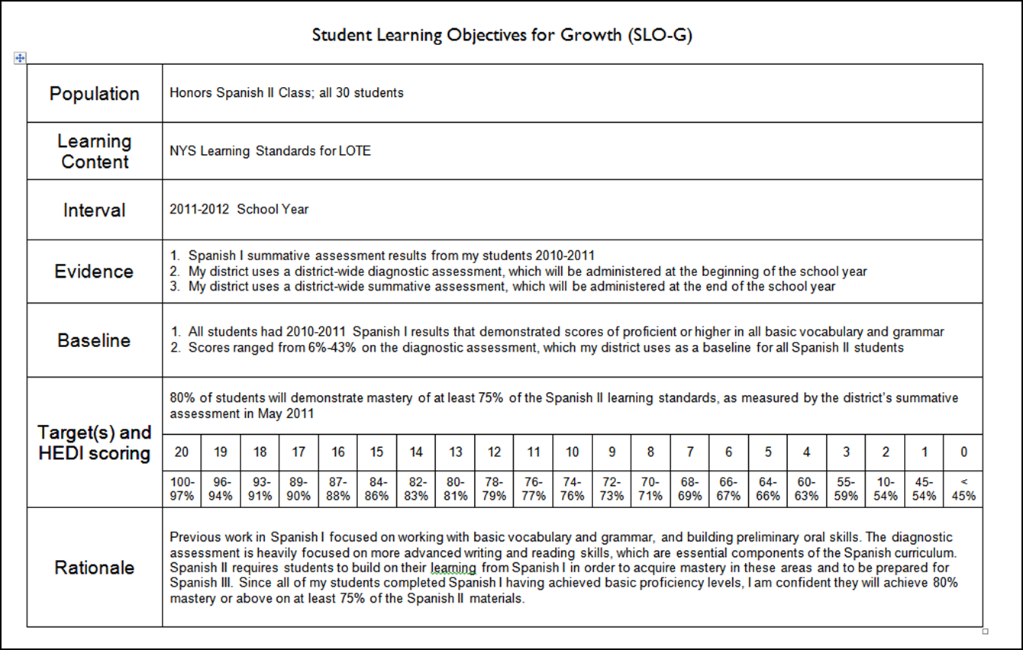
APPR
INGREDIENTS

Slide 53
SLOs
Definition (underline key words):
A student learning objective is an academic goal for a teacher’s students that is set at the start of a course. It represents the most important learning for the year (or, semester, where applicable). It must be specific and measurable, based on available prior student learning data, and aligned to Common Core, State, or national standards, as well as any other school and district priorities. Teachers’ scores are based upon the degree to which their goals were attained.
Notes:
NOTES

Slide 54
Key Points
SLOs
SLOs name what students need to know and be able to do at the end of the year.
SLOs place student learning at the center of the conversation.
SLOs are a critical part of all great educator’s practice.
SLOs are an opportunity to document the impact educators make with students.
SLOs provide principals with critical information that can be used to manage performance, differentiate and target professional development, and focus supports for teachers.
The SLO process encourages collaboration within school buildings.
School leaders are accountable for ensuring all teachers have SLOs that will support their District and school goals.

Slide 55
SLOs
State
Determines SLO process
Identifies required elements
Requires use of State test
Provides training to NTs prior to 2012-13.
Provides guidance, webinars & videos
District
District goals & priorities
Match requirements to teachers
Define processes for before & after
Identify expectations
School
LE & teacher collaborate
LE approval
Ensure security
LE monitor & evaluation
Teacher
Works with colleagues & LE
SLOs

Slide 56
SLO Decisions for Districts
SLOs
Assess and identify priorities and academic needs.
Identify who will have State-provided growth measures and who must have SLOs as “comparable growth measures.”
Determine District rules for how specific SLOs will get set.
Establish expectations for scoring SLOs and for determining teacher ratings for the growth component.
Determine District-wide processes for setting, reviewing, and assessing SLOs in schools.
March 1
April 16
May 30

Slide 57
SLO Decision # 1
SLOs
What are your district priorities?
What are your building priorities?
ELLs achievement
AP participation
SWD achievement
Graduation rate
Achievement gap
ELA? Math? Sci?
Non-fiction writing

Slide 58
SLO Decision # 2
SLOs
Go through the scenarios for different teachers
Teaching Assignment | Is there a State-Provided Growth Score (or is there a state assessment that must be used)? | What (if any) SLOs would have to be employed?
Kindergarten Common Branch
First Grade Common Branch
Third Grade Common Branch
Fourth Grade Common Branch
Fifth Grade Math
Sixth Grade Social Studies
Seventh Grade Science
8th Grade ELA and Social Studies teacher with 100 students Class One: ELA with 35 students Class Two: ELA with 20 students Class Three: SS with 30 students Class Four: SS with 15 students
Science teacher with 110 total students across five sections Two Living Environment (Regents) sections with 20 students each Two Living Environment (non-Regents) with 25 students each One Forensic Science elective with 20 students
7th grade Math and Science teacher with 130 students across 5 sections Two 7th grade Math sections with 30 students each Two 7th grade Science sections with 25 students each One Advances 7th grade Science section with 20 students
Middle school PE teacher with 5 sections and 140 students total 2 sections of 6th grade PE (60 students total) 2 sections of 7th grade PE (50 students total) Section of 8th grade PE (sop students)
High school resource teacher with a total of 25 students 2 groups of 9th grade students 2 groups of 10th grade students 1 group of 11th/12th grade students
K-6 art teacher with a total of 480 students 4 sections of K (80 students) 4 sections of 1st grade (100 students) 4 sections of 2nd grade (100 student) 3 sections of 3rd grade (90 students) 4 sections of 4th grade (110 students)
5th and 6th grade AIS/reading teacher with a total of 80 students 6 groups of 5th grade students who meet every other day (35 students total) 6 groups of 6th grade students (45 students total)
11th grade special education teacher 2 sections of co-taught ELA (class size 20 each with 6 SWD in each) 3 sections of 11th grade resource room (total of 15 students)
K-6 instrumental music teacher 4th grade lessons (30 students who meet once per week in lessons of 3 students each) 5th grade band (35 students who meet every other day) 5th grade lessons (35 students who meet once per week in lessons of 5 students each) 6th grade band (35 students who meet every other day) 6th grade lessons (35 students who meet once per week in lessons of 5 students each)
Middle-level library/media specialist (600 students in school) 5th grade classes (150 students attend library class once per week in 6 groups of 25) 6th – 8th grade students use library as needed or as scheduled in conjunction with teachers.

Slide 59
Rules
SLOs
Math and ELA trump
Use state test if there is one
Must cover 50%
Bigger enrollment to lesser enrollment

Slide 60
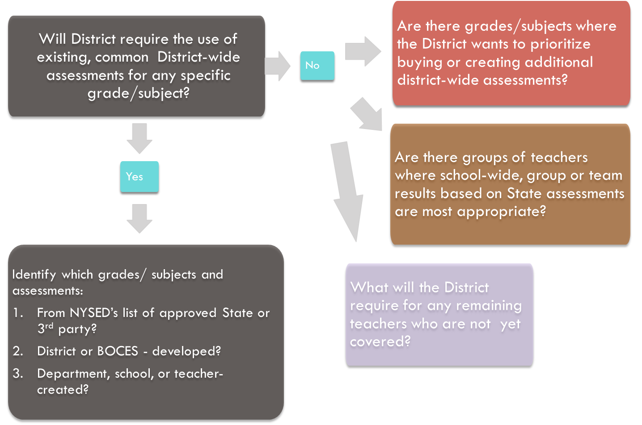
SLO Decision # 3
SLOs

Slide 61
SLO Decision # 4
SLOs
Establish expectations for scoring SLOs and for determining teacher ratings for the growth component.

Slide 62
SLO Decision # 5
SLOs
Determine District-wide processes for setting, reviewing, and assessing SLOs in schools.

Slide 63
SLOs
Population | Four sections of Regents US History (90 students)
Learning Content | NYS Learning Standards for Social Studies (History of the United States and New York, Standard 1)
Interval | 2012-2013 School Year
Evidence | District-wide diagnostic assessment (June 2009 Regents US History Exam), which will be administered at the beginning of the school year Regents US History examination will be used at the end of the year
Baseline | All of the students passed the Global Regents exam the previous year; 35% at mastery level (85% or higher) The average score on the diagnostic assessment (June 2009 Regents) was 74%; 67% of the students scored at least a 65%; 21% of the students scored at least 85%.
Target(s) and HEDI scoring | 50% of the students will score at least an 85% on the Regents exam given at the conclusion of the course.
 | 20 | 19 | 18 | 17 | 16 | 15 | 14 | 13 | 12 | 11 | 10 | 9 | 8 | 7 | 6 | 5 | 4 | 3 | 2 | 1 | 0
 | 100-85% | 80-84% | 75-79% | 70-74% | 65-69% | 60-64% | 55-59% | 50-54% | 55-59% | 51-54% | 50-53% | 49-52% | 45-48% | 41-44% | 35-40% | 30-34% | 25-29% | 20-24% | 15-19% | 10-14% | < 10%
Rationale | Almost all students have historically passed the US History Regents examination. Increasing the number of students who achieve at the mastery in social studies is a school-wide goal. The average number of students scoring at the mastery level on US History for the district has been 50%. Because students have been learning US history for much of their education (4th grade, 5th grade, 7th grade, 8th grade), the use of a past Regents exam was appropriate as a diagnostic assessment.

Slide 64
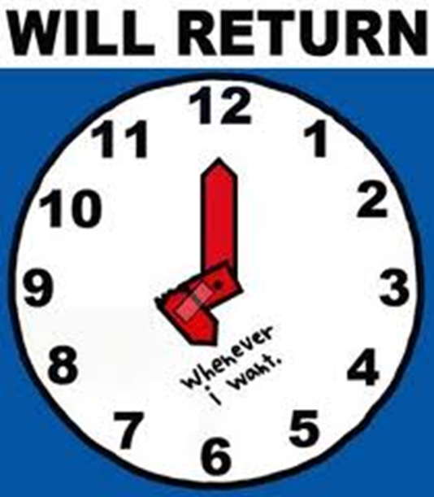
SLOs
SLO Construction
As a group of 4, make an SLO for one of the following:
2nd Grade math
7th grade social studies
Living environment
If you are part of a larger group, divide up and choose different a different SLO to work on
Take a break
Notes:
NOTES

Slide 65
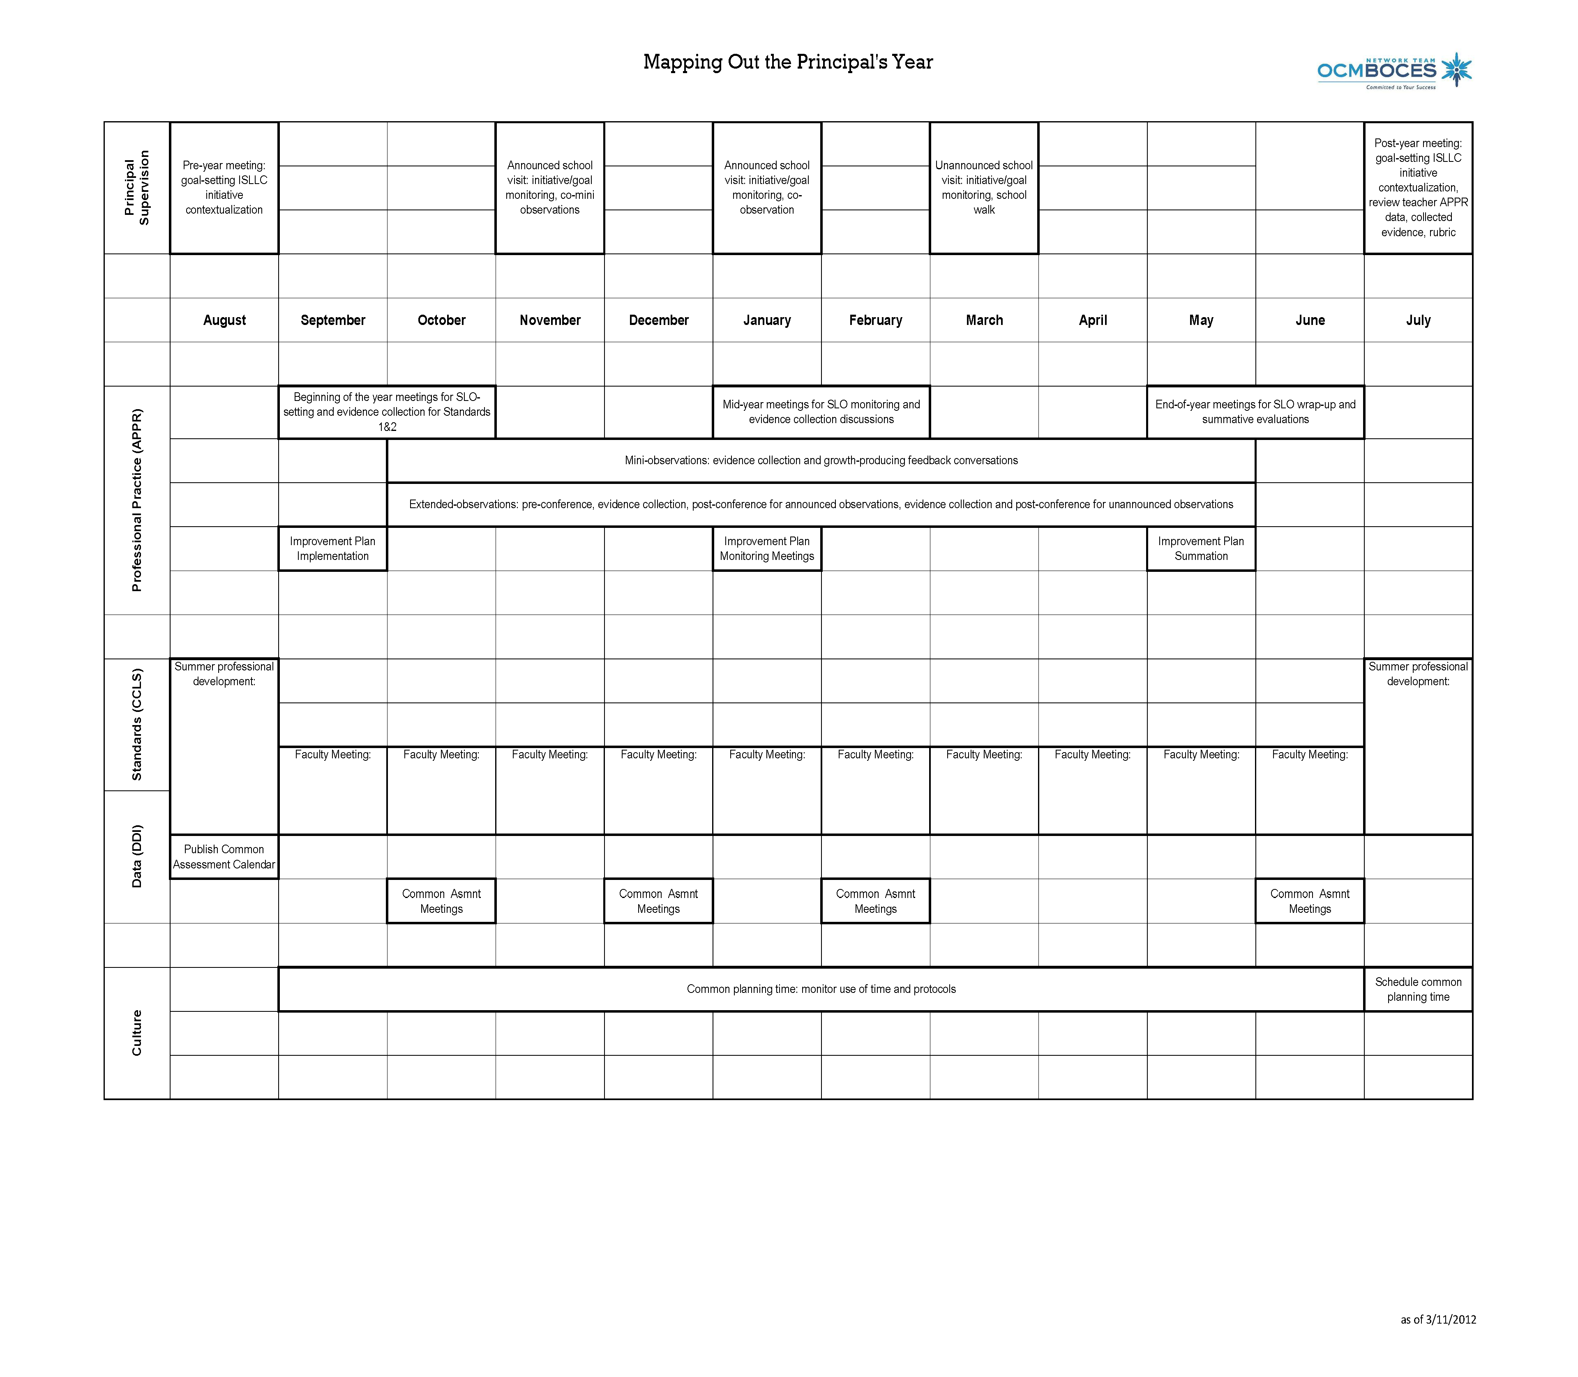
Race To The Top
Looking at Next Year
Notes:
NOTES

Slide 66
Evidence Collection

Slide 67
Evidence Collection
Evidence Collection
Watch a lesson (15 minutes)
Collect evidence (Standard 3)
Sort your evidence
Cut and paste evidence into the online form
SUBMIT after each section so nothing gets lost
When done, you may go!
Notes:
NOTES

