Slide 1
OCM BOCES
Day 7
Lead
Evaluator
Training
Notes:
NOTES

Slide 2

Day Seven Agenda
Lead Evaluator Training continues…
  RTTT Connections
  Improving Evidence Collection
  (Objectivity and subjectivity)
  Evidence Collection & clean-up
  Evidence > Rubric > Feedback
  Student Learning Objectives (SLOs)
  RTTT Connections

Slide 3
Taking Care of Business
Clarifying sign-up for half days:
  As each one approaches we will email you with a link so you can tell us which one is better for you
  The link will also be at the website
  MyLearningPlan is not flexible in this way
Reminder about how listservs work!

Slide 4
Discussion
The status of your “race”
  Color in the different race “tracks,” indicating your progress
  Talk to table mates – especially when you see different progress
Notes:
NOTES

Slide 5
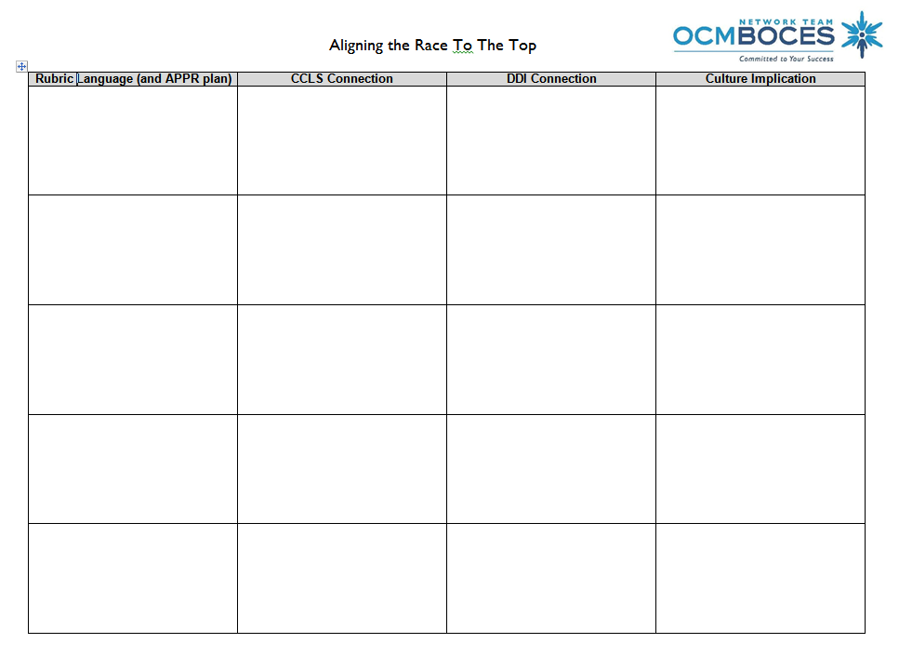
Connections
Aligning the “race”
  Work as a table to complete
  Use your rubric
  Don’t get too specific with the CCLS
Notes:
NOTES

Slide 6
Collecting Evidence
A “rubric” for evidence collection
  Alignment of evidence
  Objectivity of evidence
  Representation of evidence
Indicators | Ineffective | Developing | Effective | Highly Effective
Representation of Evidence | Evidence/facts are scant or missing for some criteria and/or do not accurately represent the lesson and associated artifacts. | Minimal evidence/facts are recorded for each criterion and/or partially represent the lesson and associated artifacts. | Sufficient evidence/facts are recorded for each criterion and accurately represents the associated artifacts | A preponderance of evidence/facts is recorded for all criteria and accurately represents what occurred in the class and in the associated artifacts.
Objectivity of Evidence | Evidence includes frequent bias opinions, summary statements, and/or judgments. | Evidence includes occasional opinions, summary statements, or judgments. Many observations are subjective in nature. | Evidence is largely free of bias, opinions, summary statements, and judgments. Few observations are subjective; most are objective. | Evidence is quantifiable when appropriate, includes specific numbers and/or time references. The evidence is completely free of bias, opinions, summary statements, and judgments.
Alignment of Evidence | Evidence is misaligned to the criteria or evidence is repeated in multiple indicators without attention to context of the evidence. | Evidence is only partially aligned to the criteria and/or is repeated in some indicators without attention to context of the evidence. | The majority of evidence is aligned to the appropriate criteria and any repeated evidence reflects the accurate context of the evidence. | All evidence is both aligned to the criteria and accurately reflects the context of the evidence.
Notes:
NOTES

Slide 7
Evidence Collection
Evidence Collection
Cleaning it up (↑objectivity ↓subjectivity
Practice and process
Collecting some of your evidence for feedback
Notes:
NOTES

Slide 8
Evidence Collection
Evidence Collection
Cleaning it up (↑objectivity ↓subjectivity
Practice and process
Collecting some of your evidence for feedback
Notes:
NOTES

Slide 9
Evidence Collection
Evidence Collection (define at your table)
Define objective:
Define subjective:
Notes:
NOTES

Slide 10
Evidence Collection
On chart paper:
Teacher behaviors:
Teacher artifacts:
Choose an indicator from the rubric (write it here)
Student behaviors:
Student products:
Notes:
NOTES

Slide 11
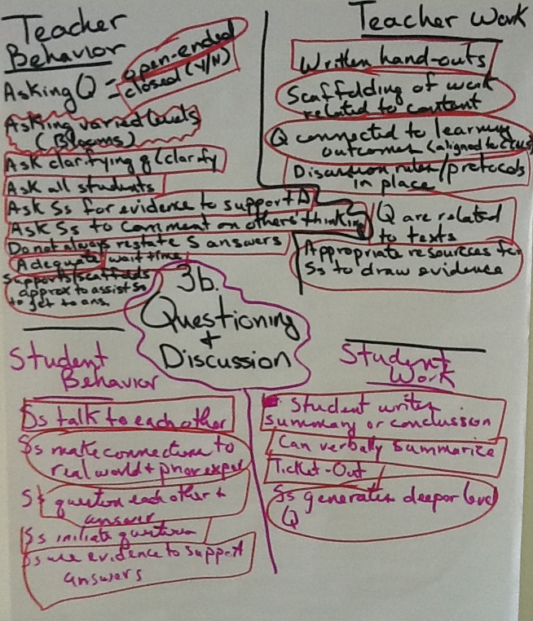
Evidence Collection
Switch with another group, and
Box the objective evidence
Circle subjective evidence
Notes:
NOTES

Slide 12
Evidence Collection
Go back to your group’s chart paper
  Look at what the other group identified as subjective
  Talk about how you could make it more objective
Notes:
NOTES

Slide 13
Evidence Collection
Evidence Collection
Cleaning it up (↑objectivity ↓subjectivity
Practice and process
Going to the rubric (again)
Notes:
NOTES

Slide 14
Evidence Collection
Evidence and a Rubric
  Review Standard IV part of the rubric (all of it)
  What are some of the things you might hope to see in a classroom with regard to this piece of the rubric?
Notes:
NOTES

Slide 15

Evidence Collection
Collect Evidence
  We will use three minute intervals
  Partner processing when we pause with different prompts at each pause:
    How were you collecting your evidence
    Look at each others for subjective/objective
    Quietly, individually record more evidence or organize the evidence that you have
Notes:
NOTES

Slide 16
Evidence Collection
Evidence Collection
Cleaning it up (↑objectivity ↓subjectivity
Practice and process
Collecting some of your evidence for feedback
Notes:
NOTES

Slide 17
Evidence Collection
Evidence and a Rubric
  How did we rate each indicator (PollEverywhere)
  Trainer feedback about each indicator
Notes:
NOTES

Slide 18
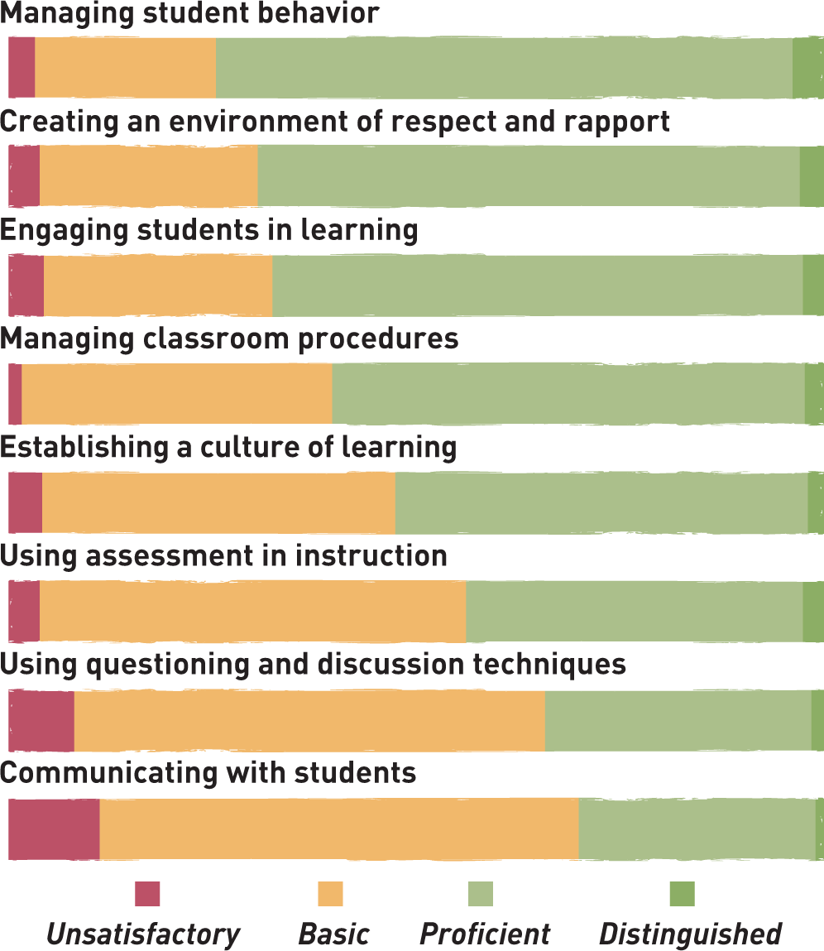

Research
Framework for Teaching

Slide 19
Research
Framework for Teaching
Highest scores for orderly environment
Lowest scores for more complex aspects of instruction

Slide 20
Recent Research
Research
MET Study
Rubrics work
Multiple observers better
Multiple measures better
More than Masters degrees
More than experience
Value-Added Teachers
Even one year makes a difference
By all sorts of measures
  Salary
  College
  Neighborhood
  Teen pregnancy
  Retirement savings

Slide 21
Test Scores Alone
Research
680
670
Achievement scores say more about students than teachers.
2015
2015
Teacher A
Teacher B

Slide 22
Growth
Research
Adding average prior achievement for the same students shows Teacher B’s students had higher growth.
Growth
+25
Growth
+20
680
670
660
645
2014
2015
2015
2014
2015
Teacher A
Teacher B

Slide 23
Value-Added
Research
Comparing growth to the average growth of “similar” students gives teacher A the higher “value-added” result.
Value-
Added
+15 Above
Average
Growth
+20
680
Growth
+25
Value-
Added
AVERAGE
665
670
670
660
645
2015
2014
2015 Avg for similar students
2015 Avg for similar students
2014
2014
2015
Teacher A
Teacher B

Slide 24

Evidence Collection

Slide 25
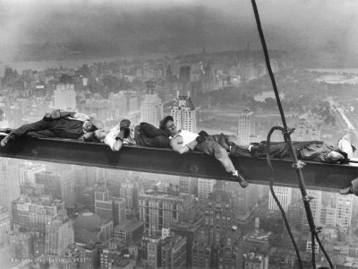
Evidence Collection
Break!
Notes:
NOTES

Slide 26
APPR
20%
Student
Growth
60%
Multiple Measures
20%
Student
Achievement

Slide 27
APPR
Growth over time
Compared to
Expected Growth
Some Variables
Considered
20%
Student
Growth
SLOs Required
60%
Multiple Measures
20%
Student
Achievement

Slide 28
APPR
20%
Student
Growth
60%
Multiple Measures
Moment in time
20%
Student
Achievement
Local or
Purchased
Some Variables
Considered
SLOs Optional

Slide 29
APPR
Knowledge of Students & Student Learning
Knowledge of Content & Instructional Planning
Instructional
Practice
60%
Multiple Measures
Learning
Environment
Assessment for
Student Learning
Professional Responsibilities
and Collaboration
Professional
Growth

Slide 30
APPR
Growth over time
Knowledge of Students & Student Learning
Compared to
Expected Growth
Knowledge of Content & Instructional Planning
Some Variables
Considered
20%
Student
Growth
SLOs Required
Instructional
Practice
60%
Multiple Measures
Learning
Environment
Moment in time
20%
Student
Achievement
Local or
Purchased
Assessment for
Student Learning
Some Variables
Considered
Professional Responsibilities
and Collaboration
SLOs Optional
Professional
Growth

Slide 31
APPR
Growth over time
Compared to
Expected Growth
Some Variables
Considered
20%
Student
Growth
SLOs Required
60%
Multiple Measures

Slide 32
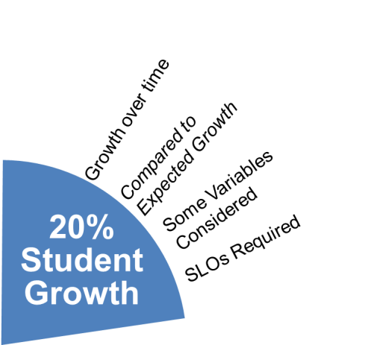
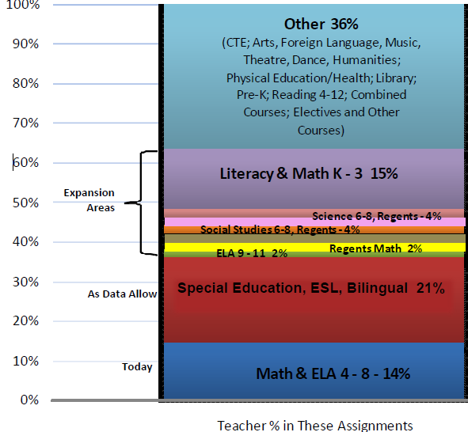
APPR
NO State-provided Growth Score; Use Student Learning Objectives
State-provided Growth Score

Slide 33
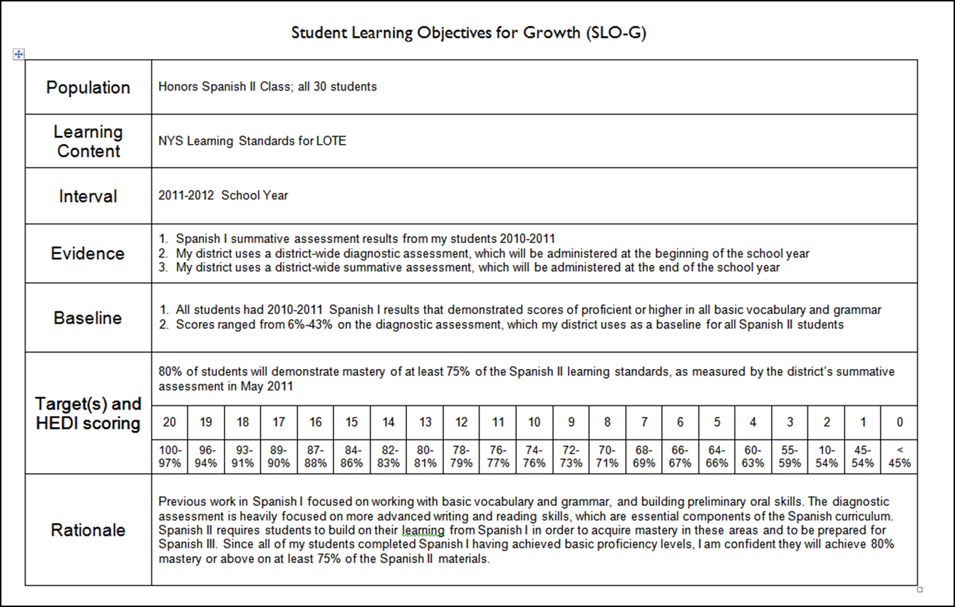
APPR

Slide 34
SLOs
Definition (underline key words):
A student learning objective is an academic goal for a teacher’s students that is set at the start of a course. It represents the most important learning for the year (or, semester, where applicable). It must be specific and measurable, based on available prior student learning data, and aligned to Common Core, State, or National standards, as well as any other school and district priorities. Teachers’ scores are based upon the degree to which their goals were attained.
Notes:
NOTES

Slide 35
Key Points
SLOs
SLOs name what students need to know and be able to do at the end of the year.
SLOs place student learning at the center of the conversation.
SLOs are a critical part of all great educator’s practice.
SLOs are an opportunity to document the impact educators make with students.
SLOs provide principals with critical information that can be used to manage performance, differentiate and target professional development, and focus supports for teachers.
The SLO process encourages collaboration within school buildings.
School leaders are accountable for ensuring all teachers have SLOs that will support their District and school goals.

Slide 36
SLOs
State
Determines SLO process
Identifies required elements
Requires use of State test
Provides training to NTs prior to 2012-13.
Provides guidance, webinars & videos
District
District goals & priorities
Match requirements to teachers
Define processes for before & after
Identify expectations
School
LE & teacher collaborate
LE approval
Ensure security
LE monitor & evaluation
Teacher
Works with colleagues & LE
SLOs

Slide 37
SLO Decisions for Districts
SLOs
Assess and identify priorities and academic needs.
Identify who will have State-provided growth measures and who must have SLOs as “comparable growth measures.”
Determine District rules for how specific SLOs will get set.
Establish expectations for scoring SLOs and for determining teacher ratings for the growth component.
Determine District-wide processes for setting, reviewing, and assessing SLOs in schools.
March 1
April 16
May 30

Slide 38
SLO Decision # 1
SLOs
What are your district priorities?
What are your building priorities?
ELLs achievement
AP participation
SWD achievement
Graduation rate
Achievement gap
ELA? Math? Sci?
Non-fiction writing

Slide 39
SLO Decision # 2
SLOs
Go through the scenarios for different teachers
Teaching Assignment | Is there a State-Provided Growth Score (or is there a state assessment that must be used)? | What (if any) SLOs would have to be employed?
Kindergarten Common Branch
First Grade Common Branch
Third Grade Common Branch
Fourth Grade Common Branch
Fifth Grade Math
Sixth Grade Social Studies
Seventh Grade Science
8th Grade ELA and Social Studies teacher with 100 students Class One: ELA with 35 students Class Two: ELA with 20 students Class Three: SS with 30 students Class Four: SS with 15 students
Science teacher with 110 total students across five sections Two Living Environment (Regents) sections with 20 students each Two Living Environment (non-Regents) with 25 students each One Forensic Science elective with 20 students
7th grade Math and Science teacher with 130 students across 5 sections Two 7th grade Math sections with 30 students each Two 7th grade Science sections with 25 students each One Advances 7th grade Science section with 20 students
Middle school PE teacher with 5 sections and 140 students total 2 sections of 6th grade PE (60 students total) 2 sections of 7th grade PE (50 students total) Section of 8th grade PE (sop students)
High school resource teacher with a total of 25 students 2 groups of 9th grade students 2 groups of 10th grade students 1 group of 11th/12th grade students
K-6 art teacher with a total of 480 students 4 sections of K (80 students) 4 sections of 1st grade (100 students) 4 sections of 2nd grade (100 student) 3 sections of 3rd grade (90 students) 4 sections of 4th grade (110 students)
5th and 6th grade AIS/reading teacher with a total of 80 students 6 groups of 5th grade students who meet every other day (35 students total) 6 groups of 6th grade students (45 students total)
11th grade special education teacher 2 sections of co-taught ELA (class size 20 each with 6 SWD in each) 3 sections of 11th grade resource room (total of 15 students)
K-6 instrumental music teacher 4th grade lessons (30 students who meet once per week in lessons of 3 students each) 5th grade band (35 students who meet every other day) 5th grade lessons (35 students who meet once per week in lessons of 5 students each) 6th grade band (35 students who meet every other day) 6th grade lessons (35 students who meet once per week in lessons of 5 students each)
Middle-level library/media specialist (600 students in school) 5th grade classes (150 students attend library class once per week in 6 groups of 25) 6th – 8th grade students use library as needed or as scheduled in conjunction with teachers.

Slide 40
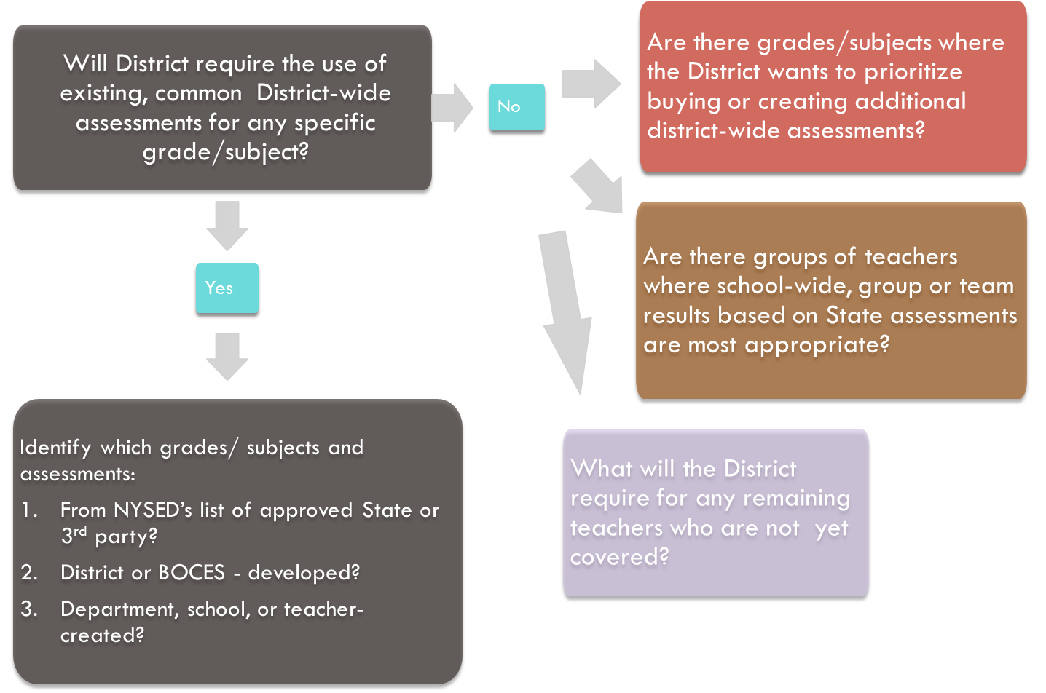
SLO Decision # 3
SLOs

Slide 41
SLO Decision # 4
SLOs
Establish expectations for scoring SLOs and for determining teacher ratings for the growth component.

Slide 42
SLO Decision # 5
SLOs
Determine District-wide processes for setting, reviewing, and assessing SLOs in schools.

Slide 43
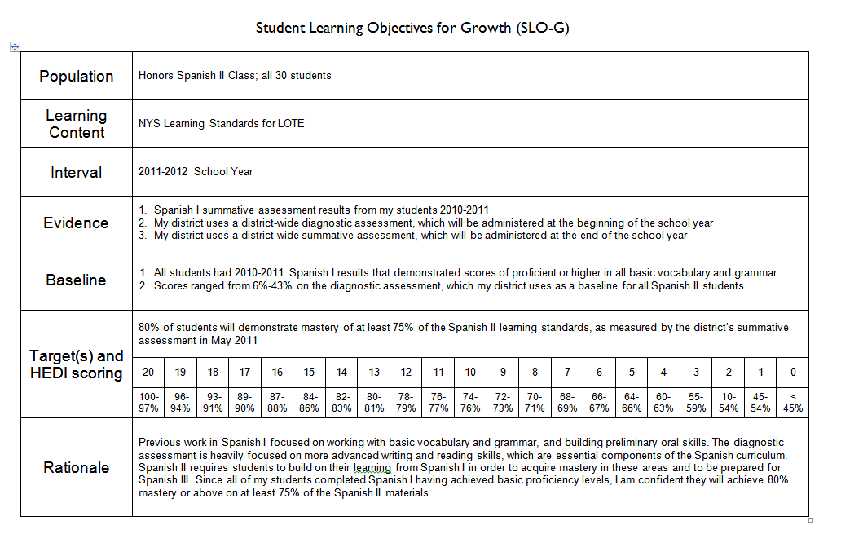
SLOs

Slide 44
SLOs
Population | Four sections of Regents US History (90 students)
Learning Content | NYS Learning Standards for Social Studies (History of the United States and New York, Standard 1)
Interval | 2012-2013 School Year
Evidence | District-wide diagnostic assessment (June 2009 Regents US History Exam), which will be administered at the beginning of the school year Regents US History examination will be used at the end of the year
Baseline | All of the students passed the Global Regents exam the previous year; 35% at mastery level (85% or higher) The average score on the diagnostic assessment (June 2009 Regents) was 74%; 67% of the students scored at least a 65%; 21% of the students scored at least 85%.
Target(s) and HEDI scoring | 50% of the students will score at least an 85% on the Regents exam given at the conclusion of the course.
 | 20 | 19 | 18 | 17 | 16 | 15 | 14 | 13 | 12 | 11 | 10 | 9 | 8 | 7 | 6 | 5 | 4 | 3 | 2 | 1 | 0
 | 100-85% | 80-84% | 75-79% | 70-74% | 65-69% | 60-64% | 55-59% | 50-54% | 55-59% | 51-54% | 50-53% | 49-52% | 45-48% | 41-44% | 35-40% | 30-34% | 25-29% | 20-24% | 15-19% | 10-14% | < 10%
Rationale | Almost all students have historically passed the US History Regents examination. Increasing the number of students who achieve at the mastery in social studies is a school-wide goal. The average number of students scoring at the mastery level on US History for the district has been 50%. Because students have been learning US history for much of their education (4th grade, 5th grade, 7th grade, 8th grade), the use of a past Regents exam was appropriate as a diagnostic assessment.

Slide 45

SLOs
Think about the SLOs; discuss in your table group:
What are your next steps?
What/when/how do you tell teachers?
Notes:
NOTES

Slide 46
Evidence Collection

Slide 47
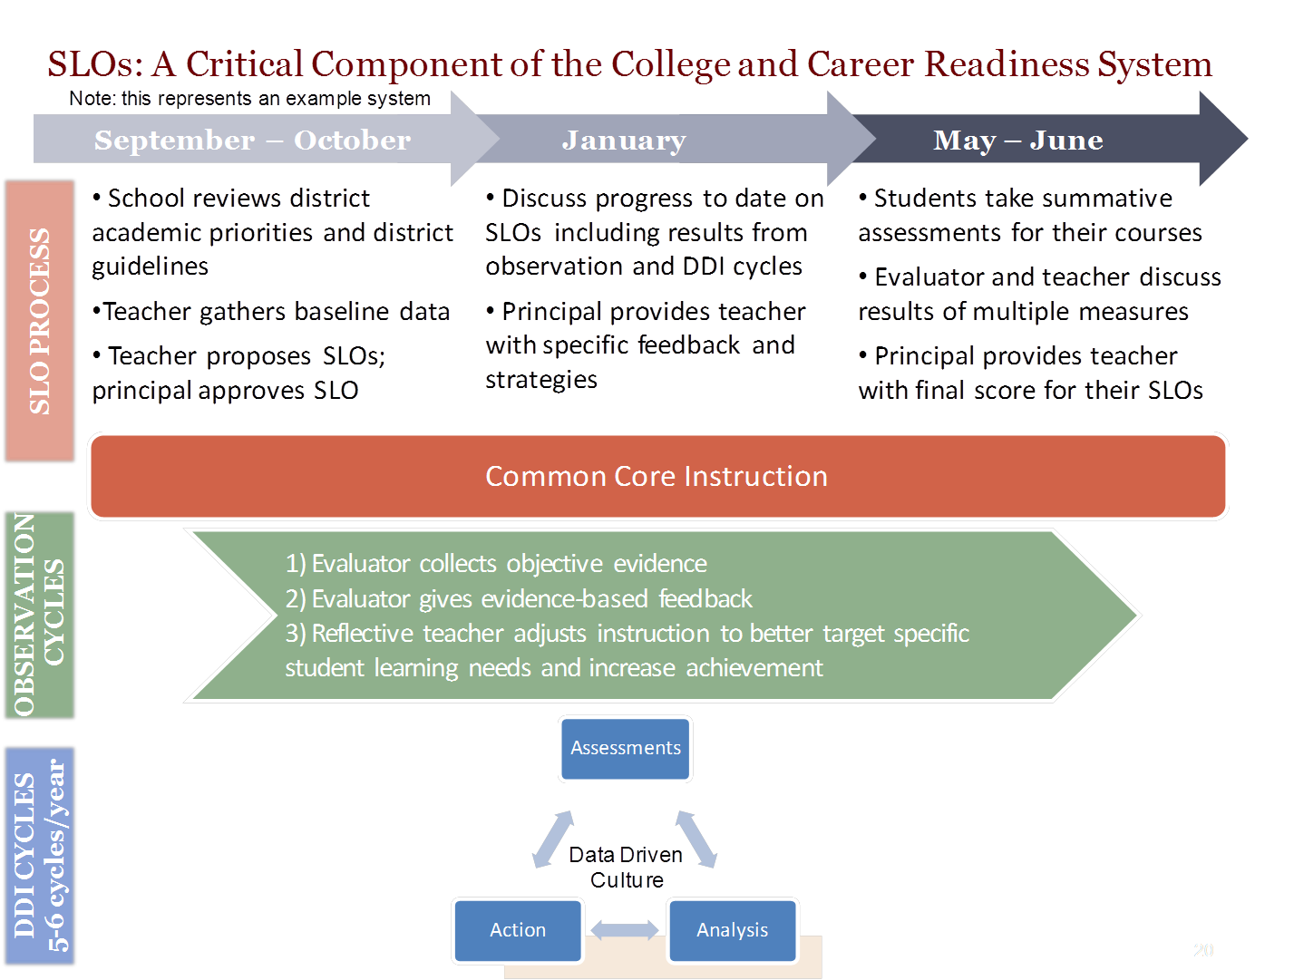
SLOs

Slide 48
Final Connections
Connections
  Lay out the cards, face down
  Turn over any two
  At the table, talk about how the two of them are connected (and then turn over three at a time… four…)

Slide 49
Next Session
Next sessions:
March 13th in Syracuse (AM or PM)
or
March 20th in Cortland (AM or PM)

Slide 50
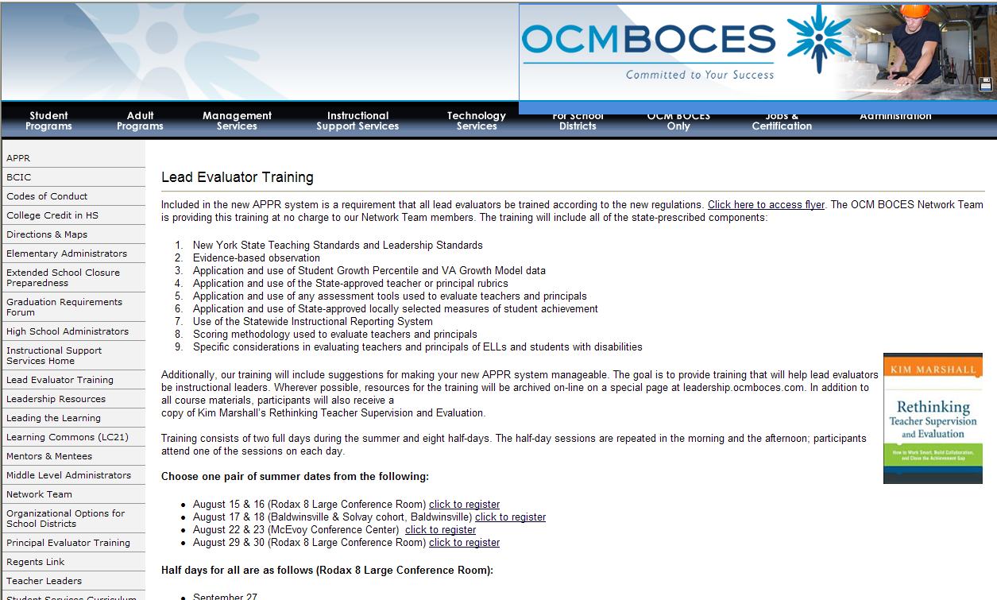
Resources
Resources are archived at the Lead Evaluator Training page off of leadership.ocmboces.org.
Notes:
NOTES

Slide 51
Closure
Questions
Visiting the Parking Lot
3-2-1
Notes:
NOTES

