Slide 1
OCM BOCES
Day 6
Lead
Evaluator
Training
Notes:
NOTES

Slide 2

Day Five Agenda
Lead Evaluator Training continues…
  What have you been up to? Sharing what we’ve done related to this work in the last month.
  Mini-lesson: Six Shifts in Math (finally)
  Getting back to the NYS Teaching Standards
  Collecting evidence at the preconference
  Evidence Collection > Rubric > Feedback
  HW: Seven decision points of mini-observations
  Student Learning Objectives (SLOs)
  Beginning of the year conference
  Picturing the year

Slide 3
Taking Care of Business
Clarifying sign-up for half days:
  As each one approaches we will email you with a link so you can tell us which one is better for you
  The link will also be at the website
  MyLearningPlan is not flexible in this way
Reminder about how listservs work!

Slide 4
Discussion
Checking in:
  What have you tried since we last met?
  Ten minutes for the table, so pace your self
Notes:
NOTES

Slide 5
CCLS Math
Finally! Math!
Notes:
NOTES

Slide 6

CCLS Math
Notes:
NOTES

Slide 7
Six Shifts: Math
CCLS Math
Focus
Coherence
Fluency
Deep Understanding
Applications
Dual Intensity

Slide 8
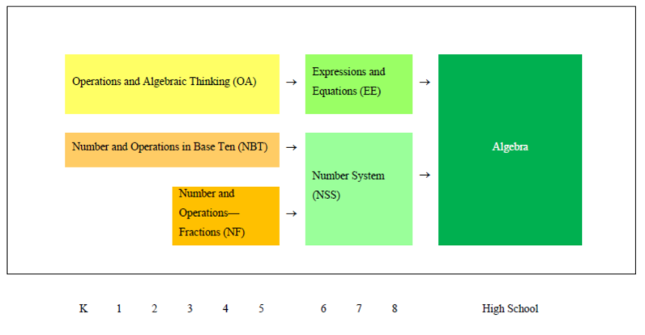
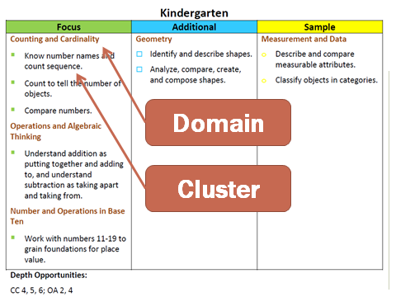

CCLS Math
2. Coherence
1. Focus
5. Application
3. Fluency
4. Deep Understanding
6. Dual Intensity

Slide 9
Habits of Mind:
CCLS Math
Make sense of problems & persevere in solving them.
Reason abstractly and quantitatively.
Construct viable arguments and critique the reasoning of others.
Model with mathematics.
Use appropriate tools strategically.
Attend to precision.
Look for and make use of structure.
Look for and express regularity in repeated reasoning.

Slide 10
Math Practices:
CCLS Math
Make sense of problems & persevere in solving them.
Reason abstractly and quantitatively.
Construct viable arguments and critique the reasoning of others.
Model with mathematics.
Use appropriate tools strategically.
Attend to precision.
Look for and make use of structure.
Look for and express regularity in repeated reasoning.

Slide 11
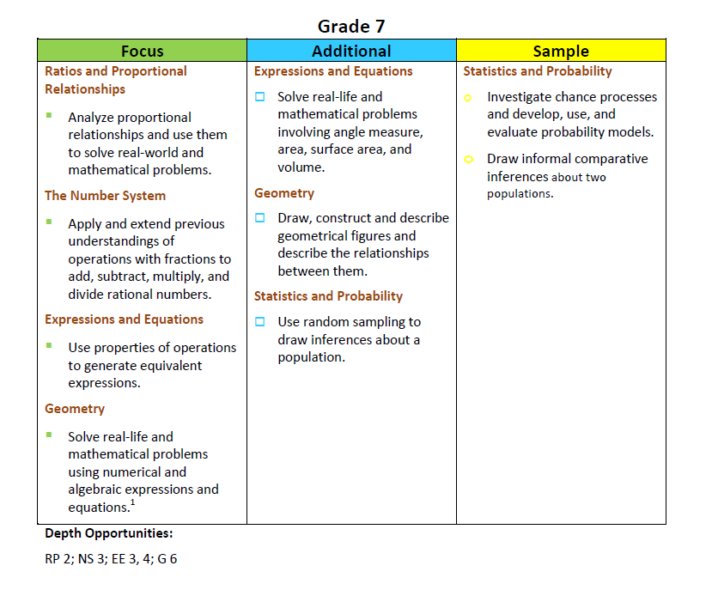
CCLS Math

Slide 12
Unpacking
CCLS Math
K-8 wiki is up
HS unpacking is scheduled:
  MARCH 9 - Unpacking Algebra.
  MARCH 23 - Unpacking Geometry
  MARCH 30 - Unpacking Algebra II

Slide 13
NYS Teaching Standards
As a table group, label the seven pieces of the “pie.”
Notes:
NOTES

Slide 14
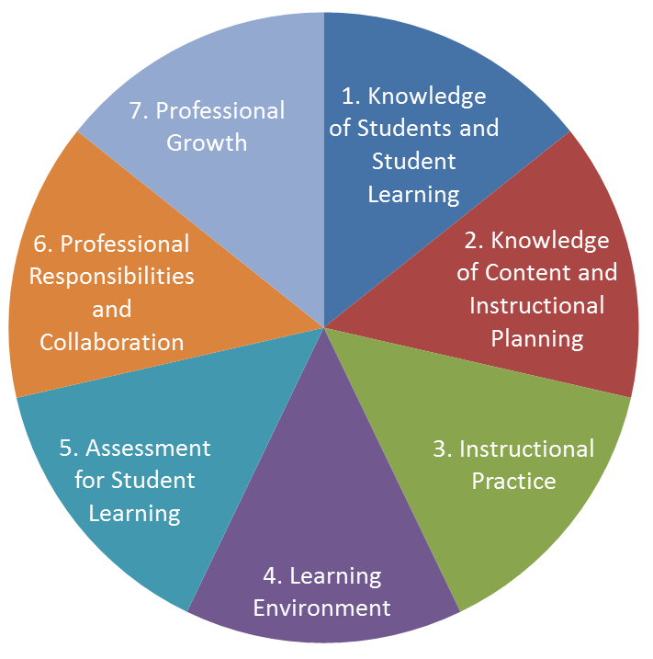
NYS Teaching Standards
Take out the evidence you collected.
Notes:
NOTES

Slide 15
NYS Teaching Standards
Take out the evidence you collected.
For which Standards did you gather evidence?
Notes:
NOTES

Slide 16
NYS Teaching Standards
Take out the evidence you collected.
For which Standards did you gather evidence?
How will you gather evidence for the others?
Notes:
NOTES

Slide 17
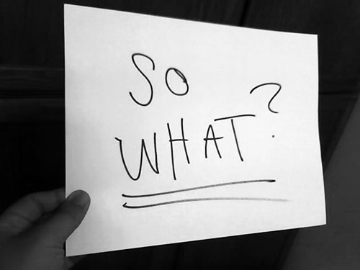
Evidence Collection

Slide 18
PreConferences
Gathering evidence at a preconference meeting
  Prior to the conference, teacher prepares for meeting by reviewing questions
  Teachers brings (electronically submits) lesson plans, maps, scopes and sequences, other artifacts
  Teachers and Lead Evaluator have conversation
  Lead Evaluator collects evidence
Notes:
NOTES

Slide 19
PreConferences
Practice a preconference meeting
  Watch the preconference
  Collect evidence on “Agenda”
Notes:
NOTES

Slide 20
Evidence Collection

Slide 21
The Evidence Cycle
COLLECT
DATA
(Evidence)
SORT TO
ALIGN
WITH YOUR
FRAMEWORK
Interpret:
Clarify
Conclusions
NO!
Impact on learning…
Support needed…
Notes:
NOTES

Slide 22
Evidence Collection
Evidence and a Rubric
  Review Element III part of the rubric (all of it)
  What might be some of the things you might hope to see in a classroom with regard to this piece of the rubric?
Notes:
NOTES

Slide 23

Evidence Collection
Going Through the Process
  Collect evidence ALONE
  Check that it is evidence (fix if needed) PARTNER
  Code it PARTNER
  Sort it ALONE
  Compare to section of the rubric PARTNER and the TABLE
  Determine HEDI for each of the indicators
Notes:
NOTES

Slide 24
Evidence Collection
Evidence and a Rubric
  How did we rate each indicator (PollEverywhere)
  Trainer feedback about each indicator
Notes:
NOTES

Slide 26
Evidence Collection

Slide 27
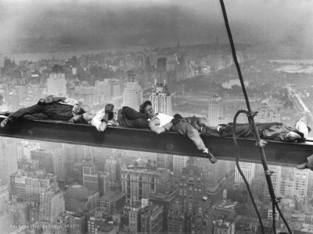
Evidence Collection
Break!
Notes:
NOTES

Slide 28
The Evidence Cycle
Conversation,
Questions &
Discussion
COLLECT
DATA
(Evidence)
Respect &
Rapport
Conclusions
Impact on learning…
Support needed…
Notes:
NOTES

Slide 29
Mini-Observations
Decision Points
  How long to stay in each classroom.
  How to keep up the pace.
  What to look for.
  Whether to take notes during visits.
  How to deliver feedback.
  Whether to give feedback to every teacher.
  Whether to use data from mini-observations in year-end teacher evaluations.
What are the answers to these decisions?
Notes:
NOTES

Slide 30
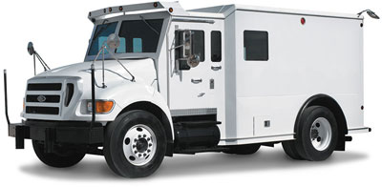
SLOs
The scores arrive…
NYS GROWTH
SCORES
Notes:
NOTES

Slide 31
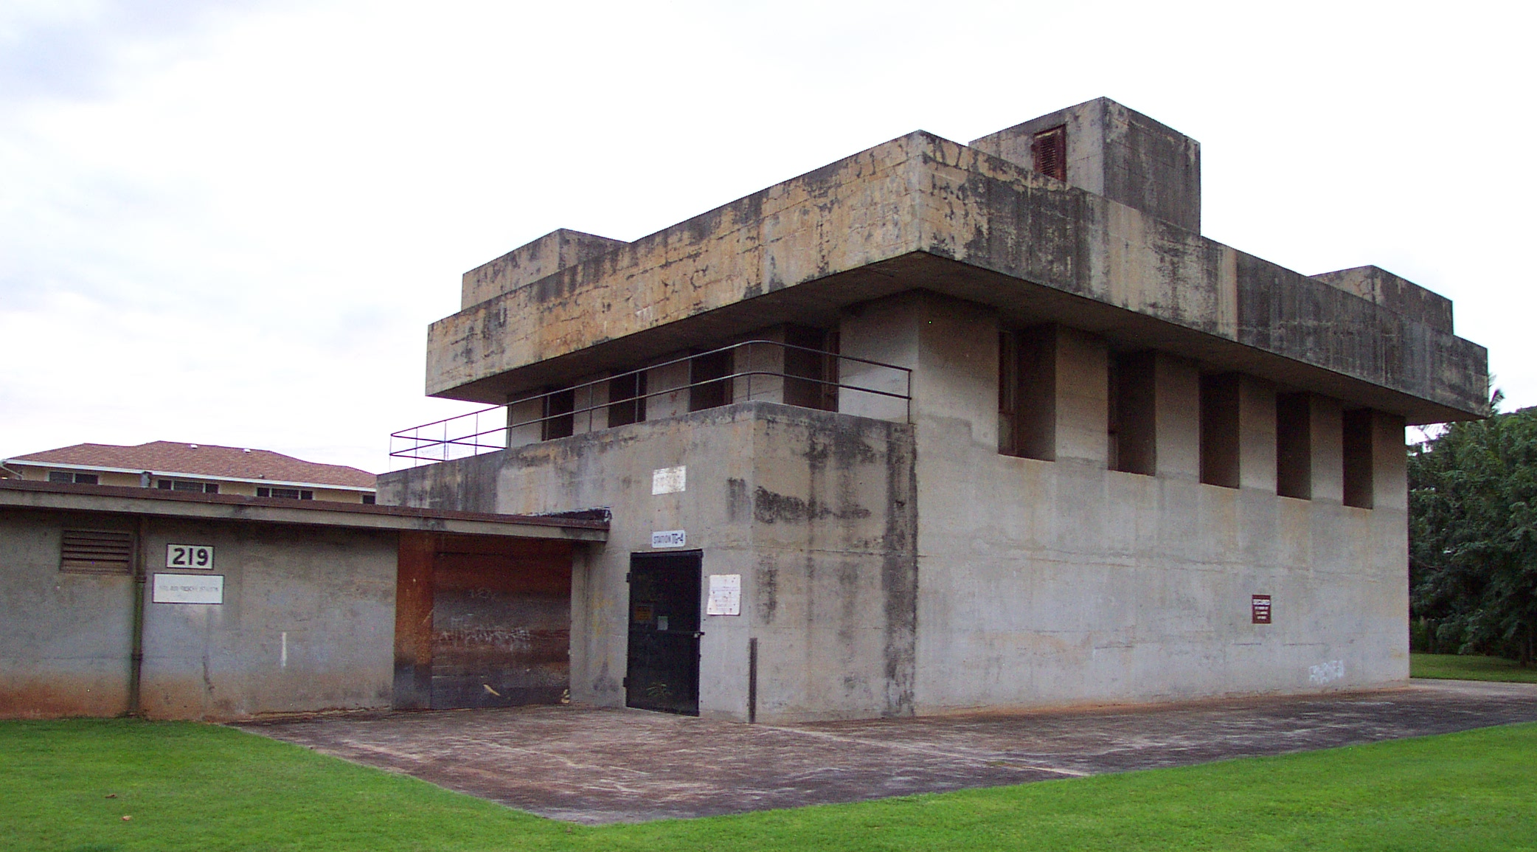
SLOs
The principal receives the results in his office…
Notes:
NOTES

Slide 32
SLOs
SLOs lesson and examples
SLO Template
More to come next time
Notes:
NOTES

Slide 33
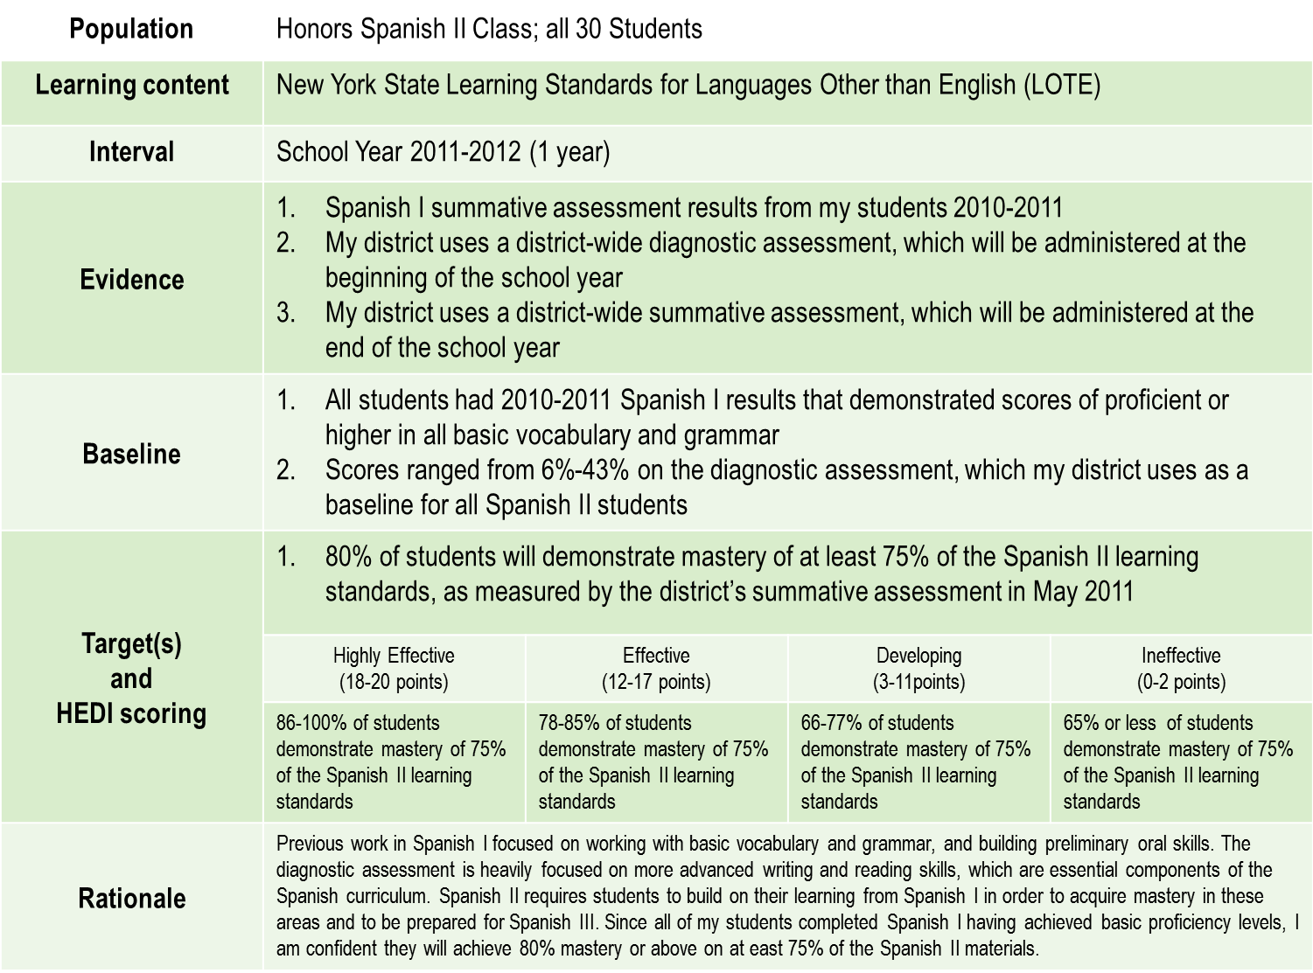

Slide 34
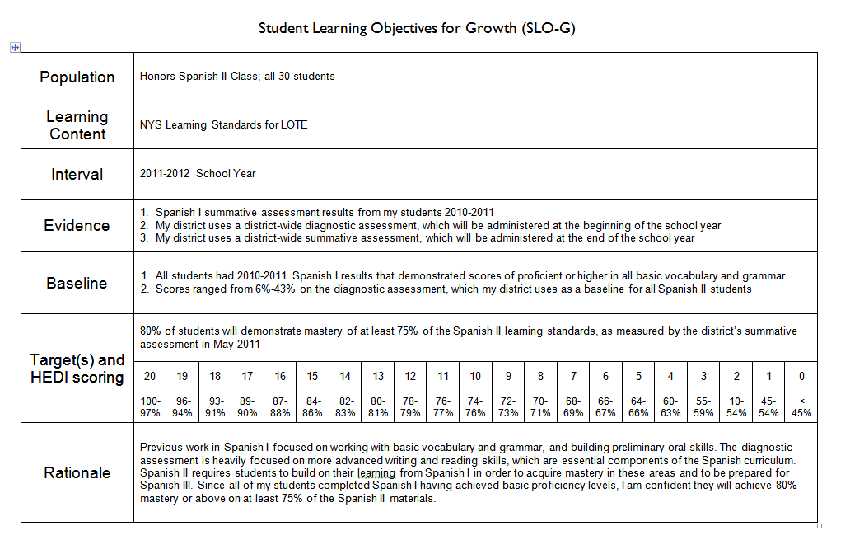
SLOs

Slide 35
Management
The Learning Map
Notes:
NOTES

Slide 36
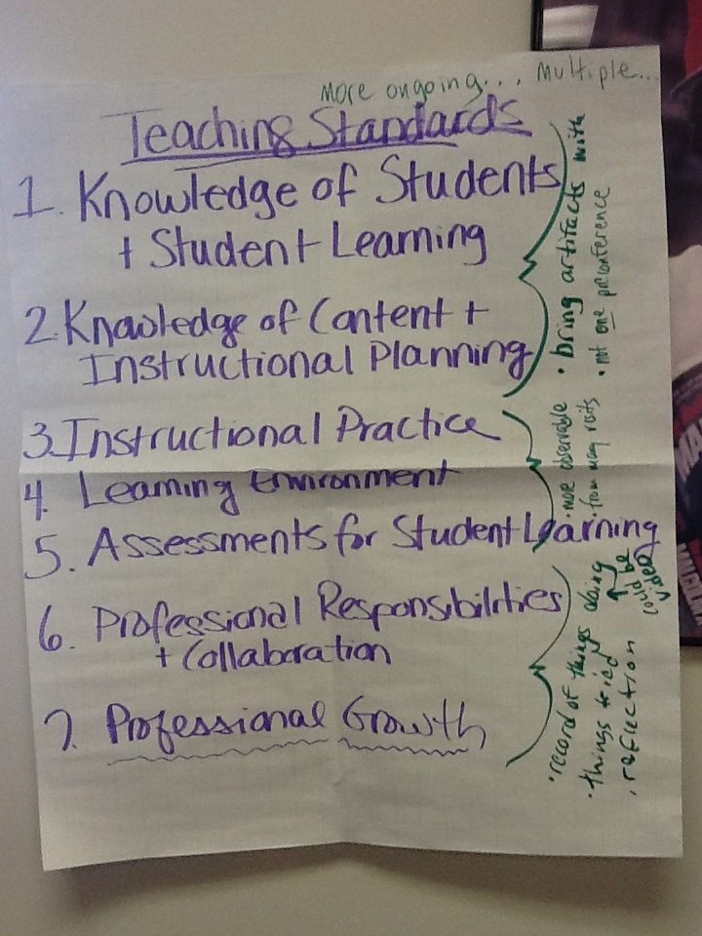
Management
What a year “looks like”
Notes:
NOTES

Slide 37
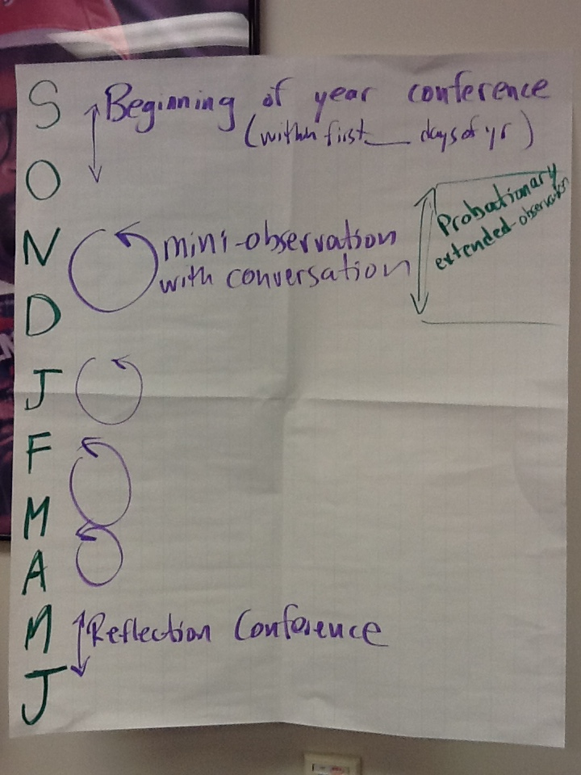
Management
What a year “looks like”
Notes:
NOTES

Slide 38
Evidence Collection
Homework:
Gather evidence, electronically, from a classroom in your school
and
Mini-observations

Slide 39
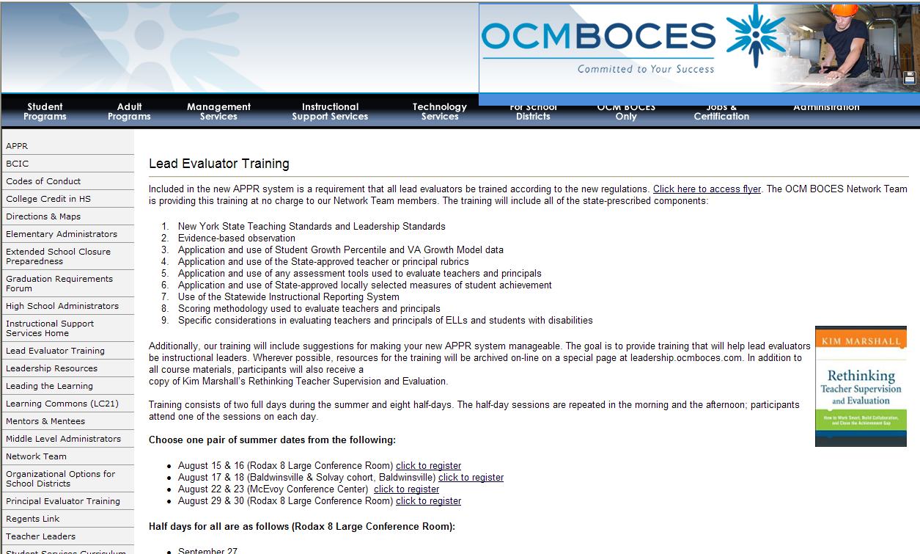
Resources
Resources are archived at the Lead Evaluator Training page off of leadership.ocmboces.org.
Notes:
NOTES

Slide 40
Closure
Questions
Visiting the Parking Lot
+/∆
+
∆
Notes:
NOTES

