Slide 1
OCM BOCES
Day 5
Lead
Evaluator
Training
Notes:
NOTES

Slide 2

Day Five Agenda
Lead Evaluator Training continues…
  What have you been up to? Sharing what we’ve done related to this work in the last month.
  A little more on the Six shifts in ELA/Literacy
  Technical v. Personal
  Observation > Evidence Collection > Label >
  Sort > Rubric
  Another mini-observation and follow-up conversation

Slide 3
Taking Care of Business
Clarifying sign-up for half days:
  As each one approaches we will email you with a link so you can tell us which one is better for you
  The link will also be at the website
  MyLearningPlan is not flexible in this way
Reminder about how listservs work!

Slide 4
Getting Oriented
Warming up:
  Organize the white cards.
Constructivism
Evidence
Collection
Bias
21st Century Skills
Cognitive
engagement
Rubric
Fairness
HEDI
APPR
Observation
Mini
Observation
Reliability
Supervision
Evaluation
Validity
Notes:
NOTES

Slide 5
Getting Oriented
Warming up:
  Now integrate the colored cards into your scheme.
Continuous
Improvement
Feedback
Professional
Development
Risk-taking
Change
Growth
Support
Evaluation
Reflection
Notes:
NOTES

Slide 6

Getting Oriented

Slide 7
A Good Quote
The essential message is not “you are broken and I’m here to fix you” but instead “you are so valuable and worthy, our mission so vital, the future lives of our students so precious, that we have a joint responsibility to each other.”
-Doug Reeves

Slide 8
Mini Lesson
A little bit more about the shifts in ELA…
Notes:
NOTES

Slide 9
Six Shifts: ELA/Literacy
The Six Shifts in ELA
Balancing Informational & Literary Texts (Grades PK-5)
Knowledge in the Disciplines (Grades 6-12)
Staircase of Complexity
Text-based Answers
Writing from Sources
Academic Vocabulary

Slide 10
Staircase of Complexity
Interquartile Ranges Shown (25% - 75%)
1600
1400
1200
Text Lexile Measure (L)
1000
800
600
High
School
Literature
College
Literature
High
School
Textbooks
College
Textbooks
Military
Personal
Use
Entry-Level
Occupations
SAT 1,
ACT,
AP*
* Source of National Test Data: MetaMetrics

Slide 11
ELA/Literacy Shift 1: Balancing Informational and Literary Text
What the Student Does… | What the Teacher Does… | What the Principal Does…
Build background knowledge to increase reading skill Exposure to the world through reading Apply strategies to reading informational text. | Provide students equal #s of informational and literary texts Ensure coherent instruction about content Teach strategies for informational texts Teach “through” and “with” informational texts Scaffold for the difficulties that informational text present to students Ask students, “What is connected here? How does this fit together? What details tell you that? “ | Purchase and provide equal amounts of informational and literacy text to students Hold teachers accountable for building student content knowledge through text Provide PD and co-planning opportunities for teachers to become more intimate with non fiction texts and the way they spiral together
Notes:
This shift involves simply reading more informational text – balancing the amount of literature with informational text. Elementary teachers are the students tour guide to world – to culture, to society. Rather than telling students about what is happening out there, we need to have them read about it. More literary non fiction, more information being conveyed through writing. Less fiction. Less telling and summarizing by the teacher.

Slide 12
ELA/Literacy Shift 2: 6-12 Knowledge in the Disciplines
What the Student Does… | What the Teacher Does… | What the Principal Does…
Become better readers by building background knowledge Handle primary source documents with confidence Infer, like a detective, where the evidence is in a text to support an argument or opinion See the text itself as a source of evidence (what did it say vs. what did it not say?) | Shift identity: “I teach reading.” Stop referring and summarizing and start reading Slow down the history and science classroom Teach different approaches for different types of texts Treat the text itself as a source of evidence Teach students to write about evidence from the text Teach students to support their opinion with evidence. Ask : “How do you know? Why do you think that? Show me in the text where you see evidence for your opinion. “ | Support and demand the role of all teachers in advancing students’ literacy Provide guidance and support to ensure the shift to informational texts for 6-12 Give teachers permission to slow down and deeply study texts with students
Notes:
Students must be ready to handle more informational text. In order to do this, teachers must work to build their own skills to deliver this
Instead of “telling” the students information, have them read about it. We all must have a balance of accessing informational text; accessing non-fiction in general. And, all content teachers 6-12, must do this as well. The Common Core is asking that all teachers become reading teachers. For example, instead of telling students about the Civil Rights Movement, teachers find text for them to read about the Civil Rights Movement. The way that content should be delivered is through sources; through texts, through data, through information online.

Slide 13
ELA/Literacy Shift 3: Staircase of Complexity
What the Student Does… | What the Teacher Does… | What the Principal Does…
Read to see what more they can find and learn as they re-read texts again and again Read material at own level to build joy of reading and pleasure in the world Be persistent despite challenges when reading; good readers tolerate frustration | Ensure students are engaged in more complex texts at every grade level Engage students in rigorous conversation Provide experience with complex texts Give students less to read, let them re-read Use leveled texts carefully to build independence in struggling readers More time on more complex texts Provide scaffolding Engage with texts w/ other adults Get kids inspired and excited about the beauty of language | Ensure that complexity of text builds from grade to grade. Look at current scope and sequence to determine where/how to incorporate greater text complexity Allow and encourage teachers to build a unit in a way that has students scaffold to more complex texts over time Allow and encourage teachers the opportunity to share texts with students that may be at frustration level
Notes:
Students must be reading in all content areas. Increasingly complex texts throughout P-12. The Common Core is often defining grade level text complexity as texts that are 2-3 grade levels more complex than the current grade level texts in school so that they are actually prepared to access the complexity they encounter in careers and college. Appendix B of the Common Core State Standards includes a list of texts that model levels of complexity for every grade level. This is an important portion of standards and should be reviewed.

Slide 14
ELA/Literacy Shift 4: Text Based Answers
What the Student Does… | What the Teacher Does… | What the Principal Does…
Go back to text to find evidence to support their argument in a thoughtful, careful, precise way Develop a fascination with reading Create own judgments and become scholars, rather than witnesses of the text Conducting reading as a close reading of the text and engaging with the author and what the author is trying to say | Facilitate evidence based conversations with students, dependent on the text Have discipline about asking students where in the text to find evidence, where they saw certain details, where the author communicated something, why the author may believe something; show all this in the words from the text. Plan and conduct rich conversations about the stuff that the writer is writing about. Keep students in the text Identify questions that are text-dependent, worth asking/exploring, deliver richly, Provide students the opportunity to read the text, encounter references to another text, another event and to dig in more deeply into the text to try and figure out what is going on. Spend much more time preparing for instruction by reading deeply. | Allow teachers the time to spend more time with students writing about the texts they read- and to revisit the texts to find more evidence to write stronger arguments. Provide planning time for teachers to engage with the text to prepare and identify appropriate text-dependent questions. Create working groups to establish common understanding for what to expect from student writing at different grade levels for text based answers. Structure student work protocols for teachers to compare student work products; particularly in the area of providing evidence to support arguments/conclusions.
Notes:
Students need to develop the ability to engage in rich, evidence-based dialogue about a text they have read. Having students have conversations about text and teachers’ facilitation of these conversations, requires a higher level of sophistication for both teachers and students. Rather than the quicker connections between text and self, teachers must now train students to stay in the text, to draw conclusions and make arguments about the text and do so through the text itself. Teachers will often be asking, “where do you see that in the text? What paragraph? What sentence? What word?” students must begin to think and argue through and with texts by constantly being asked to find evidence in what they have read.

Slide 15
ELA/Literacy Shift 5: Writing from Sources
What the Student Does… | What the Teacher Does… | What the Principal Does…
Begin to generate own informational texts | Expect that students will generate their own informational texts (spending much less time on personal narratives) Present opportunities to write from multiple sources about a single topic. Give opportunities to analyze, synthesize ideas across many texts to draw an opinion or conclusion. Find ways to push towards a style of writing where the voice comes from drawing on powerful, meaningful evidence. Give permission to students to start to have their own reaction and draw their own connections. | Build teacher capacity and hold teachers accountable to move students towards informational writing
Notes:
This is evidence based WRITING about texts. We are shifting away from an overemphasis on narrative writing because it is a skill not often demanded by career and college. What IS demanded by career and college is to synthesize and react to what we have read. Therefore, the Common Core asks that students, across content areas, are being asked to interact with and make arguments through sources – texts, data, etc. Students must be trained to use the evidence they collect from what they read in order to form cogent and convincing argument in the text they produce.

Slide 16
ELA/Literacy Shift 6: Academic Vocabulary
What the Student Does… | What the Teacher Does… | What the Principal Does…
Spend more time learning words across “webs” and associating words with others instead of learning individual, isolated vocabulary words. | Develop students’ ability to use and access words that show up in everyday text and that may be slightly out of reach Be strategic about the kind of vocabulary you’re developing and figure out which words fall into which categories- tier 2 vs. tier 3 Determine the words that students are going to read most frequently and spend time mostly on those words Teach fewer words but teach the webs of words around it Shift attention on how to plan vocabulary meaningfully using tiers and transferability strategies | Provide training to teachers on the shift for teaching vocabulary in a more meaningful, effective manner.
Notes:
What the Common Core is asking of us is to consistently develop students ability to use and access words that are showing up in everyday vocabulary but that are slightly out of reach for our students.
It is really about giving students the right tools. There are certain words that are great tools as the students will see them in lots of context; when they read, across different disciplines etc. There are other words that are interesting and may come up in certain areas; content specific words like “amoeba;” or there are other words that are sort of esoteric and interesting but they are not words that students will confront frequently as they read.
It is important to be strategic about the kind of vocabulary we are teaching. We need to consider what category these words fall in to.
Isabel Beck talks about Tier I words as very common words, Tier 2 as words that are powerfully useful and frequently occurring and Tier 3 as domain-specific words. The challenge is in figuring out which words are Tier 2 words and which words to teach. This takes careful planning.
it is important to understand the nuances between words, people tend to over rely on synonyms – i.e.. happy and pleased. The author makes a choice between these words. To identify these Tier 2 words it is important to understand what the author is conveying and also to know what words are really going to occur most frequently.
Regarding synonyms, fewer words may be taught but also teach the web of words around them. The goal is for the students to not only know the words as a reader, but invest in the words as a writer.

Slide 17
Mini Lesson
100%:
% of your staff who have heard of the Common Core but not the 6 shifts in ELA/Literacy | % of your staff who have had an introduction to the 6 shifts in ELA/Literacy and been told that it applies to them in some way | % of your staff who have internalized that the 6 shifts in ELA/Literacy require some amount of change in their practice | % of your staff who have started to do something about the 6 shifts in ELA/Literacy when it comes to their planning and instruction | % of your staff who embraced the 6 shifts and who are regularly making changes to their planning and instruction
What is your next step(s)?
Notes:
NOTES

Slide 18
Evidence Collection

Slide 19
Rubrics
Rubric as Road Maps
  Identify your destination
  Identify your current location
  Design the best route to your destination and move forward
  NOT as inspection tools
Notes:
NOTES

Slide 20
The Evidence Cycle
COLLECT
DATA
(Evidence)
SORT TO
ALIGN
WITH YOUR
FRAMEWORK
Interpret:
Clarify
Conclusions
NO!
Impact on learning…
Support needed…
Notes:
NOTES

Slide 21

Teacher Evaluation
Three “Gates” for Effective Teacher Evaluation
Fairness
Reliability
Validity
Notes:
NOTES

Slide 22
Evidence Collection
Evidence and a Rubric
  Review the a part of the rubric (3.2)
  What might be some of the things you might hope to see in a classroom with regard to this piece of the rubric?
Notes:
NOTES

Slide 23

Evidence Collection
Going Through the Process
  Collect evidence ALONE
  Check that it is evidence (fix if needed) PARTNER
  Code it PARTNER
  Sort it ALONE
  Compare to section of the rubric PARTNER and the TABLE
Notes:
NOTES

Slide 24
Evidence Collection
Evidence and a Rubric – REPEAT!
  Review the a part of the rubric (4.2)
  What might be some of the things you might hope to see in a classroom with regard to this piece of the rubric?
Notes:
NOTES

Slide 25
Evidence Collection
Going Through the Process
  Collect evidence ALONE
  Check that it is evidence (fix if needed) PARTNER
  Code it PARTNER
  Sort it ALONE
  Compare to section of the rubric PARTNER and the TABLE
Notes:
NOTES

Slide 26
Evidence Collection

Slide 27
Feedback
Conversations
  Do a mini-observation
  Collect Evidence
  Prepare your thoughts for your follow-up conversation with the teacher. Make sure you have your opening line ready!
  Role-play the conversation.
  Repeat.
Notes:
NOTES

Slide 28
Evidence Collection
Homework:
Gather evidence, electronically, from a classroom in your school
Bring it to our January 10 & 13 Lead Evaluator Training
and
Try a cycle of 4 mini-observations
and
Think about inviting us to do some mini-observations with you in you school!

Slide 29
The Evidence Cycle
Conversation,
Questions &
Discussion
COLLECT
DATA
(Evidence)
Respect &
Rapport
Conclusions
Impact on learning…
Support needed…
Notes:
NOTES

Slide 30
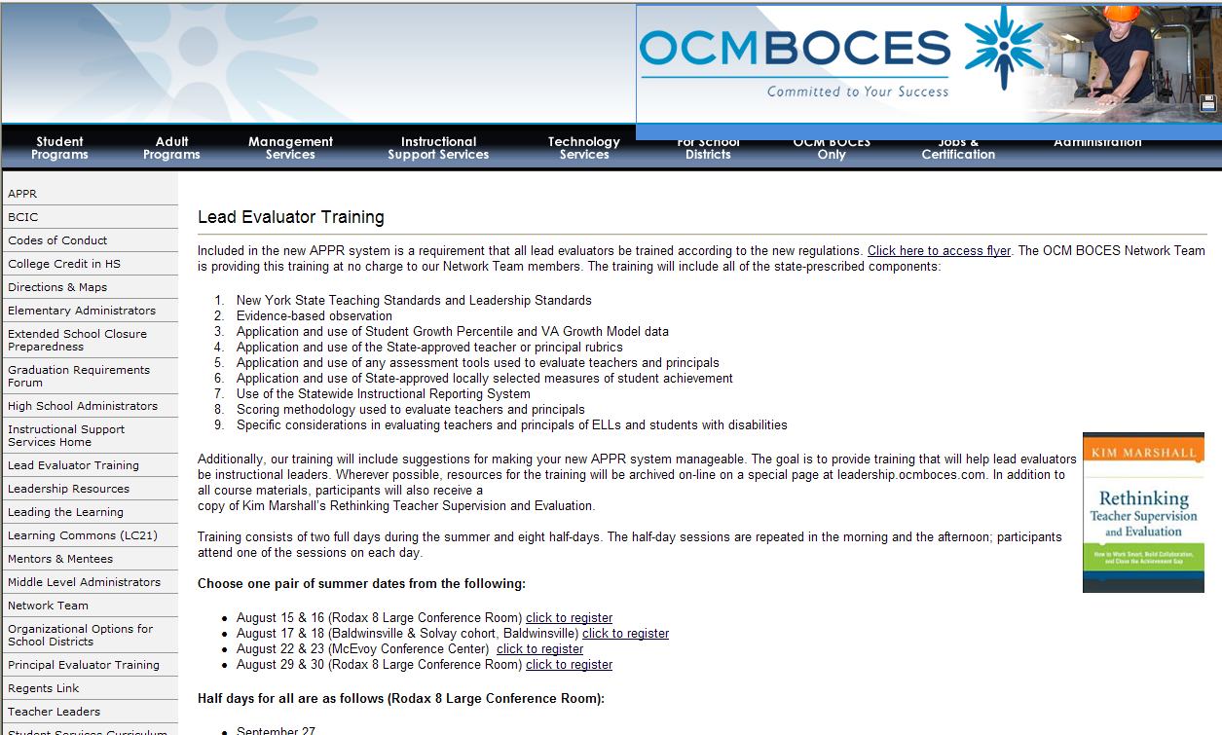
Resources
Resources are archived at the Lead Evaluator Training page off of leadership.ocmboces.org.
Notes:
NOTES

Slide 31

Closure
Questions
On-line feedback survey coming…
Notes:
NOTES

