Slide 1
OCM BOCES
Day 4
Lead
Evaluator
Training
Notes:
NOTES

Slide 2

Day Four Agenda
Lead Evaluator Training continues…
  What have you been up to? Sharing what we’ve done related to this work in the last month.
  More on the Six shifts in ELA/Literacy
  Your Evidence collection
  Evidence collection and a rubric
  Managing mini-observations
  Growth-Producing Feedback

Slide 3
Taking Care of Business
Clarifying sign-up for half days:
  As each one approaches we will email you with a link so you can tell us which one is better for you
  The link will also be at the website
  MyLearningPlan is not flexible in this way
Reminder about how listservs work!

Slide 4
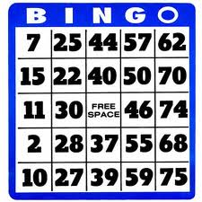
Taking Care of Business
Lead Evaluator Bingo
  Listen for the words or terms on your BINGO card
  Cross of those things you hear in the training
  Shout “LEAD EVALUATOR BINGO” when you have a BINGO
  Turn in your card at the end of the session for grand prize drawing
Notes:
NOTES

Slide 5
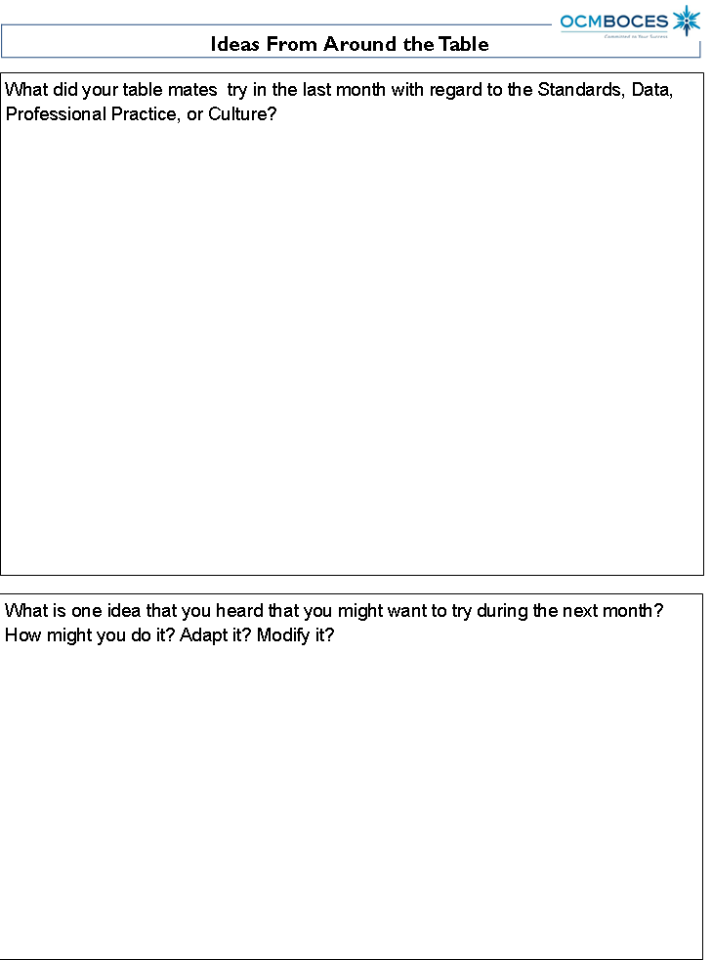
Discussion
Checking in:
  What have you tried since we last met?
  Ten minutes for the table, so pace your self
  Use the organizer to take notes of the table conversation
Notes:
NOTES

Slide 6
Background Information
NYSUT’S TED:
  Teacher Evaluation and Development
  Handbook and Workbook
  Similar to SED’s recommended training
  Some differences, however:
    Begins with self-reflection process
    Defines multiple measures as more than one traditional observation cycle (no mention of mini-observations)
    Implies that goal-setting is a requirement for a significant amount of points
    Implies that anything is appealable
    Cautions against school-wide measures

Slide 7
Mini Lesson
Six Shifts in math POSTPONED until next month.
Instead, more on ELA/Literacy Shifts:
  A quick look at an engageNY video
  Publishers criteria has more info
  November issue of NTnews distributed
  Before/after examples of the shifts
Notes:
NOTES

Slide 8
Six Shifts: ELA/Literacy
The Six Shifts in ELA
Balancing Informational & Literary Texts (Grades PK-5)
Knowledge in the Disciplines (Grades 6-12)
Staircase of Complexity
Text-based Answers
Writing from Sources
Academic Vocabulary
Notes:
Use Common Core Shifts ELA/Literacy: Planner in conjunction. Participants read through the expanded explanations of the shifts. Encourage discussion around the language used & what these shifts might mean in individual schools/districts.

Slide 9


Pre-CCLS
Core Text
SHIFT 1
Balancing Informational and Literary Texts
SHIFT 2
Building Knowledge in the Disciplines
Notes:
Pre-CCLS: A unit of study might be based on one core fictional text and exhibit an inclusive focus on just the one text (i.e., Class, for the next few weeks, we will be reading and studying The Odyssey). Outside (other) text references are brief in nature and not included in the original unit plans, often offered as on-the-spot examples to help further explain, support, or identify the sole work being studied.

Slide 10


Post-CCLS
Core Texts
SHIFT 1
Balancing Informational and Literary Texts
SHIFT 2
Building Knowledge in the Disciplines
Paired Texts: The Hero’s Journey
Notes:
Post-CCLS: A unit utilizing paired texts of both fiction and nonfiction are given (fairly) equal billing in the study of a larger, key theme (the hero’s journey as opposed to The Odyssey). This balance of texts provides students with practice reading different text structures as well as opportunities to learn about the subject matter in the discipline (The Hero with the Thousand Faces provides a detailed history of the hero’s journey via a comprehensive analysis of myths throughout the ages).

Slide 11
Pre-CCLS
SHIFT 3
Staircase of Complexity
Refusal of the Call
Often when the call [to adventure] is given, the future hero refuses to heed it. This may be from a sense of duty or obligation, fear, insecurity, a sense of inadequacy, or any of a range of reasons that work to hold the person in his or her current circumstances.
Notes:
Pre-CCLS: This might be a typical text-book explanation for one piece of the hero’s journey. The text is not particularly demanding in terms of understanding the concept.

Slide 12
Post-CCLS
SHIFT 3
Staircase of Complexity
Refusal of the Call
Often in actual life, and not infrequently in the myths and popular tales, we encounter the dull case of the call unanswered; for it is always possible to turn the ear to other interests. Refusal of the summons converts the adventure into its negative. Walled in boredom, hard work, or "culture," the subject loses the power of significant affirmative action and becomes a victim to be saved. His flowering world becomes a wasteland of dry stones and his life feels meaningless—even though, like King Minos, he may through titanic effort succeed in building an empire of renown. Whatever house he builds, it will be a house of death: a labyrinth of cyclopean walls to hide from him his Minotaur. All he can do is create new problems for himself and await the gradual approach
of his disintegration.
Excerpt from The Hero with a Thousand Faces
Notes:
Post-CCLS: When confronted with the increased demands of text complexity required by the CCLS, one can quickly see the difference in what students would need to understand reading this as to what they needed to understand the text in the previous slide. Excerpted from the core text The Hero of a Thousand Faces, this text requires a skill set that includes figurative language, visual imagery, inferencing, prior knowledge of well-known myths, vocabulary usage, etc. that were not as evident or prevalent in the previous slide.

Slide 13
Pre-CCLS
SHIFT 4
Text-based Answers
Question:
What reasons might a hero use to refuse the call to adventure?
Refusal of the Call
Often when the call [to adventure] is given, the future hero refuses to heed it. This may be from a sense of duty or obligation, fear, insecurity, a sense of inadequacy, or any of a range of reasons that work to hold the person in his or her current circumstances.
Notes:
Pre-CCLS: Students would not necessarily need to read a specific text in order to answer these questions. Currently posed, students’ answers would be based on prior knowledge and experiences with the concepts of “mythology” and “hero”. The CCLS requires students to base answers upon what a text says or doesn’t say. Personal connections and prior knowledge are acceptable as long as the text under study remains the focus of their analysis.
A text-based question/answer for Slide 21: What reasons might a hero use to refuse the call to adventure? Students could list the reasons (referencing the text, but not learning from the text)

Slide 14
Post-CCLS
SHIFT 4
Text-based Answers
Question:
What fate awaits the (future) hero who refuses the call to adventure?
Use specific examples from the text to support your answer.
Refusal of the Call
Often in actual life, and not infrequently in the myths and popular tales, we encounter the dull case of the call unanswered; for it is always possible to turn the ear to other interests. Refusal of the summons converts the adventure into its negative. Walled in boredom, hard work, or "culture," the subject loses the power of significant affirmative action and becomes a victim to be saved. His flowering world becomes a wasteland of dry stones and his life feels meaningless—even though, like King Minos, he may through titanic effort succeed in building an empire of renown. Whatever house he builds, it will be a house of death: a labyrinth of cyclopean walls to hide from him his Minotaur. All he can do is create new problems for himself and await the gradual approach
of his disintegration.
Excerpt from The Hero with a Thousand Faces
Notes:
Post-CCLS: Questions are planned with the text in mind, requiring students to go beyond the literal to more in-depth analysis of the text under discussion while building knowledge in the content (author’s craft in using symbolism & explanation of the complex story structure of the hero’s journey). Students must cite specific references and examples from the text, but can still build meaning for themselves by considering the text through the lens of introspection.
Text-based question/answer for Slide 22: What fate awaits the (future) hero who refuses the call to adventure? Use specific examples from the text to support your answer. Posed in this manner, a student would have to first determine the negative impact & then isolate examples to support their answer.

Slide 15
Pre-CCLS
Pre-CCLS
What is a mythological hero?
Are you a hero?
SHIFT 4
Text-based Answers
(Text-dependent questions)
Notes:
Pre-CCLS: Students would not necessarily need to read a specific text in order to answer these questions. Currently posed, students’ answers would be based on prior knowledge and experiences with the concepts of “mythology” and “hero”. The CCLS requires students to base answers upon what a text says or doesn’t say. Personal connections and prior knowledge are acceptable as long as the text under study remains the focus of their analysis.
A text-based question/answer for Slide 21: What reasons might a hero use to refuse the call to adventure? Students could list the reasons (referencing the text, but not learning from the text)

Slide 16
Post-CCLS
Post-CCLS
In The Odyssey, how does the author’s use of symbolism complement the hero’s journey? How did this specific technique impact you as a reader of this text?
As you read The Lost City of Z, mark any passages or sentences which exemplify elements of the hero’s journey. How do your choices illustrate the hero’s journey? What questions do they raise for you?
SHIFT 4
Text-based Answers
(Text-dependent questions)
Notes:
Post-CCLS: Questions are planned with the text in mind, requiring students to go beyond the literal to more in-depth analysis of the text under discussion while building knowledge in the content (author’s craft in using symbolism & explanation of the complex story structure of the hero’s journey). Students must cite specific references and examples from the text, but can still build meaning for themselves by considering the text through the lens of introspection.
Text-based question/answer for Slide 22: What fate awaits the (future) hero who refuses the call to adventure? Use specific examples from the text to support your answer. Posed in this manner, a student would have to first determine the negative impact & then isolate examples to support their answer.

Slide 17
Pre-CCLS
SHIFT 5
Writing from Sources
Write about a time you had to make a difficult decision. Describe the situation and the heroic qualities you exhibited.
Notes:
Pre-CCLS: This writing prompt requires no text association for the students in order to answer. The new CCLS requires proficient and rigorous analysis of texts in writing.
With the emphasis on close reading of text and students’ ability to respond to those texts, writing tasks or prompts will need to reflect this change. Students will be required to use the text flexibly to not only support arguments, but to inform as well. Narrative writings are still required, but take on a less prominent role in the CCLS as students progress through the grades.

Slide 18
SHIFT 5
Writing from Sources
Post-CCLS
Write a critical essay in which you discuss The Odyssey and The Lost City of Z from the perspective provided in the Critical Lens. In your essay:
Provide a valid interpretation of the statement.
Agree or disagree with the statement as you’ve interpreted it.
Support your opinion using specific references from the two works listed above.
Critical Lens
Nothing is given to man on earth – struggle is built into the nature of life, and conflict is possible - the hero is the man who lets no obstacle prevent him from pursuing the values he has chosen.
Notes:
Post-CCLS: The writing prompt for this unit requires students to demonstrate their understanding of the hero’s journey by specifically referring to the texts studied.
With the emphasis on close reading of text and students’ ability to respond to those texts, writing tasks or prompts will need to reflect this change. Students will be required to use the text flexibly to not only support arguments, but to inform as well. Narrative writings are still required, but take on a less prominent role in the CCLS as students progress through the grades.

Slide 19
Pre-CCLS
Pre-CCLS
Archetype
Epic Poetry
Mythology
Odyssey
SHIFT 6
Academic Vocabulary
Notes:
Pre-CCLS: Vocabulary selections for the The Odyssey would focus specifically on Tier 3 words with little to no direct instruction of Tier 2 words.
Tier 3 (domain specific) vocabulary are often well-supported instructionally as they are the key concepts and/or terms students need to access the content. Hence, class time is dedicated to the direct instruction of such words. Due to other factors (mostly a lack of time and uncertainty of which words to select), many Tier 2 words (those non-domain specific words, not well-defined through context) are not adequately identified for direct instruction. Students, therefore, are left to figure these words out on their own often minimizing their understanding of the text.

Slide 20
Post-CCLS
Tier 3 Words
Archetype
Epic Poetry
Mythology
Odyssey
Tier 2 Words
Summons
Affirmative
Titanic
Disintegration
SHIFT 6
Academic Vocabulary
Notes:
Post-CCLS: Continuing with the Hero’s Journey unit, an increase in attention to the direct instruction of Tier 2 words (in addition to Tier 3 words) is expected.
With a shift in the text expectations, so too comes a shift in the vocabulary instruction students must receive. Text selections from primary sources or authentic texts often do not demonstrate a level of text cohesion one might find in a heavily scaffolded textbook. As a result, equal attention to those words exhibiting the characteristics of Tier 2 Words is required so that students can better access i.e., understand and attend to the increased demands of the text.

Slide 21

Mini Lesson
Think about this activity; discuss in your table group:
Would you do this activity with teachers?
What would it accomplish?
Notes:
NOTES

Slide 22
Evidence Collection
How did your homework go?
  Make eye contact with someone across the room who you don’t know very well
  Introduce yourselves
  Share your evidence and process with each other
  Discuss with your partner how the process worked for you
  What did you learn about yourself and the process that will inform how you proceed in the future?
Notes:
NOTES

Slide 23
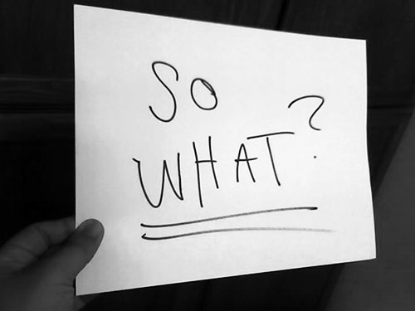
Evidence Collection
Notes:
We have to make sure we chart these pieces of “evidence” for use later!!!

Slide 24
Evidence Collection
Evidence and a Rubric
  Individually, use the evidence at the bottom of the page to identify levels on the rubric (3.2)
  Debrief with your elbow partner? How did it go?
Notes:
NOTES

Slide 25

Evidence Collection
How did your homework go?
  Mini-observation evidence gathering
  Take a look at one example “under development”
  Volunteers from group to share something that worked for them
Notes:
NOTES

Slide 26
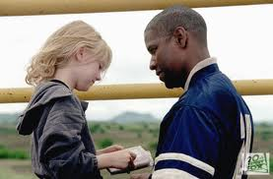
Feedback
Qualities of Growth-Producing Feedback?
  From Man on Fire, what are
  the qualities of
  Growth-Producing Feedback?
  Take a look at
  Paula Rutherford’s list
  Check out a teacher-principal
  conversation
Notes:
NOTES

Slide 27


Feedback
Checking in with Kim
  Read what Kim has to say about feedback to teachers
  Discuss as a table group: how does his advice compare to your experiences at a cycle?
Page 80
Notes:
NOTES

Slide 28
Feedback
Conversations
  Form a triad
  Each person gets a different colored half-sheet
  Prepare your opening line (30 seconds)
  First triad member says opening line to the two others
  Two others give first person feedback
  Repeat the process until everyone in the group has gone
Notes:
NOTES

Slide 29
Feedback
Conversations
  Do a mini-observation
  Collect Evidence
  Prepare your thoughts for your follow-up conversation with the teacher. Make sure you have your opening line ready!
  Role-play the conversation.
  Repeat.
Notes:
NOTES

Slide 30
The Evidence Cycle
Conversation,
Questions &
Discussion
COLLECT
DATA
(Evidence)
Respect &
Rapport
Conclusions
Impact on learning…
Support needed…
Notes:
NOTES

Slide 31
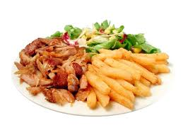
Evidence Collection
Same Homework:
Gather evidence, electronically, from a classroom in your school
Bring it to our October 27th Lead Evaluator Training
and
Try a cycle of 4 mini-observations.
Yes, this seems like a lot of
homework. But it is our job.

Slide 32
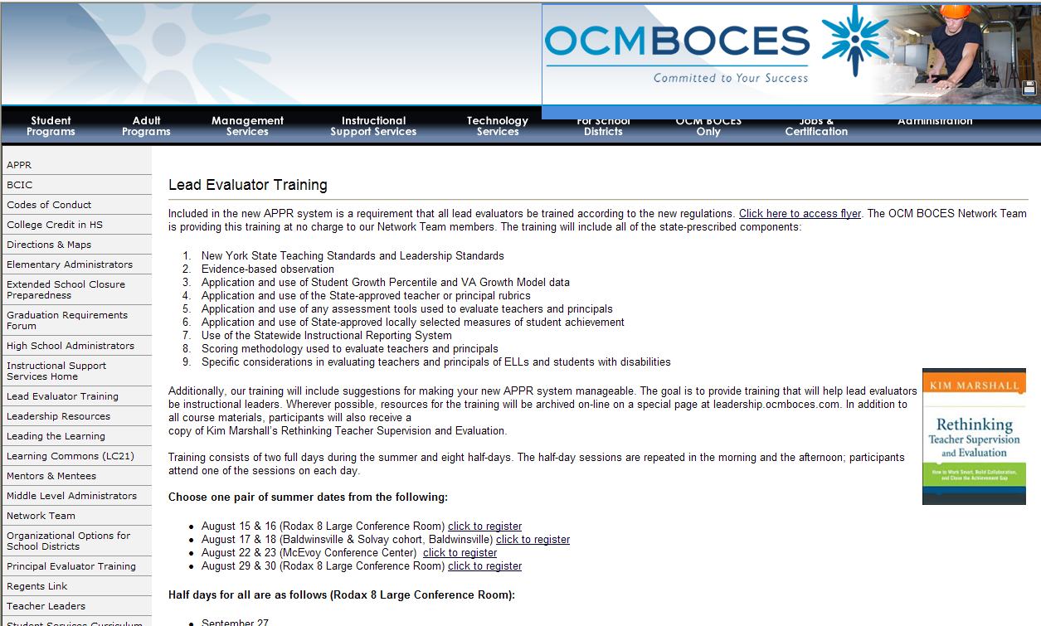
Resources
Resources are archived at the Lead Evaluator Training page off of leadership.ocmboces.org.
Notes:
NOTES

Slide 33

Closure
Questions
Visiting the Parking Lot
Hits, Misses, and Suggestions
Notes:
NOTES

