Slide 1
OCM BOCES Day 1 & 2
Lead
Evaluator
Training
Notes:
NOTES

Slide 2
Day Three Agenda
Lead Evaluator Training continues…
What have you been up to? Sharing what we’ve done related to this work as a new year began.
Six shifts in ELA/Literacy mini-lesson
Evidence collection
Managing mini-observations
More evidence collection

Slide 3
Day Three Agenda
Clarifying sign-up for half days:
As each one approaches we will email you with a link so you can tell us which one is better for you
The link will also be at the website
MyLearningPlan is not flexible in this way
Reminder about how listservs work!

Slide 4
Discussion
Starting of the year:
What did you do this year to start things off?
Ten minutes for the table, so pace your self
Record ideas on the 5x8 index card (neatly)
At the opening day meeting we…
Notes:
NOTES

Slide 5
Discussion
Notes:
NOTES

Slide 6
Mini Lesson
Six Shifts in ELA: SO WHAT?
PK-5: Balancing Informational & Literary Texts (50-50)
6-12: Building Knowledge in the Disciplines
Staircase of Complexity
Text-base answers
Writing from sources
Academic vocabulary
Notes:
NOTES

Slide 7
Mini Lesson
Six Shifts in ELA: SO WHAT?
Notes:
NOTES

Slide 8
Unit Planning
The Commissioner says:
"This year, I’m asking every teacher to try at least one Common Core-aligned unit each semester.
ELA teachers will provide a thoughtful learning experience around a particular text that should result in students’ ability to make an argument about that text.
Math teachers should select one of the priority concepts at the strategic expense of other, less critical topics and go deep in a way they haven’t before.
Content area teachers can fulfill the “Literacy” aspect of this transformation by providing similar learning experiences built around pivotal texts in their subject area"
Notes:
NOTES

Slide 9
Evidence Collection
Before we collect evidence form a classroom, some review:
The three priorities of the Teaching Standards and the rubrics
NYS Teaching Standards
Evidence Collection
Bias

Slide 10
Evidence Collection
Each of the four group members chose one of the four:
The three priorities of the Teaching Standards and the rubrics
NYS Teaching Standards
Evidence Collection
Bias
You have two minutes to prepare a one-minute elevator speech about your item.
Conduct fast-paced reporting out (one minute limit)

Slide 11
Evidence Collection
Observe what the teacher and the students are doing in this lesson
Collect evidence electronically; be prepared to share your evidence.

Slide 12
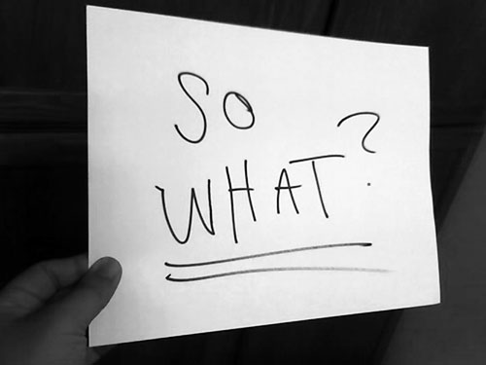
Evidence Collection
Report out an item or two of evidence
Label it by NYS Teaching Standard (as a group Sort it together
Make some observations about our sorted evidence: so what?
Notes:
We have to make sure we chart these pieces of “evidence” for use later!!!

Slide 13
Day Three Agenda
Break! During the break, check out some of the ideas you colleagues have tried so far this year on the “wall.”
Notes:
NOTES

Slide 14
The Evidence Cycle
COLLECT DATA
(Evidence)
SORT TO
ALIGN
WITH YOUR
FRAMEWORK
Interpret:
Clarify
Conclusions
NO!
Impact on learning…
Support needed…
Notes:
NOTES

Slide 15
The Evidence Cycle
Conversation, Questions & Discussion
COLLECT DATA
(Evidence)
Respect & Rapport
Conclusions
Impact on learning…
Support needed…
Notes:
NOTES

Slide 16
Evidence Collection
Jigsaw!
Turn to page 46 in Marshall.
Each of six group members chooses a section:
An Idea is Born
Mini-Observations Take Off
Developing a Style
Keeping Track of Visits
Keeping it Up
Closing the Loop with Teachers
Page 46
Notes:
Groups of six work better for this

Slide 17
Evidence Collection
Jigsaw!
Share out what you read in your section
Follow the chronology in the book:
An Idea is Born
Mini-Observations Take Off
Developing a Style
Keeping Track of Visits
Keeping it Up
Closing the Loop with Teachers

Slide 18
Evidence Collection
Kim’s essential elements of mini-observations:
Being organized and systematic about getting into all classrooms on a regular basis
Not announcing visits in order to get a representative sampling of teachers’ work
Keeping visits to five to ten minutes in order to boost frequency and observe each teacher at least every two or three weeks
Giving prompt, thoughtful, face-to-face feedback to the teacher after every observation
Making visits and follow-up informal and low-stakes to maximize adult learning

Slide 19
Evidence Collection
The benefits of mini-observations (as Kim sees it):
Get an accurate sense of the quality of instruction students are experiencing on a daily basis
See students in an instructional setting and get to know their strengths and needs
Get to know teachers better, both as instructors and as people
Develop “situational awareness” – having a finger on the pulse of the school’s culture and climate

Slide 20
Evidence Collection
The benefits of mini-observations (as Kim sees it):
Build trust, the lubricant of effective schools
Identify teachers who are having difficulty so they can get additional support
Develop a de-bureaucratized, informal style that facilitates collegial learning
Be well-informed for meetings with the leadership team, teacher teams, and parents

Slide 21
Evidence Collection
The benefits of mini-observations (as Kim sees it):
Gather lots of data for end-of-year teacher evaluations

Slide 22
Evidence Collection
The benefits of mini-observations (as Kim sees it):
Gather lots of data for end-of-year teacher evaluations

Slide 23
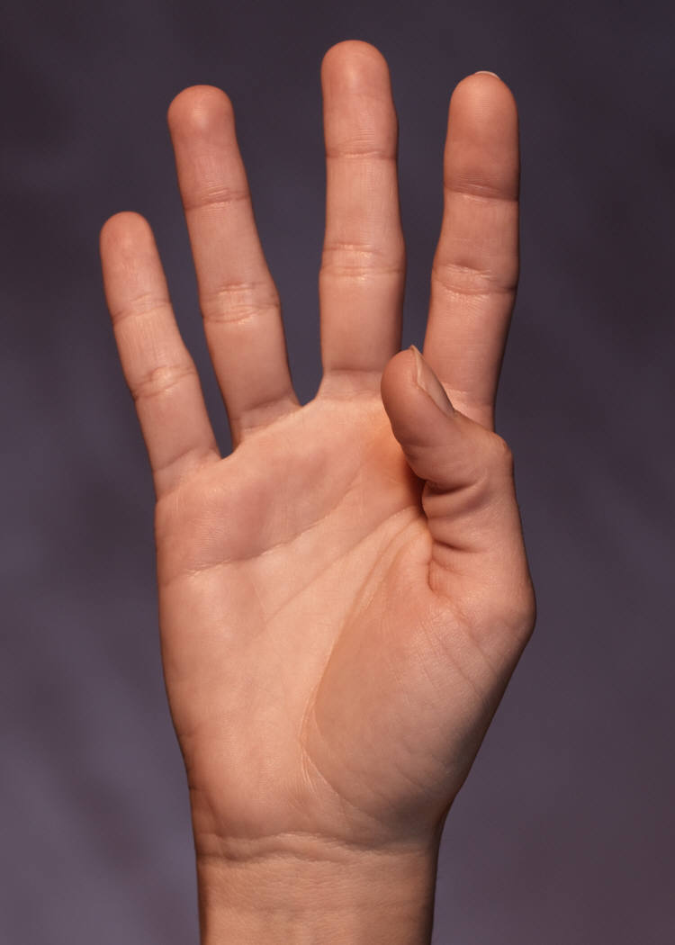
Evidence Collection

Slide 24
Evidence Collection
# of teachers you have _____
÷ by the # of administrators you have
= _____
÷ by 4
= the number of days for a cycle in your building

Slide 25
Evidence Collection

Slide 26
Evidence Collection
What is it going to take?
Must have a goal
Make it a numerical target (not fuzzy)
Make it realistic
How will you record and keep track of your notes?
What do you have to do with your schedule, routines, style, etc. in order to build this into your day?

Slide 27
Evidence Collection
Record evidence, electronically, from another classroom.
Label it by NYS Teaching Standard. Sort it.
Make some observations about the sorted evidence: so what?
Notes:
We have to make sure we chart these pieces of “evidence” for use later!!!

Slide 28
Evidence Collection
Make some observations about you and the sorted evidence.
Notes:
We have to make sure we chart these pieces of “evidence” for use later!!!

Slide 29
Evidence
Review: Why is this important?
We are human beings and we bring with our own lenses and experience and biases.
There’s no chance at fairness, reliability and validity unless we can observe things similarly, from classroom to classroom and school to school and district to district
Notes:
NOTES

Slide 30
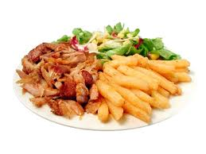
Evidence Collection
Homework:
Gather evidence, electronically, from a classroom in your school
Bring it to out October 27th Lead Evaluator Training
and
Try a cycle of 4 mini-observations.
Yes, this seems like a lot of homework. But it is our job.

Slide 31
Resources
Resources are archived at the Lead Evaluator Training page off of leadership.ocmboces.org.
Notes:
NOTES

Slide 32
Closure
Questions
Visiting the Parking Lot
+/∆
+
∆
Notes:
NOTES

