Slide 1
OCM BOCES Day 10 (year one)
Lead
Evaluator
Training
Notes:
NOTES

Slide 2
Taking Care of Business
April’s session was cancelled due to the change in calendar. An “independent study” was not sent to you.
We encourage you to:
Review special considerations for SWDs
Review special considerations for ELLs

Slide 3
Day Ten Agenda
Lead Evaluator Training continues…
Look ahead to next year
Summative evaluation with the rubric
Beginning of the year/SLO meetings
Making a strategy for next year

Slide 4
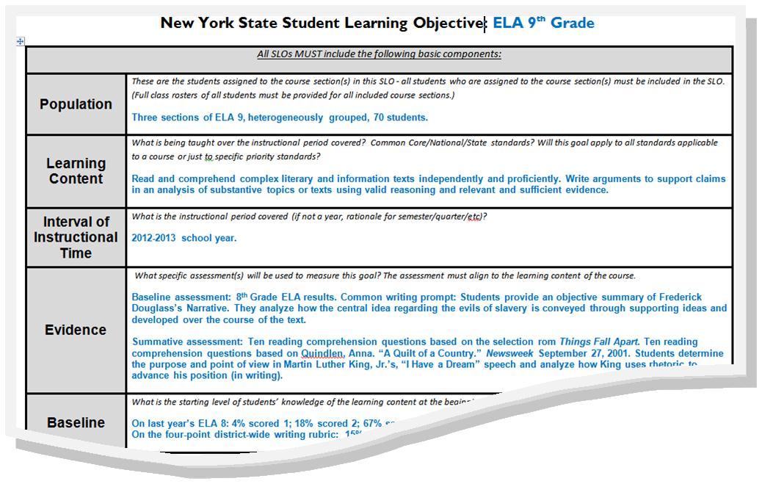
Day Ten Agenda
But first…
Review of SLO Resources
Introduce LATs
SLO Q and A

Slide 5
Next Year
Look Ahead to Next Year
Talk through the year
With your elbow partner or as a table group, sketch or map out the big pieces of APPR for next year

Slide 6
Next Year
Look Ahead to Next Year
Talk through the year
With your elbow partner or as a table group, sketch or map out the big pieces of APPR for next year
Open up the bag of cards, add each term to your sketch/map of next year

Slide 7
Next Year
Look Ahead to Next Year
Talk through the year
With your elbow partner or as a table group, sketch or map out the big pieces of APPR for next year
Open up the bag of cards, add each term to your sketch/map of next year
Have this out as we proceed through the rest of the agenda

Slide 8
Next Year
Beginning of the Year
Beginning of the year meeting
Standards I and II
SLO and local (LAT) target setting

Slide 9
Next Year
Guiding Questions:
Beginning of the Year
Beginning of the year meeting
Standards I and II
SLO and local (LAT) target setting
As a table group, identify the questions you might ask during the meeting

Slide 10
Next Year
Guiding Questions:
Beginning of the Year
Beginning of the year meeting
Standards I and II
SLO and local (LAT) target setting
As a table group, identify the questions you might ask during the meeting
Watch it “live”
Debrief

Slide 11
Evidence Collection

Slide 12
Next Year
Beginning of the Year
Beginning of the year meeting
Standards I and II
SLO and local (LAT) target setting
As a table group, identify the questions you might ask during the meeting
Watch it “live”
Debrief
New Conversations: Growth Producing Feedback

Slide 13
Next Year
Most of the Year
Evidence Submission by Teacher
Evidence Collection
Sharing the evidence
Feedback Conversations
New Conversations: Growth Producing Feedback

Slide 14
Evidence Collection

Slide 15
Next Year
Summative Evaluation
Evidence from the year collected
Compare collected evidence to the rubric

Slide 16
Next Year
Summative Evaluation
Evidence from the year collected
Compare collected evidence to the rubric
Teacher and Lead Evaluator do together with teacher?
Lead Evaluator completed it prior to meeting and review together?
Teacher and Lead Evaluator do rubric independently prior to meeting
Discuss these options.

Slide 17
Next Year

Slide 18
Next Year
Summative Evaluation
Evidence from the year collected
Compare collected evidence to the rubric
Teacher and Lead Evaluator do together with teacher?
Lead Evaluator completed it prior to meeting and review together?
Teacher and Lead Evaluator do rubric independently prior to meeting
New Conversations: Growth Producing Feedback

Slide 19
Next Year
Look Ahead to Next Year - MORE
Go back to your picture
Talk through the year
Start to add some dates and a timeline to it
What are the “new” pieces?
What are the deadlines you will face?
What strategy will you employ?
Jot things down on the organizer
Growth Producing Feedback

Slide 20
Taking Care of Business
Ongoing Lead Evaluator Training
Next year (tentatively)
Four half-days of training distributed across year
and, optionally,
“Growth Producing Feedback” course
2 summer days to prepare for beginning of year
1 fall day to prepare for generic
1 spring day to prepare for summative meetings

Slide 21
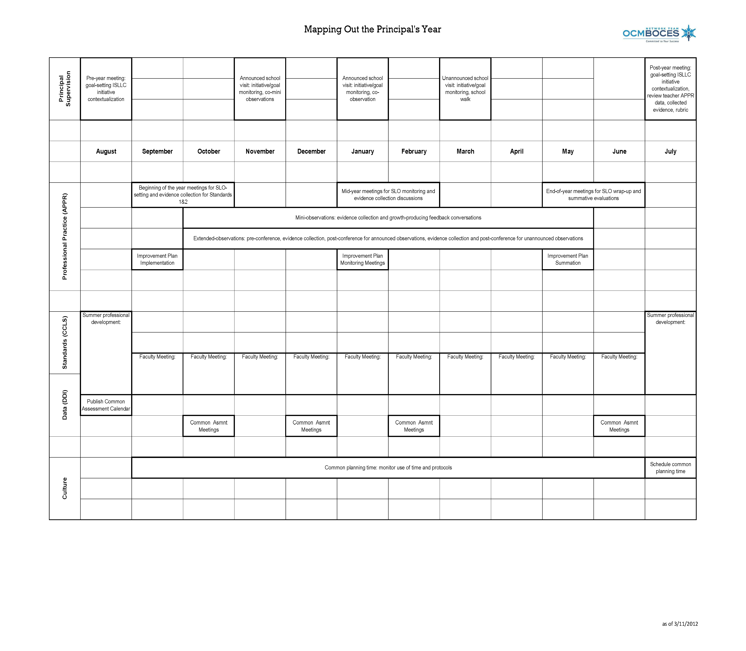
Next Year
Looking at Next Year
Notes:
NOTES

Slide 22
LE “Certification”
The Nine Required Components
New York State Teaching Standards and Leadership Standards
Evidence-based observation
Application and use of Student Growth Percentile and VA Growth Model data
Application and use of the State-approved teacher or principal rubrics
Application and use of any assessment tools used to evaluate teachers and principals
Notes:
NOTES

Slide 23
LE “Certification”
The Nine Required Components
Application and use of State-approved locally selected measures of student achievement
Use of the Statewide Instructional Reporting System
Scoring methodology used to evaluate teachers and principals
Specific considerations in evaluating teachers and principals of ELLs and students with disabilities
Notes:
NOTES

