Slide 1
Lead Evaluator Training
2015-2016
Final Session

Slide 2
Agenda
What You Need
Research Update
Evidence Collection
SLO Summative Help
Summative Evaluation
Growth-Producing Feedback
The Start of the Second Half
Notes:
Review the agenda.

Slide 3
Lead Evaluator Training
Year 1
New York State Teaching Standards and Leadership Standards
Evidence-based observation
Application and use of Student Growth Percentile and VA Growth Model data
Application and use of the State-approved teacher or principal rubrics
Application and use of any assessment tools used to evaluate teachers and principals
Application and use of State-approved locally selected measures of student achievement
Use of the Statewide Instructional Reporting System
Scoring methodology used to evaluate teachers and principals
Specific considerations in evaluating teachers and principals of ELLs and students with disabilities
Notes:
These are the “nine” official goals of Lead Evaluator Training.

Slide 4
Lead Evaluator Training
Ongoing
From the Review Room: “Describe the process by which evaluators will be trained and the process for how the district will certify and re-certify lead evaluators. Describe the process for ensuring
inter-rater reliability. Describe the duration and nature of such training.”
Notes:
This is where ongoing training is mentioned in the Review Room.

Slide 5
Lead Evaluator Training
Ongoing
Continue to collect evidence
Use collected evidence to rate teachers on a rubric (with feedback)
Manage the new system
Employ growth-producing feedback to increase the quality of teaching
Implement the Reform Agenda (RTTT)
Notes:
Our local goals for Lead Evaluator Training, in addition to the required components.

Slide 6
Lead Evaluator Training
Ongoing
Continue to collect evidence
Use collected evidence to rate teachers on a rubric (with feedback)
Manage the new system
Employ growth-producing feedback to increase the quality of teaching
Implement the Reform Agenda (RTTT)
Notes:
Our local goals for Lead Evaluator Training, in addition to the required components.

Slide 7


Slide 8
Warm-Up

Slide 9
What’s One Thing…
Think of one thing you did that you feel GOOD about in the last two weeks related to Professional Practice (APPR)
See if you can think of something that you didn’t do LAST year
Each person takes a turn to share

Slide 10
What You Need

Slide 11
What You Need
More scoring practice (with agreement and reliability)
Growth-Producing Feedback
Crucial Conversations
Time Management
Other disciplines and student needs
Future Support

Slide 12
Research Update:
Effective use of Time

Slide 13
Research Brief
“Effective Instructional Time Use for School Leaders: Longitudinal Evidence from Observations of Principals”
Coaching teachers (yet is a relatively rare thing)
Development and involvement in the school’s educational program
Evaluating teachers
Classroom walkthroughs as a defined part of professional development for teachers

Slide 14
Research Brief
Classroom walkthroughs that were conducted just for the sake of presence, without a focus and clearly understood purpose, didn’t contribute to higher student achievement.
Especially true at the high school

Slide 15
Research Brief
Impacts of coaching, walkthroughs, educational program involvement, and walkthroughs are all greatly magnified with systems thinking.
Conversely, these activities perceived as isolated or unconnected activities are negatively associated with student achievement

Slide 16
The Year at a Glance
Beginning of the Year
Ongoing
End of the Year
Beginning of the year meeting
Standards I and II
SLO and
local (LAT) target setting
Evidence Submission by
Teacher
Evidence Collection
Sharing the evidence
Feedback Conversations
Evidence from the year collected
Compare collected evidence to the rubric
Summative score determination and communication

Slide 17
APPR “Transition”
§3012-c and §3012-d
January 2016
Slides updated 1.24.16

Slide 18
Emergency Action
At their December 2015 meeting, the Board of Regents [again] took emergency action
Introduced APPR transition scores and ratings for 2015-16 through 2018-19.
This was in response to the Governors’ Common Core Commission recommendation #21.
Both §3012-c and §3012-d were impacted.

Slide 19
“Transition” Period
During the transition period, LEAs must calculate both original and transition scores and ratings.
The results of grades 3-8 ELA/math State assessments and any State-provided growth scores must be excluded from the transition score/rating calculations.
State-provided growth scores and the original scores and ratings must still be provided for advisory purposes.
Notes:
9-12 can’t use building wide measure (i.e., principal growth score) but can still use SLOs with the Regents exams
Can still use NYSAA and NYSELAT
Target setting with NYSAA-there will be a conversion chart, continue to target set as you have before

Slide 20
2015-16 in “Transition” Period
Continue to calculate scores and ratings pursuant to the approved APPR plan.
Also calculate transition scores and ratings that exclude the results of 3-8 ELA/math State assessments and any State-provided growth scores.
Transition scores are based upon the remaining subcomponents of the APPR that are not based on the grade 3-8 ELA or math State assessments or a State-provided growth score on Regents exams.
Notes:
The Department anticipates returning to the Board of Regents at its February 2016 meeting with proposed regulatory changes that will provide districts implementing APPR plans pursuant to Education Law §3012-d during the 2015-16 school year the same protections that the new transition regulations provide districts implementing APPR plans pursuant to Education Law §3012-c during the 2015-16 school year.

Slide 21
Rest of the “Transition” Period
Transition scores and ratings will be determined based upon the remaining subcomponents of the APPR that are not based on the grade 3-8 ELA or math or a State-provided growth scores.
Where no scores or ratings in the subcomponents of the Student Performance Category can be generated, an alternate SLO must be developed using assessments approved by the Department that are not 3-8 ELA and math State assessments.
Notes:
It is assumed all will be at 3012(d)
If already approved 3012(d) the department will being releasing a form, an addendum to come into compliance with these requirements. The form will require signatures

Slide 22
“Transition” Period
Assessment options include:
  4 and 8 State Science assessments
  Regents examinations
  State-approved third-party assessments
  State-approved district, regional, or BOCES-developed assessments
During the transition period, common branch teachers will not be required to have at least one math and one ELA SLO.
Alternate SLOs may utilize district-wide measures
Notes:
District measure still can’t use 3-8 ELA and/or math
Currently only state assessments are to be used for a building-wide/school/group or team measure. This change is being considered by the department
*In order for third-party and locally-developed assessments to be used for evaluations under Ed. Law §3012-d, an application must be submitted to the Assessment RFQ. The Department is reviewing these applications in an expedited manner and the requirements for assessments for use with SLOs were revised on September 18, 2015 to significantly reduce the amount of information that applicants need to provide.
For 2016-17 and forward-3rd grade teachers still have to set a SLO using the 3rd grade ELA and math test. They will also need another student performance measure that does not include the 3-8 ELA and/or math assessments
3012(d) 4-8 ELA and math (2016-17, 2017-18, 2018-19)
Overall: transition SLO that does not use the state 3-8 ELA or math assessments
Original (state provided growth score): state-provided growth score and an alternate SLO
“You are still expected to implement your plan as approved. In the plan you had approved you attested that there will be back-up SLOs for 3-8 ELA and math. Even though you will not be using these scores for transition scores, you are still required to have them for the advisory score reasons during the transition period”

Slide 23
Waivers
Hardship Waivers will be automatically renewed for all districts that are currently implementing a §3012-c APPR plan pursuant to a Hardship Waiver that was approved by the November 15, 2015 deadline.

Slide 24
§3012-d Plans
Districts must still have a §3012-d APPR plan approved by the Department by September 1, 2016 to maintain eligibility for State aid increase.
Districts should submit their §3012-d APPR plans by July 1, 2016 to ensure approval by September 1, 2016.
The APPR portal is being updated for the 2016-17 school year to accommodate entry of alternate SLOs during the transition period.
Notes:
3012(d) plan to SED by July 1 to get approval by Sept 1
Alternate SLO form, for those with approved 3012(d) plans will be available in March

Slide 25
§3012-d Plans
If your district/BOCES already has an approved §3012-d APPR plan you do not need to be revise it for the 2015-16 school year.
You will have to submit a supplemental form describing the alternate SLOs that will be used during the transition period so that you do not need to re-open the entire APPR plan.
Notes:
3012(d) plan to SED by July 1 to get approval by Sept 1
Alternate SLO form, for those with approved 3012(d) plans will be available in March

Slide 26
Employment Decisions
For all employment related decisions and TIP/PIP determinations, districts/BOCES must use the overall composite transition rating.
Notes:
Eligibility to appeal of original scores is actually higher than transition scores will be locally determined.

Slide 27
Reporting Implications
Both the original and transition scores and ratings will be reported to SED.
The reporting template will be changed.

Slide 28
Parent Requests for Scores
Both the original composite score and the overall transition composite score will be reported if requested
Include an explanation of the transition score/rating.
Public Data Access Site will report both original and transition ratings.

Slide 29
§3012-c

Slide 30
For Most in §3012-c
20%
Student
Growth
60%
Multiple Measures
20%
Student
Achievement
20 + 20 + 60

Slide 31
For Some Teachers
X
20%
Student
Growth
60%
Multiple Measures
20%
Student
Achievement
(20 + 60) x 100/80
Notes:
This is also applicable to principal receiving a growth score from the state or other teachers tied to a growth-derived 3-8 score

Slide 32
For Few Teachers
X
20%
Student
Growth
X
60%
Multiple Measures
20%
Student
Achievement
(60) x 100/60
Notes:
This is if both 20%s and any back-up SLOs are based on state 3-8 scores

Slide 33
§3012-d

Slide 34
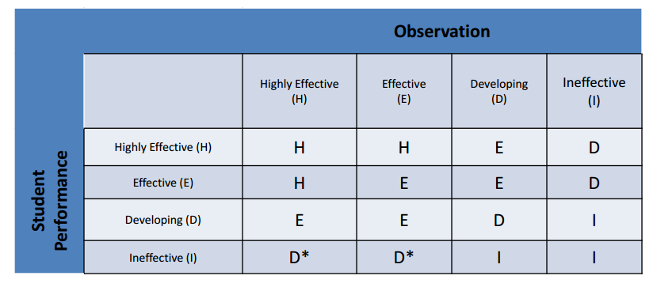
For Some in §3012-d
X

Slide 35
For Most in §3012-d
Notes:
This is if both the performance measure and any back-up SLOs are based on state 3-8 scores or derived from a state-provided growth score

Slide 36
Evidence Collection

Slide 37
Evidence Collection
Watch another mini-observation (the end of the Gallegos lesson)
Collect evidence

Slide 38
Evidence Collection
What evidence did we take?
Cleaning it up
Coding it
Sorting it
Rating it (but not today)
Review the process…

Slide 39

Growth-Producing Feedback
Choose one of the cards from the center of the table. READ IT.
Think about how you would talk about the situation described on the card.

Slide 40
Growth-Producing Feedback
Go talk to someone from another table WHO DOESN’T HAVE THE SAME CARD AS YOU.
First share the situation, and then how you would tackle it in a conversation with the teacher.
Switch!

Slide 41
The Year at a Glance
Beginning of the Year
Ongoing
End of the Year
Beginning of the year meeting
Standards I and II
SLO and
local (LAT) target setting
Evidence Submission by
Teacher
Evidence Collection
Sharing the evidence
Feedback Conversations
Evidence from the year collected
Compare collected evidence to the rubric
Summative score determination and communication

Slide 42
SLOs and
Summative Assessment

Slide 43

SLO Summative Resources
Posted at APPR microsite:
Checklist
Proctor Attestation
Scorer Attestation
Sample Student Roster
Remember: BALANCE!

Slide 44

Quick break

Slide 45
Preparing for the
Summative Evaluation

Slide 46

Summative Evaluation
At your table, generate a list of everything you are going to need to be able to do your summative evaluations and End-of-the-Year Meetings.

Slide 47
Summative Evaluation
SLO scoring conversion
LAT scoring conversion
Rubric scaling to 60 points
Total Score > HEDI scale
Growth-Producing Feedback
PD recommendations
Improvement Plan Requirements

Slide 48

SLO/LAT Scoring Conversion
Figure out the score this teacher would get on her LAT. It is the same process as for an SLO.

Slide 49
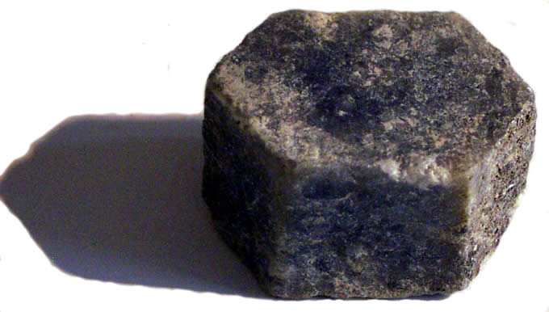
Multiple Measures Scoring
Figure out the score this teacher would get on her 60%. Use the final scores provided and your district’s APPR plan.

Slide 50
Total Summative Score
What would the score be for the teacher?
HEDI?

Slide 51
Total Summative Score
What professional development would you recommend for this teacher for next year?

Slide 52
§3012-d
Let’s repeat this for §3012-d

Slide 53
Preparing for the
End-of-the-Year Meeting

Slide 54
Meeting Plan (or Map*)
What will be your agenda for these meetings?
As a table, make a plan!

Slide 55
Improvement Plan
What would you want to see in the improvement plan?

Slide 56
Growth-Producing Feedback
With your neighbor, plan your conversation with the teacher

Slide 58
Culture

Slide 59
Culture Reminder
There will be an impact on school culture
It may be more pronounced than we have experienced so far

Slide 60
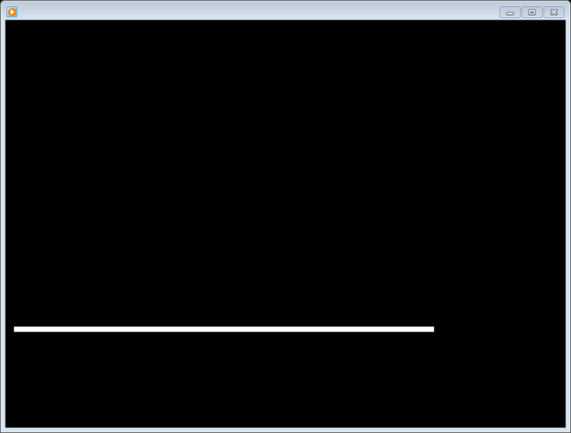
Culture Reminder
Leadership responsibilities
Focus on future, not the romanticized past

Slide 61
The Second Half

Slide 62
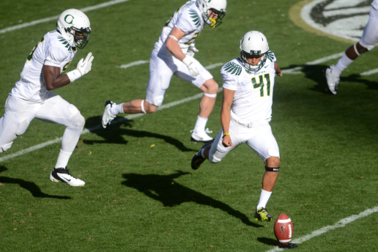
2nd Semester
Individually, start to map out your second half of the year.
If you already have a map, use it
Share with your partner and table

Slide 63
Graduation

Slide 64

Next…
APPR microsite
Call or email Jeff
Ongoing training next year… probably 3 ½ days per year (merge with last year’s cohort)
Attendance information to districts

Slide 65
Lead Evaluator Training
2015-2016
Final Session

