Slide 1
Lead Evaluator Training
2013-2014
Day 9

Slide 2
Agenda
Research Update
Evidence Collection
SLO Summative Help
Summative Evaluation
Growth-Producing Feedback
The Start of the Second Half
Notes:
Review the agenda.

Slide 3
Lead Evaluator Training
Year 1
New York State Teaching Standards and Leadership Standards
Evidence-based observation
Application and use of Student Growth Percentile and VA Growth Model data
Application and use of the State-approved teacher or principal rubrics
Application and use of any assessment tools used to evaluate teachers and principals
Application and use of State-approved locally selected measures of student achievement
Use of the Statewide Instructional Reporting System
Scoring methodology used to evaluate teachers and principals
Specific considerations in evaluating teachers and principals of ELLs and students with disabilities
Notes:
These are the “nine” official goals of Lead Evaluator Training.

Slide 4
Lead Evaluator Training
Ongoing
From the Review Room: “Describe the process by which evaluators will be trained and the process for how the district will certify and re-certify lead evaluators. Describe the process for ensuring
inter-rater reliability. Describe the duration and nature of such training.”
Notes:
This is where ongoing training is mentioned in the Review Room.

Slide 5
Lead Evaluator Training
Ongoing
Continue to collect evidence
Use collected evidence to rate teachers on a rubric (with feedback)
Manage the new system
Employ growth-producing feedback to increase the quality of teaching
Implement the Reform Agenda (RTTT)
Notes:
Our local goals for Lead Evaluator Training, in addition to the required components.

Slide 6
Lead Evaluator Training
Ongoing
Continue to collect evidence
Use collected evidence to rate teachers on a rubric (with feedback)
Manage the new system
Employ growth-producing feedback to increase the quality of teaching
Implement the Reform Agenda (RTTT)
Notes:
Our local goals for Lead Evaluator Training, in addition to the required components.

Slide 7


Slide 8
Warm-Up

Slide 9
What’s One Thing…
Think of one thing you did that you feel GOOD about in the last two weeks related to Professional Practice (APPR)
See if you can think of something that you didn’t do LAST year
Each person takes a turn to share
Go around at your table group

Slide 10
Research Update:
Effective use of Time

Slide 11
Research Brief
“Effective Instructional Time Use for School Leaders: Longitudinal Evidence from Observations of Principals”
Coaching teachers (yet is a relatively rare thing)
Development and involvement in the school’s educational program
Evaluating teachers
Classroom walkthroughs as a defined part of professional development for teachers

Slide 12
Research Brief
Classroom walkthroughs that were conducted just for the sake of presence, without a focus and clearly understood purpose, didn’t contribute to higher student achievement.
Especially true at the high school

Slide 13
Research Brief
Impacts of coaching, walkthroughs, educational program involvement, and walkthroughs are all greatly magnified with systems thinking.
Conversely, these activities perceived as isolated or unconnected activities are negatively associated with student achievement

Slide 14
The Year at a Glance
Beginning of the Year
Ongoing
End of the Year
Beginning of the year meeting
Standards I and II
SLO and
local (LAT) target setting
Evidence Submission by
Teacher
Evidence Collection
Sharing the evidence
Feedback Conversations
Evidence from the year collected
Compare collected evidence to the rubric
Summative score determination and communication

Slide 15
Evidence Collection

Slide 16
Evidence Collection
Watch another mini-observation (the end of the Gallegos lesson)
Collect evidence

Slide 17
Evidence Collection
What evidence did we take?
Cleaning it up
Coding it
Sorting it
Rating it (but not today)
Review the process…

Slide 18

Growth-Producing Feedback
Choose one of the cards from the center of the table. READ IT.
Think about how you would talk about the situation described on the card.

Slide 19
Growth-Producing Feedback
Go talk to someone from another table WHO DOESN’T HAVE THE SAME CARD AS YOU.
First share the situation, and then how you would tackle it in a conversation with the teacher.
Switch!

Slide 20
The Year at a Glance
Beginning of the Year
Ongoing
End of the Year
Beginning of the year meeting
Standards I and II
SLO and
local (LAT) target setting
Evidence Submission by
Teacher
Evidence Collection
Sharing the evidence
Feedback Conversations
Evidence from the year collected
Compare collected evidence to the rubric
Summative score determination and communication

Slide 21
SLOs and
Summative Assessment

Slide 22

SLO Summative Resources
Posted at APPR microsite:
Checklist
Proctor Attestation
Scorer Attestation
Sample Student Roster
Remember: BALANCE!

Slide 23

Quick break

Slide 24
Preparing for the
Summative Evaluation

Slide 25

Summative Evaluation
At your table, generate a list of everything you are going to need to be able to do your summative evaluations and End-of-the-Year Meetings.

Slide 26
Summative Evaluation
SLO scoring conversion
LAT scoring conversion
Rubric scaling to 60 points
Total Score > HEDI scale
Growth-Producing Feedback
PD recommendations
Improvement Plan Requirements

Slide 27
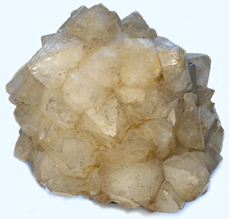
SLO/LAT Scoring Conversion
Figure out the score this teacher would get on her LAT. It is the same process as for an SLO.

Slide 28
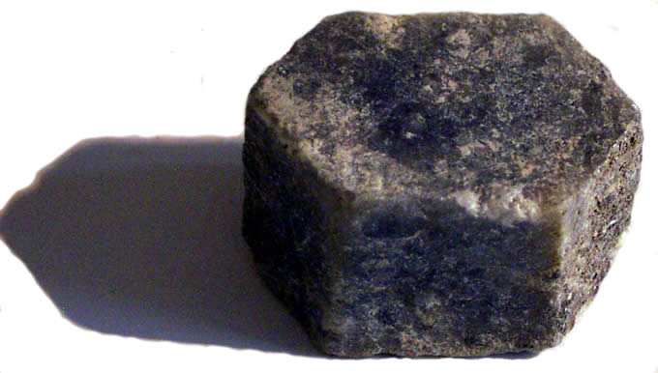
Multiple Measures Scoring
Figure out the score this teacher would get on her 60%. Use the final scores provided and your district’s APPR plan.

Slide 29
Total Summative Score
What would the score be for the teacher?
HEDI?

Slide 30
Total Summative Score
What professional development would you recommend for this teacher for next year?

Slide 31
Preparing for the
End-of-the-Year Meeting

Slide 32
Meeting Plan (or Map*)
What will be your agenda for these meetings?
As a table, make a plan!

Slide 33
Improvement Plan
What would you want to see in the improvement plan?

Slide 34
Growth-Producing Feedback
With your neighbor, plan your conversation with the teacher

Slide 36
Culture

Slide 37
Culture Reminder
There will be an impact on school culture
It may be more pronounced than we have experienced so far

Slide 38
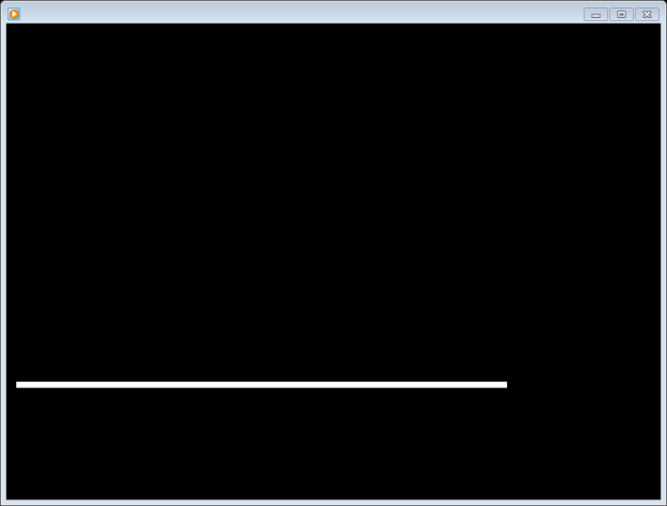
Culture Reminder
Leadership responsibilities
Focus on future, not the romanticized past

Slide 39
The Second Half

Slide 40
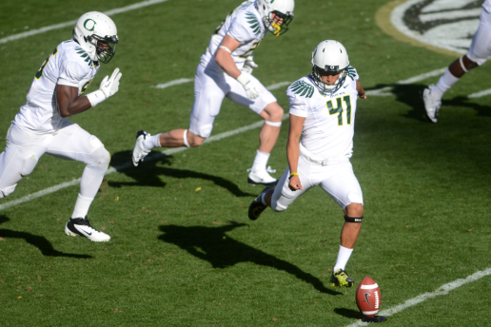
2nd Semester
Individually, start to map out your second half of the year.
If you already have a map, use it
Share with your partner and table

Slide 41
Graduation

Slide 42

Next…
APPR microsite
Call or email Jeff
Ongoing training next year… probably 3 or 4 ½ days per year (merge with last year’s cohort)
One more request for the on-line survey will come soon
Attendance information to districts

Slide 43
Lead Evaluator Training
2013-2014
Day 9

