Slide 1
Lead Evaluator Training
2012-2013
Day 9

Slide 2
Agenda
Research Update
Evidence Collection
SLO Summative Help
Summative Evaluation
Growth-Producing Feedback
The Start of the Second Half
Notes:
Review the agenda.

Slide 3
Lead Evaluator Training
Year 1
New York State Teaching Standards and Leadership Standards
Evidence-based observation
Application and use of Student Growth Percentile and VA Growth Model data
Application and use of the State-approved teacher or principal rubrics
Application and use of any assessment tools used to evaluate teachers and principals
Application and use of State-approved locally selected measures of student achievement
Use of the Statewide Instructional Reporting System
Scoring methodology used to evaluate teachers and principals
Specific considerations in evaluating teachers and principals of ELLs and students with disabilities
Notes:
These are the “nine” official goals of Lead Evaluator Training.

Slide 4
Lead Evaluator Training
Ongoing
From the Review Room: “Describe the process by which evaluators will be trained and the process for how the district will certify and re-certify lead evaluators. Describe the process for ensuring
inter-rater reliability. Describe the duration and nature of such training.”
Notes:
This is where ongoing training is mentioned in the Review Room.

Slide 5
Lead Evaluator Training
Ongoing
Continue to collect evidence
Use collected evidence to rate teachers on a rubric (with feedback)
Manage the new system
Employ growth-producing feedback to increase the quality of teaching
Implement the Reform Agenda (RTTT)
Notes:
Our local goals for Lead Evaluator Training, in addition to the required components.

Slide 6
Lead Evaluator Training
Ongoing
Continue to collect evidence
Use collected evidence to rate teachers on a rubric (with feedback)
Manage the new system
Employ growth-producing feedback to increase the quality of teaching
Implement the Reform Agenda (RTTT)
Notes:
Our local goals for Lead Evaluator Training, in addition to the required components.

Slide 7


Slide 8
Research Update:
Measures of Effective Teachers
(MET)

Slide 9

Measures of Effective Teaching

Slide 10
Measures of Effective Teaching
The research confirmed that, as a group, teachers previously identified as more effective caused students to learn more.
Groups of teachers who had been identified as less effective caused students to learn less.
Circular logic warning!!!

Slide 11
Measures of Effective Teaching
Adding lessons and observers increases the reliability of classroom observations.
Student perception surveys and classroom observations can provide meaningful feedback to teachers.
Implementing specific procedures in evaluation systems can increase trust in the data and the results.
Each measure adds something of value.
A balanced approach is most sensible when assigning weights to form a composite measure.
There is great potential in using video for teacher feedback and for the training and assessment of observers.

Slide 12
Evidence Collection

Slide 13
Evidence Collection
Watch the mini-observation (Gallegos)
Collect evidence
Focus on environment
  Standard 4 (Teaching Standards and NYSUT)

Slide 14
Evidence Collection
Rate the teacher on Standard IV (NYSUT).
As prompted in polleverywhere, text your rating
Where were you, compared to
  Others in the room
  (inter-rater agreement)
  The facilitator
  (inter-rater reliability)

Slide 15
SLOs and
Summative Assessment

Slide 16

SLO Summative Resources
Posted at APPR microsite:
Checklist
Proctor Attestation
Scorer Attestation
Sample Student Roster
Remember: BALANCE!

Slide 17

Quick break

Slide 18
Preparing for the
Summative Evaluation

Slide 19

Summative Evaluation
At your table, generate a list of everything you are going to need to be able to do your summative evaluations and End-of-the-Year Meetings.

Slide 20
Summative Evaluation
SLO scoring conversion
LAT scoring conversion
Rubric scaling to 60 points
Total Score > HEDI scale
Growth-Producing Feedback
PD recommendations
Improvement Plan Requirements

Slide 21
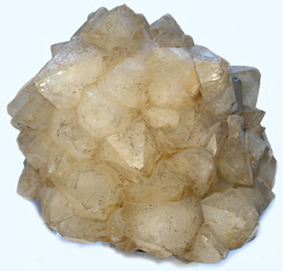
SLO/LAT Scoring Conversion
Figure out the score this teacher would get on her LAT. It is the same process as for an SLO.

Slide 22
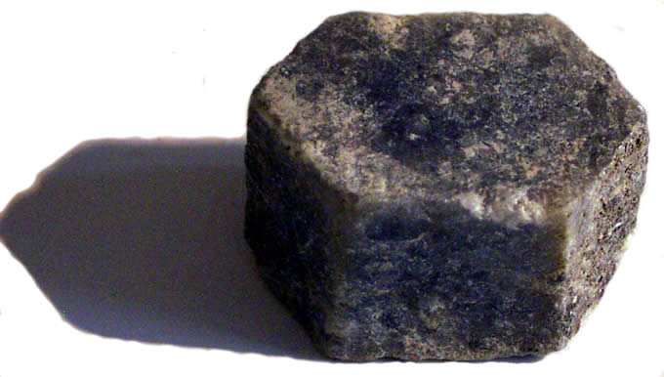
Multiple Measures Scoring
Figure out the score this teacher would get on her 60%. Use the final scores provided and your district’s APPR plan.

Slide 23
Total Summative Score
What would the score be for the teacher?
HEDI?

Slide 24
Total Summative Score
What professional development would you recommend for this teacher for next year?

Slide 25
Preparing for the
End-of-the-Year Meeting

Slide 26
Meeting Plan (or Map*)
What will be your agenda for these meetings?
As a table, make a plan!

Slide 27
Improvement Plan
What would you want to see in the improvement plan?

Slide 28

Growth-Producing Feedback
With your neighbor, plan your conversation with the teacher

Slide 30
Culture

Slide 31
Culture Reminder
There will be an impact on school culture
It may be more pronounced than we have experienced so far

Slide 32

Culture Reminder
Leadership responsibilities
Focus on future, not the romanticized past

Slide 33
The Second Half

Slide 34
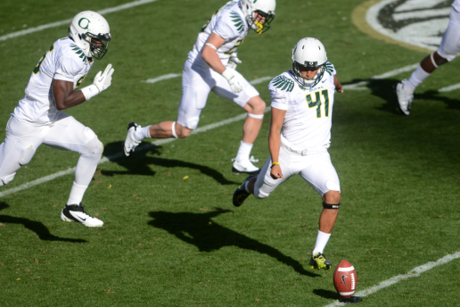
2nd Semester
Individually, start to map out your second half of the year.
If you already have a map, use it
Share with your partner and table

Slide 35
Graduation

Slide 36

Next…
APPR microsite
Call or email Jeff
Ongoing training next year… probably 4 ½ days per year (merge with last year’s cohort)
One more request for the on-line survey will come soon
Attendance information to districts

Slide 37
Lead Evaluator Training
2012-2013
Day 9

