Slide 1
Lead Evaluator Training
2012-2013
Day 8

Slide 2
Agenda
Aligning RTTT
Growth and Value-Added
Evidence Collection
Inter-rater agreement and reliability
Growth-Producing Feedback
Notes:
Review the agenda.

Slide 3
Lead Evaluator Training
Year 1
New York State Teaching Standards and Leadership Standards
Evidence-based observation
Application and use of Student Growth Percentile and VA Growth Model data
Application and use of the State-approved teacher or principal rubrics
Application and use of any assessment tools used to evaluate teachers and principals
Application and use of State-approved locally selected measures of student achievement
Use of the Statewide Instructional Reporting System
Scoring methodology used to evaluate teachers and principals
Specific considerations in evaluating teachers and principals of ELLs and students with disabilities
Notes:
These are the “nine” official goals of Lead Evaluator Training.

Slide 4
Lead Evaluator Training
Ongoing
From the Review Room: “Describe the process by which evaluators will be trained and the process for how the district will certify and re-certify lead evaluators. Describe the process for ensuring
inter-rater reliability. Describe the duration and nature of such training.”
Notes:
This is where ongoing training is mentioned in the Review Room.

Slide 5
Lead Evaluator Training
Ongoing
Continue to collect evidence
Use collected evidence to rate teachers on a rubric (with feedback)
Manage the new system
Employ growth-producing feedback to increase the quality of teaching
Implement the Reform Agenda (RTTT)
Notes:
Our local goals for Lead Evaluator Training, in addition to the required components.

Slide 6
Lead Evaluator Training
What You Said
Growth & Value Added
RTTT/Reform Agenda
21st Century Skills
Evidence Collection
Conversations
School Culture
Summative Evaluation
Notes:
This is based on feedback from the last meeting.

Slide 7
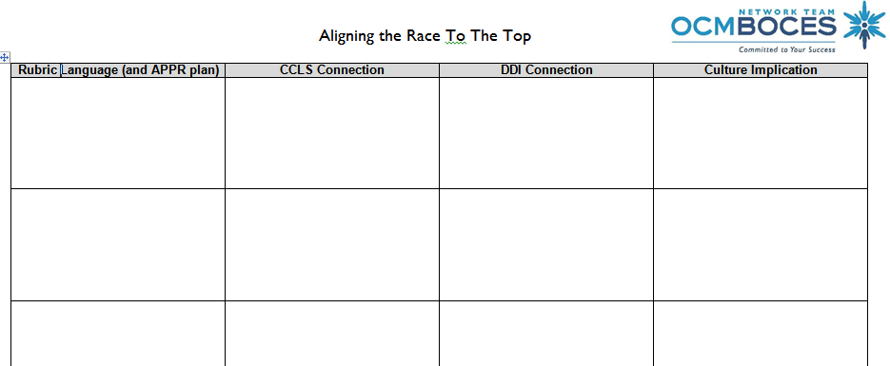

Aligning the “race” to the top
  Work as a table to complete
  Use your rubric
  Don’t get too specific with the CCLS
Notes:
NOTES

Slide 8
Aligning the “race”
  Work as a table to complete
  Use your rubric
  Don’t get too specific with the CCLS
Reflecting on Teaching (Accuracy and Use in Future)
Notes:
NOTES

Slide 9
Aligning the “race”
  Work as a table to complete
  Use your rubric
  Don’t get too specific with the CCLS
Reflecting on Teaching (Accuracy and Use in Future)
Are lessons becoming more aligned to CCLS
Notes:
NOTES

Slide 10
Aligning the “race”
  Work as a table to complete
  Use your rubric
  Don’t get too specific with the CCLS
Reflecting on Teaching (Accuracy and Use in Future)
Are lessons becoming more aligned to CCLS
Did instructional changes I made based on common formative assessment work?
Notes:
NOTES

Slide 11
Aligning the “race”
  Work as a table to complete
  Use your rubric
  Don’t get too specific with the CCLS
Reflecting on Teaching (Accuracy and Use in Future)
Are lessons becoming more aligned to CCLS
Did instructional changes I made based on common formative assessment work?
Do schedules have built-in time for teachers to co-labor?
Notes:
NOTES

Slide 12


Slide 13
SED’s Research
Behind Teacher Evaluation

Slide 14
Teacher Effectiveness Research
Teacher effectiveness matters!
This is the right work!
Two big [recent] research studies confirm this

Slide 15

Chetty, Friedman & Rockoff
The Long-Term Impacts of Teachers: Teacher Value-added and Student Outcomes in Adulthood
Notes:
http://obs.rc.fas.harvard.edu/chetty/value_added.html

Slide 16
Chetty, Friedman & Rockoff
2.5M children from childhood to early adulthood in 1 large district
Teacher/course linkages and test scores in grades 3-8 from 1991-2009
US government tax data from W-2s: on parents AND students
About parents: household income, retirement savings, home ownership, marriage, age when student born
About students up to age 28: teen birth, college attendance, earnings, neighborhood “quality”

Slide 17
Chetty, Friedman & Rockoff
Having a higher value-added teacher for even one year in grades 4-8 has substantial positive long-term impacts on a student’s life outcomes including:
Likelihood of attending college (↑ 1.25%)
Likelihood of teen pregnancy (↓ 1.25%)
Salary earned in lifetime (↑ $25K )
Neighborhood (↑ college grads)
Retirement savings (↑)

Slide 18
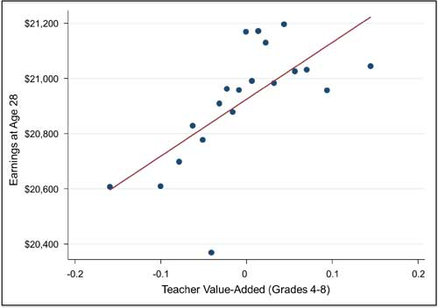
Chetty, Friedman & Rockoff
Student
Future
Earnings

Slide 19
What is “teacher value added”
A statistical measure of the growth of a teacher’s students that takes into account the differences in students across classrooms that school systems can measure but teachers can’t control.
Growth compared to the average growth of similar students

Slide 20
Test Scores Alone
680
670
Achievement scores say more about students than teachers.
2015
2015
Teacher A
Teacher B

Slide 21
Growth
Adding average prior achievement for the same students shows Teacher B’s students had higher growth.
Growth
+25
Growth
+20
680
670
660
645
2014
2015
2015
2014
2015
Teacher A
Teacher B

Slide 22
Value-Added
Comparing growth to the average growth of “similar” students gives teacher A the higher “value-added” result.
Value-
Added
+15 Above
Average
Growth
+20
680
Growth
+25
Value-
Added
AVERAGE
665
670
670
660
645
2015
2015 Avg for similar students
2015 Avg for similar students
2014
2014
2014
2015
Teacher A
Teacher B

Slide 23
What do you think would happen:
A high value-added teacher (top 5%) arrives in a new school to teach fourth grade:
What happens to the new teacher’s kids’ fourth grade test scores?

Slide 24
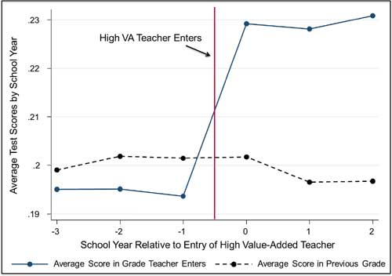
The scores go up.

Slide 25
But what about?
Maybe the “high value-added teacher’s” kids were all from high income families?
  The researchers thought of that, got the data and it doesn’t change the fact that having a high value-added teacher matters.
Maybe “high value-added teachers” are always assigned to the higher achieving kids.
  They thought of that, got the data, and it doesn’t change the fact that (guess what)…...
Maybe it’s just true for the top 5% of teachers. We can’t all be superstars.
  They thought of that (and guess what?)

Slide 26
But what about?
Recent questions about the study point out that these data come from a period prior to high stakes testing?
  Chetty said it was possible that in high-stakes conditions the usefulness of value-added ratings could be impacted, but implausible that the effect would totally disappear.
Could it be that teachers under pressure to raise their students’ scores through extensive test preparation will get inflated results that do not carry over positively to adulthood?
  This might be true except for the fact that test prep has been proven to have a negative impact on student achievement – thus inflated results due to test prep does not occur.

Slide 27

Measures of Effective Teaching

Slide 28
Measures of Effective Teaching
Indicators tested:
    5 instruments for classroom observations
    Student surveys (Tripod Survey)
    Value-added on state tests
Size:
    3,000 teachers
    22,500 observation scores (7,500 lesson videos x 3 scores)
    900 + trained observers
    44,500 students completing surveys and supplemental assessments
Outcomes studied:
    Gains on state math and ELA tests
    Gains on supplemental tests (BAM & SAT9 OE)
    Student-reported outcomes (effort and enjoyment in class)

Slide 29
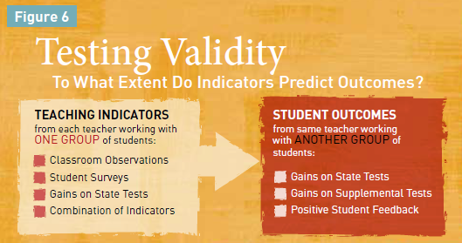
Predictive power: Which measure could most accurately identify teachers likely to have large gains when working with another group of students?
Reliability: Which measures were most stable from section to section or year to year for a given teacher?
Potential for Diagnostic Insight: Which have the potential to help a teacher see areas of practice needing improvement

Slide 30
Measures of Effective Teaching
H
M
L
M
H
M
L
M/H
H

Slide 31
Use multiple measures
All the observation rubrics are positively associated with student achievement gains
Using multiple observations per teacher is VERY important (and ideally multiple observers)
The student feedback survey tested is ALSO positively associated with student achievement gains

Slide 32
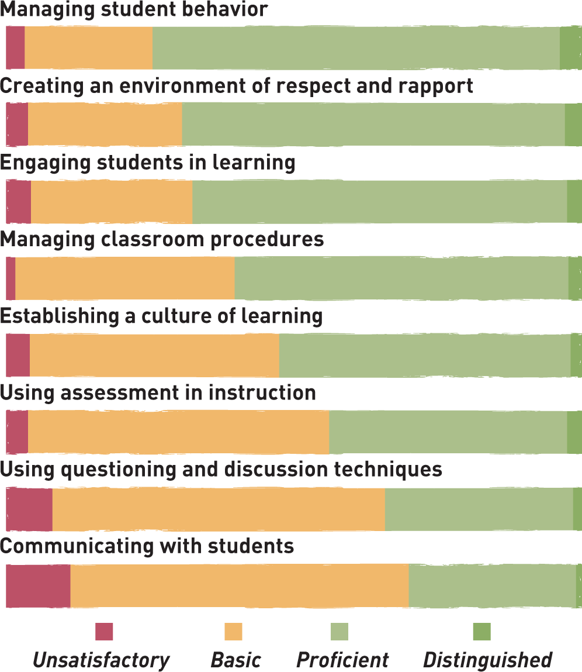

Framework for Teaching

Slide 33
Framework for Teaching
Highest scores for orderly environment
Lowest scores for more complex aspects of instruction

Slide 34
Student Feedback
Rank
Survey Statement
Student survey items with strongest relationship to middle school math gains:
1
Students in this class treat the teacher with respect
2
My classmates behave the way my teacher wants them to
3
Our class stays busy and doesn’t waste time
4
In this class, we learn a lot every day
5
In this class, we learn to correct our mistakes

Slide 35
Student Feedback
Rank
Survey Statement
Student survey items with the weakest relationship to middle school math gains:
38
I have learned a lot this year about [the state test]
39
Getting ready for [state test] takes a lot of time in our class

Slide 36
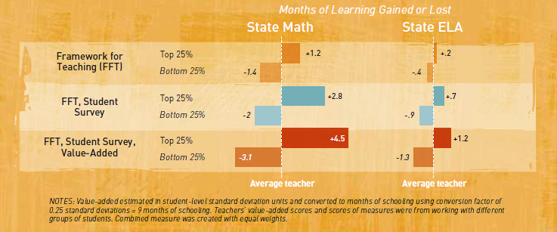
Multiple Measures

Slide 37
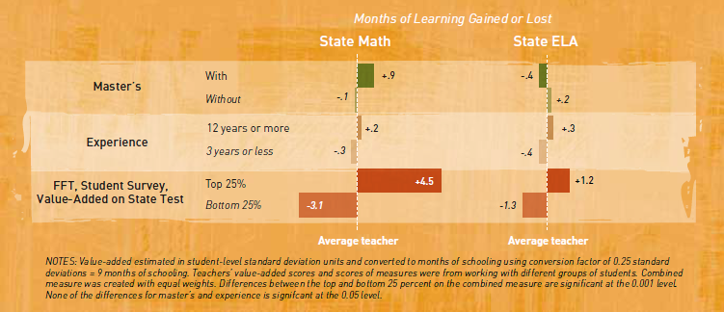
Traditional Measures

Slide 38
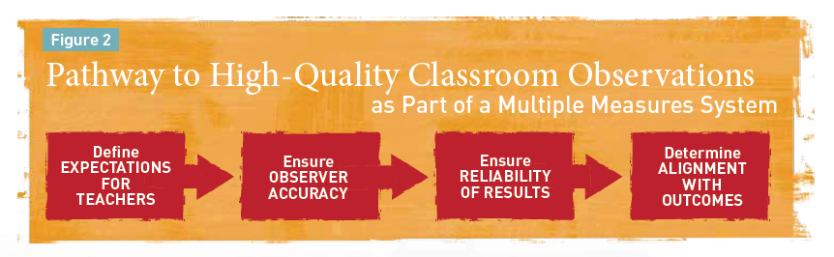
Four Steps

Slide 39
How would you answer?
New York’s evaluation system is based mostly on State test scores and that’s not good.
A principal knows a good teacher when s/he sees one; we don’t need to include value-added results too.
I’ve been doing teacher observations for years. I don’t need to go to your training.
Teacher Value-added information is unreliable and shouldn’t be a part of teacher evaluation.
By putting test scores into teacher evaluation, everyone will do even more to “teach to the test” and if that doesn’t work, they’ll cheat.
Notes:
New York’s evaluation system is based mostly on State test scores and that’s not good.
NY uses multiple measures as research advises. 60% involves measures of educator practice. 20-25% involves GROWTH on state assessments or comparable measures. And the remaining points will be a locally-selected measure of student growth or achievement.
A principal knows a good teacher when s/he sees one; we don’t need to include value-added results too.
Recent METS study shows that combining observation results and teacher value-added is more predictive and reliable than either measure alone.
I’ve been doing teacher observations for years.
I don’t need to go to your training.
The MET study shows that regularly recalibrating observers against benchmarks of accurate observation ratings is critical to ensuring a valid and reliable evaluation system. Even the best observers can “drift” over time. And the best can help others stay in sync. In addition, NYS training will help everyone identify evidence that the new Common core standards are being implemented well in classrooms.
Teacher Value-added information is unreliable and shouldn’t be a part of teacher evaluation.
Many researchers have shown that teacher value-added is the best predictor we have of the future learning growth of a teacher’s students. Two new research studies, Chetty/Friedman/Rockoff and the Measures of Effective Teaching Study add new evidence in support of this argument.
By putting test scores into teacher evaluation, everyone will do even more to “teach to the test” and if that doesn’t work, they’ll cheat.
No one has been able to research yet the predictiveness and reliability of teacher value-added measures when they are used in high stakes environments since such evaluation systems are just beginning across the country. Some teachers may try to game the system. Others may strive to develop the skills research says align with higher value-added results. However, the power of these measures argues for including them as part of a multiple measures system.

Slide 40

Quick break

Slide 41
Mini-lesson:
21st Century Skills

Slide 42


Slide 43
21C Scavenger Hunt
In the document provided to your table, look through it and highlight any references to
21st Century Skills
Communication
Collaboration
Critical Thinking
Creativity and Problem Solving

Slide 44
NYS Teaching Standards III.5
Teachers engage students in the development of multidisciplinary skills, such as communication, collaboration, critical thinking, and use of technology.
Students synthesize and express ideas both in written and oral formats.
Students work effectively with others, including those from diverse groups and with opposing points of view.
Students make decisions, solve problems, and take actions as appropriate.
Students solve problems and/or acquire new knowledge through creative and innovative approaches to learning.
Students utilize technologies and resources to solve real world problems.

Slide 45
NYS Teaching Standards III.5
Teachers engage students in the development of multidisciplinary skills, such as communication, collaboration, critical thinking, and use of technology.
Students synthesize and express ideas both in written and oral formats.
Students work effectively with others, including those from diverse groups and with opposing points of view.
Students make decisions, solve problems, and take actions as appropriate.
Students solve problems and/or acquire new knowledge through creative and innovative approaches to learning.
Students utilize technologies and resources to solve real world problems.
THESE ARE THE 4 Cs!

Slide 46
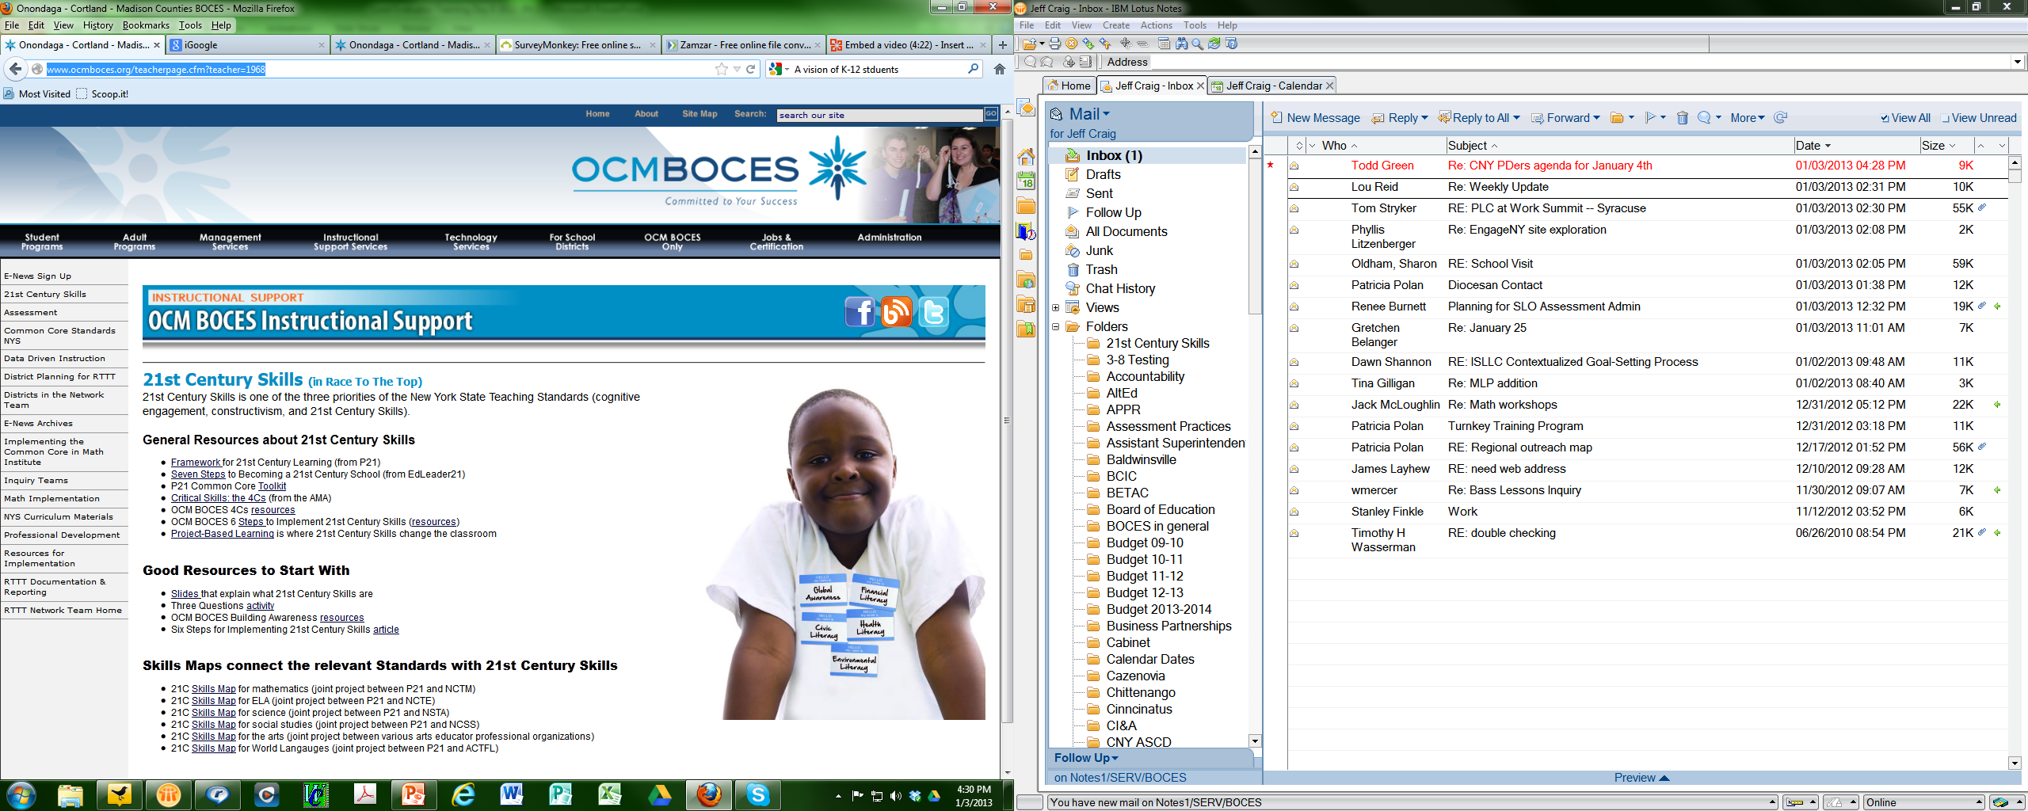
21C Resources

Slide 47
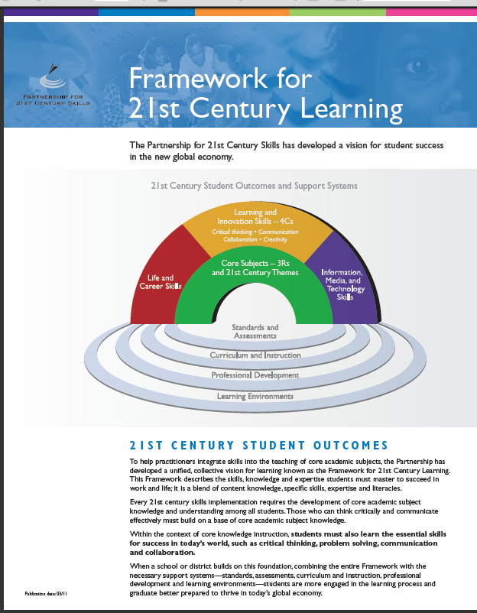
21C Resources

Slide 48
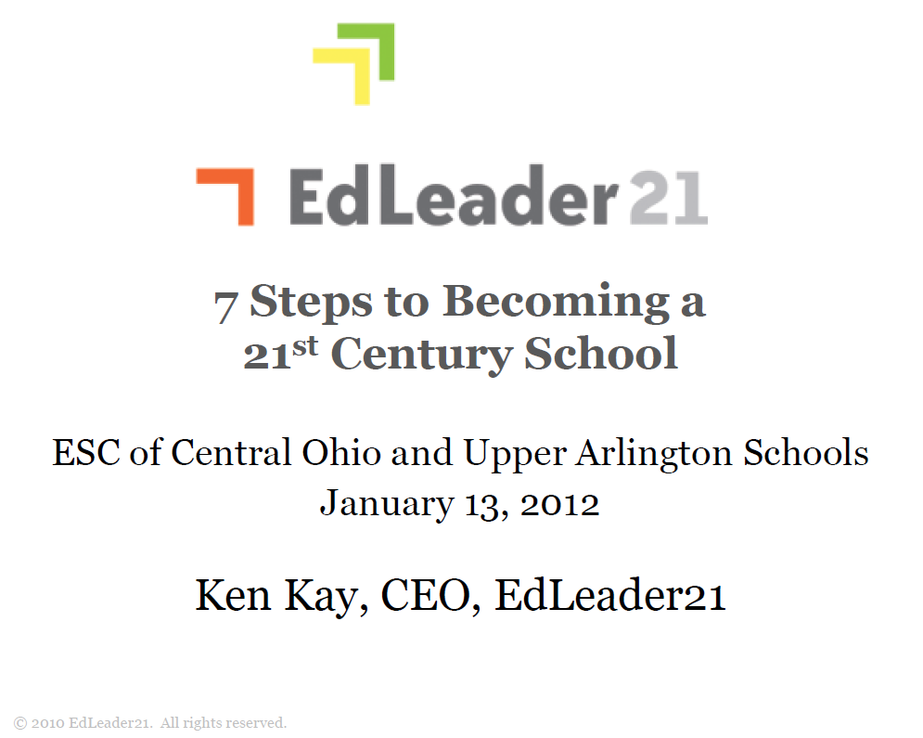
21C Resources

Slide 49

21C Resources

Slide 50
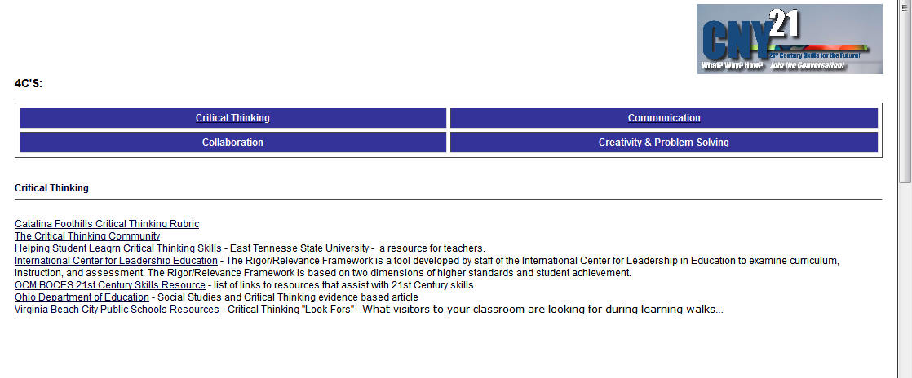
21C Resources

Slide 51
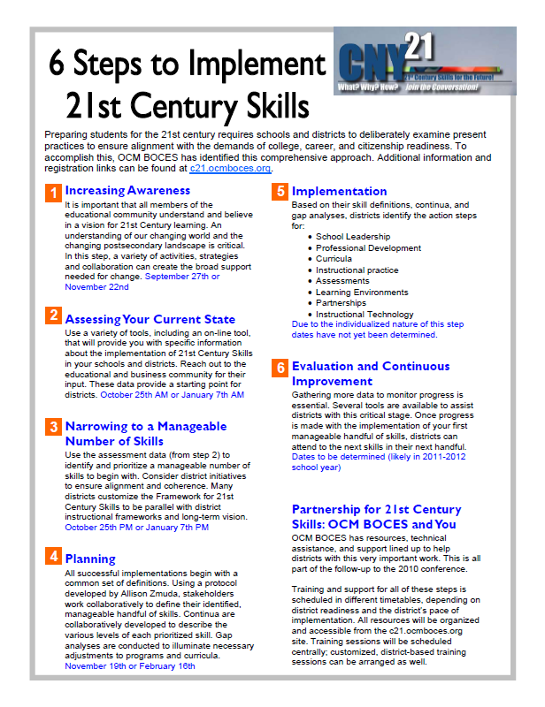
21C Resources

Slide 52

21C Resources

Slide 53
21C Resources

Slide 54

21C Resources

Slide 55
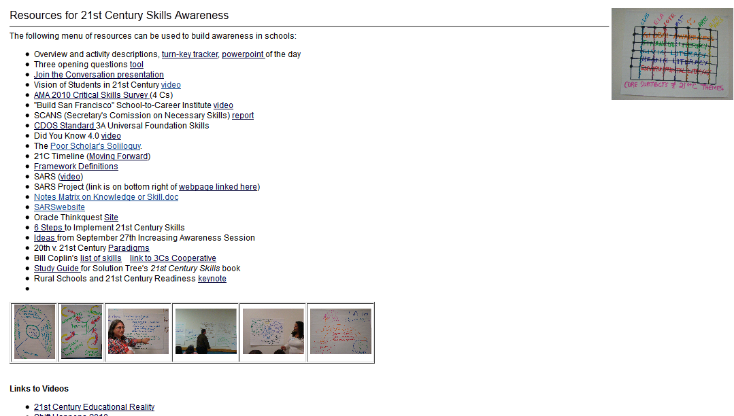
21C Resources

Slide 56
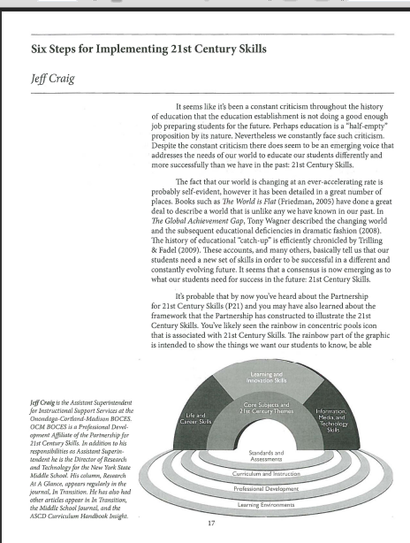
21C Resources

Slide 57
Quick break

Slide 58
Evidence Collection and
Growth-Producing Feedback

Slide 59
Evidence Collection
Watch the video
Collect evidence
Focus on instruction
  Standard III (Teaching Standards and NYSUT)
  Domain 3 (Danielson)

Slide 60
Evidence Collection
Label the evidence provided to you
Use Standards (or refer to Danielson)

Slide 61
Evidence Collection
Rate the teacher on Standard 3 (NYSUT).
As prompted in polleverywhere, text your rating
Where were you, compared to
  Others in the room
  (inter-rater agreement)
  The facilitator
  (inter-rater reliability)

Slide 62

Growth-Producing Feedback
With your neighbor, plan your conversation with the teacher

Slide 63
Growth-Producing Feedback
Choose one of the cards from the center of the table. READ IT.
Think about how you would talk about the situation described on the card.

Slide 64
Growth-Producing Feedback
Go talk to someone from another table WHO DOESN’T HAVE THE SAME CARD AS YOU.
First share the situation, and then how you would tackle it in a conversation with the teacher.
Switch!

Slide 66
Final Connections
Lay out the cards, face down
Turn over any two
At the table, talk about how the two of them are connected (and then turn over 3 at a time… 4…)

Slide 67
Next Session
January 25th in Syracuse
Agenda will include
  Evidence Collection and
  Growth-Producing Feedback
  Preparing for Summative Conversations

Slide 68
Session Close
We don’t have too much Year One Lead Evaluator Training left.
What questions do you still have about the process?
What questions do you have about the nine components?

