Slide 1
Lead Evaluator Training
2013-2014
Day 7

Slide 2
Agenda
What’s the Buzz
“Specific considerations in evaluating teachers and principals of ELLs and students with disabilities”
Mini-Lesson: Data Driven Instruction
Evidence Collection
Inter-rater agreement and reliability
Notes:
Review the agenda.

Slide 3
Checking in
Since Last Time

Slide 4

We’re Not in Kansas Anymore
Talk in schools – has it changed at all?

Slide 5
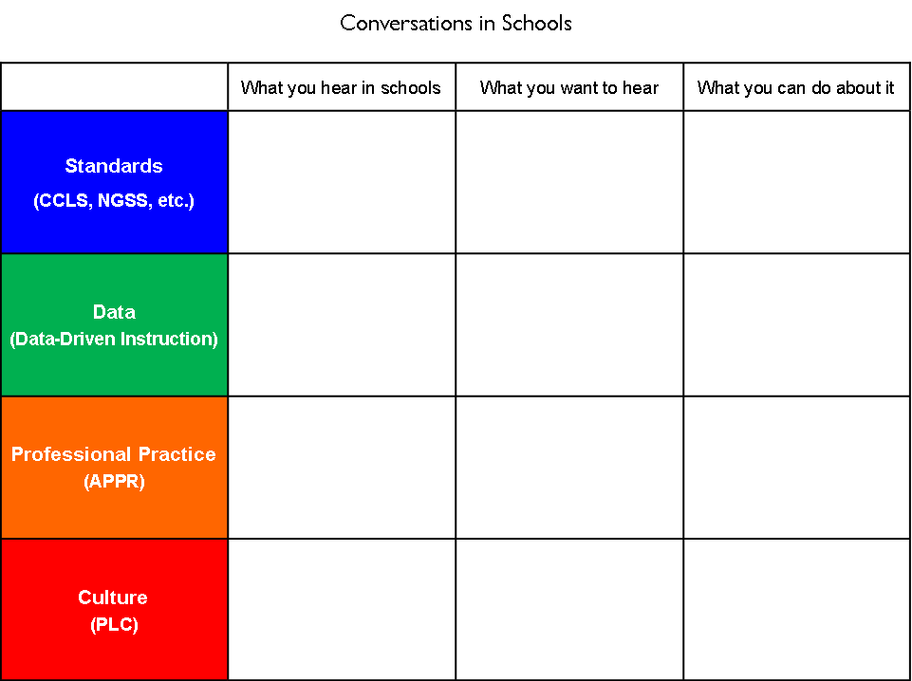
We’re Not in Kansas Anymore
What’s the talk in school?
What do you want it to be?
What can you do
to get it there?

Slide 6
Mini-lesson:
Data-Driven Instruction

Slide 7

Assessment
What is the current “story” of assessment?
Talk at your table

Slide 8
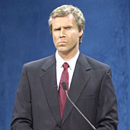
Assessment
We need a little “strategery”
Organize the cards in the envelope as a table

Slide 9
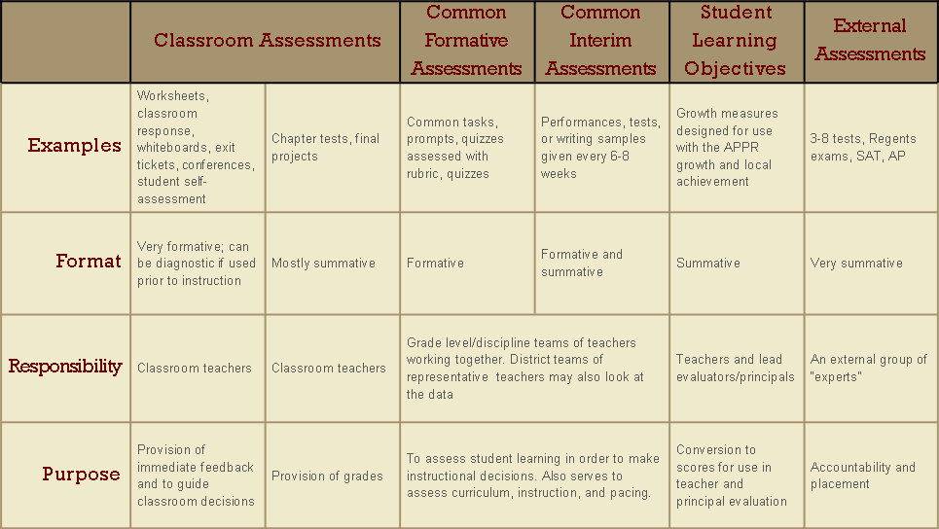
Balanced Assessment
Notes:
HO: “Balanced Assessment System”
The chart shows the variety of assessments we use, as well as the purpose of each. Here we see that Common Formative and Common Interim Assessments are similar, but Common Interim Assessments are regularly spaced out and calendared during the course of the school year. They can be used both formatively and summatively.

Slide 10
Balanced Assessment
BE STRATEGIC!
Notes:
HO: “Balanced Assessment System”
The chart shows the variety of assessments we use, as well as the purpose of each. Here we see that Common Formative and Common Interim Assessments are similar, but Common Interim Assessments are regularly spaced out and calendared during the course of the school year. They can be used both formatively and summatively.

Slide 11

Assessment
What do we want to assess?
What do we assess?
Coherence & systems thinking
Are we missing an
opportunity?

Slide 12
Professional
Practice
Standards
Data
Culture

Slide 13
Data

Slide 14
It’s always been here…

Slide 15
ITBS
Report Cards
Unit Tests
State Tests
Letters
Performance
Quizzes
Terra Nova
Attendance
Reports
Samples
Notebook
Regents
Inventories
Essay
Anecdotal
Performance
Unit Tests
Scores
Logs
Homework
Pictures
Journals
Posttest
RCT
Rubrics
Conferences
Pretest
PET
Checklists
Interview

Slide 16
It’s not really the data

Slide 17
It is
about
what we
do about
data

Slide 18
Common
Interim
Assessments

Slide 19
give the
test
make
the
test
analyze
the
work
do something about it

Slide 20
every
6-8
weeks

Slide 21
Interim Assessments and DDI
Interim Assessment Design and Implementation
Understand the relationship of common interim assessments and Data Driven Instruction (DDI) as part of Race to the Top
A calendar of an interim assessment schedule
Understand and engage in a process for creating an interim assessment
One completed interim assessment for your course
Outcomes

Slide 22
Interim Assessments and DDI
Interim Assessment Design and Implementation
Understand the relationship of common interim assessments and Data Driven Instruction (DDI) as part of Race to the Top
A calendar of an interim assessment schedule
Understand and engage in a process for creating an interim assessment
One completed interim assessment for your course
BE STRATEGIC!
Outcomes

Slide 23
SLO
baseline
SLO
Summative Assessment
Formative Assessment
Formative Assessment
Formative Assessment
Formative Assessment
Formative Assessment
How does this all fit together?
After establishing the most important learning for your course with the SLO, periodically measure student progress toward that goal throughout the school year.
Notes:
The WHY slide: after establishing the most important learning for your course with the SLO, periodically measure student progress toward that goal throughout the year with CFAs.
Formative Assessments serve as a map or GPS on the learning journey. They may be spaced out over the course of the school year so that students are formatively assessed at approximately 6-8 week intervals.

Slide 24
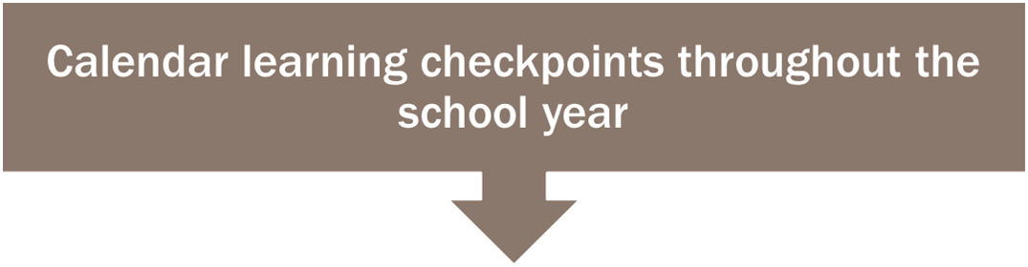
SLO
baseline
SLO
Summative Assessment
November 1
December 12
January 30
March 6
April 24
Calendar Learning Checkpoints
Notes:
The following dates have been selected as learning checkpoints for the interim assessments

Slide 25
Common
Formative
Interim
Assessment
Common
Formative
Interim
Assessment
Common
Formative
Interim
Assessment
September
June
UNIT
UNIT
UNIT
UNIT
UNIT
UNIT
SLO Baseline
Common
Formative
Interim
Assessment
Common
Formative
Interim
Assessment
SLO Summative
Notes:
Here is another slide that illustrates the big picture of how the SLO acts as bookends to the instruction over the course of the year. As instruction ensues, so does periodic learning check points that assess students progress toward the year end summative learning goals.

Slide 26
Common
Formative
Interim
Assessment
Common
Formative
Interim
Assessment
Common
Formative
Interim
Assessment
September
June
UNIT
UNIT
UNIT
UNIT
UNIT
UNIT
SLO Baseline
Common
Formative
Interim
Assessment
Common
Formative
Interim
Assessment
SLO Summative
Notes:
These Common Formative Assessments are spaces out across the year at approximately every 6-8 weeks

Slide 27
Common
Formative
Interim
Assessment
Common
Formative
Interim
Assessment
Common
Formative
Interim
Assessment
September
June
UNIT
UNIT
UNIT
UNIT
UNIT
UNIT
SLO Baseline
Common
Formative
Interim
Assessment
Common
Formative
Interim
Assessment
SLO Summative
Notes:
These assessment are standards based and may not rely on the content specifically. They are not necessarily a summative assessment, but they are used formatively to assess students’ progress toward the larger year-end learning goals.

Slide 28
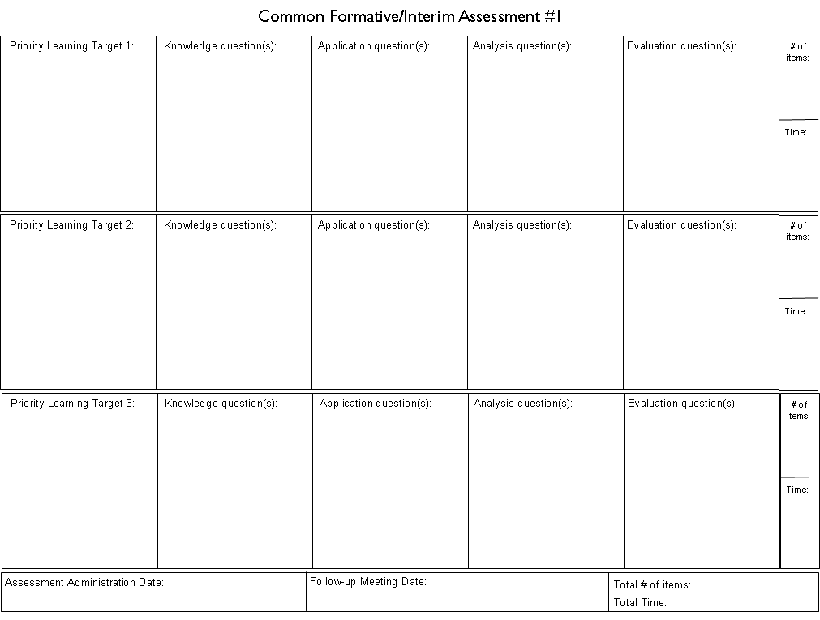
READY! FIRE! AIM!
First: Lay out your targets for the year
Second: Make the first assessment (including calendaring the assessment(s) and scheduling the follow-up meeting)

Slide 29
GETTING TO WORK…

Slide 30
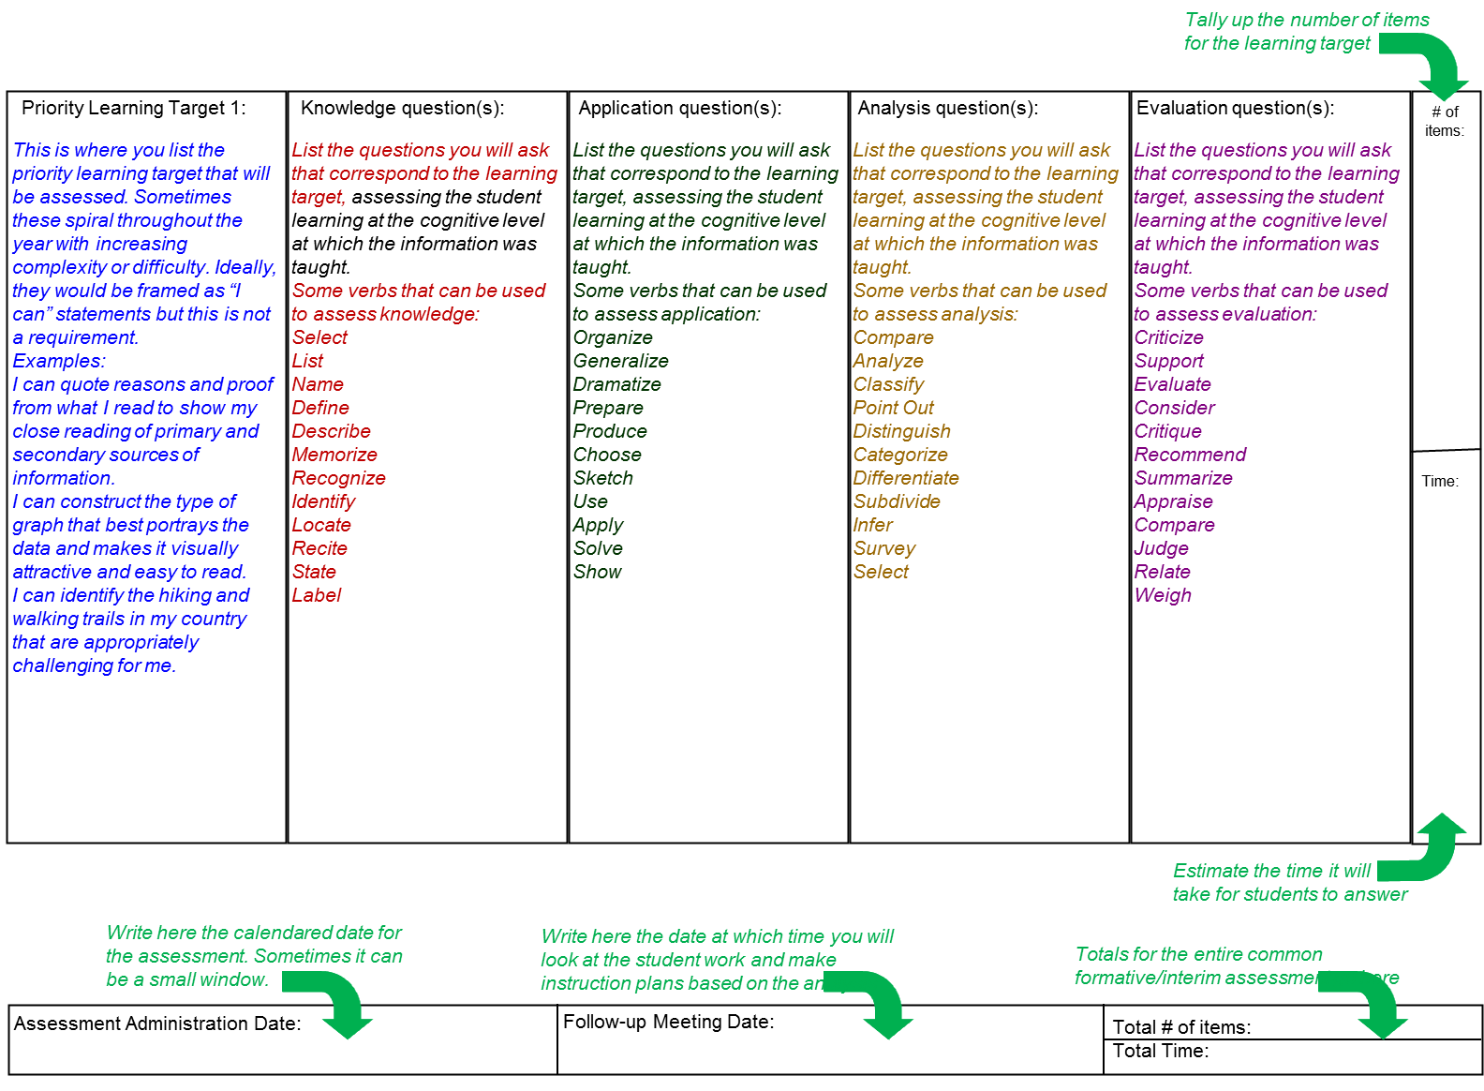
Lay out the learning targets
for ALL of the common formative/interim assessments and THEN make the actual assessments.

Slide 31
Find/make items that match the learning targets. You might not have all four types for each target, but “aim high” on Bloom’s

Slide 32
Keep a tally of your items and estimate the time. Think: GOLDILOCKS!

Slide 33
Your assessment totals go here. Think: GOLDILOCKS!

Slide 34
Calendar the COMMON assessment administration.

Slide 35
When will you meet to look at the student work AND make instructional plans based on your analysis?

Slide 37

break

Slide 38

Thinking Environment…
Take a look at the ‘What to Look for in a Classroom”

Slide 39
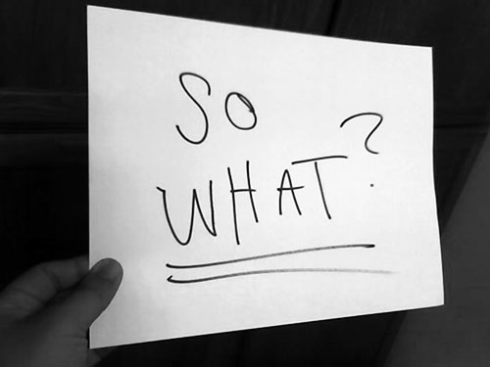

Slide 40
Evidence Collection and
Growth-Producing Feedback

Slide 41
Evidence Collection
Watch the video
Collect evidence
Focus on instruction
  Standard 4 (Teaching Standards and NYSUT)
  Domain 2 (Danielson)

Slide 42
Evidence Collection
Label the evidence provided to you
Use Standards (or refer to Danielson)

Slide 43
Evidence Collection
Rate the teacher on Standard 4 (NYSUT).
As prompted in polleverywhere, text your rating
Where were you, compared to
  Others in the room
  (inter-rater agreement)
  The facilitator
  (inter-rater reliability)

Slide 44

Growth-Producing Feedback
With your neighbor, plan your conversation with the teacher

Slide 46
Next Session
December 2nd in Syracuse
Agenda will include
  Evidence Collection and
  Growth-Producing Feedback
  “Specific considerations in evaluating teachers and principals of ELLs and students with disabilities”
  Preparing for Summative Conversations
  Mini-lesson: 21st Century Skills in RTTT
  Alignment of everything!

Slide 47
Session Close
We don’t have too much Year One Lead Evaluator Training left.
What questions do you still have about the process?
What questions do you have about the nine components?

