Slide 1
Lead Evaluator Training
2013-2014
Day 6

Slide 2
Agenda
Just how is this thing supposed to go?
Math!
Evidence Collection
Inter-rater agreement and reliability
“Specific considerations in evaluating teachers and principals of ELLs and students with disabilities”
Notes:
Review the agenda.

Slide 3
On the chart paper at your table, draw a flow chart of how the process is supposed to work. Include:
Required pieces:
Evidence Collection(s)
Labeling(s)
Sorting(s)
Growth-Producing Feedback(s)
Score on rubric
Optional pieces:
Pre conference conversation
Post conference conversation
Beginning of the year meeting
Summative meeting

Slide 4
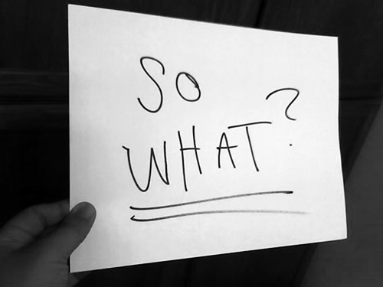

Slide 5
Mathematics

Slide 6

Introduction

Slide 7
Six Shifts: Math
Focus
Coherence
Fluency
Deep Understanding
Applications
Dual Intensity

Slide 8
Needed Change
The practices, more than the content, are what make the Common Core essential for student success:
Make sense and persevere in solving problems.
Reason abstractly and quantitatively.
Construct viable arguments and critique the reasoning of others.

Slide 9
Needed Change
The practices, continued:
Model with mathematics.
Use appropriate tools strategically.
Attend to precision.
Look for and make use of structure.
Look for and express regularity in repeated reasoning.

Slide 10
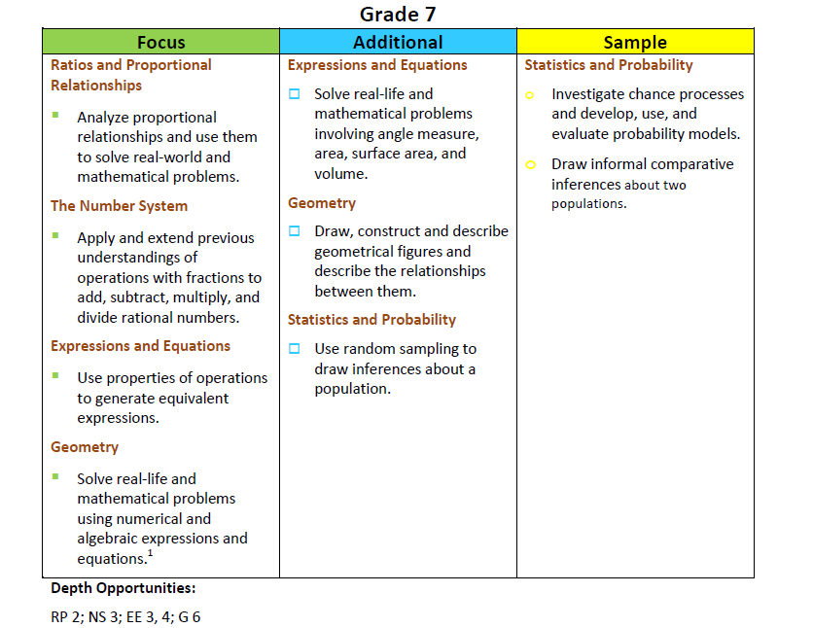
Math Emphases

Slide 11
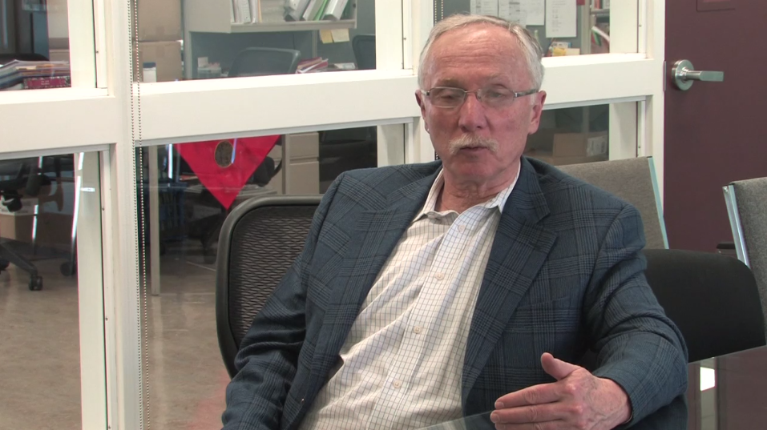
Math Thinking

Slide 12
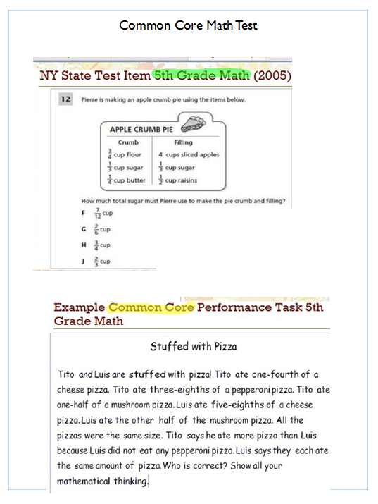
Math Test

Slide 13


Slide 14
Needed Change
This is what has to change:
Equity: focus on all students
Curriculum: ensure consistent content focus
Teaching and Learning: monitor changes in instructional practices
Assessment: Common formative/interim assessment (DDI process)
Technology: appropriate implementation and utilization

Slide 15
Focus on Students
Big ideas:
Opportunity to Learn: guaranteed and viable curriculum
  Timelines, scope & sequences, etc.
  Materials
  All classrooms
  Assessed
  Note: make sure old materials and ideas are removed

Slide 16
Focus on Students
Big ideas:
Visible Thinking: conceptual fluency over procedural fluency
  Metacognition
  Math talk
  Constructivism
  Note: make sure “fluency” is understood

Slide 17
Focus on Students
Big ideas:
Engaging Lessons: cognitive engagement
  Active
  High expectations
  Writing and explanations
  Students doing the work
  Note: traditional lesson structure has to be discarded (HW-lesson-start HW)

Slide 18
Focus on Students
Big ideas:
Group-Worthy Problems: students need to work together on challenging problems
  Collaboration
  Open-ended
  Multiple pathways
  Important content
  Note: Math Solutions is great with this

Slide 19
Focus on Students
Big ideas:
RtI: Data-Driven Process
  common formative/interim assessment
  Tier 1
  Tier 2
  PLC
  Note: need to ensure that intervention is occurring

Slide 20
Common Core Instruction
Teachers will need to
Understand the practices
Understand how kids learn mathematics
Be able to collaboratively unit plan
Know and apply effective strategies
Monitor learning (and adjust)

Slide 21
Sustain the Change
Leadership team will maintain pressure via
Coaching
Ongoing professional development
Appropriate decisions about materials (carefully piloted by later adopters)
Classroom visits and monitoring
Communication of progress
Expectations for all teachers to work collaboratively

Slide 22





Standards meet DDI meet Culture

Slide 23
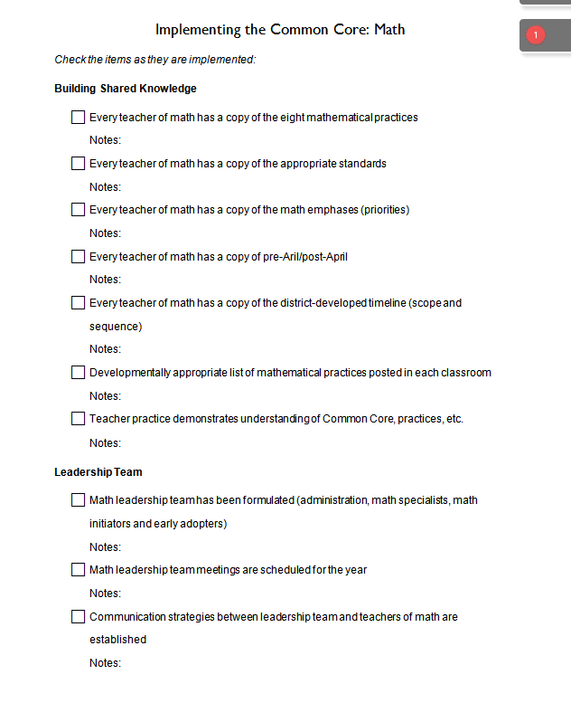
What’s a Leader To Do?
Here’s a checklist that you can use to keep guide (and keep track of) building and district actions
Which can you
check off now?

Slide 24
Specific Considerations in Evaluating Teachers and Principals of ELLs and Students with Disabilities

Slide 25
Evidence Collection and
Growth-Producing Feedback

Slide 26
Evidence Collection
Watch the video
Collect evidence
Focus on instruction
  Standard III (Teaching Standards and NYSUT)
  Domain 3 (Danielson)

Slide 27
Evidence Collection
Label the evidence provided to you
Use Standards (or refer to Danielson)

Slide 28
Evidence Collection
Rate the teacher on Standard 3 (NYSUT).
As prompted in polleverywhere, text your rating
Where were you, compared to
  Others in the room
  (inter-rater agreement)
  The facilitator
  (inter-rater reliability)

Slide 29

Growth-Producing Feedback
With your neighbor, plan your conversation with the teacher

Slide 31
Next Session
November 18th in Syracuse
Agenda will include
  Evidence Collection and
  Growth-Producing Feedback
  Mini-lesson: Data-Driven Instruction
  Special Considerations (Teachers of ELLs)

