Slide 1
Lead Evaluator Training
2012-2013
Day 6

Slide 2
Agenda
Just how is this thing supposed to go?
Math!
Evidence Collection
Inter-rater agreement and reliability
“Specific considerations in evaluating teachers and principals of ELLs and students with disabilities”
Notes:
Review the agenda.

Slide 3
On the chart paper at your table, draw a flow chart of how the process is supposed to work. Include:
Required pieces:
Evidence Collection(s)
Labeling(s)
Sorting(s)
Growth-Producing Feedback(s)
Score on rubric
Optional pieces:
Pre conference conversation
Post conference conversation
Beginning of the year meeting
Summative meeting

Slide 4
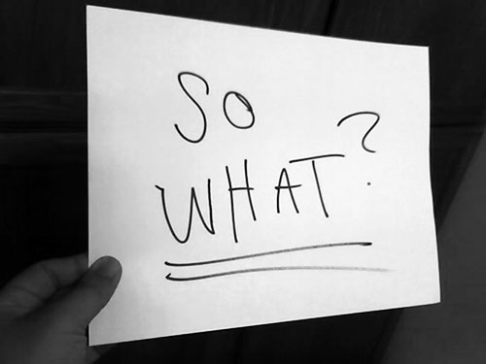

Slide 5
ELA

Slide 6
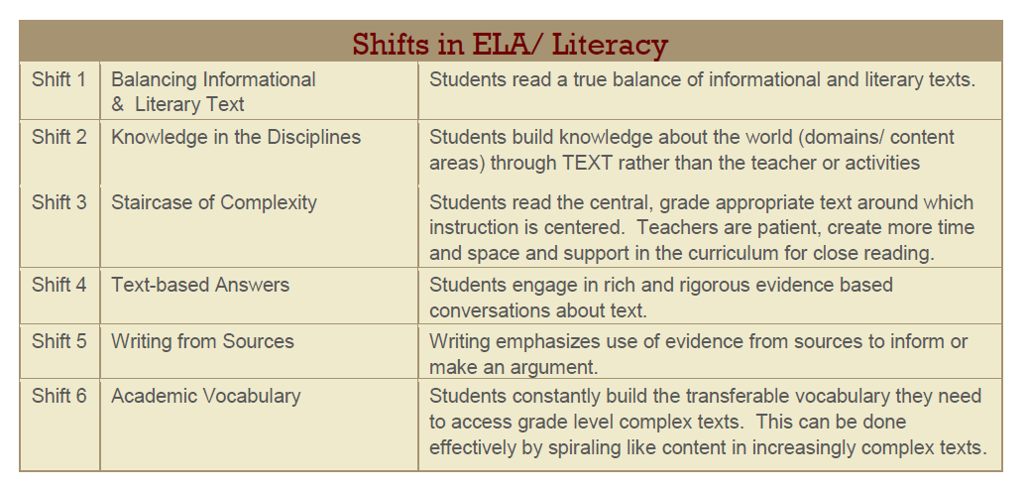
One More Thing For Now… Posters!

Slide 7
Mathematics

Slide 8

Introduction

Slide 9
Six Shifts: Math
Focus
Coherence
Fluency
Deep Understanding
Applications
Dual Intensity

Slide 10
Mathematical Practices:
Make sense of problems & persevere in solving them.
Reason abstractly and quantitatively.
Construct viable arguments and critique the reasoning of others.
Model with mathematics.
Use appropriate tools strategically.
Attend to precision.
Look for and make use of structure.
Look for and express regularity in repeated reasoning.

Slide 11
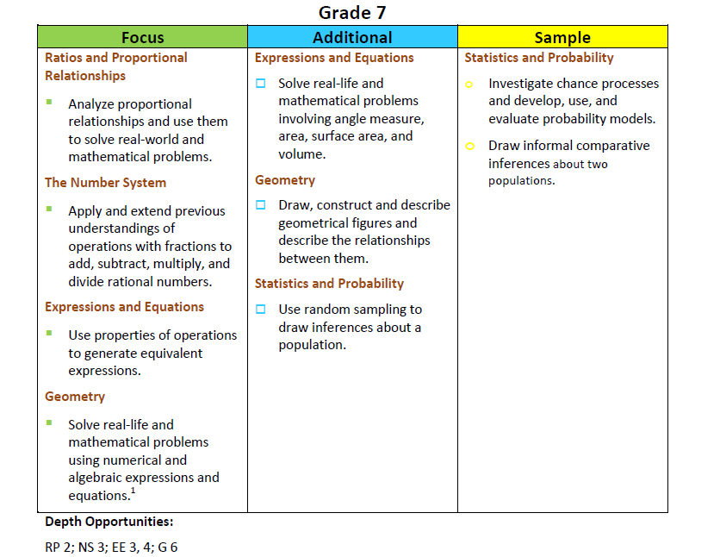
Math Emphases

Slide 13
Math Walk
You will need:
  Sample assessment items
  Common Core Learning Standards
You might also need:
  preApril/postApril
  Math emphases
Notes:
Before beginning the actual activity, make sure that everyone understand the resources available to them at the table.

Slide 14
Math Walk
Select one sample assessment item from a 3rd grade test
With the corresponding grade’s standards in front of you, discuss that item and its annotation with your colleague. What is it measuring? What choices did the item writer make?
Trace one of those measured standards backwards to lower grades. What is happening in those grades in that same standard? How does it build through P-2?
Focus now on 2nd grade. How would you measure student knowledge/skill? In that standard for 1st grade?
So What? Does this mean for your math program?

Slide 15
Math Walk - continued
Trace that same standard up to 8th grade
Look at the 8th grade sample items and see how it plays out in those questions
So What? are the instructional and programmatic implications?

Slide 17
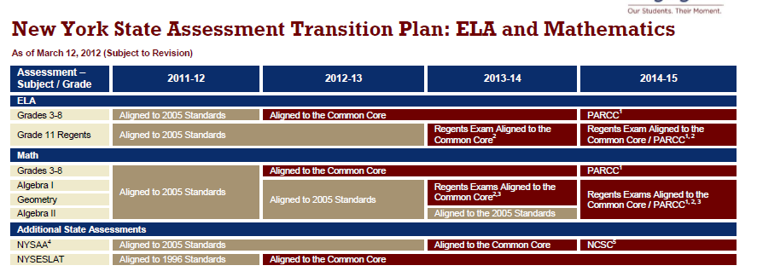
Timeline
For 3-8 (P-8) now (you should be operating on your bridge plan)
For high school, here’s the assessment schedule:
  A1 2013-2014
  Geometry 2013-2014
  A2 2014-2015 (PARCC?)

Slide 18
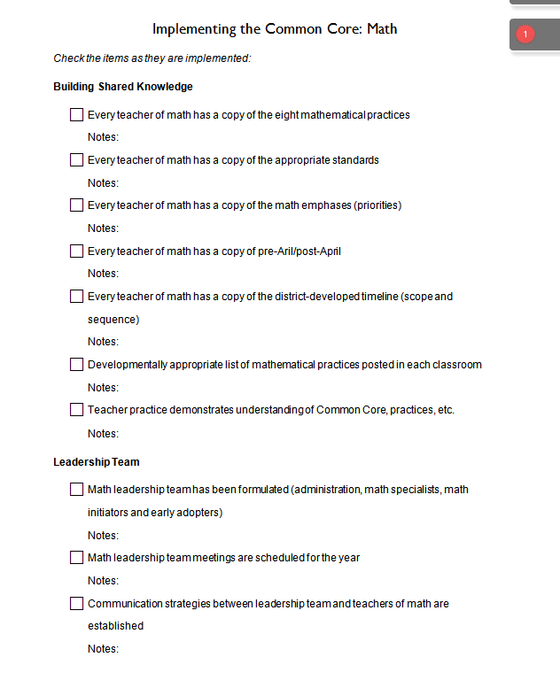
What’s a Leader To Do?
Here’s a checklist that you can use to keep guide (and keep track of) building and district actions
Which can you
check off now?

Slide 19

Think about this activity; discuss in your table group:
Would you do this activity with teachers?
All of them or just your 3-8?
What would it accomplish?
Notes:
NOTES

Slide 20
Evidence Collection and
Growth-Producing Feedback

Slide 21
Evidence Collection
Watch the video
Collect evidence
Focus on instruction
  Standard III (Teaching Standards and NYSUT)
  Domain 3 (Danielson)

Slide 22
Evidence Collection
Label the evidence provided to you
Use Standards (or refer to Danielson)

Slide 23
Evidence Collection
Rate the teacher on Standard 3 (NYSUT).
As prompted in polleverywhere, text your rating
Where were you, compared to
  Others in the room
  (inter-rater agreement)
  The facilitator
  (inter-rater reliability)

Slide 24

Growth-Producing Feedback
With your neighbor, plan your conversation with the teacher

Slide 26
Next Session
December 14th in Syracuse
Agenda will include
  Evidence Collection and
  Growth-Producing Feedback
  Mini-lesson: Data-Driven Instruction
  Special Considerations (Teachers of ELLs)

