Slide 1
Lead Evaluator Training
2015-2016
Day 5

Slide 2
Here We Are: 9 Components
3012-c
3012-d
New York State Teaching Standards and Leadership Standards
Evidence-based observation
Application and use of Student Growth Percentile and VA Growth Model data
Application and use of the State-approved teacher or principal rubrics
Application and use of any assessment tools used to evaluate teachers and principals
New York State Teaching Standards and Leadership Standards
Evidence-based observation
Application and use of Student Growth Percentile method
Application and use of the State-approved teacher or principal rubrics
Application of assessment tools the district employs

Slide 3
Here We Are: 9 Components
3012-c
3012-d
Application and use of State-approved locally selected measures of student achievement
Use of the Statewide Instructional Reporting System
Scoring methodology used to evaluate teachers and principals
Specific considerations in evaluating teachers and principals of ELLs and students with disabilities
Application and use of State-approved locally selected measures of student growth
Use of the Statewide Instructional Reporting System
Scoring methodology used by the state and the district
Specific considerations in evaluating teachers and principals of ELLs and students with disabilities

Slide 4
Here We Are: 9+ Components
Managing the APPR
Connecting it to Race To The Top
Increasing the likelihood that it makes a difference

Slide 5
Agenda
What the heck is going on?
Just how is this thing supposed to go?
Specific considerations in evaluating teachers and principals of ELLs and students with disabilities
Evidence Collection
Inter-rater agreement and reliability
Notes:
Review the agenda.

Slide 6
3012-c? d? e?
Recommendation 21: Until the new system is fully phased in, the results from assessments aligned to the current Common Core Standards, as well as the updated standards, shall only be advisory and not be used to evaluate the performance of individual teachers or students.
Given the amount of work needed to get the new system right, the Task Force recommends that until the transition to a new system is complete, i.e. New York State-specific standards are fully developed along with corresponding curriculum and tests, State-administered standardized ELA and Mathematics assessments for grades three through eight aligned to the Common Core or updated standards shall not have consequences for individual students or teachers. Further, any growth model based on these Common Core tests or other state assessments shall not have consequences and shall only be used on an advisory basis for teachers.
The transition phase shall last until the start of the 2019-2020 school year.

Slide 7
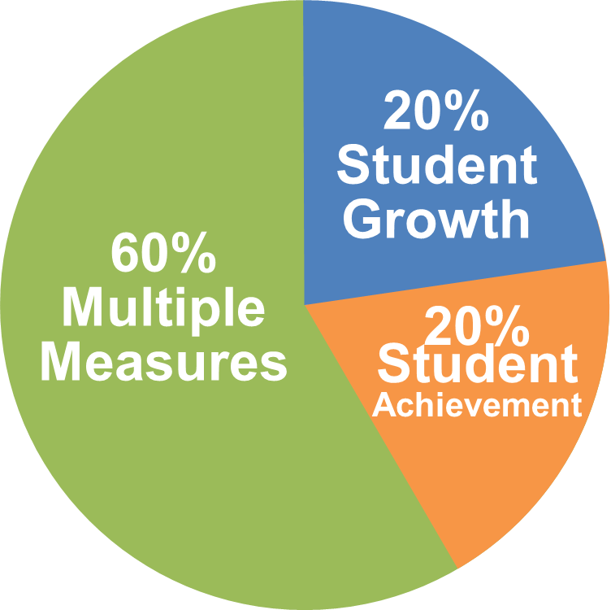
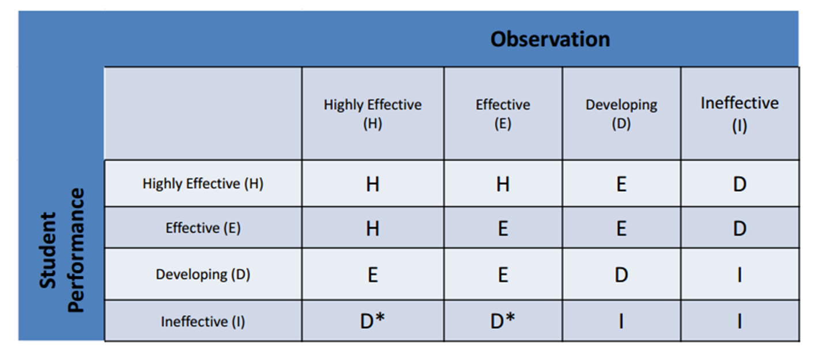
However:

Slide 8
On the chart paper at your table, draw a flow chart of how the process is supposed to work. Include:
Required pieces:
Evidence Collection(s)
Labeling(s)
Sorting(s)
Growth-Producing Feedback(s)
Score on rubric
Optional pieces:
Pre conference conversation
Post conference conversation
Beginning of the year meeting
Summative meeting

Slide 9


Slide 10
Specific considerations in evaluating teachers and principals of ELLs and students with disabilities

Slide 11

break

Slide 12
Evidence Collection and
Growth-Producing Feedback

Slide 13
Evidence Collection
Watch the video
Collect evidence
Focus on instruction
  Standard 4 (Teaching Standards and NYSUT)
  Domain 2 (Danielson)

Slide 14
Evidence Collection
Label the evidence provided to you
Use Standards (or refer to Danielson)

Slide 15
Evidence Collection
Rate the teacher on Standard 4 (Domain 2)
Use the answer sheet
As prompted in polleverywhere, text your rating
Where were you, compared to
  Others in the room
  (inter-rater agreement)
  The facilitator
  (inter-rater reliability)

Slide 16
Growth-Producing Feedback
With your neighbor, plan your conversation with the teacher (focusing on Standard 4/Domain 2):
Points of emphasis?
Desired next steps for teacher?
Next steps for you?
Opening line?

Slide 17
Session Close
We don’t have too much Year One Lead Evaluator Training left.
What questions do you still have about the process?
What questions do you have about the nine components?

Slide 18
Next Session
January 25th
Agenda will include
  Summative Calculations
  Summative Conversations
  Looking to the future

