Slide 1
Lead Evaluator Training
2014-2015
Day 5

Slide 2
Agenda
What have you been up to? Sharing what we’ve done related to this work in the last month.
A little more on the Six shifts in ELA/Literacy
Technical v. Personal
Observation > Evidence Collection > Label >
Sort > Rubric
Another mini-observation and follow-up conversation
Notes:
Review the agenda.

Slide 3
Warming up:
  Organize the blue cards.
Constructivism
Evidence
Collection
Bias
21st Century Skills
Cognitive
engagement
Rubric
Fairness
HEDI
APPR
Observation
Mini
Observation
Reliability
Supervision
Evaluation
Validity
Notes:
NOTES

Slide 4
Warming up:
  Now integrate the yellow cards into your scheme.
Continuous
Improvement
Feedback
Professional
Development
Risk-taking
Change
Growth
Support
Evaluation
Reflection
Notes:
NOTES

Slide 5


Slide 6
The essential message is not “you are broken and I’m here to fix you” but instead “you are so valuable and worthy, our mission so vital, the future lives of our students so precious, that we have a joint responsibility to each other.”
-Doug Reeves

Slide 7
ELA/Literacy and the
Common Core

Slide 8
Six Shifts: ELA/Literacy
Balancing Informational & Literary Texts (Grades PK-5)
Knowledge in the Disciplines (Grades 6-12)
Staircase of Complexity
Text-based Answers
Writing from Sources
Academic Vocabulary

Slide 9
Staircase of Complexity
Interquartile Ranges Shown (25% - 75%)
1600
1400
1200
Text Lexile Measure (L)
1000
800
600
High
School
Literature
College
Literature
High
School
Textbooks
College
Textbooks
Military
Personal
Use
Entry-Level
Occupations
SAT 1,
ACT,
AP*
* Source of National Test Data: MetaMetrics

Slide 10
Shift 1: Balancing Informational and Literary Text
What the Student Does… | What the Teacher Does… | What the Principal Does…
Build background knowledge to increase reading skill Exposure to the world through reading Apply strategies to reading informational text. | Provide students equal #s of informational and literary texts Ensure coherent instruction about content Teach strategies for informational texts Teach “through” and “with” informational texts Scaffold for the difficulties that informational text present to students Ask students, “What is connected here? How does this fit together? What details tell you that? “ | Purchase and provide equal amounts of informational and literacy text to students Hold teachers accountable for building student content knowledge through text Provide PD and co-planning opportunities for teachers to become more intimate with non fiction texts and the way they spiral together
Notes:
This shift involves simply reading more informational text – balancing the amount of literature with informational text. Elementary teachers are the students tour guide to world – to culture, to society. Rather than telling students about what is happening out there, we need to have them read about it. More literary non fiction, more information being conveyed through writing. Less fiction. Less telling and summarizing by the teacher.

Slide 11
Shift 1: Balancing Informational and Literary Text
What the Student Does… | What the Teacher Does… | What the Principal Does…
Build background knowledge to increase reading skill Exposure to the world through reading Apply strategies to reading informational text. | Provide students equal #s of informational and literary texts Ensure coherent instruction about content Teach strategies for informational texts Teach “through” and “with” informational texts Scaffold for the difficulties that informational text present to students Ask students, “What is connected here? How does this fit together? What details tell you that? “ | Purchase and provide equal amounts of informational and literacy text to students Hold teachers accountable for building student content knowledge through text Provide PD and co-planning opportunities for teachers to become more intimate with non fiction texts and the way they spiral together
To what extent are you seeing this in your school? In all classes, or just ELA?
Notes:
This shift involves simply reading more informational text – balancing the amount of literature with informational text. Elementary teachers are the students tour guide to world – to culture, to society. Rather than telling students about what is happening out there, we need to have them read about it. More literary non fiction, more information being conveyed through writing. Less fiction. Less telling and summarizing by the teacher.

Slide 12
Shift 2: Knowledge in the Disciplines
What the Student Does… | What the Teacher Does… | What the Principal Does…
Become better readers by building background knowledge Handle primary source documents with confidence Infer, like a detective, where the evidence is in a text to support an argument or opinion See the text itself as a source of evidence (what did it say vs. what did it not say?) | Shift identity: “I teach reading.” Stop referring and summarizing and start reading Slow down the history and science classroom Teach different approaches for different types of texts Treat the text itself as a source of evidence Teach students to write about evidence from the text Teach students to support their opinion with evidence. Ask : “How do you know? Why do you think that? Show me in the text where you see evidence for your opinion. “ | Support and demand the role of all teachers in advancing students’ literacy Provide guidance and support to ensure the shift to informational texts for 6-12 Give teachers permission to slow down and deeply study texts with students
Notes:
Students must be ready to handle more informational text. In order to do this, teachers must work to build their own skills to deliver this
Instead of “telling” the students information, have them read about it. We all must have a balance of accessing informational text; accessing non-fiction in general. And, all content teachers 6-12, must do this as well. The Common Core is asking that all teachers become reading teachers. For example, instead of telling students about the Civil Rights Movement, teachers find text for them to read about the Civil Rights Movement. The way that content should be delivered is through sources; through texts, through data, through information online.

Slide 13
Shift 2: Knowledge in the Disciplines
What the Student Does… | What the Teacher Does… | What the Principal Does…
Become better readers by building background knowledge Handle primary source documents with confidence Infer, like a detective, where the evidence is in a text to support an argument or opinion See the text itself as a source of evidence (what did it say vs. what did it not say?) | Shift identity: “I teach reading.” Stop referring and summarizing and start reading Slow down the history and science classroom Teach different approaches for different types of texts Treat the text itself as a source of evidence Teach students to write about evidence from the text Teach students to support their opinion with evidence. Ask : “How do you know? Why do you think that? Show me in the text where you see evidence for your opinion. “ | Support and demand the role of all teachers in advancing students’ literacy Provide guidance and support to ensure the shift to informational texts for 6-12 Give teachers permission to slow down and deeply study texts with students
To what extent are you seeing this in your school? In all classes, or just ELA?
Notes:
Students must be ready to handle more informational text. In order to do this, teachers must work to build their own skills to deliver this
Instead of “telling” the students information, have them read about it. We all must have a balance of accessing informational text; accessing non-fiction in general. And, all content teachers 6-12, must do this as well. The Common Core is asking that all teachers become reading teachers. For example, instead of telling students about the Civil Rights Movement, teachers find text for them to read about the Civil Rights Movement. The way that content should be delivered is through sources; through texts, through data, through information online.

Slide 14
Shift 3: Staircase of Complexity
What the Student Does… | What the Teacher Does… | What the Principal Does…
Read to see what more they can find and learn as they re-read texts again and again Read material at own level to build joy of reading and pleasure in the world Be persistent despite challenges when reading; good readers tolerate frustration | Ensure students are engaged in more complex texts at every grade level Engage students in rigorous conversation Provide experience with complex texts Give students less to read, let them re-read Use leveled texts carefully to build independence in struggling readers More time on more complex texts Provide scaffolding Engage with texts w/ other adults Get kids inspired and excited about the beauty of language | Ensure that complexity of text builds from grade to grade. Look at current scope and sequence to determine where/how to incorporate greater text complexity Allow and encourage teachers to build a unit in a way that has students scaffold to more complex texts over time Allow and encourage teachers the opportunity to share texts with students that may be at frustration level
Notes:
Students must be reading in all content areas. Increasingly complex texts throughout P-12. The Common Core is often defining grade level text complexity as texts that are 2-3 grade levels more complex than the current grade level texts in school so that they are actually prepared to access the complexity they encounter in careers and college. Appendix B of the Common Core State Standards includes a list of texts that model levels of complexity for every grade level. This is an important portion of standards and should be reviewed.

Slide 15
Shift 3: Staircase of Complexity
What the Student Does… | What the Teacher Does… | What the Principal Does…
Read to see what more they can find and learn as they re-read texts again and again Read material at own level to build joy of reading and pleasure in the world Be persistent despite challenges when reading; good readers tolerate frustration | Ensure students are engaged in more complex texts at every grade level Engage students in rigorous conversation Provide experience with complex texts Give students less to read, let them re-read Use leveled texts carefully to build independence in struggling readers More time on more complex texts Provide scaffolding Engage with texts w/ other adults Get kids inspired and excited about the beauty of language | Ensure that complexity of text builds from grade to grade. Look at current scope and sequence to determine where/how to incorporate greater text complexity Allow and encourage teachers to build a unit in a way that has students scaffold to more complex texts over time Allow and encourage teachers the opportunity to share texts with students that may be at frustration level
To what extent are you seeing this in your school? In all classes, or just ELA?
Notes:
Students must be reading in all content areas. Increasingly complex texts throughout P-12. The Common Core is often defining grade level text complexity as texts that are 2-3 grade levels more complex than the current grade level texts in school so that they are actually prepared to access the complexity they encounter in careers and college. Appendix B of the Common Core State Standards includes a list of texts that model levels of complexity for every grade level. This is an important portion of standards and should be reviewed.

Slide 16
Shift 4: Text Based Answers
What the Student Does… | What the Teacher Does… | What the Principal Does…
Go back to text to find evidence to support their argument in a thoughtful, careful, precise way Develop a fascination with reading Create own judgments and become scholars, rather than witnesses of the text Conducting reading as a close reading of the text and engaging with the author and what the author is trying to say | Facilitate evidence based conversations with students, dependent on the text Have discipline about asking students where in the text to find evidence, where they saw certain details, where the author communicated something, why the author may believe something; show all this in the words from the text. Plan and conduct rich conversations about the stuff that the writer is writing about. Keep students in the text Identify questions that are text-dependent, worth asking/exploring, deliver richly, Provide students the opportunity to read the text, encounter references to another text, another event and to dig in more deeply into the text to try and figure out what is going on. Spend much more time preparing for instruction by reading deeply. | Allow teachers the time to spend more time with students writing about the texts they read- and to revisit the texts to find more evidence to write stronger arguments. Provide planning time for teachers to engage with the text to prepare and identify appropriate text-dependent questions. Create working groups to establish common understanding for what to expect from student writing at different grade levels for text based answers. Structure student work protocols for teachers to compare student work products; particularly in the area of providing evidence to support arguments/conclusions.
Notes:
Students need to develop the ability to engage in rich, evidence-based dialogue about a text they have read. Having students have conversations about text and teachers’ facilitation of these conversations, requires a higher level of sophistication for both teachers and students. Rather than the quicker connections between text and self, teachers must now train students to stay in the text, to draw conclusions and make arguments about the text and do so through the text itself. Teachers will often be asking, “where do you see that in the text? What paragraph? What sentence? What word?” students must begin to think and argue through and with texts by constantly being asked to find evidence in what they have read.

Slide 17
Shift 4: Text Based Answers
What the Student Does… | What the Teacher Does… | What the Principal Does…
Go back to text to find evidence to support their argument in a thoughtful, careful, precise way Develop a fascination with reading Create own judgments and become scholars, rather than witnesses of the text Conducting reading as a close reading of the text and engaging with the author and what the author is trying to say | Facilitate evidence based conversations with students, dependent on the text Have discipline about asking students where in the text to find evidence, where they saw certain details, where the author communicated something, why the author may believe something; show all this in the words from the text. Plan and conduct rich conversations about the stuff that the writer is writing about. Keep students in the text Identify questions that are text-dependent, worth asking/exploring, deliver richly, Provide students the opportunity to read the text, encounter references to another text, another event and to dig in more deeply into the text to try and figure out what is going on. Spend much more time preparing for instruction by reading deeply. | Allow teachers the time to spend more time with students writing about the texts they read- and to revisit the texts to find more evidence to write stronger arguments. Provide planning time for teachers to engage with the text to prepare and identify appropriate text-dependent questions. Create working groups to establish common understanding for what to expect from student writing at different grade levels for text based answers. Structure student work protocols for teachers to compare student work products; particularly in the area of providing evidence to support arguments/conclusions.
To what extent are you seeing this in your school? In all classes, or just ELA?
Notes:
Students need to develop the ability to engage in rich, evidence-based dialogue about a text they have read. Having students have conversations about text and teachers’ facilitation of these conversations, requires a higher level of sophistication for both teachers and students. Rather than the quicker connections between text and self, teachers must now train students to stay in the text, to draw conclusions and make arguments about the text and do so through the text itself. Teachers will often be asking, “where do you see that in the text? What paragraph? What sentence? What word?” students must begin to think and argue through and with texts by constantly being asked to find evidence in what they have read.

Slide 18
Shift 5: Writing from Sources
What the Student Does… | What the Teacher Does… | What the Principal Does…
Begin to generate own informational texts | Expect that students will generate their own informational texts (spending much less time on personal narratives) Present opportunities to write from multiple sources about a single topic. Give opportunities to analyze, synthesize ideas across many texts to draw an opinion or conclusion. Find ways to push towards a style of writing where the voice comes from drawing on powerful, meaningful evidence. Give permission to students to start to have their own reaction and draw their own connections. | Build teacher capacity and hold teachers accountable to move students towards informational writing
Notes:
This is evidence based WRITING about texts. We are shifting away from an overemphasis on narrative writing because it is a skill not often demanded by career and college. What IS demanded by career and college is to synthesize and react to what we have read. Therefore, the Common Core asks that students, across content areas, are being asked to interact with and make arguments through sources – texts, data, etc. Students must be trained to use the evidence they collect from what they read in order to form cogent and convincing argument in the text they produce.

Slide 19
Shift 5: Writing from Sources
What the Student Does… | What the Teacher Does… | What the Principal Does…
Begin to generate own informational texts | Expect that students will generate their own informational texts (spending much less time on personal narratives) Present opportunities to write from multiple sources about a single topic. Give opportunities to analyze, synthesize ideas across many texts to draw an opinion or conclusion. Find ways to push towards a style of writing where the voice comes from drawing on powerful, meaningful evidence. Give permission to students to start to have their own reaction and draw their own connections. | Build teacher capacity and hold teachers accountable to move students towards informational writing
To what extent are you seeing this in your school? In all classes, or just ELA?
Notes:
This is evidence based WRITING about texts. We are shifting away from an overemphasis on narrative writing because it is a skill not often demanded by career and college. What IS demanded by career and college is to synthesize and react to what we have read. Therefore, the Common Core asks that students, across content areas, are being asked to interact with and make arguments through sources – texts, data, etc. Students must be trained to use the evidence they collect from what they read in order to form cogent and convincing argument in the text they produce.

Slide 20
Shift 6: Academic Vocabulary
What the Student Does… | What the Teacher Does… | What the Principal Does…
Spend more time learning words across “webs” and associating words with others instead of learning individual, isolated vocabulary words. | Develop students’ ability to use and access words that show up in everyday text and that may be slightly out of reach Be strategic about the kind of vocabulary you’re developing and figure out which words fall into which categories- tier 2 vs. tier 3 Determine the words that students are going to read most frequently and spend time mostly on those words Teach fewer words but teach the webs of words around it Shift attention on how to plan vocabulary meaningfully using tiers and transferability strategies | Provide training to teachers on the shift for teaching vocabulary in a more meaningful, effective manner.
Notes:
What the Common Core is asking of us is to consistently develop students ability to use and access words that are showing up in everyday vocabulary but that are slightly out of reach for our students.
It is really about giving students the right tools. There are certain words that are great tools as the students will see them in lots of context; when they read, across different disciplines etc. There are other words that are interesting and may come up in certain areas; content specific words like “amoeba;” or there are other words that are sort of esoteric and interesting but they are not words that students will confront frequently as they read.
It is important to be strategic about the kind of vocabulary we are teaching. We need to consider what category these words fall in to.
Isabel Beck talks about Tier I words as very common words, Tier 2 as words that are powerfully useful and frequently occurring and Tier 3 as domain-specific words. The challenge is in figuring out which words are Tier 2 words and which words to teach. This takes careful planning.
it is important to understand the nuances between words, people tend to over rely on synonyms – i.e.. happy and pleased. The author makes a choice between these words. To identify these Tier 2 words it is important to understand what the author is conveying and also to know what words are really going to occur most frequently.
Regarding synonyms, fewer words may be taught but also teach the web of words around them. The goal is for the students to not only know the words as a reader, but invest in the words as a writer.

Slide 21
Shift 6: Academic Vocabulary
What the Student Does… | What the Teacher Does… | What the Principal Does…
Spend more time learning words across “webs” and associating words with others instead of learning individual, isolated vocabulary words. | Develop students’ ability to use and access words that show up in everyday text and that may be slightly out of reach Be strategic about the kind of vocabulary you’re developing and figure out which words fall into which categories- tier 2 vs. tier 3 Determine the words that students are going to read most frequently and spend time mostly on those words Teach fewer words but teach the webs of words around it Shift attention on how to plan vocabulary meaningfully using tiers and transferability strategies | Provide training to teachers on the shift for teaching vocabulary in a more meaningful, effective manner.
To what extent are you seeing this in your school? In all classes, or just ELA?
Notes:
What the Common Core is asking of us is to consistently develop students ability to use and access words that are showing up in everyday vocabulary but that are slightly out of reach for our students.
It is really about giving students the right tools. There are certain words that are great tools as the students will see them in lots of context; when they read, across different disciplines etc. There are other words that are interesting and may come up in certain areas; content specific words like “amoeba;” or there are other words that are sort of esoteric and interesting but they are not words that students will confront frequently as they read.
It is important to be strategic about the kind of vocabulary we are teaching. We need to consider what category these words fall in to.
Isabel Beck talks about Tier I words as very common words, Tier 2 as words that are powerfully useful and frequently occurring and Tier 3 as domain-specific words. The challenge is in figuring out which words are Tier 2 words and which words to teach. This takes careful planning.
it is important to understand the nuances between words, people tend to over rely on synonyms – i.e.. happy and pleased. The author makes a choice between these words. To identify these Tier 2 words it is important to understand what the author is conveying and also to know what words are really going to occur most frequently.
Regarding synonyms, fewer words may be taught but also teach the web of words around them. The goal is for the students to not only know the words as a reader, but invest in the words as a writer.

Slide 23
Divide 100% of your staff between:
% of your staff who have heard of the Common Core but not the 6 shifts in ELA/Literacy | % of your staff who have had an introduction to the 6 shifts in ELA/Literacy and been told that it applies to them in some way | % of your staff who have internalized that the 6 shifts in ELA/Literacy require some amount of change in their practice | % of your staff who have started to do something about the 6 shifts in ELA/Literacy when it comes to their planning and instruction | % of your staff who embraced the 6 shifts and who are regularly making changes to their planning and instruction
What is your next step(s)?
Notes:
NOTES

Slide 24
Growth-Producing Feedback

Slide 25
The Year at a Glance
Beginning of the Year
Ongoing
End of the Year
Beginning of the year meeting
Standards I and II
SLO and
local (LAT) target setting
Evidence Submission by
Teacher
Evidence Collection
Sharing the evidence
Feedback Conversations
Evidence from the year collected
Compare collected evidence to the rubric
Summative score determination and communication

Slide 26
Conversation,
Questions &
Discussion
COLLECT
DATA
(Evidence)
Respect &
Rapport
Conclusions
Impact on learning…
Support needed…
Notes:
NOTES

Slide 27

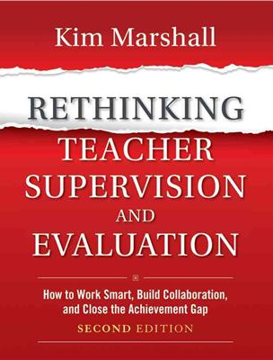
Checking in with Kim
  Read what Kim has to say about feedback to teachers
  Discuss as a table group: how does his advice compare to
  your walkthrough/mini experiences?
Page 80
Notes:
NOTES

Slide 28
Evidence Collection and
Growth-Producing Feedback

Slide 29

ELA Classroom
Observe what the teacher and the students are doing in this lesson (excerpt)
Collect evidence electronically
Label it by NYS Teaching Standard or Domain
Sort it
Compare with your neighbor/table

Slide 30
Rubric as Road Maps
  Identify your destination
  Identify your current location
  Design the best route to your destination and move forward
  NOT as inspection tools
Notes:
NOTES

Slide 31
Evidence and a Rubric
  Individually, review the evidence and the slice of the rubric.
  What would be your opening line with the teacher?
  How might the teacher reply?
  Now, score the rubric (together).
  Plan the opening line and anticipate the teacher’s response.
  Any difference?
Notes:
If time allows

Slide 32

Growth-Producing Feedback
With your neighbor, plan your conversation with the teacher

Slide 34
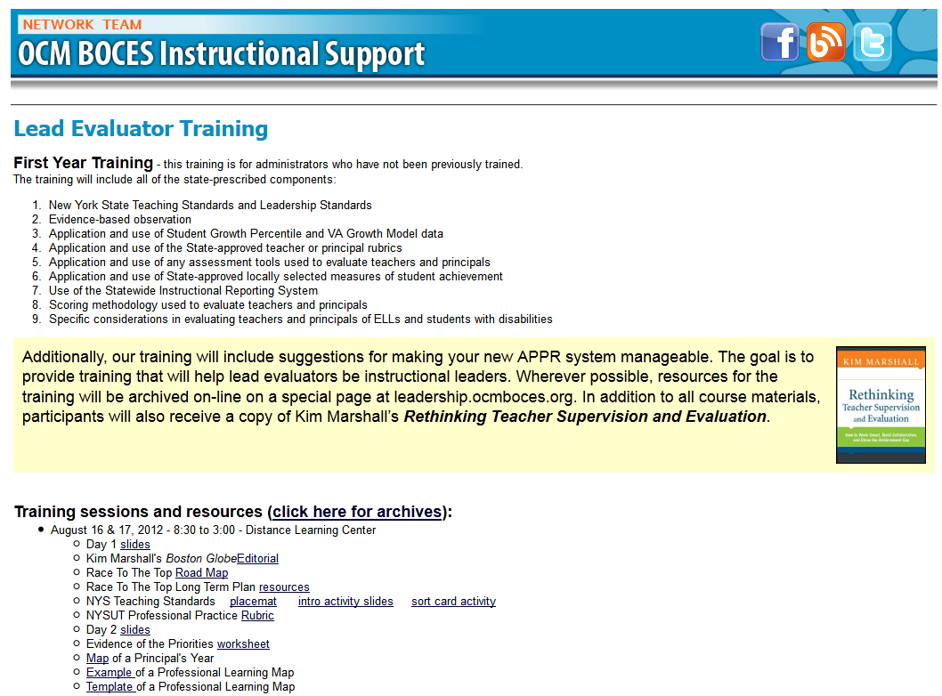
Resources

Slide 35
Next Session
October 28th in Syracuse
Agenda will include
  Math mini-lesson
  Evidence Collection
  Growth-Producing Feedback

