Slide 1
Lead Evaluator Training
2015-2016
Day 4

Slide 2
Here We Are: 9 Components
3012-c
3012-d
New York State Teaching Standards and Leadership Standards
Evidence-based observation
Application and use of Student Growth Percentile and VA Growth Model data
Application and use of the State-approved teacher or principal rubrics
Application and use of any assessment tools used to evaluate teachers and principals
New York State Teaching Standards and Leadership Standards
Evidence-based observation
Application and use of Student Growth Percentile method
Application and use of the State-approved teacher or principal rubrics
Application of assessment tools the district employs

Slide 3
Here We Are: 9 Components
3012-c
3012-d
Application and use of State-approved locally selected measures of student achievement
Use of the Statewide Instructional Reporting System
Scoring methodology used to evaluate teachers and principals
Specific considerations in evaluating teachers and principals of ELLs and students with disabilities
Application and use of State-approved locally selected measures of student growth
Use of the Statewide Instructional Reporting System
Scoring methodology used by the state and the district
Specific considerations in evaluating teachers and principals of ELLs and students with disabilities

Slide 4
Here We Are: 9+ Components
Managing the APPR
Connecting it to Race To The Top
Increasing the likelihood that it makes a difference

Slide 5
Agenda
What have you been up to? Sharing what we’ve done related to this work in October and November…
ELA mini-observation with evidence collection
Going to a rubric
Growth-Producing Feedback
Notes:
Review the agenda.

Slide 6
Agenda
What have you been up to? Sharing what we’ve done related to this work in the last month.
A little more on the Six shifts in ELA/Literacy
Technical v. Personal
Observation > Evidence Collection > Label >
Sort > Rubric
Another mini-observation and follow-up conversation
Notes:
Review the agenda.

Slide 7
Warming up:
  Organize the blue cards.
Constructivism
Evidence
Collection
Bias
21st Century Skills
Cognitive
engagement
Rubric
Fairness
HEDI
APPR
Observation
Mini
Observation
Reliability
Supervision
Evaluation
Validity
Notes:
NOTES

Slide 8
Warming up:
  Now integrate the yellow cards into your scheme.
Continuous
Improvement
Feedback
Professional
Development
Risk-taking
Change
Growth
Support
Evaluation
Reflection
Notes:
NOTES

Slide 9
The Year at a Glance
Beginning of the Year
Ongoing
End of the Year
Beginning of the year meeting
Standards I and II
SLO and
local (LAT) target setting
Evidence Submission by
Teacher
Evidence Collection
Sharing the evidence
Feedback Conversations
Evidence from the year collected
Compare collected evidence to the rubric
Summative score determination and communication

Slide 10
Evidence Collection and
Growth-Producing Feedback

Slide 11

ELA Classroom
Observe what the teacher and the students are doing in this lesson (excerpt)
Collect evidence electronically
Label it by NYS Teaching Standard or Domain
Sort it
Compare with your neighbor/table

Slide 12
Rubric as Road Maps
  Identify your destination
  Identify your current location
  Design the best route to your destination and move forward
  NOT as inspection tools
Notes:
NOTES

Slide 13
Evidence and a Rubric
  Individually, review the evidence and the slice of the rubric.
  What would be your opening line with the teacher?
  How might the teacher reply?
  Now, score the rubric (together).
  Plan the opening line and anticipate the teacher’s response.
  Any difference?
Notes:
If time allows

Slide 14
Growth-Producing
Feedback

Slide 15
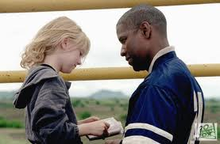
Qualities of Growth-Producing Feedback?
  From Man on Fire, what are
  the qualities of
  Growth-Producing Feedback?
  Take a look at
  Paula Rutherford’s list
  Check out a teacher-principal
  conversation
Notes:
NOTES

Slide 16


Checking in with Kim
  Read what Kim has to say about feedback to teachers
  Discuss as a table group: how does his advice compare to
  your walkthrough/mini experiences?
  Pages 65-68
Page 65
Notes:
NOTES

Slide 17
Conversations (example)
  Form a triad
  Each person gets a different colored half-sheet
  Prepare your opening line (<30 seconds)
  First triad member says opening line to the two others
  Two others give first person feedback
  Repeat the process until everyone in the group has gone
Notes:
NOTES

Slide 18

Growth-Producing Feedback
With your neighbor, plan your conversation with the teacher

Slide 19
Conversations
  Go back to the mini-observation
  Review the Evidence
  Prepare your thoughts for your follow-up conversation with the teacher. Make sure you have your opening line ready!
  Role-play the conversation.
  Repeat.
Notes:
NOTES

Slide 20
Conversation,
Questions &
Discussion
COLLECT
DATA
(Evidence)
Respect &
Rapport
Conclusions
Impact on learning…
Support needed…
Notes:
NOTES

Slide 21
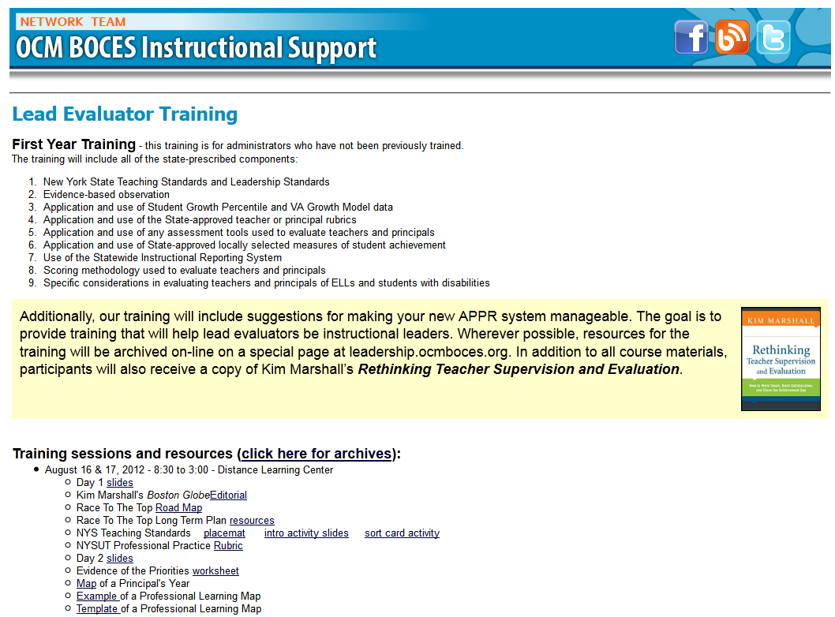
Resources

Slide 22
Next Session
December14th
Agenda will include
  Evidence Collection
  Ongoing Growth-Producing Feedback
  SWDs and ELLs
Reschedule to January 25, 8:30a

Slide 23

Questions
Hits, Misses, and Suggestions
Notes:
NOTES

