Slide 1
Lead Evaluator Training
2014-2015
Day 4

Slide 2
Agenda
What have you been up to? How are you doing with SLOs?
Mini-lesson: Six shifts in ELA/Literacy
Mini-observations
Managing your time
Evidence collection
Growth-Producing Feedback
Notes:
Review the agenda.

Slide 3
The Year at a Glance
Beginning of the Year
Ongoing
End of the Year
Beginning of the year meeting
Standards I and II
SLO and local (LAT) target setting
Evidence Submission by Teacher
Evidence Collection
Sharing the evidence
Feedback Conversations
Evidence from the year collected
Compare collected evidence to the rubric
Summative score determination and communication

Slide 4
SLO Warm Up Activity
What SLO questions and decisions have you encountered so far?
At your tables, each person should share one question you faced and how you answered.

Slide 5
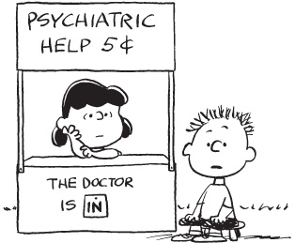
SLO Q & A
SLO HELP 5¢
Notes:
What question do you have?
What situations have you faced?

Slide 6
SLO Setting & Beginning of the Year Meetings
What is your strategy?
Is the time blocked in to your calendar?
How are you protecting the time?
What’s the status?
How are you keeping track?
How’s the culture?

Slide 7
SLO Celebration
When the SLO setting is over, is that worth recognition? Celebration?
What are some of the ways you do things in school to keep things positive?

Slide 8
ELA/literacy and the Common Core

Slide 9
Six Shifts of ELA/literacy
A quick look at an engageNY video
Publishers criteria has more info
November 2011 issue of NTnews
Before/after examples of the shifts

Slide 10
Six Shifts: ELA/Literacy
Balancing Informational & Literary Texts (Grades PK-5)
Knowledge in the Disciplines (Grades 6-12)
Staircase of Complexity
Text-based Answers
Writing from Sources
Academic Vocabulary
Notes:
Use Common Core Shifts ELA/Literacy: Planner in conjunction. Participants read through the expanded explanations of the shifts. Encourage discussion around the language used & what these shifts might mean in individual schools/districts.

Slide 11
I already do this…

Slide 12
What might the shifts look like? What the shifts aren’t?

Slide 13
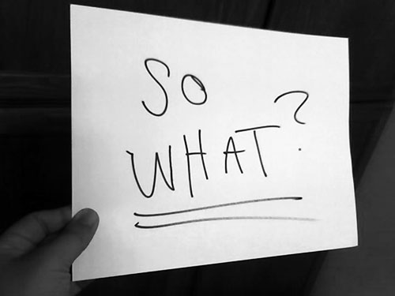
Are you seeing this in your school? What are you going to do about it?

Slide 14
The Power of Mini-Observations

Slide 15
The Year at a Glance
Beginning of the Year
Ongoing
End of the Year
Beginning of the year meeting
Standards I and II
SLO and local (LAT) target setting
Evidence Submission by Teacher
Evidence Collection
Sharing the evidence
Feedback Conversations
Evidence from the year collected
Compare collected evidence to the rubric
Summative score determination and communication

Slide 16
COLLECT DATA
(Evidence)
SORT TO
ALIGN
WITH YOUR
FRAMEWORK
Interpret:
Clarify
Conclusions
NO!
Impact on learning…
Support needed…
Notes:
NOTES

Slide 17
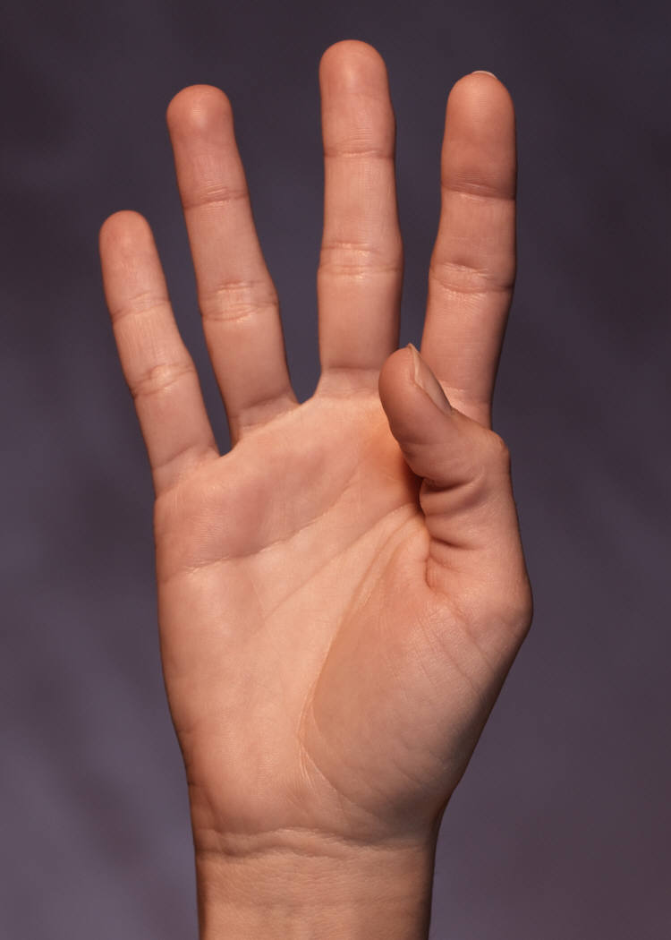

Slide 18
What is it going to take?
Must have a goal
Make it a numerical target (not fuzzy)
Make it realistic
How will you record and keep track of your notes?
What do you have to do with your schedule, routines, style, etc. in order to build this into your day?

Slide 24
Take Out Your Calendar
What evidence is there of:
Beginning-of-the-Year Meetings
Evidence collection visits to classrooms
Post-visit growth-producing feedback conversations?

Slide 25
Evidence Collection
Do a mini-observation
Collect evidence
Code the evidence
Sort it
Show it to your neighbor
Notes:
NOTES

Slide 26
Growth-Producing Feedback

Slide 27
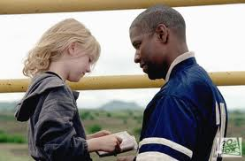
Qualities of Growth-Producing Feedback?
From Man on Fire, what are the qualities of Growth-Producing Feedback?
Take a look at Paula Rutherford’s list
Check out a teacher-principal conversation
Notes:
NOTES

Slide 28
Checking in with Kim
Read what Kim has to say about feedback to teachers
Discuss as a table group: how does his advice compare to your walkthrough/mini experiences?
Page 80
Notes:
NOTES

Slide 29
Conversations (example)
Form a triad
Each person gets a different colored half-sheet
Prepare your opening line (<30 seconds)
First triad member says opening line to the two others
Two others give first person feedback
Repeat the process until everyone in the group has gone
Notes:
NOTES

Slide 30
Conversations
Go back to the mini-observation
Review the Evidence
Prepare your thoughts for your follow-up conversation with the teacher. Make sure you have your opening line ready!
Role-play the conversation.
Repeat.
Notes:
NOTES

Slide 31
Conversation, Questions & Discussion
COLLECT DATA
(Evidence)
Respect & Rapport
Conclusions
Impact on learning…
Support needed…
Notes:
NOTES

Slide 32
Resources

Slide 33
Next Session
October 14th
Agenda will include
A little more on ELA
Evidence Collection
Ongoing Growth-Producing Feedback

Slide 34
Questions
Hits, Misses, and Suggestions
Notes:
NOTES

