Slide 1
Lead Evaluator Training
2012-2013
Day 4

Slide 2
Agenda
What have you been up to? How are you doing with the SLOs?
Mini-lesson: Six shifts in ELA/Literacy
Your Evidence collection
Evidence collection and a rubric
Managing mini-observations
Growth-Producing Feedback
Notes:
Review the agenda.

Slide 3
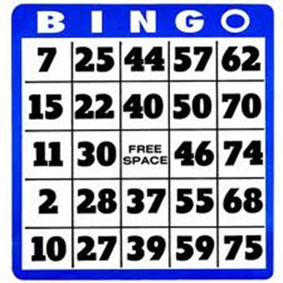
Lead Evaluator BINGO
Listen for the words or terms on your BINGO card
Cross of those things you hear in the training
Shout “BINGO” when
you have a BINGO

Slide 4
The Year at a Glance
Beginning of the Year
Ongoing
End of the Year
Beginning of the year meeting
Standards I and II
SLO and
local (LAT) target setting
Evidence Submission by
Teacher
Evidence Collection
Sharing the evidence
Feedback Conversations
Evidence from the year collected
Compare collected evidence to the rubric
Summative score determination and communication

Slide 5
SLO Setting
What’s been your meeting strategy?
What’s the status?
How are you keeping track?
How’s the culture?

Slide 6
SLO Celebration
When the SLO setting is over, is that worth recognition? Celebration?
What are some of the ways you do things in school to keep things positive?

Slide 7
ELA/literacy and the
Common Core

Slide 8
Six Shifts of ELA/literacy
A quick look at an engageNY video
Publishers criteria has more info
November 2011 issue of NTnews
Before/after examples of the shifts

Slide 9
Six Shifts: ELA/Literacy
Balancing Informational & Literary Texts (Grades PK-5)
Knowledge in the Disciplines (Grades 6-12)
Staircase of Complexity
Text-based Answers
Writing from Sources
Academic Vocabulary
Notes:
Use Common Core Shifts ELA/Literacy: Planner in conjunction. Participants read through the expanded explanations of the shifts. Encourage discussion around the language used & what these shifts might mean in individual schools/districts.

Slide 10


Pre-CCLS
Core Text
SHIFT 1
Balancing Informational and Literary Texts
SHIFT 2
Building Knowledge in the Disciplines
Notes:
Pre-CCLS: A unit of study might be based on one core fictional text and exhibit an inclusive focus on just the one text (i.e., Class, for the next few weeks, we will be reading and studying The Odyssey). Outside (other) text references are brief in nature and not included in the original unit plans, often offered as on-the-spot examples to help further explain, support, or identify the sole work being studied.

Slide 11


Post-CCLS
Core Texts
SHIFT 1
Balancing Informational and Literary Texts
SHIFT 2
Building Knowledge in the Disciplines
Paired Texts: The Hero’s Journey
Notes:
Post-CCLS: A unit utilizing paired texts of both fiction and nonfiction are given (fairly) equal billing in the study of a larger, key theme (the hero’s journey as opposed to The Odyssey). This balance of texts provides students with practice reading different text structures as well as opportunities to learn about the subject matter in the discipline (The Hero with the Thousand Faces provides a detailed history of the hero’s journey via a comprehensive analysis of myths throughout the ages).

Slide 12
Pre-CCLS
SHIFT 3
Staircase of Complexity
Refusal of the Call
Often when the call [to adventure] is given, the future hero refuses to heed it. This may be from a sense of duty or obligation, fear, insecurity, a sense of inadequacy, or any of a range of reasons that work to hold the person in his or her current circumstances.
Notes:
Pre-CCLS: This might be a typical text-book explanation for one piece of the hero’s journey. The text is not particularly demanding in terms of understanding the concept.

Slide 13
Post-CCLS
SHIFT 3
Staircase of Complexity
Refusal of the Call
Often in actual life, and not infrequently in the myths and popular tales, we encounter the dull case of the call unanswered; for it is always possible to turn the ear to other interests. Refusal of the summons converts the adventure into its negative. Walled in boredom, hard work, or "culture," the subject loses the power of significant affirmative action and becomes a victim to be saved. His flowering world becomes a wasteland of dry stones and his life feels meaningless—even though, like King Minos, he may through titanic effort succeed in building an empire of renown. Whatever house he builds, it will be a house of death: a labyrinth of cyclopean walls to hide from him his Minotaur. All he can do is create new problems for himself and await the gradual approach
of his disintegration.
Excerpt from The Hero with a Thousand Faces
Notes:
Post-CCLS: When confronted with the increased demands of text complexity required by the CCLS, one can quickly see the difference in what students would need to understand reading this as to what they needed to understand the text in the previous slide. Excerpted from the core text The Hero of a Thousand Faces, this text requires a skill set that includes figurative language, visual imagery, inferencing, prior knowledge of well-known myths, vocabulary usage, etc. that were not as evident or prevalent in the previous slide.

Slide 14
Pre-CCLS
SHIFT 4
Text-based Answers
Question:
What reasons might a hero use to refuse the call to adventure?
Refusal of the Call
Often when the call [to adventure] is given, the future hero refuses to heed it. This may be from a sense of duty or obligation, fear, insecurity, a sense of inadequacy, or any of a range of reasons that work to hold the person in his or her current circumstances.
Notes:
Pre-CCLS: Students would not necessarily need to read a specific text in order to answer these questions. Currently posed, students’ answers would be based on prior knowledge and experiences with the concepts of “mythology” and “hero”. The CCLS requires students to base answers upon what a text says or doesn’t say. Personal connections and prior knowledge are acceptable as long as the text under study remains the focus of their analysis.
A text-based question/answer for Slide 21: What reasons might a hero use to refuse the call to adventure? Students could list the reasons (referencing the text, but not learning from the text)

Slide 15
Post-CCLS
SHIFT 4
Text-based Answers
Question:
What fate awaits the (future) hero who refuses the call to adventure?
Use specific examples from the text to support your answer.
Refusal of the Call
Often in actual life, and not infrequently in the myths and popular tales, we encounter the dull case of the call unanswered; for it is always possible to turn the ear to other interests. Refusal of the summons converts the adventure into its negative. Walled in boredom, hard work, or "culture," the subject loses the power of significant affirmative action and becomes a victim to be saved. His flowering world becomes a wasteland of dry stones and his life feels meaningless—even though, like King Minos, he may through titanic effort succeed in building an empire of renown. Whatever house he builds, it will be a house of death: a labyrinth of cyclopean walls to hide from him his Minotaur. All he can do is create new problems for himself and await the gradual approach
of his disintegration.
Excerpt from The Hero with a Thousand Faces
Notes:
Post-CCLS: Questions are planned with the text in mind, requiring students to go beyond the literal to more in-depth analysis of the text under discussion while building knowledge in the content (author’s craft in using symbolism & explanation of the complex story structure of the hero’s journey). Students must cite specific references and examples from the text, but can still build meaning for themselves by considering the text through the lens of introspection.
Text-based question/answer for Slide 22: What fate awaits the (future) hero who refuses the call to adventure? Use specific examples from the text to support your answer. Posed in this manner, a student would have to first determine the negative impact & then isolate examples to support their answer.

Slide 16
Pre-CCLS
SHIFT 5
Writing from Sources
Write about a time you had to make a difficult decision. Describe the situation and the heroic qualities you exhibited.
Notes:
Pre-CCLS: This writing prompt requires no text association for the students in order to answer. The new CCLS requires proficient and rigorous analysis of texts in writing.
With the emphasis on close reading of text and students’ ability to respond to those texts, writing tasks or prompts will need to reflect this change. Students will be required to use the text flexibly to not only support arguments, but to inform as well. Narrative writings are still required, but take on a less prominent role in the CCLS as students progress through the grades.

Slide 17
SHIFT 5
Writing from Sources
Post-CCLS
Write a critical essay in which you discuss The Odyssey and The Lost City of Z from the perspective provided in the Critical Lens. In your essay:
Provide a valid interpretation of the statement.
Agree or disagree with the statement as you’ve interpreted it.
Support your opinion using specific references from the two works listed above.
Critical Lens
Nothing is given to man on earth – struggle is built into the nature of life, and conflict is possible - the hero is the man who lets no obstacle prevent him from pursuing the values he has chosen.
Notes:
Post-CCLS: The writing prompt for this unit requires students to demonstrate their understanding of the hero’s journey by specifically referring to the texts studied.
With the emphasis on close reading of text and students’ ability to respond to those texts, writing tasks or prompts will need to reflect this change. Students will be required to use the text flexibly to not only support arguments, but to inform as well. Narrative writings are still required, but take on a less prominent role in the CCLS as students progress through the grades.

Slide 18
Pre-CCLS
Pre-CCLS
Archetype
Epic Poetry
Mythology
Odyssey
SHIFT 6
Academic Vocabulary
Notes:
Pre-CCLS: Vocabulary selections for the The Odyssey would focus specifically on Tier 3 words with little to no direct instruction of Tier 2 words.
Tier 3 (domain specific) vocabulary are often well-supported instructionally as they are the key concepts and/or terms students need to access the content. Hence, class time is dedicated to the direct instruction of such words. Due to other factors (mostly a lack of time and uncertainty of which words to select), many Tier 2 words (those non-domain specific words, not well-defined through context) are not adequately identified for direct instruction. Students, therefore, are left to figure these words out on their own often minimizing their understanding of the text.

Slide 19
Post-CCLS
Tier 3 Words
Archetype
Epic Poetry
Mythology
Odyssey
Tier 2 Words
Summons
Affirmative
Titanic
Disintegration
SHIFT 6
Academic Vocabulary
Notes:
Post-CCLS: Continuing with the Hero’s Journey unit, an increase in attention to the direct instruction of Tier 2 words (in addition to Tier 3 words) is expected.
With a shift in the text expectations, so too comes a shift in the vocabulary instruction students must receive. Text selections from primary sources or authentic texts often do not demonstrate a level of text cohesion one might find in a heavily scaffolded textbook. As a result, equal attention to those words exhibiting the characteristics of Tier 2 Words is required so that students can better access i.e., understand and attend to the increased demands of the text.

Slide 20

What does this mean for teachers?
What does this mean for leaders?

Slide 21

Think about this activity; discuss in your table group:
Would you do this activity with teachers?
What would it accomplish?
Notes:
NOTES

Slide 22
The Power of
Mini-Observations

Slide 23
The Year at a Glance
Beginning of the Year
Ongoing
End of the Year
Beginning of the year meeting
Standards I and II
SLO and
local (LAT) target setting
Evidence Submission by
Teacher
Evidence Collection
Sharing the evidence
Feedback Conversations
Evidence from the year collected
Compare collected evidence to the rubric
Summative score determination and communication

Slide 24
Conversation,
Questions &
Discussion
COLLECT
DATA
(Evidence)
Respect &
Rapport
Conclusions
Impact on learning…
Support needed…
Notes:
NOTES

Slide 25
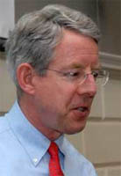
Kim says:
Essentials of
Mini-Observations
Being organized and systematic about getting into all classrooms on a regular basis
Not announcing visits in order to get a representative sampling of teachers’ work
Keeping visits to five to ten minutes in order to boost frequency and observe each teacher at least every two or three weeks

Slide 26
Kim says:
Essentials of
Mini-Observations
Giving prompt, thoughtful, face-to-face feedback to the teacher after every observation
Making visits and follow-up informal and low-stakes to maximize adult learning

Slide 27
Kim says:
Essentials of
Mini-Observations
Being organized and systematic about getting into all classrooms on a regular basis
Not announcing visits in order to get a representative sampling of teachers’ work
Keeping visits to five to ten minutes in order to boost frequency and observe each teacher at least every two or three weeks

Slide 28
Kim says:
Essentials of
Mini-Observations
Giving prompt, thoughtful, face-to-face feedback to the teacher after every observation
Making visits and follow-up informal and low-stakes to maximize adult learning

Slide 29
Kim says:
Essentials of
Mini-Observations
Getting an accurate sense of the quality of instruction students are experiencing on a daily basis
Seeing students in an instructional setting and get to know their strengths and needs

Slide 30
Kim says:
Essentials of
Mini-Observations
Getting to know teachers better, both as instructors and as people
Developing “situational awareness” – having a finger on the pulse of the school’s culture and climate

Slide 31
Kim says:
Essentials of
Mini-Observations
Building trust, the lubricant of effective schools
Identifying teachers who are having difficulty so they can get additional support

Slide 32
Kim says:
Essentials of
Mini-Observations
Developing a de-bureaucratized, informal style that facilitates collegial learning
Being well-informed for meetings with the leadership team, teacher teams, and parents

Slide 33
Kim says:
Essentials of
Mini-Observations
Gathering lots of data for end-of-year teacher evaluations

Slide 34


Slide 35
# of teachers you have _____
÷ by the # of administrators you have
= _____
÷ by 4
= the number of days for a cycle in your building

Slide 36
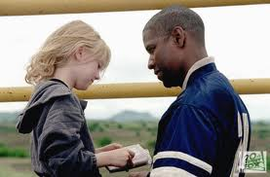
Qualities of Growth-Producing Feedback?
  From Man on Fire, what are
  the qualities of
  Growth-Producing Feedback?
  Take a look at
  Paula Rutherford’s list
  Check out a teacher-principal
  conversation
Notes:
NOTES

Slide 37



Checking in with Kim
  Read what Kim has to say about feedback to teachers
  Discuss as a table group: how does his advice compare to
  your walkthrough/mini experiences?
Page 80
Notes:
NOTES

Slide 38
Conversations (example)
  Form a triad
  Each person gets a different colored half-sheet
  Prepare your opening line (<30 seconds)
  First triad member says opening line to the two others
  Two others give first person feedback
  Repeat the process until everyone in the group has gone
Notes:
NOTES

Slide 39
Conversations
  Do a mini-observation
  Collect Evidence
  Prepare your thoughts for your follow-up conversation with the teacher. Make sure you have your opening line ready!
  Role-play the conversation.
  Repeat.
Notes:
NOTES

Slide 40
Conversation,
Questions &
Discussion
COLLECT
DATA
(Evidence)
Respect &
Rapport
Conclusions
Impact on learning…
Support needed…
Notes:
NOTES

Slide 41
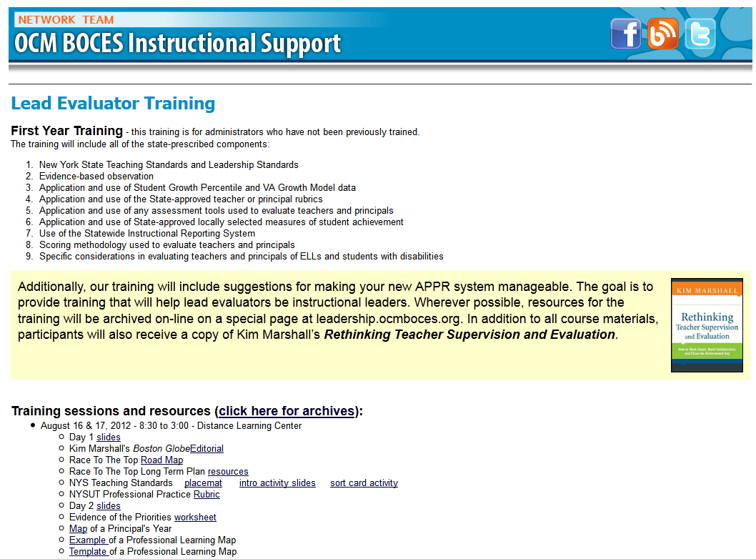
Resources

Slide 42
Next Session
November 2nd in Syracuse
Agenda will include
  Evidence Collection
  Ongoing Growth-Producing Feedback

Slide 43

Questions
Visiting the Parking Lot
Hits, Misses, and Suggestions
Notes:
NOTES

Slide 44
Evidence and a Rubric
  Individually, use the evidence at the bottom of the page to identify levels on the rubric (3.2)
  Debrief with your elbow partner? How did it go?
Notes:
If time allows

