Slide 1
Lead Evaluator Training
2015-2016
Day 3

Slide 2
Here We Are: 9 Components
3012-c
3012-d
New York State Teaching Standards and Leadership Standards
Evidence-based observation
Application and use of Student Growth Percentile and VA Growth Model data
Application and use of the State-approved teacher or principal rubrics
Application and use of any assessment tools used to evaluate teachers and principals
New York State Teaching Standards and Leadership Standards
Evidence-based observation
Application and use of Student Growth Percentile method
Application and use of the State-approved teacher or principal rubrics
Application of assessment tools the district employs

Slide 3
Here We Are: 9 Components
3012-c
3012-d
Application and use of State-approved locally selected measures of student achievement
Use of the Statewide Instructional Reporting System
Scoring methodology used to evaluate teachers and principals
Specific considerations in evaluating teachers and principals of ELLs and students with disabilities
Application and use of State-approved locally selected measures of student growth
Use of the Statewide Instructional Reporting System
Scoring methodology used by the state and the district
Specific considerations in evaluating teachers and principals of ELLs and students with disabilities

Slide 4
Here We Are: 9+ Components
Managing the APPR
Connecting it to Race To The Top
Increasing the likelihood that it makes a difference

Slide 5
Agenda
What have you been up to? Sharing what we’ve done related to this work as a new year began.
Beginning of the Year
SLO (and LAT) Setting
Mini-Observations & Evidence collection
Managing mini-observations
Notes:
Review the agenda.

Slide 6
Starting off the Year
What did you do this year to start things off?
Ten minutes for the table, so pace yourselves

Slide 7
Review
Before we move on, some review:
The three priorities of the Teaching Standards and the rubrics
NYS Teaching Standards
Evidence Collection
Bias
Each of the four group members choose one of the four (above). You have two minutes to prepare a one-minute elevator speech about your item.
Conduct fast-paced reporting out (one minute limit)
Notes:
Keep this fast-paced; use the time.

Slide 8
Beginning of the Year Meeting

Slide 9
The Year at a Glance
Beginning of the Year
Ongoing
End of the Year
Beginning of the year meeting
Standards I and II
SLO and local (LAT) target setting
Evidence Submission by Teacher
Evidence Collection
Sharing the evidence
Feedback Conversations
Evidence from the year collected
Compare collected evidence to the rubric
Summative score determination and communication

Slide 10
The Year at a Glance
Beginning of the Year
Ongoing
End of the Year
Beginning of the year meeting
Standards I and II
SLO and local (LAT) target setting
Evidence Submission by Teacher
Evidence Collection
Sharing the evidence
Feedback Conversations
Evidence from the year collected
Compare collected evidence to the rubric
Summative score determination and communication

Slide 11
Artifacts
For Teaching Standards 1 & 2 (FFT Domain 1), what kind of artifacts are helpful?
LAT
Lesson Plan
Unit Plan
Schedule
Other items

Slide 12
Beginning of the Year
Beginning of the year meeting
Standards I and II
SLO and local (LAT) target setting
Notes:
Visit the resources on the page. Go through them.
.

Slide 13
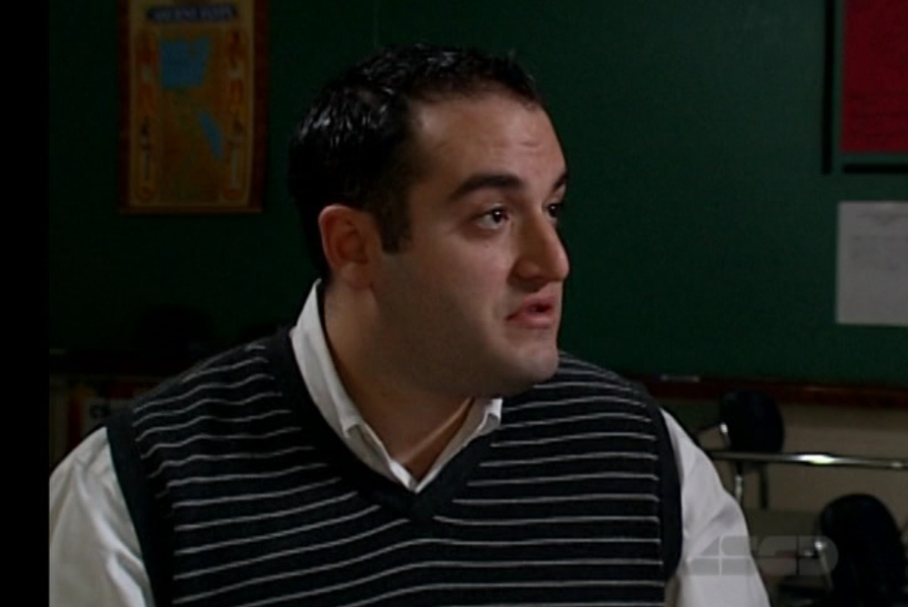
Introduction
Mr. Greenburgh
6th Grade Math Teacher
Notes:
Review the agenda.

Slide 14
SLO Review
Population
Learning Content
Interval of Time
Evidence
Baseline
Target
HEDI
Rationale

Slide 15
Mr. Greenburgh’s LAT
The fundamental goal is to set a target for STUDENTS at the end of the year on a summative assessment
There are three basic ways to do this:
Group target
Individual targets
Banded targets
Examples
How it works at the end of the year
Notes:
Use the MontoyaSLOTargetSetting file to demonstrate this.

Slide 16
Review of Artifacts
Take a look at the artifacts in the folder.
What do you see?
What is missing?
What questions do you have for the teacher?

Slide 17
§3012-d Note: Observation Process
?
These are prohibited from being used in an evaluation:
Lesson plans or other artifacts of practice
Parent or student feedback
Goal setting
Unapproved assessments
Some things such as lesson plans may be observable during a pre or post; these may be considered.

Slide 18
The Power of Mini-Observations

Slide 19
The Year at a Glance
Beginning of the Year
Ongoing
End of the Year
Beginning of the year meeting
Standards I and II
SLO and local (LAT) target setting
Evidence Submission by Teacher
Evidence Collection
Sharing the evidence
Feedback Conversations
Evidence from the year collected
Compare collected evidence to the rubric
Summative score determination and communication

Slide 20
COLLECT DATA
(Evidence)
SORT TO
ALIGN
WITH YOUR
FRAMEWORK
Interpret:
Clarify
Conclusions
NO!
Impact on learning…
Support needed…
Notes:
NOTES

Slide 21
Conversation, Questions & Discussion
COLLECT DATA
(Evidence)
Respect & Rapport
Conclusions
Impact on learning…
Support needed…
Notes:
NOTES

Slide 23
Jigsaw
Turn to page 43 in Marshall.
Pick a section:
Supervision Hits a Brick Wall
Managing by Rushing Around
An Idea is Born
Mini-Observations Take Off
Developing a Style
Keeping Track of Visits
Keeping it Up
Closing the Loop with Teachers
So Far, So Good
p. 43

Slide 24
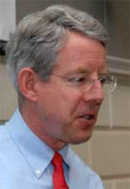
Kim says:
Essentials of Mini-Observations
Being organized and systematic about getting into all classrooms on a regular basis
Not announcing visits in order to get a representative sampling of teachers’ work
Keeping visits to five to ten minutes in order to boost frequency and observe each teacher at least every two or three weeks

Slide 25
Kim says:
Essentials of Mini-Observations
Giving prompt, thoughtful, face-to-face feedback to the teacher after every observation
Making visits and follow-up informal and low-stakes to maximize adult learning

Slide 26
Kim says:
Essentials of Mini-Observations
Getting an accurate sense of the quality of instruction students are experiencing on a daily basis
Seeing students in an instructional setting and get to know their strengths and needs

Slide 27
Kim says:
Essentials of Mini-Observations
Getting to know teachers better, both as instructors and as people
Developing “situational awareness” – having a finger on the pulse of the school’s culture and climate

Slide 28
Kim says:
Essentials of Mini-Observations
Building trust, the lubricant of effective schools
Identifying teachers who are having difficulty so they can get additional support

Slide 29
Kim says:
Essentials of Mini-Observations
Developing a de-bureaucratized, informal style that facilitates collegial learning
Being well-informed for meetings with the leadership team, teacher teams, and parents

Slide 30
Kim says:
Essentials of Mini-Observations
Gathering lots of data for end-of-year teacher evaluations

Slide 32
# of teachers you have _____
÷ by the # of administrators you have
= _____
÷ by 4
= the number of days for a cycle in your building

Slide 33
What is it going to take?
Must have a goal
Make it a numerical target (not fuzzy)
Make it realistic
How will you record and keep track of your notes?
What do you have to do with your schedule, routines, style, etc. in order to build this into your day?

Slide 39
Evidence Collection

Slide 40
Social Studies Mini-Observation
Observe what the teacher and the students are doing in this lesson (5 minutes)
Collect evidence electronically; be prepared to share your evidence.
Report out an item or two of evidence
Label it by NYS Teaching Standard (as a group)
Sort it together (then do yours)

Slide 41
Make some observations about you and the sorted evidence.
Notes:
We have to make sure we chart these pieces of “evidence” for use later!!!

Slide 42
Why is this important?
We are human beings and we bring with our own lenses and experience and biases.
There’s no chance at fairness, reliability and validity unless we can observe things similarly, from classroom to classroom and school to school and district to district
Notes:
NOTES

Slide 43
Resources

Slide 44
Questions
Visiting the Parking Lot
+/∆
+
∆
Notes:
NOTES

Slide 45
Ever wonder about those people who say they are giving more than 100 percent?

Slide 46
If:
A B C D E F G H I J K L M N O P Q R S T U V W X Y Z
Is represented as:
1 2 3 4 5 6 7 8 9 10 11 12 13 14 15 16 17 18 19 20 21 22 23 24 25 26
Then…

Slide 47
H A R D W O R K
8 1 18 4 23 15 18 11

Slide 48
H A R D W O R K
8 1 18 4 23 15 18 11 = 98%

Slide 49
K N O W L E D G E
11 14 15 23 12 5 4 7 5 =

Slide 50
K N O W L E D G E
11 14 15 23 12 5 4 7 5 = 96%

Slide 51
A T T I T U D E
But…
1 20 20 9 20 21 4 5

Slide 52
A T T I T U D E
But…
1 20 20 9 20 21 4 5 = 100%

Slide 53
B U L L S H I T
And…
2 21 12 12 19 8 9 20 = 103%

Slide 54
So, it stands to reason that hard work and knowledge will get you close, attitude will get you there, but bullshit will put you over the top.

Slide 55
Next Sessions
September 30^{th –} POSSIBLE CANCELLATION
October 14th
Agendas will include
Evidence Collection
Ongoing Growth-Producing Feedback

