Slide 1
Lead Evaluator Training
2012-2013
Day 3

Slide 2
Agenda
What have you been up to? Sharing what we’ve done related to this work as a new year began.
Beginning of the Year Meeting (continued)
Mini-Observations & Evidence collection
Managing mini-observations
Notes:
Review the agenda.

Slide 3
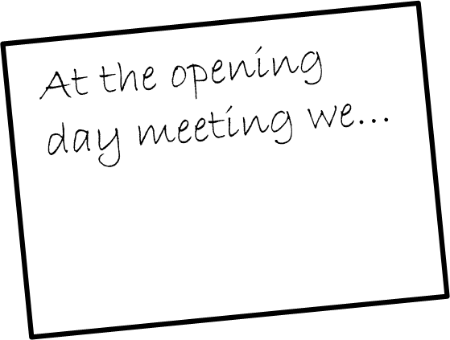
Starting off the Year
What did you do this year to start things off?
Ten minutes for the table,
so pace yourselves
Record ideas on the 5x8
index card (neatly)

Slide 4
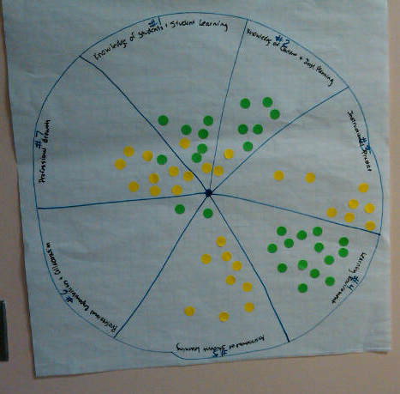
Notes:
NOTES

Slide 5
Review
Before we move on, some review:
The three priorities of the Teaching Standards and the rubrics
NYS Teaching Standards
Evidence Collection
Bias
Each of the four group members chose one of the four (above). You have two minutes to prepare a one-minute elevator speech about your item.
Conduct fast-paced reporting out (one minute limit)
Notes:
Keep this fast-paced; use the time.

Slide 6
Beginning of the Year Meeting

Slide 7
The Year at a Glance
Beginning of the Year
Ongoing
End of the Year
Beginning of the year meeting
Standards I and II
SLO and
local (LAT) target setting
Evidence Submission by
Teacher
Evidence Collection
Sharing the evidence
Feedback Conversations
Evidence from the year collected
Compare collected evidence to the rubric
Summative score determination and communication

Slide 8
The Year at a Glance
Beginning of the Year
Ongoing
End of the Year
Beginning of the year meeting
Standards I and II
SLO and
local (LAT) target setting
Evidence Submission by
Teacher
Evidence Collection
Sharing the evidence
Feedback Conversations
Evidence from the year collected
Compare collected evidence to the rubric
Summative score determination and communication

Slide 9
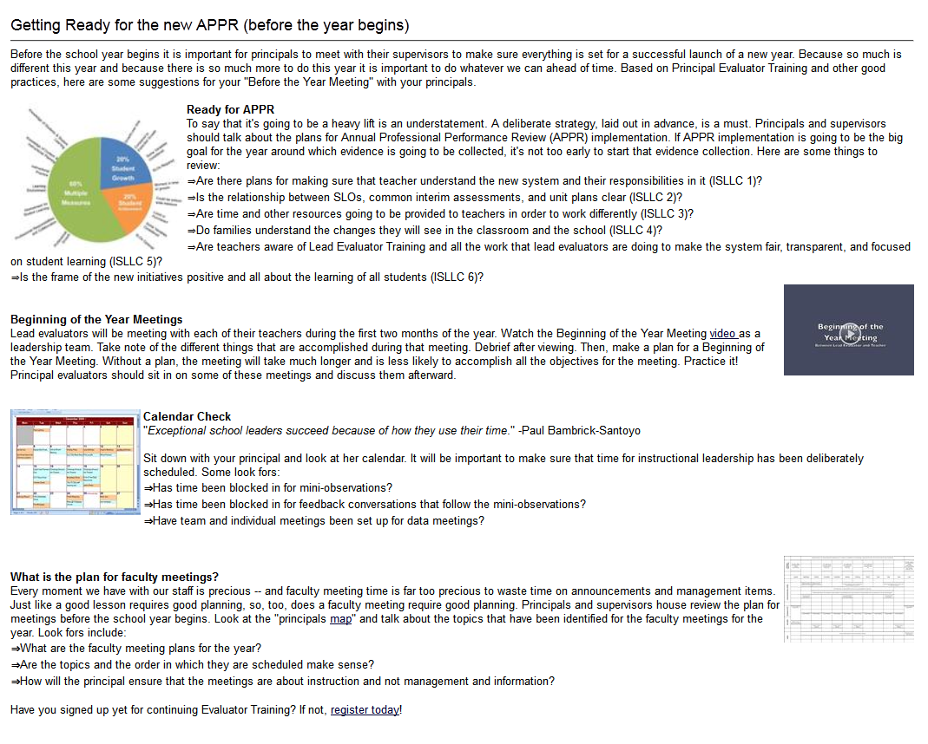
Beginning of the Year
  Beginning of the year meeting
  Standards I and II
  SLO and
  local (LAT) target setting
Notes:
Visit the resources on the page. Go through them.
.

Slide 10
Meet Ms. Montoya
Your goal is to plan for and conduct a “beginning of the year” meeting
With a partner, plan the meeting. Do you want a shared agenda? Pre-meeting reflection questions?
Notes:
This simulation is designed to help evaluators prepare for the Beginning of the Year meetings they will soon be holding. This scenario is truncated because it does not include LATs because districts are doing so many different things at the local level.
Partners plan for the meeting. Then, partners match up with another set at their table and one set does the role play while the other watches and afterward provides feedback.

Slide 11

Break! During the break, check out some of the ideas your colleagues have tried so far this year on the “wall.”
Notes:
NOTES

Slide 12
The Power of
Mini-Observations

Slide 13
The Year at a Glance
Beginning of the Year
Ongoing
End of the Year
Beginning of the year meeting
Standards I and II
SLO and
local (LAT) target setting
Evidence Submission by
Teacher
Evidence Collection
Sharing the evidence
Feedback Conversations
Evidence from the year collected
Compare collected evidence to the rubric
Summative score determination and communication

Slide 14
COLLECT
DATA
(Evidence)
SORT TO
ALIGN
WITH YOUR
FRAMEWORK
Interpret:
Clarify
Conclusions
NO!
Impact on learning…
Support needed…
Notes:
NOTES

Slide 15
Conversation,
Questions &
Discussion
COLLECT
DATA
(Evidence)
Respect &
Rapport
Conclusions
Impact on learning…
Support needed…
Notes:
NOTES

Slide 16
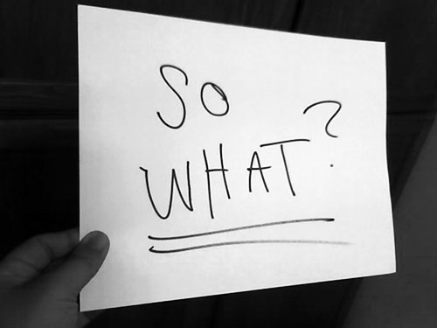

Slide 17

Jigsaw
Turn to page 46 in Marshall.
Each of six group members chooses a section:
An Idea is Born
Mini-Observations Take Off
Developing a Style
Keeping Track of Visits
Keeping it Up
Closing the Loop with Teachers

Slide 18
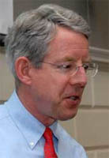
Kim says:
Essentials of
Mini-Observations
Being organized and systematic about getting into all classrooms on a regular basis
Not announcing visits in order to get a representative sampling of teachers’ work
Keeping visits to five to ten minutes in order to boost frequency and observe each teacher at least every two or three weeks

Slide 19
Kim says:
Essentials of
Mini-Observations
Giving prompt, thoughtful, face-to-face feedback to the teacher after every observation
Making visits and follow-up informal and low-stakes to maximize adult learning

Slide 20
Kim says:
Essentials of
Mini-Observations
Being organized and systematic about getting into all classrooms on a regular basis
Not announcing visits in order to get a representative sampling of teachers’ work
Keeping visits to five to ten minutes in order to boost frequency and observe each teacher at least every two or three weeks

Slide 21
Kim says:
Essentials of
Mini-Observations
Giving prompt, thoughtful, face-to-face feedback to the teacher after every observation
Making visits and follow-up informal and low-stakes to maximize adult learning

Slide 22
Kim says:
Essentials of
Mini-Observations
Getting an accurate sense of the quality of instruction students are experiencing on a daily basis
Seeing students in an instructional setting and get to know their strengths and needs

Slide 23
Kim says:
Essentials of
Mini-Observations
Getting to know teachers better, both as instructors and as people
Developing “situational awareness” – having a finger on the pulse of the school’s culture and climate

Slide 24
Kim says:
Essentials of
Mini-Observations
Building trust, the lubricant of effective schools
Identifying teachers who are having difficulty so they can get additional support

Slide 25
Kim says:
Essentials of
Mini-Observations
Developing a de-bureaucratized, informal style that facilitates collegial learning
Being well-informed for meetings with the leadership team, teacher teams, and parents

Slide 26
Kim says:
Essentials of
Mini-Observations
Gathering lots of data for end-of-year teacher evaluations

Slide 27
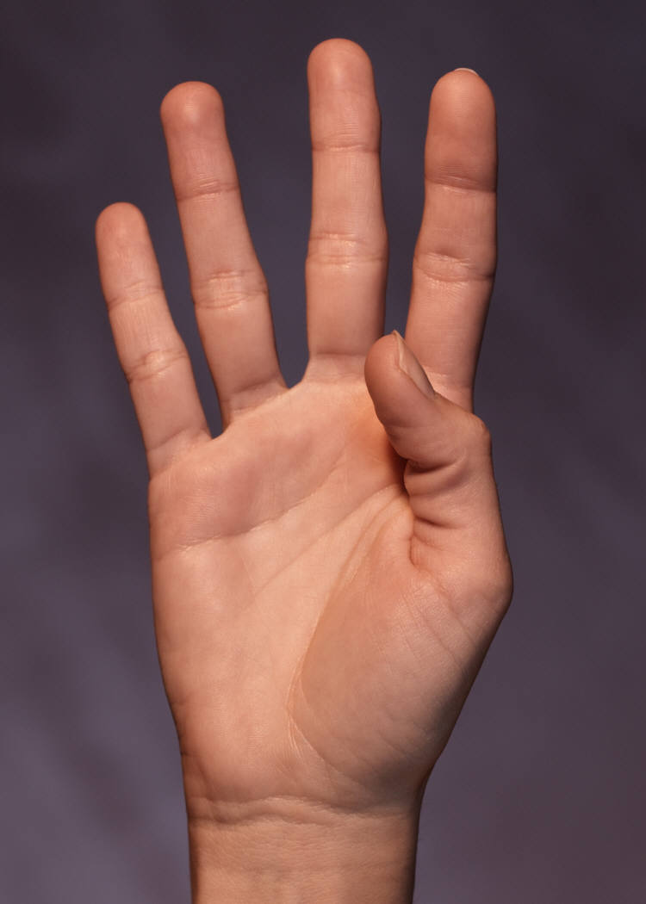

Slide 28
# of teachers you have _____
÷ by the # of administrators you have
= _____
÷ by 4
= the number of days for a cycle in your building

Slide 29
What is it going to take?
Must have a goal
Make it a numerical target (not fuzzy)
Make it realistic
How will you record and keep track of your notes?
What do you have to do with your schedule, routines, style, etc. in order to build this into your day?

Slide 35
Evidence Collection

Slide 36

Social Studies Mini-Observation
Observe what the teacher and the students are doing in this lesson (5 minutes)
Collect evidence electronically; be prepared to share your evidence.
Report out an item or two of evidence
Label it by NYS Teaching Standard (as a group)
Sort it together (then do yours)

Slide 37
Make some observations about you and the sorted evidence.
Notes:
We have to make sure we chart these pieces of “evidence” for use later!!!

Slide 38

Why is this important?
We are human beings and we bring with our own lenses and experience and biases.
There’s no chance at fairness, reliability and validity unless we can observe things similarly, from classroom to classroom and school to school and district to district
Notes:
NOTES

Slide 39
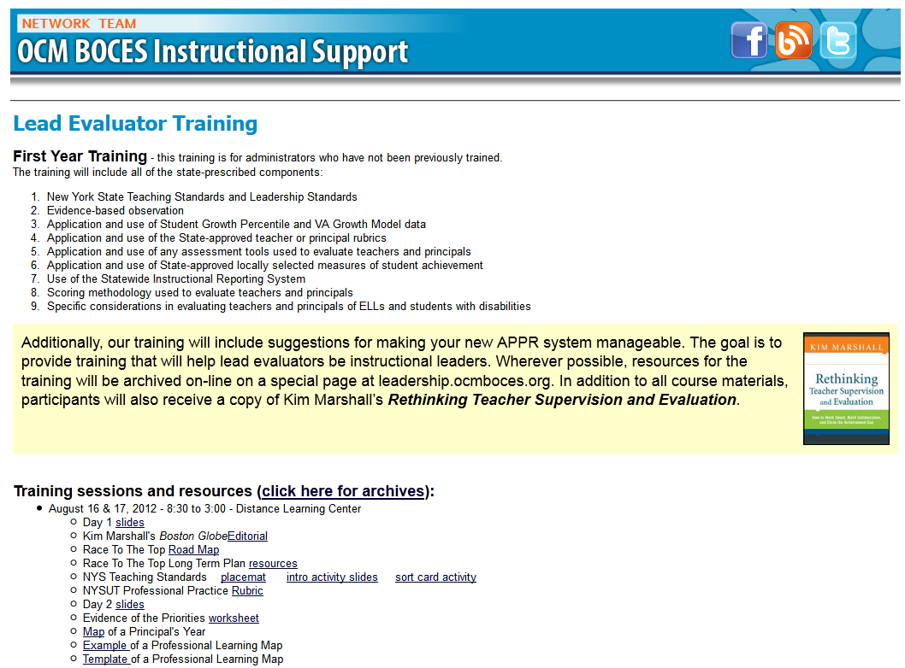
Resources

Slide 40
Questions
Visiting the Parking Lot
+/∆
+
∆
Notes:
NOTES

Slide 41
Ever wonder about those people who say they are giving more than 100 percent?

Slide 42
If:
A B C D E F G H I J K L M N O P Q R S T U V W X Y Z
Is represented as:
1 2 3 4 5 6 7 8 9 10 11 12 13 14 15 16 17 18 19 20 21 22 23 24 25 26
Then…

Slide 43
H A R D W O R K
8 1 18 4 23 15 18 11

Slide 44
H A R D W O R K
8 1 18 4 23 15 18 11 = 98%

Slide 45
K N O W L E D G E
11 14 15 23 12 5 4 7 5 =

Slide 46
K N O W L E D G E
11 14 15 23 12 5 4 7 5 = 96%

Slide 47
A T T I T U D E
But…
1 20 20 9 20 21 4 5

Slide 48
A T T I T U D E
But…
1 20 20 9 20 21 4 5 = 100%

Slide 49
B U L L S H I T
And…
2 21 12 12 19 8 9 20 = 103%

Slide 50
So, it stands to reason that hard work and knowledge will get you close, attitude will get you there, but bullshit will put you over the top.

Slide 51
Next Session
October 12th in Syracuse
Agenda will include
  Evidence Collection
  Ongoing Growth-Producing Feedback

