Slide 1
Lead Evaluator Training
Day 2

Slide 2
Agenda
Objectives and Agenda Review
Focusing on the learners
Teacher Evaluation
The nature of evaluation (feedback, evidence, bias)
Collecting Some Evidence
Beginning of the Year (meetings, SLOs, etc.)
Getting It Done
Culture: Living in c and thinking about d
Closure

Slide 3
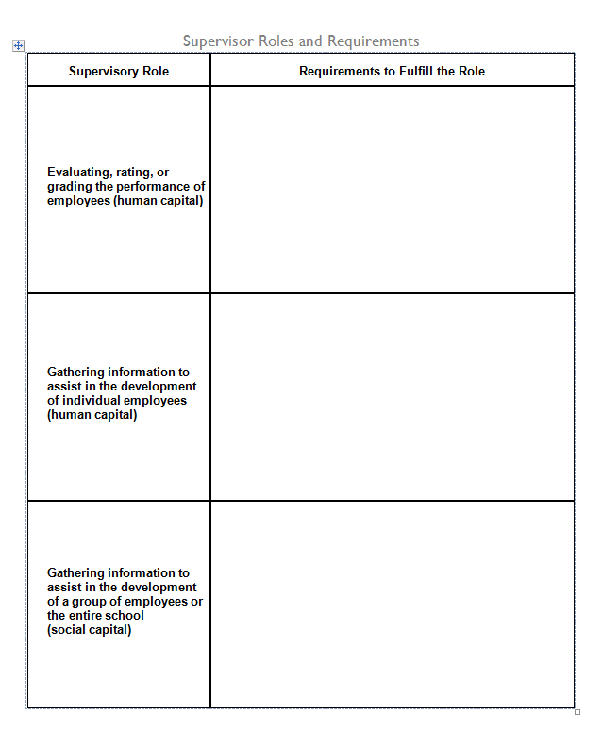
Roles of the Supervisor
Think about the different supervisory roles that you might play as a Lead Evaluator.
Jot down the things you might have to know, or be like, be able to do.

Slide 4

There are three priorities in the Teaching Standards
Engagement
Constructivism
21st Century
Readiness
PRIORITIES
Notes:
NOTES

Slide 5
In your role as a leader you will be expected to be an instructional expert and to be able to recognize the priorities of the Teaching Standards and rubric in every classroom.
With a partner, choose one of the classroom contexts on the worksheet and describe the specific examples of what you would actually see and hear in the classrooms described.
Be prepared to share your work
Notes:
NOTES

Slide 6
The setting: 5th grade blended physical education class (includes APE). Two teachers. Twenty-five students.
Examples of what would be seen and heard:
  Cognitive engagement:
  Constructivism:
  21st Century Readiness:

Slide 7
The setting: 5th grade blended physical education class. Two teachers.
Examples of what would be seen and heard:
  Cognitive engagement: students talking to each other about the health and social benefits of walking. They refer to a rubric for walking. They look at maps of County Parks highlighting the walking trails with different color highlighters depending on the difficulty of the walk and whether it is wheelchair accessible.
  Constructivism:
  21st Century Readiness:

Slide 8
The setting: 5th grade blended physical education class. Two teachers.
Examples of what would be seen and heard:
  Cognitive engagement:
  Constructivism: Student partners are making plans for how much walking they should be doing according to their fitness gram and goals. They prepare a chart that they will use to record the walks they take during the next month.
  21st Century Readiness:

Slide 9
The setting: 5th grade blended physical education class. Two teachers.
Examples of what would be seen and heard:
  Cognitive engagement:
  Constructivism:
  21st Century Readiness: health literacy, meaningful collaboration, discuss the impact of unhealthy lifestyles on society

Slide 10
The setting: 2nd grade literacy block (inclusion class). Twenty-four students. Two teachers. Eight students with IEPs.
Examples of what would be seen and heard:
  Cognitive engagement
  Constructivism
  21st Century Readiness

Slide 11
The setting: 10th grade living environment class. Twenty-three students in the class. 2 ELLs, 2 SWDs, 1 504.
Examples of what would be seen and heard:
  Cognitive engagement
  Constructivism
  21st Century Readiness

Slide 12
The setting: 7th grade accelerated math class. Thirty-three students in the class. Four were not recommended by placement process but parent insistence resulted in their being included on a trial basis.
Examples of what would be seen and heard:
  Cognitive engagement
  Constructivism
  21st Century Readiness

Slide 13

Think about this activity; discuss in your table group:
Would you do this activity with teachers?
All of them or just your 4-8?
What would it accomplish?
Notes:
NOTES

Slide 14

What are the purposes of evaluation?
Quality Assurance
Professional Learning
Improving teacher quality
Other
Other
Notes:
NOTES

Slide 15


What’s wrong with teacher evaluation?
Why we need a new approach
In CHAPTER 2 (p. 19)
Notes:
Have to get away from the dog and pony show element of this. Many teachers expect evaluators to stay for their whole specially prepared lesson. Have to move away from this to multiple observations not all of full-length.

Slide 16
Read a part of chapter 2:
A: page 19-20
B: page 21-22
C:There Isn’t a Shared Definition… p. 23-27
D: The Principal Sees Only… p. 27-28
E: The Principal's Presence… p. 29-31
F: Full-lesson Write-Ups… p. 33- 35
G: The Process is Extremely… p. 35 - 36
H: Teachers are Passive… p. 36-38
I: Student Learning Is… p. 38-40
J: The Imperative for… p. 40-41
Notes:
NOTES

Slide 17
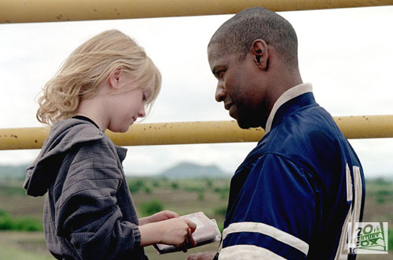
What’s wrong with teacher evaluation?
Why hasn’t it traditionally resulted in professional growth?
What conditions support growth?
Notes:
Watch the video of the conversation between the teacher and the principal.

Slide 18
Observe what students are doing that shows evidence of engagement, constructing meaning, or 21C. Each group member is responsible for one priority.
Collect evidence and be prepared to share your evidence.
Flash Back to Yesterday
And the “Best Deal” Lesson.
engagement
constructivism
21C

Slide 19
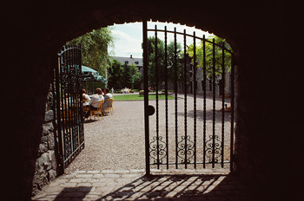
Three “Gates” for Effective Teacher Evaluation
Fairness
Reliability
Validity
Notes:
NOTES

Slide 20
Effective teacher evaluation research identifies six best practices:
Annual Processes
Clear, rigorous expectations
Multiple measures
Multiple ratings
Regular feedback
Significance
http://www.tntp.org/index.php/publications/issue-analysis/teacher-evaluation-2.0/
20
Notes:
NOTES

Slide 21
Discuss the following:
  Why is it important to understand the 3 “gates” and best practices in educator evaluation (fairness, reliability, validity)?
  How will you present this information to teachers who have different experiences with evaluation?
Notes:
NOTES

Slide 22

Evidence is a factual reporting of events.
  It may include teacher and student actions and/or behaviors.
  It may also include artifacts prepared by the teacher, students, or others.
  It is not clouded with personal opinion or biases.
  It is selected using professional judgment by the observer and / or the teacher.
Notes:
Go back to the chart paper list of evidence from the watching of the fist video. Which ones are evidence and which are opinions.

Slide 23

Types of Observation Evidence
Verbatim scripting of teacher or student comments: “Bring your white boards, markers and erasers to the carpet and sit on your square.”
Non-evaluative statements of observed teacher or student behavior: Teacher presented the content from the front of room.
Numeric information about time, student participation, resource use, etc.: [9:14 – 9:29] Warm-up. 8 of 22 Ss finished at 9:20, sat still until 9:29
An observed aspect of the environment: Desks were arranged in groups of four with room to walk between each group.
Notes:
NOTES

Slide 24

Evidence v. opinion:
Back to yesterday’s video observation notes (on chart paper). Decide – is it evidence or opinion?
Notes:
From yesterday following the math lesson.

Slide 25
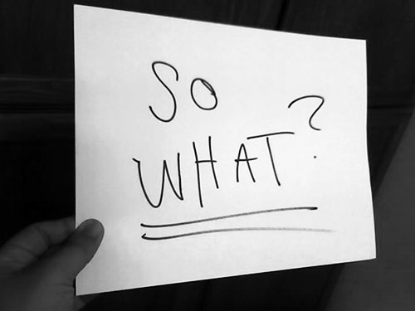
Why is this important?
We are human beings and we bring with our own lenses and experience and biases.
There’s no chance at fairness, reliability and validity unless we can observe things similarly, from classroom to classroom and school to school and district to district
Notes:
NOTES

Slide 26
Definition of bias (and we all have biases):
Attaching positive or negative meaning to elements in our environment based on personal or societal influences that shape our thinking.
A biased judgment is based on outside influences and is not necessarily related to a teacher’s effectiveness.
  Example: “Mrs. T does so much for the school, she is an excellent teacher. “
  The actual classroom evidence may not support the rating of the teacher as “excellent.”
Notes:
NOTES

Slide 27
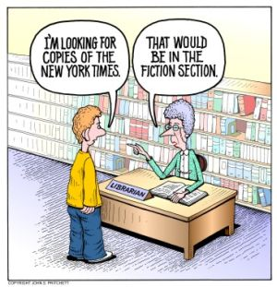
Other Threats to Observer Accuracy
Assessor bias
Leniency
Central Tendency
“Halo” or “Horns”
Effect
Notes:
NOTES

Slide 28
COLLECT
DATA
(Evidence)
SORT TO
ALIGN
WITH YOUR
FRAMEWORK
Interpret:
Clarify
Conclusions
NO!
Impact on learning…
Support needed…
Notes:
NOTES

Slide 29
Remember the Priorities
  Cognitive Engagement
  Constructivist Learning
  21st Century Skills
Review the Standards/Rubrics
  What type of evidence must you collect to assess the priorities of the rubrics?
Be ready to collect the evidence
  Electronically
  iPad? Laptop? Handheld?
  Template or open-ended?
  Placemat?
Notes:
NOTES

Slide 30
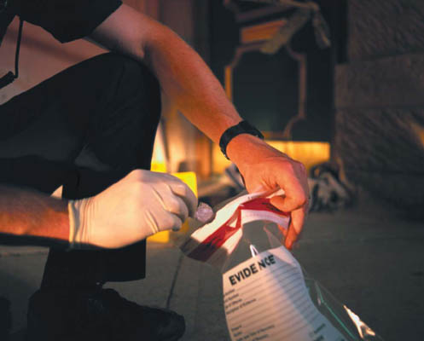
Observe what students are doing that shows evidence of elements of NYS Teaching Standard 3 (Instruction)
Collect evidence as you watch, ideally, electronically.
Notes:
Use high school history example from ASCD collection.

Slide 31

Use the self-check questions to review your evidence collection
  Have I recorded only facts?
  Is my evidence relevant to the criteria being examined?
  Whenever possible, have I quantified words such as few, some, and most?
  Have I used quotation marks when quoting a teacher or student?
  Does my selection or documentation of evidence indicate any personal or professional preferences?
  Have I included any opinion (in the guise of fact)?
Notes:
NOTES

Slide 32
COLLECT
DATA
(Evidence)
SORT TO
ALIGN
WITH YOUR
FRAMEWORK
Interpret:
Clarify
Conclusions
NO!
Impact on learning…
Support needed…
Notes:
NOTES

Slide 33

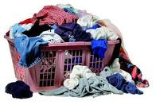
Go back to your evidence. Get out your placemat.
  Go back to your evidence
  Get out the placemat of your preferred framework
  Label each of your pieces of evidence with the standard number – put it to the left of the beginning of each piece of evidence
  Use your computer to sort
Notes:
It might be necessary to go through an example with some of the evidence they suggested.

Slide 34
Observe what students are doing that shows evidence of elements of NYS Teaching Standard 3 (Instruction).
Collect evidence as you watch, ideally electronically.
Let’s do it again!
Notes:
Watch the History Class video. Each participant should collect evidence.

Slide 35
“Teacher evaluation can be an opportunity for genuine professional learning. When organized around clearly established and accepted standards of practice, teacher evaluation offers an opportunity for educators to reflect seriously on their practice, and promote learning.”
Charlotte Danielson
The Handbook for Enhancing Professional Practice
Notes:
NOTES

Slide 36
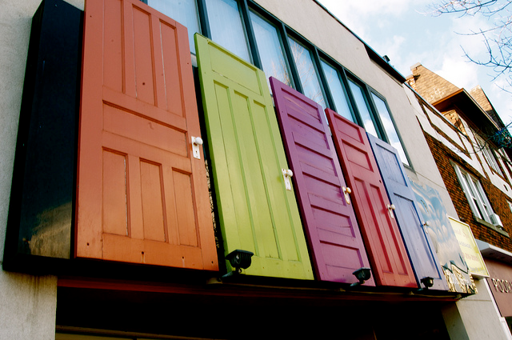
You decide…
Notes:
Time for lunch break.

Slide 37
Agenda
Reconvene and regroup
Objectives and Agenda Review
Focusing on the learners
Teacher Evaluation
The nature of evaluation (feedback, evidence, bias)
Collecting Some Evidence
Getting It Done
Closure

Slide 38
Getting it Done

Slide 39
The Year at a Glance
Beginning of the Year
Ongoing
End of the Year
Beginning of the year meeting
Standards I and II
SLO and
local (LAT) target setting
Evidence Submission by
Teacher
Evidence Collection
Sharing the evidence
Feedback Conversations
Evidence from the year collected
Compare collected evidence to the rubric
Summative score determination and communication

Slide 40
The Year at a Glance
Beginning of the Year
Ongoing
End of the Year
Beginning of the year meeting
Standards I and II
SLO and
local (LAT) target setting
Evidence Submission by
Teacher
Evidence Collection
Sharing the evidence
Feedback Conversations
Evidence from the year collected
Compare collected evidence to the rubric
Summative score determination and communication

Slide 41
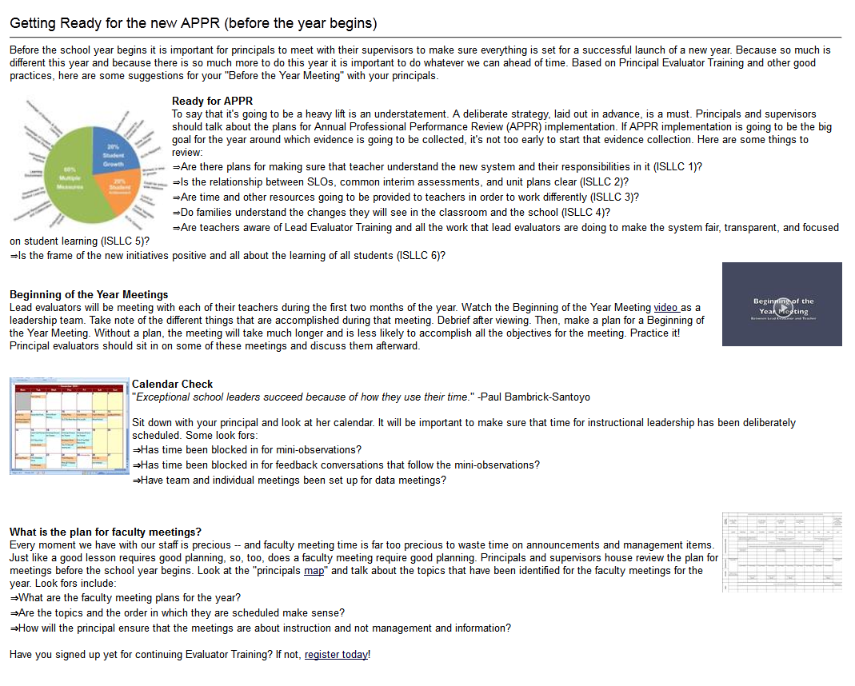
Beginning of the Year
  Beginning of the year meeting
  Standards I and II
  SLO and
  local (LAT) target setting
Notes:
Visit the resources on the page. Go through them.
.

Slide 42
Beginning of the Year Meeting

Slide 43
Guiding Questions:
Beginning of the Year
  Beginning of the year meeting
  Standards I and II
  SLO and local (LAT) target setting
  As a table group, identify the questions you might ask during the meeting

Slide 44
Guiding Questions:
Beginning of the Year
  Beginning of the year meeting
  Standards I and II
  SLO and local (LAT) target setting
  As a table group, identify the questions you might ask during the meeting
  Watch it
  Debrief

Slide 45
Meet Ms. Montoya
Your goal is to plan for and conduct a “beginning of the year” meeting
With a partner, plan the meeting. Do you want a shared agenda? Pre-meeting reflection questions?
Notes:
This simulation is designed to help evaluators prepare for the Beginning of the Year meetings they will soon be holding. This scenario is truncated because it does not include LATs because districts are doing so many different things at the local level.
Partners plan for the meeting. Then, partners match up with another set at their table and one set does the role play while the other watches and afterward provides feedback.

Slide 47
SLOs and LATs

Slide 48
Beginning of the Year
  Beginning of the year meeting
  Standards I and II
  SLO and local (LAT) target setting

Slide 49
SLOs
  Connection to Balanced Assessment System
  District Decision Points
  An Example
  (Ms. Montoya & 3rd Grade Math)

Slide 50
Getting it Done

Slide 51
The Year at a Glance
Beginning of the Year
Ongoing
End of the Year
Beginning of the year meeting
Standards I and II
SLO and
local (LAT) target setting
Evidence Submission by
Teacher
Evidence Collection
Sharing the evidence
Feedback Conversations
Evidence from the year collected
Compare collected evidence to the rubric
Summative score determination and communication

Slide 52
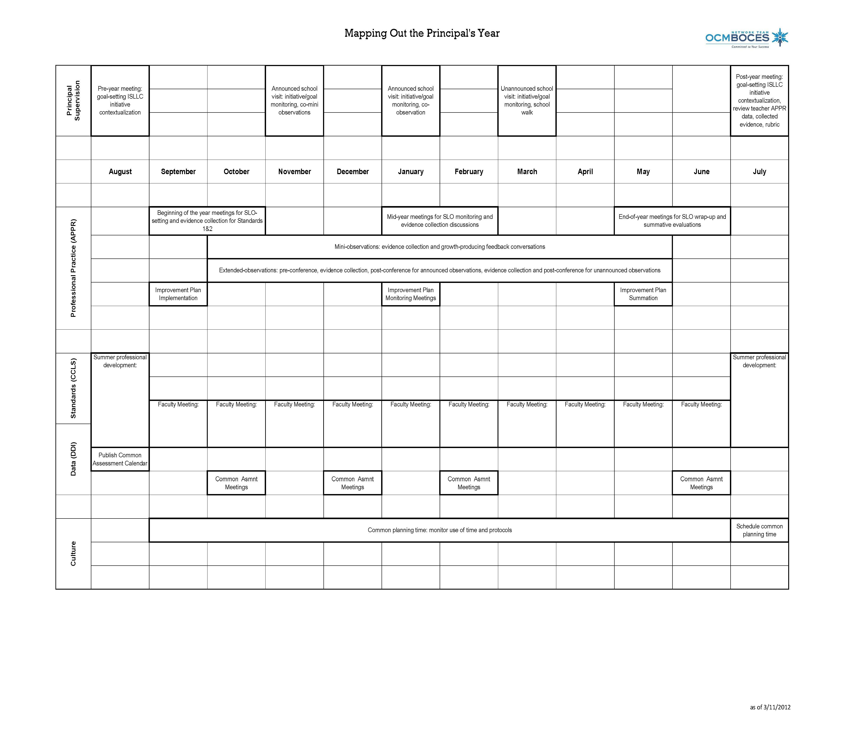
Looking At the Year
Notes:
NOTES

Slide 53
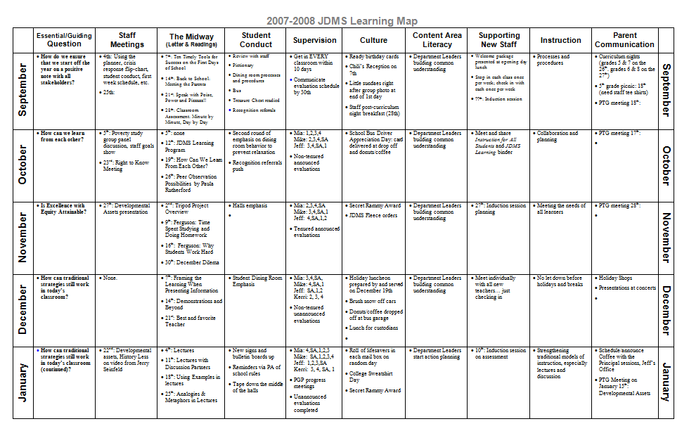
Another Way of At the Year

Slide 54
Time Allocation

Slide 60
Don’t Forget Culture
You will be operating in 3012-c land, but people will be talking about 3012-d land.
Drama about state tests will persist.
What should you do?

Slide 61
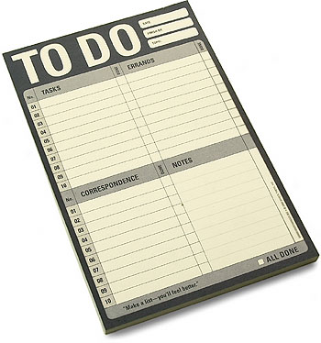

Slide 62
Agenda
Objectives and Agenda Review
Focusing on the learners
Teacher Evaluation
The nature of evaluation (feedback, evidence, bias)
Collecting Some Evidence
Beginning of the Year (meetings, SLOs, etc.)
Getting It Done
Closure

Slide 63
Next Time
September 28th
  8:30a – 11:30a
Evidence Collection and scoring
“How’s it going?”
  Beginning of the Year
  SLOs
  Scheduling your time

Slide 64
Questions
Visiting the Parking Lot
+/∆
+
∆
Notes:
NOTES

Slide 65
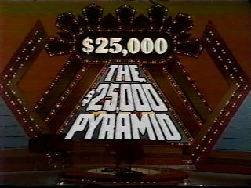
Review

Slide 66
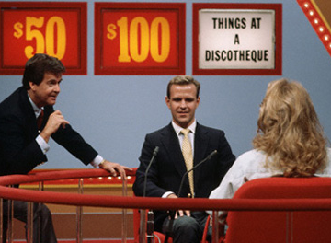
Review

Slide 67
$25K
$1000
$10K
$50
$100
$500

Slide 68
Standards

Slide 69
Data

Slide 70
21stC Readiness

Slide 71
Professional
Practice

Slide 72
Evidence

Slide 73
Culture

Slide 74
Engagement

Slide 75
Constructivism

Slide 76
Feedback

Slide 77
Good-bye!

