Slide 1
Lead Evaluator Training
Day 1

Slide 2
Agenda: Preview
Introductions
Objectives and Agenda Review
The Big Picture/Regents Reform Agenda
Common Language in Schools
Teaching Standards (priorities & observable)
Engagement, Constructivism & 21C
Observing a lesson
Teacher Evaluation
Rubric Organization - Levels of Performance
Closure

Slide 3
Resources are Archived

Slide 4
Who Are We?
Name
District/school
Position/role
Supervisees
What are your goals for Lead Evaluator Training? (chart these)

Slide 5
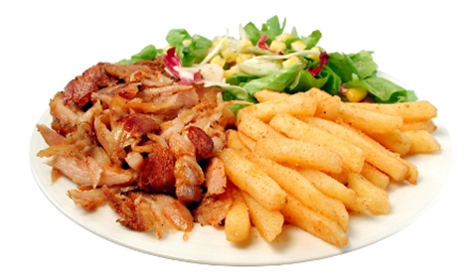
What’s On Your Plate
Fill in your plate with all your professional and personal obligations, responsibilities, initiatives, and goals
At your table, share these (if you don’t know everyone, do introductions, too)
After everyone has shared, make a generalization(s) about “what’s on our plates”

Slide 6
Here We Are: 9 Components
3012-c
3012-d
New York State Teaching Standards and Leadership Standards
Evidence-based observation
Application and use of Student Growth Percentile and VA Growth Model data
Application and use of the State-approved teacher or principal rubrics
Application and use of any assessment tools used to evaluate teachers and principals
New York State Teaching Standards and Leadership Standards
Evidence-based observation
Application and use of Student Growth Percentile method
Application and use of the State-approved teacher or principal rubrics
Application of assessment tools the district employs

Slide 7
Here We Are: 9 Components
3012-c
3012-d
Application and use of State-approved locally selected measures of student achievement
Use of the Statewide Instructional Reporting System
Scoring methodology used to evaluate teachers and principals
Specific considerations in evaluating teachers and principals of ELLs and students with disabilities
Application and use of State-approved locally selected measures of student growth
Use of the Statewide Instructional Reporting System
Scoring methodology used by the state and the district
Specific considerations in evaluating teachers and principals of ELLs and students with disabilities

Slide 8
Here We Are: 9+ Components
Managing the APPR
Connecting it to Race To The Top
Increasing the likelihood that it makes a difference

Slide 9
Here We Are: 9+ Components
What questions or ideas do the objectives bring to mind?
How will the objectives help you in your work?
What objectives would you like to add to the agenda?

Slide 10
Ground Rules
No one in the room has all the answers; we all have regulatory questions and concerns we have to work out in our districts
Remember that we’re leaders
Improving teaching and learning is the point
The State has high standards for observers when they observe teachers

Slide 11
Ground Rules

Slide 12
Ground Rules

Slide 13
REMEMBER, APPR is only PART of the Regents Reform Agenda

Slide 14
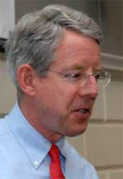
Meet Kim
Notes:
Read Kim’s Op-Ed from the Boston Globe; include 15 minute break.

Slide 15
So, what is the Regents Reform Agenda?

Slide 16
Drama
Race To The Top & the Reform Agenda
Truth

Slide 17
Professional Practice
Standards
School
Turnaround
Data

Slide 18
Professional Practice
Standards
Data
Culture

Slide 19
The Story of Standards

Slide 20
SCANS
Report
NY CCLS
Compact for Learning
A Nation At Risk
NYS Learning Standards
CCSS
Regents Action Plan
Math
Pre/post March
Social Studies Framework
1970
1980
1990
2000
2010
2020

Slide 21
ELA/Literacy
Mathematics
Next Generation Science
Social Studies Framework
Arts? World Languages?

Slide 22
ELA/Literacy
Mathematics
Social Studies Framework
Next Generation Science?
Arts? World Languages?

Slide 23
ELA/Literacy
Mathematics
Social Studies Framework
Next Generation Science?
Arts? World Languages?

Slide 24
ELA/Literacy
Mathematics
Social Studies Framework
New York State Science Learning Standards
Next Generation Science?
Arts? World Languages?

Slide 25
Six Shifts: ELA & Literacy
Balancing Fiction and Nonfiction
Building Knowledge in the Disciplines
Staircase of Complexity
Text-Based Answers (close reading)
Nonfiction Writing
Academic Vocabulary

Slide 26
Six Shifts: ELA & Literacy
Balancing Fiction and Nonfiction
Building Knowledge in the Disciplines
Staircase of Complexity
Text-Based Answers (close reading)
Nonfiction Writing
Academic Vocabulary

Slide 27
Six Shifts: Math
Focus
Coherence
Fluency
Deep Understanding
Applications
Dual Intensity (really, tri)

Slide 28
Six Shifts: Math
Focus
Coherence
Fluency
Deep Understanding
Applications
Dual Intensity (really, tri)

Slide 29
Shifts: Social Studies
Away from facts
Focus on Conceptual Understanding
Away from teacher and textbook
Student Inquiry, Collaboration, and Informed Action
Read, discuss, and write like social scientists
Purposefully Integrate Content and Skills

Slide 30
What might you see or hear about STANDARDS?
Federal v. State
Publishing Companies
Taking away professionalism
All sorts of other drama

Slide 31
What should you see or hear about STANDARDS?
Curriculum revision projects
Standards-based planning
Literacy in all disciplines

Slide 32
Professional Practice
Standards
Data
Culture

Slide 33
Data

Slide 34
It’s always been here…

Slide 35
ITBS
Report Cards
Unit Tests
State Tests
Letters
Performance
Quizzes
Terra Nova
Attendance
Reports
Samples
Notebook
Regents
Inventories
Essay
Anecdotal
Performance
Unit Tests
Scores
Logs
Homework
Pictures
Journals
Posttest
RCT
Rubrics
Conferences
Pretest
PET
Checklists
Interview

Slide 36
It’s not really the data

Slide 37
It is about what we do with the data

Slide 38
Common
Interim
Assessments

Slide 39
give the test
make the test
analyze
the work
do something about it

Slide 40
What might you see or hear about DATA?
3-8 Assessments
Scale Scores
AIS cut points
PARCC
Big Brother
Cloud
Privacy

Slide 41
What should you see or hear about DATA?
Common Formative Assessments
Professional Learning Communities
Data Teams

Slide 42
Professional Practice
Standards
Data
Culture

Slide 43
Professional
Practice

Slide 44
APPR

Slide 45
20%
Student Growth
60%
Multiple Measures
20%
Student Achievement

Slide 46
Growth over time
Knowledge of Students & Student Learning
Compared to Expected Growth
Knowledge of Content & Instructional Planning
Some Variables Considered
20%
Student Growth
SLOs Required
Instructional Practice
60%
Multiple Measures
Moment in time or growth
Learning Environment
20%
Student Achievement
Could be school-
wide measure
Assessment for Student Learning
Local or Purchased
Professional Responsibilities and Collaboration
Some Variables Considered
SLOs Optional
Professional Growth

Slide 47
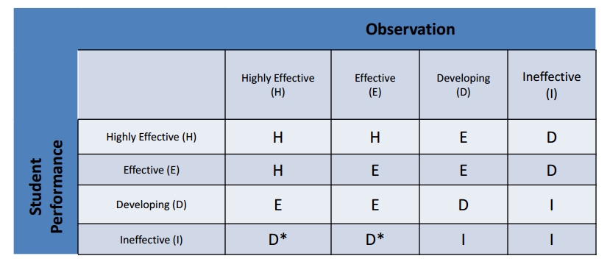
The Matrix
3012-d
Scores from rubrics have to be converted to H-E-D-I levels for the matrix.
Notes:
* If the state-provided score is ineffective and an additional growth component is included and also ineffective the teacher can be rated no high than ineffective.

Slide 49
What might you see or hear about PROFESSIONAL PRACTICE?
APPR (plans and approval, SLOs, rubrics, HEDI scales, teacher/principal growth scores)
Teachers losing their jobs

Slide 50
What should you see or hear about PROFESSIONAL PRACTICE (but probably won’t because of APPR)?
NYS Teaching Standards
Continuous Improvement
Growth Producing Feedback

Slide 51
Professional Practice
Standards
Data
Culture

Slide 52
What should our schools be like?

Slide 53
Educators working collaboratively… taking collective responsibility for student learning.

Slide 54
Collaborative learning teams implementing a guaranteed and viable curriculum.

Slide 55
Collaborative learning teams using assessment data and student work to make instructional decisions.

Slide 56
Where students find meaning in what they do.

Slide 57
Where students make decisions about what they learn and how they learn it.

Slide 58
Where the 4Cs are embedded in the 3Rs.

Slide 59
Where its about the student's future rather than the adults’ past.

Slide 60
Accountability
Focus Schools
LAPs
Scores
What might a you see or hear about CULTURE?

Slide 61
21C, PBL
College, Career & Citizenship Ready
Professional Learning Community
What should you see or hear about CULTURE?

Slide 62
Professional Practice
Standards
Data
Culture

Slide 63
Drama
Race To The Top & the Reform Agenda
Truth

Slide 64
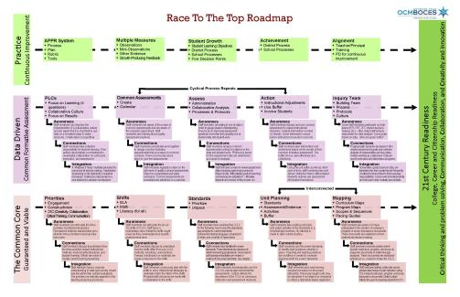
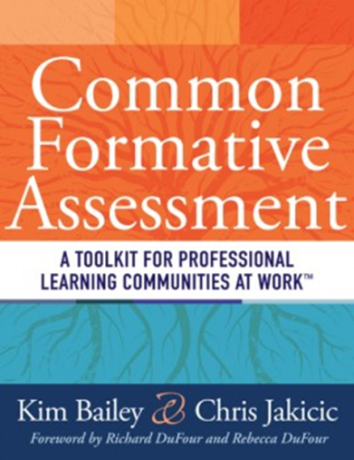
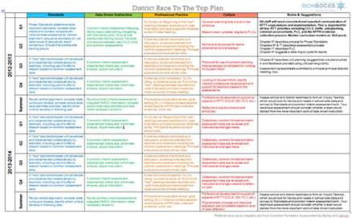
Another Way To Look at the Work
RTTT Road Map
RTTT “textbook”

Slide 65
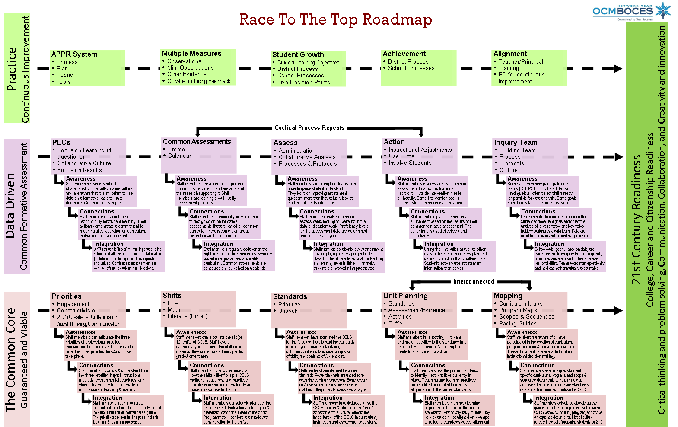
Regents Reform Agenda Road Map
Where are you now?
Notes:
NOTES

Slide 66
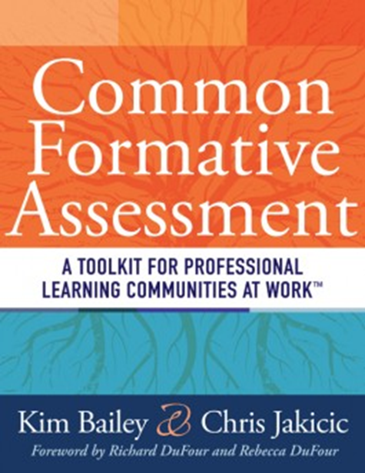
Introducing the “textbook”

Slide 67
Introducing the “textbook”
Intro to PLC
DuFour
Hattie
Deming

Slide 68
Introducing the “textbook”
Intro to PLC

Slide 69
Introducing the “textbook”
Intro to PLC

Slide 70
Introducing the “textbook”
Assessment Overview
DuFour
Stiggins
Wiliam

Slide 71
Introducing the “textbook”
What’s Most Important
Marzano
Ainsworth

Slide 72
Introducing the “textbook”
Unpacking
Marzano
Wiggins
McTighe
Ainsworth

Slide 73
Introducing the “textbook”
Assessment Design
Reeves
Ainsworth
Marzano
Stiggins
Popham

Slide 74
Introducing the “textbook”
Unit Planning & Mapping
Covey
Wiggins
McTighe
p21

Slide 75
Introducing the “textbook”
Data-Based Action
Schmoker
DuFour
Wellman
Lipton

Slide 76
Introducing the “textbook”
Involving Students
Popham
Wiliam
Brookhart
Hattie

Slide 77
Introducing the “textbook”
Sustaining the Effort
DuFour
Newmann
Deming

Slide 78
Remember that Plate?

Slide 79
But how is it adding too much to our plates to…

Slide 80
Be clear about what we expect children to learn…

Slide 81
Use assessment and data to nurture and guide learning…

Slide 82
Try to become a better teacher or leader…

Slide 83
Work collaboratively to prepare students for their future?

Slide 84
Are we adding to our plates or is this the way we should already be doing business?

Slide 85
School can be a jungle…
Notes:
Take a break after the video

Slide 86
REMEMBER, APPR is only PART of the Regents Reform Agenda

Slide 87
Professional Practice

Slide 88
Imagine you are in the classroom of a highly effective teacher:
What would you see?
What would you hear?
What would the students be doing or saying?
Individually, write one idea per post-it note.
Notes:
NOTES

Slide 89
As a group, arrange the sticky notes in a way that makes sense, grouping similar ideas together.
Notes:
Need for a common languages. Even thought we had a convergent sense of what should be occurring in a classroom, we all have different descriptors and ways of talking about it

Slide 90
Draw the pie on chart paper.
Label the slices.
Now stick the sticky notes in the slice of the pie in which they belong
Standard 7
Professional Growth
Notes:
NOTES

Slide 91
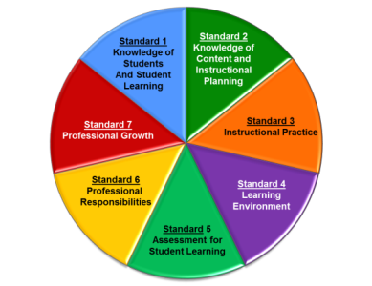
Standard 1: Knowledge of Students & Student Learning
Knowledge of child development
Knowledge of research…
Knowledge of diverse learning needs
Knowledge of individual students
Knowledge of economic, social
Knowledge of technological literacy…
Notes:
NOTES

Slide 92
Standard 2: Knowledge of Content & Instructional Planning
Knowledge of content…
Connect concepts across disciplines…
Uses a broad range of instructional strategies
Establishes goals & expectations
Designs instruction
Evaluate / utilize resources
Notes:
NOTES

Slide 93
Standard 3: Instructional Practice
Research-based practices
Communicates clearly…
High expectations…
Variety of instructional… to engage student
Engage students in multi-disciplinary skills
Monitor and assess progress
Notes:
NOTES

Slide 94
Standard 4: The Learning Environment
Creates a respectful, safe and supportive environment
Creates an intellectually stimulating environment
Manages the learning environment
Organize and utilize available resources (e.g. physical space, time, technology…)
Notes:
NOTES

Slide 95
Standard 5: Assessment for Student Learning
Range of assessment tools
Understand, analyze, use data for differentiation*
Communicates assessment system*
Reflect upon assessment system and adjust*
Prepare students for assessments
* - assessed through “multiple measures”
Notes:
NOTES

Slide 96
Standard 6: Professional Responsibilities
Upholds standards and policies
Collaborate with colleagues
Communicate & collaborate with families
Perform non-instructional duties
Complies with laws and polices
Notes:
NOTES

Slide 97
Standard 7: Professional Growth
Reflect on practice
Set goals for professional development
Communicate and collaborate to improve practice
Remain current in knowledge of content and pedagogy
Notes:
NOTES

Slide 98
Using the placemat for the NYS Teaching Standards, re-sort your table’s post-it notes by Standard
Notes:
NOTES

Slide 99
3012-d Update
These are prohibited from being used in an evaluation (but not for now):
Lesson plans or other artifacts of practice
Parent or student feedback
Goal setting
Unapproved assessments
Some things such as lesson plans may be observable during a pre or post; these may be considered.

Slide 100
There are three priorities in the Teaching Standards
Engagement
Constructivism
21st Century Readiness
PRIORITIES
Notes:
NOTES

Slide 101
Engagement:
Cognitive
Zone of proximal development
Every student (ELLS, SWD, too)
ENGAGEMENT
Notes:
NOTES

Slide 102
Constructivism:
Making connections
Making meaning
Relate to world outside
Relate to personal future
CONSTRUCTIVISM
Notes:
NOTES

Slide 103
21C Readiness:
College
Career
Citizenship
Collaboration
Communication
Critical Thinking & Problem Solving
Creativity
21C READINESS
Notes:
NOTES

Slide 104
Observe what students are doing that shows evidence of engagement, constructing meaning, or 21C. Each triad member is responsible for one priority.
Collect evidence in a table, be prepared to share your evidence.
engagement
constructivism
21C
Notes:
Watch 15 minutes of a lesson. Use math “best deal” video? We have to make sure we chart these pieces of “evidence” for use later!!!

Slide 105
How would you rate this lesson, on a scale of 1-10?
Notes:
Use sticky dots to record the spread of the scores.

Slide 106
What did you observe in the video?
Evidence from the video
Notes:
We have to make sure we chart these pieces of “evidence” for use later!!!

Slide 107
In addition to the three priorities, other common themes of the Standards (and rubrics):
Upholds standards and policies
Equity
Cultural competence
High expectations
Developmental appropriateness
A focus on individuals, including those with special needs
Appropriate use of technology
Student assumption of responsibility
Notes:
NOTES

Slide 108
Translating this to Evaluation…

Slide 109
Translating this to Evaluation… adds Accountability…

Slide 110
Translating this to Evaluation… adds Accountability… for Teachers and Evaluators

Slide 111
Highly Effective
Effective
Developing
Ineffective
Notes:
NOTES

Slide 112
Ineffective – Teaching shows evidence of not understanding the concepts underlying the component - may represent practice that is harmful - requires intervention
Developing – Teaching shows evidence of knowledge and skills related to teaching - but inconsistent performance
Notes:
NOTES

Slide 113
This
Is
our focus!
Effective - Teaching shows evidence of thorough knowledge of all aspects of the profession. Students are engaged in learning. This is successful, accomplished, professional, and effective teaching.
Highly Effective – Classroom functions as a community of learners with student assumption of responsibility for learning.
Notes:
NOTES

Slide 114
H
E
D
I
Notes:
NOTES

Slide 115
H
E
D
I
?
Notes:
NOTES
As a table, think of a HEDI scale for an example other than swimming. Ask one or two tables to share.

Slide 116
HEDI in the Classroom

Slide 117
NYSUT Rubric
Knowledge of Students & Student Learning
Element 1.1 Demonstrate knowledge of child and adolescent development including cognitive, language, social, emotional, and physical developmental levels.
A) Describes developmental characteristics of students
Standards
Summary statements
Elements
Indicators
Notes:
117
NOTES

Slide 118
FFT Rubric
Domain
1. Planning and Preparation
1.a Demonstrating
Knowledge of Students
Component
Critical Attributes and Possible Examples are included in 2011 & 2013 versions
Notes:
118
NOTES

Slide 119
A look at a rubric:
Read the descriptors for Standard 3 or Domain 3 of the rubric
Highlight or underline the verbs / phrases that distinguish the differences among the levels of performance
Notes:
NOTES

Slide 120
An even closer look at the rubric:
Analyze your assigned part of the rubric
On the left side of the chart paper, summarize your element
On the right side of your chart paper, describe what the students might be doing in the classroom that exemplifies that element (observable)
element summary
what students do
Notes:
NOTES

Slide 121
Gallery walk of the elements 3.1 – 3.6 and 5.1:
Docent at posters, answering questions only!
Carry two sticky notes with you: one with something you expected to see, one for something that surprised you
Place two notes on charts at the end of gallery
Something you expected to see
One thing that surprised you
Notes:
NOTES

Slide 122
The priorities of the framework are critically important to understanding the rubrics and the assessment of teaching practice. How might you respond to the following questions/statements (discuss at table):
“We don’t have a lot of technology in our district so I don’t think we can hold teachers responsible for 21st Century skills.”
“We have embraced direct instruction in our district so we can’t expect teachers to be highly effective because direct instruction doesn’t allow for students to take control of the classroom.”
“How can students be cognitively engaged in something like PE?”
“I don’t think these rubrics will work for all teachers.”
Notes:
NOTES

Slide 123
YOUR System to Ensure that the NYS Teaching Standards are Implemented in Every Classroom

Slide 124
APPR Plans
Take out your APPR Plan.
Which rubric?
Extended observations?
Mini-observations?
Paperwork requirements?
Conversation expectations?
Management of it all?
Complete the worksheet!

Slide 125
APPR Plans
Other than with rubrics, paperwork, procedures, and all of the things in the APPR plan…
How can you really influence teaching and learning in your school?

Slide 126
Learning by Adults and Learning by Children

Slide 127
Conditions for Learning
Reflect on something you recently learned.
How did you learn it?
How do you know?
What conditions help you learned it?

Slide 128
Conditions for Learning
Reflect on something you recently learned.
How did you learn it?
How do you know?
What conditions helped you learn it?
It’s hard to learn on your own without any feedback…

Slide 129
Effective Feedback
What were the qualities of the best feedback you have received?
What were the qualities of ineffective feedback?
Notes:
Click on picture to access video clips. Use in order.

Slide 130
Effective Feedback
It’s all about the feedback and the conversations we have with teachers on a regular basis.

Slide 131
What shifts have to occur…
In teachers’ thinking?
In teachers’ actions?
Notes:
NOTES

Slide 132
What shifts have to occur…
In principals’ thinking?
In principals’ actions?
Notes:
NOTES

Slide 133
What shifts have to occur…
In the culture of the district?
In the culture of the school?
Notes:
NOTES

Slide 134
Agenda: Review
Introductions
Objectives and Agenda Review
The Big Picture/Regents Reform Agenda
Common Language in Schools
Teaching Standards (priorities & observable)
Engagement, Constructivism & 21C
Observing a lesson
Teacher Evaluation
Rubric Organization - Levels of Performance
Closure

Slide 135
Agenda: Preview
Reconvene and regroup
Objectives
Focusing on the learners
Teacher Evaluation
The nature of evaluation (feedback, evidence, bias)
Collecting Some Evidence
Getting It Done
Closure

Slide 136
Questions
Visiting the Parking Lot
+/∆
+
∆
Notes:
NOTES

Slide 137
Lead Evaluator Training
Day 1

