Slide 1
Lead Evaluator Training
Day 1

Slide 2
Agenda
Introductions
Objectives and Agenda Review
RTTT: The Big Picture (and resources)
Common Language in Schools
Priorities in the Teaching Standards
Engagement, Constructivism & 21C
Observing a lesson
Teacher Evaluation
Rubric Organization - Levels of Performance
Closure

Slide 3
Resources are Archived

Slide 4
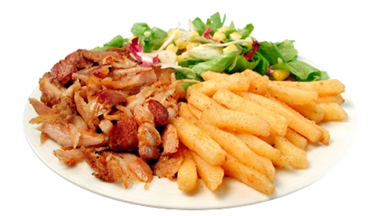
What’s On Your Plate
Fill in your plate with all your professional and personal obligations, responsibilities, initiatives, and goals
At your table, share these (if you don’t know everyone, do introductions, too)
After everyone has shared, make a generalization(s) about “what’s on our plates”

Slide 5
Here We Are: 9 Components
New York State Teaching Standards and Leadership Standards
Evidence-based observation
Application and use of Student Growth Percentile and VA Growth Model data
Application and use of the State-approved teacher or principal rubrics
Application and use of any assessment tools used to evaluate teachers and principals

Slide 6
Here We Are: 9 Components
Application and use of State-approved locally selected measures of student achievement
Use of the Statewide Instructional Reporting System
Scoring methodology used to evaluate teachers and principals
Specific considerations in evaluating teachers and principals of ELLs and students with disabilities

Slide 7
Here We Are: 9+ Components
Managing the APPR
Connecting it to Race To The Top
Increasing the likelihood that it makes a difference

Slide 8
Here We Are: 9+ Components
What questions or ideas do the objectives bring to mind?
How will the objectives help you in your work?
What objectives would you like to add to the agenda?

Slide 9
Ground Rules
No one in the room has all the answers; we all have regulatory questions and concerns we have to work out in our districts
Remember that we’re leaders
Improving teaching and learning is the point
The State has high standards for observers when they observe teachers

Slide 10
Ground Rules

Slide 11
Ground Rules

Slide 12
REMEMBER, APPR is only PART of Race To The Top and the Regents Reform Agenda

Slide 13
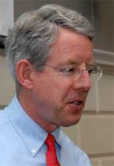
Meet Kim
Notes:
Read Kim’s Op-Ed from the Boston Globe; include 15 minute break.

Slide 14
So, what is Race To The Top and the Regents Reform Agenda?

Slide 15
Professional Practice
Standards
Data
Culture

Slide 16
The Story of Standards

Slide 17
SCANS
Report
NY CCLS
Compact for Learning
A Nation At Risk
NYS Learning Standards
CCSS
Regents Action Plan
Math
Pre/post March
1970
1980
1990
2000
2010
2020

Slide 18
ELA/Literacy
Mathematics
Coming Soon:
Next Generation Science
Coming Soon:
CCLS-infused SS

Slide 19
Six Shifts: ELA
Balancing Fiction and Nonfiction
Building Knowledge in the Disciplines
Staircase of Complexity
Text-Based Answers (close reading)
Nonfiction Writing
Academic Vocabulary

Slide 20
Six Shifts: Math
Focus
Coherence
Fluency
Deep Understanding
Applications
Dual Intensity (really, tri)

Slide 21
Professional Practice
Standards
Data
Culture

Slide 22
Data

Slide 23
It’s always been here…

Slide 24
ITBS
Report Cards
Unit Tests
State Tests
Letters
Performance
Quizzes
Terra Nova
Attendance
Reports
Samples
Notebook
Regents
Inventories
Essay
Anecdotal
Performance
Unit Tests
Scores
Logs
Homework
Pictures
Journals
Posttest
RCT
Rubrics
Conferences
Pretest
PET
Checklists
Interview

Slide 25
It’s not really the data

Slide 26
It is about what we do about data

Slide 27
Common
Interim
Assessments

Slide 28
give the test
make the test
analyze
the work
do something about it

Slide 29
Professional Practice
Standards
Data
Culture

Slide 30
Professional
Practice

Slide 31
APPR
Growth over time
Knowledge of Students & Student Learning
Compared to Expected Growth
Knowledge of Content & Instructional Planning
Some Variables Considered
20%
Student Growth
SLOs Required
Instructional Practice
60%
Multiple Measures
Moment in time or growth
Learning Environment
20%
Student Achievement
Could be school-
wide measure
Assessment for Student Learning
Local or Purchased
Professional Responsibilities and Collaboration
Some Variables Considered
SLOs Optional
Professional Growth

Slide 32
APPR

Slide 33
Professional Practice
Standards
Data
Culture

Slide 34
What should our schools be like?

Slide 35
Educators working collaboratively… taking collective responsibility for student learning.

Slide 36
Collaborative learning teams implementing a guaranteed and viable curriculum.

Slide 37
Collaborative learning teams monitoring student learning through ongoing common assessments.

Slide 38
Collaborative learning teams using assessment data and student work to make instructional decisions.

Slide 39
Where students find meaning in what they do.

Slide 40
Where students make decisions about what they learn and how they learn it.

Slide 41
Where the 4Cs are embedded in the 3Rs.

Slide 42
Where it’s about the student's future rather than the adults’ past.

Slide 43
That’s what our schools should be like!

Slide 44
Professional Practice
Standards
Data
Culture

Slide 45
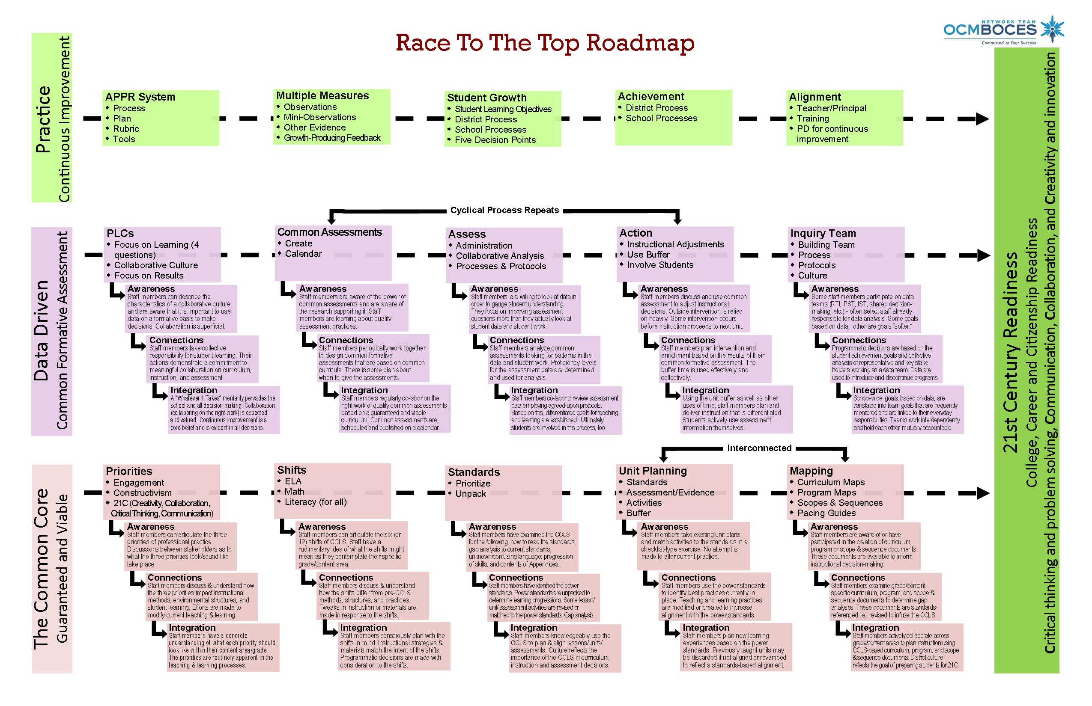
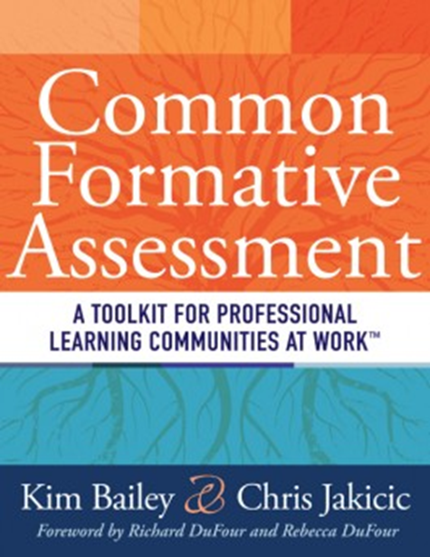
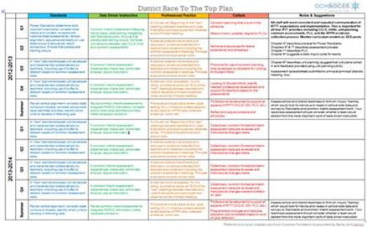
Another Way To Look at the Work
RTTT Road Map
RTTT “textbook”

Slide 46
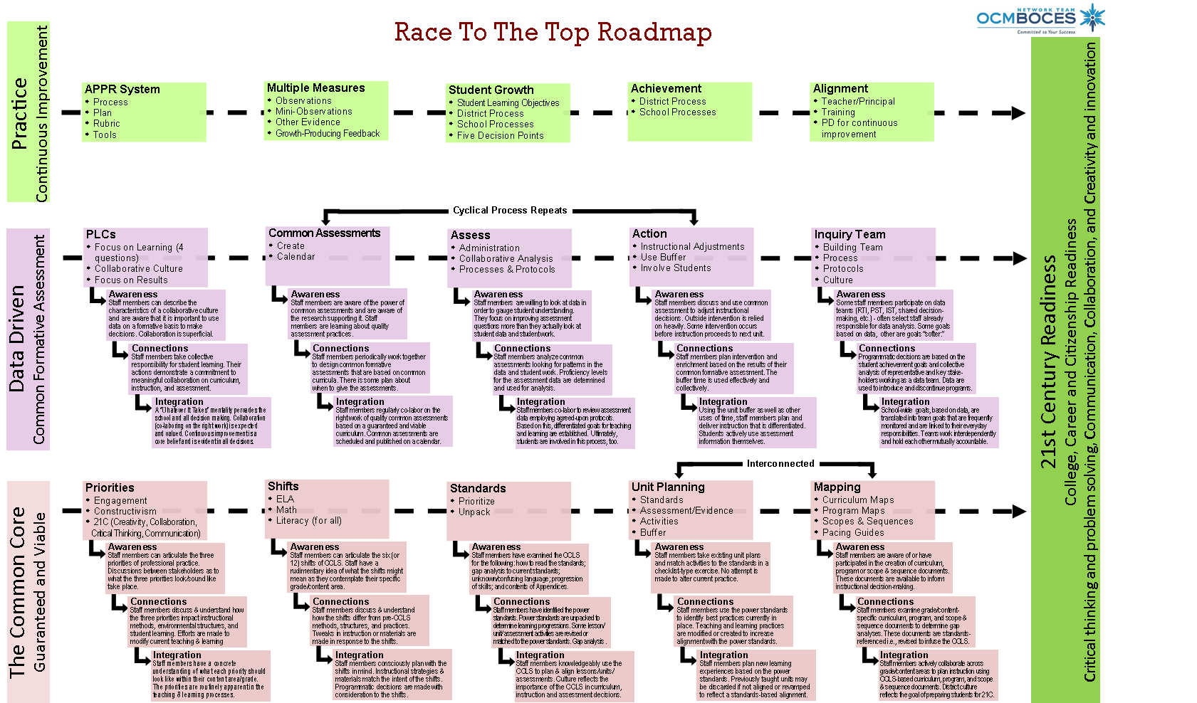
Race To The Top Road Map
Where are you now?
Notes:
NOTES

Slide 47
Introducing the “textbook”

Slide 48
Introducing the “textbook”
Intro to PLC
DuFour
Hattie
Deming

Slide 49
Introducing the “textbook”
Intro to PLC

Slide 50
Introducing the “textbook”
Intro to PLC

Slide 51
Introducing the “textbook”
Assessment Overview
DuFour
Stiggins
Wiliam

Slide 52
Introducing the “textbook”
What’s Most Important
Marzano
Ainsworth

Slide 53
Introducing the “textbook”
Unpacking
Marzano
Wiggins
McTighe
Ainsworth

Slide 54
Introducing the “textbook”
Assessment Design
Reeves
Ainsworth
Marzano
Stiggins
Popham

Slide 55
Introducing the “textbook”
Unit Planning & Mapping
Covey
Wiggins
McTighe
p21

Slide 56
Introducing the “textbook”
Data-Based Action
Schmoker
DuFour
Wellman
Lipton

Slide 57
Introducing the “textbook”
Involving Students
Popham
Wiliam
Brookhart
Hattie

Slide 58
Introducing the “textbook”
Sustaining the Effort
DuFour
Newmann
Deming

Slide 59
Remember that Plate?

Slide 60
But how is it adding too much to our plates to…

Slide 61
Be clear about what we expect children to learn…

Slide 62
Use assessment and data to nurture and guide learning…

Slide 63
Try to become a better teacher or leader…

Slide 64
Work collaboratively to prepare students for their future?

Slide 65
Are we adding to our plates or is this the way we should already be doing business?

Slide 66
School can be a jungle…
Notes:
Take a break after the video

Slide 67
REMEMBER, APPR is only PART of Race To The Top and the Regents Reform Agenda

Slide 68
Professional Practice

Slide 69
Imagine you are in the classroom of a highly effective teacher:
What would you see?
What would you hear?
What would the students be doing or saying?
Individually, write one idea per post-it note.
Notes:
NOTES

Slide 70
As a group, arrange the sticky notes in a way that makes sense, grouping similar ideas together.
Notes:
Need for a common languages. Even thought we had a convergent sense of what should be occurring in a classroom, we all have different descriptors and ways of talking about it

Slide 71
Draw the pie on chart paper.
Label the slices.
Now stick the sticky notes in the slice of the pie in which they belong
Standard 7
Professional Growth
Notes:
NOTES

Slide 72
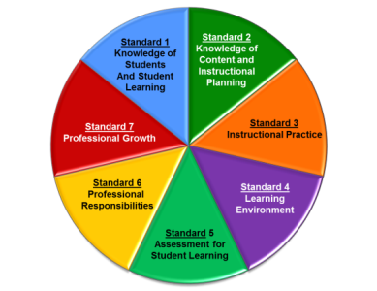
Standard 1: Knowledge of Students & Student Learning
Knowledge of child development
Knowledge of research…
Knowledge of diverse learning needs
Knowledge of individual students
Knowledge of economic, social
Knowledge of technological literacy…
Notes:
NOTES

Slide 73
Standard 2: Knowledge of Content & Instructional Planning
Knowledge of content…
Connect concepts across disciplines…
Uses a broad range of instructional strategies
Establishes goals & expectations
Designs instruction
Evaluate / utilize resources
Notes:
NOTES

Slide 74
Standard 3: Instructional Practice
Research-based practices
Communicates clearly…
High expectations…
Variety of instructional… to engage student
Engage students in multi-disciplinary skills
Monitor and assess progress
Notes:
NOTES

Slide 75
Standard 4: The Learning Environment
Creates a respectful, safe and supportive environment
Creates an intellectually stimulating environment
Manages the learning environment
Organize and utilize available resources (e.g. physical space, time, technology…)
Notes:
NOTES

Slide 76
Standard 5: Assessment for Student Learning
Range of assessment tools
Understand, analyze, use data for differentiation*
Communicates assessment system*
Reflect upon assessment system and adjust*
Prepare students for assessments
* - assessed through “multiple measures”
Notes:
NOTES

Slide 77
Standard 6: Professional Responsibilities
Upholds standards and policies
Collaborate with colleagues
Communicate & collaborate with families
Perform non-instructional duties
Complies with laws and polices
Notes:
NOTES

Slide 78
Standard 7: Professional Growth
Reflect on practice
Set goals for professional development
Communicate and collaborate to improve practice
Remain current in knowledge of content and pedagogy
Notes:
NOTES

Slide 79
Using the placemat for the NYS Teaching Standards, re-sort your table’s post-it notes by Standard
Notes:
NOTES

Slide 80
There are three priorities in the Teaching Standards
Engagement
Constructivism
21st Century Readiness
PRIORITIES
Notes:
NOTES

Slide 81
Engagement:
Cognitive
Zone of proximal development
Every student (ELLS, SWD, too)
ENGAGEMENT
Notes:
NOTES

Slide 82
Constructivism:
Making connections
Making meaning
Relate to world outside
Relate to personal future
CONSTRUCTIVISM
Notes:
NOTES

Slide 83
21C Readiness:
College
Career
Citizenship
Collaboration
Communication
Critical Thinking & Problem Solving
Creativity
21C READINESS
Notes:
NOTES

Slide 84
Observe what students are doing that shows evidence of engagement, constructing meaning, or 21C. Each triad member is responsible for one priority.
Collect evidence in a table, be prepared to share your evidence.
engagement
constructivism
21C
Notes:
Watch 15 minutes of a lesson. Use math “best deal” video? We have to make sure we chart these pieces of “evidence” for use later!!!

Slide 85
What did you observe in the video?
Evidence from the video
Notes:
We have to make sure we chart these pieces of “evidence” for use later!!!

Slide 86
In addition to the three priorities, other common themes of the Standards (and rubrics):
Upholds standards and policies
Equity
Cultural competence
High expectations
Developmental appropriateness
A focus on individuals, including those with special needs
Appropriate use of technology
Student assumption of responsibility
Notes:
NOTES

Slide 87
NYSUT Rubric
Knowledge of Students & Student Learning
Element 1.1 Demonstrate knowledge of child and adolescent development including cognitive, language, social, emotional, and physical developmental levels.
A) Describes developmental characteristics of students
Standards
Summary statements
Elements
Indicators
Notes:
87
NOTES

Slide 88
FFT Rubric
Domain
1. Planning and Preparation
1.a Demonstrating
Knowledge of Students
Component
Critical Attributes and Possible Examples are included in 2011 & 2013 versions
Notes:
88
NOTES

Slide 89
YOUR System to Ensure that the NYS Teaching Standards are Implemented in Every Classroom

Slide 90
APPR Plans
Take out your APPR Plan.
Which rubric?
Extended observations?
Mini-observations?
Paperwork requirements?
Conversation expectations?
Management of it all?
Complete the worksheet!

Slide 91
APPR Plans
Other than with rubrics, paperwork, procedures, and all of the things in the APPR plan…
How can you really influence teaching and learning in your school?

Slide 92
Learning by Adults and Learning by Children

Slide 93
Conditions for Learning
Reflect on something you recently learned.
How did you learn it?
How do you know?
What conditions help you learned it?

Slide 94
Conditions for Learning
Reflect on something you recently learned.
How did you learn it?
How do you know?
What conditions helped you learn it?
It’s hard to learn on your own without any feedback…

Slide 95
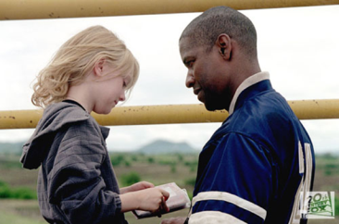
Effective Feedback
What were the qualities of the best feedback you have received?
What were the qualities of ineffective feedback?
Notes:
Click on picture to access video clips. Use in order.

Slide 96
Translating this to Evaluation…

Slide 97
Translating this to Evaluation… adds Accountability…

Slide 98
Translating this to Evaluation… adds Accountability… for Teachers and Evaluators

Slide 99
Highly Effective
Effective
Developing
Ineffective
Notes:
NOTES

Slide 100
Ineffective – Teaching shows evidence of not understanding the concepts underlying the component - may represent practice that is harmful - requires intervention
Developing – Teaching shows evidence of knowledge and skills related to teaching - but inconsistent performance
Notes:
NOTES

Slide 101
This
Is
our focus!
Effective - Teaching shows evidence of thorough knowledge of all aspects of the profession. Students are engaged in learning. This is successful, accomplished, professional, and effective teaching.
Highly Effective – Classroom functions as a community of learners with student assumption of responsibility for learning.
Notes:
NOTES

Slide 102
H
E
D
I
Notes:
NOTES

Slide 103
H
E
D
I
?
Notes:
NOTES
As a table, think of a HEDI scale for an example other than swimming. Ask one or two tables to share.

Slide 104
A second look at a rubric:
Read the descriptors for Element III.4 of the rubric
Highlight the verbs / phrases that distinguish the differences among the levels of performance
Notes:
NOTES

Slide 105
An even closer look at the rubric:
Analyze your assigned element from the rubric (from Standard 3.1 – 3.6 or Standard 5.1)
On the left side of the chart paper, summarize your element
On the right side of your chart paper, describe what the students might be doing in the classroom that exemplifies that element
element summary
what students do
Notes:
NOTES

Slide 106
Gallery walk of the elements 3.1 – 3.6 and 5.1:
Docent at posters, answering questions only!
Carry two sticky notes with you: one with something you expected to see, one for something that surprised you
Place two notes on charts at the end of gallery
Something you expected to see
One thing that surprised you
Notes:
NOTES

Slide 107
The priorities of the framework are critically important to understanding the rubrics and the assessment of teaching practice. How might you respond to the following questions/statements (discuss at table):
“We don’t have a lot of technology in our district so I don’t think we can hold teachers responsible for 21st Century skills.”
“We have embraced direct instruction in our district so we can’t expect teachers to be highly effective because direct instruction doesn’t allow for students to take control of the classroom.”
“How can students be cognitively engaged in something like PE?”
“I don’t think these rubrics will work for all teachers.”
Notes:
NOTES

Slide 108
What shifts have to occur…
In teachers’ thinking?
In teachers’ actions?
Notes:
NOTES

Slide 109
What shifts have to occur…
In principals’ thinking?
In principals’ actions?
Notes:
NOTES

Slide 110
What shifts have to occur…
In the culture of the district?
In the culture of the school?
Notes:
NOTES

Slide 111
Agenda
Introductions
Objectives and Agenda Review
RTTT: The Big Picture (and resources)
Common Language in Schools
Priorities in the Teaching Standards
Engagement, Constructivism & 21C
Observing a lesson
Teacher Evaluation
Rubric Organization - Levels of Performance
Closure

Slide 112
Agenda Preview
Reconvene and regroup
Objectives and Agenda Review
Focusing on the learners
Teacher Evaluation
The nature of evaluation (feedback, evidence, bias)
Collecting Some Evidence
Getting It Done
Closure

Slide 113
Questions
Visiting the Parking Lot
+/∆
+
∆
Notes:
NOTES

Slide 114
Lead Evaluator Training
Day 1

