Slide 1

Lead Evaluator Training
Day 1

Slide 2
Agenda
Introductions
Objectives and Agenda Review
RTTT: The Big Picture (and resources)
Common Language in Schools
Priorities in the Teaching Standards
Engagement, Constructivism & 21C
Observing a lesson
Teacher Evaluation
Rubric Organization - Levels of Performance
Closure

Slide 3
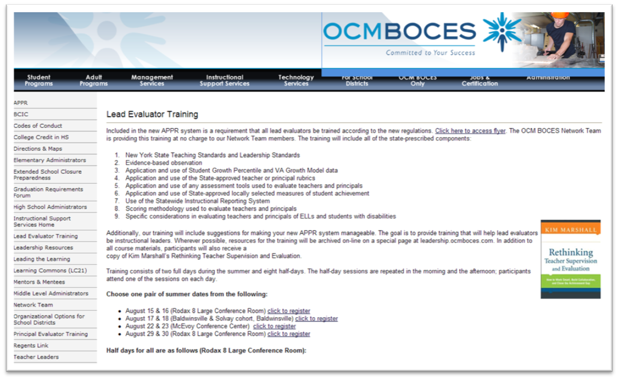
Resources are Archived

Slide 4
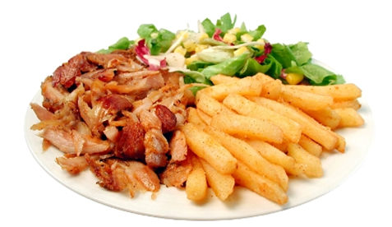
What’s On Your Plate
Fill in your plate with all your professional and personal obligations, responsibilities, initiatives, and goals
At your table, share these (if you don’t know everyone, do introductions, too)
After everyone has shared, make a generalization(s) about
“what’s on our plates”

Slide 5
Here We Are: 9 Components
New York State Teaching Standards and Leadership Standards
Evidence-based observation
Application and use of Student Growth Percentile and VA Growth Model data
Application and use of the State-approved teacher or principal rubrics
Application and use of any assessment tools used to evaluate teachers and principals

Slide 6
Here We Are: 9 Components
Application and use of State-approved locally selected measures of student achievement
Use of the Statewide Instructional Reporting System
Scoring methodology used to evaluate teachers and principals
Specific considerations in evaluating teachers and principals of ELLs and students with disabilities

Slide 7
Here We Are: 9+ Components
Managing the APPR
Connecting it to Race To The Top
Increasing the likelihood that it makes a difference

Slide 8
Here We Are: 9+ Components
What questions or ideas do the objectives bring to mind?
How will the objectives help you in your work?
What objectives would you like to add to the agenda?

Slide 9
Ground Rules
No one in the room has all the answers; we all have regulatory questions and concerns we have to work out in our districts
Remember that we’re leaders
Improving teaching and learning is the point
The State has high standards for observers
when they observe teachers

Slide 10

Ground Rules

Slide 11

Ground Rules

Slide 12
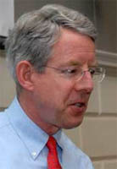
Meet Kim
Notes:
Read Kim’s Op-Ed from the Boston Globe; include 15 minute break.

Slide 13
Professional
Practice
Standards
Data
Culture

Slide 14
The Story of Standards

Slide 15

SCANS
Report
NY
CCLS
Compact for Learning
A Nation
At Risk
NYS Learning
Standards
CCSS
Regents Action Plan
Math
Pre/post
March
1970
1980
1990
2000
2010
2020

Slide 16
ELA/Literacy
Mathematics
Coming Soon:
Next Generation Science
Coming Soon:
CCLS-infused SS

Slide 17
Six Shifts: ELA
Balancing Fiction and Nonfiction
Building Knowledge in the Disciplines
Staircase of Complexity
Text-Based Answers (close reading)
Nonfiction Writing
Academic Vocabulary

Slide 18
Six Shifts: Math
Focus
Coherence
Fluency
Deep Understanding
Applications
Dual Intensity (really, tri)

Slide 19
Professional
Practice
Standards
Data
Culture

Slide 20
Data

Slide 21
It’s always been here…

Slide 22
ITBS
Report Cards
Unit Tests
State Tests
Letters
Performance
Quizzes
Terra Nova
Attendance
Reports
Samples
Notebook
Regents
Inventories
Essay
Anecdotal
Performance
Unit Tests
Scores
Logs
Homework
Pictures
Journals
Posttest
RCT
Rubrics
Conferences
Pretest
PET
Checklists
Interview

Slide 23
It’s not really the data

Slide 24
It is
about
what we
do about
data

Slide 25
Common
Interim
Assessments

Slide 26
give the
test
make
the
test
analyze
the
work
do something about it

Slide 27
Professional
Practice
Standards
Data
Culture

Slide 28
Professional
Practice

Slide 29
APPR
Growth over time
Knowledge of Students & Student Learning
Compared to
Expected Growth
Knowledge of Content & Instructional Planning
Some Variables
Considered
20%
Student
Growth
SLOs Required
Instructional
Practice
60%
Multiple Measures
Moment in time
or growth
Learning
Environment
20%
Student
Achievement
Could be school-
wide measure
Assessment for
Student Learning
Local or
Purchased
Professional Responsibilities
and Collaboration
Some Variables
Considered
SLOs Optional
Professional
Growth

Slide 30
APPR

Slide 31
Professional
Practice
Standards
Data
Culture

Slide 32
What should our schools be like?

Slide 33
Educators working collaboratively… taking collective responsibility for student learning.

Slide 34
Collaborative learning teams implementing a guaranteed and viable curriculum.

Slide 35
Collaborative learning teams monitoring student learning through ongoing common assessments.

Slide 36
Collaborative learning teams using assessment data and student work to make instructional decisions.

Slide 37
Where students find meaning in what they do.

Slide 38
Where students make decisions about what they learn and how they learn it.

Slide 39
Where the 4Cs are embedded in the 3Rs.

Slide 40
Where its about the student's future rather than the adults’ past.

Slide 41
That’s what our schools should be like!

Slide 42
Professional
Practice
Standards
Data
Culture

Slide 43
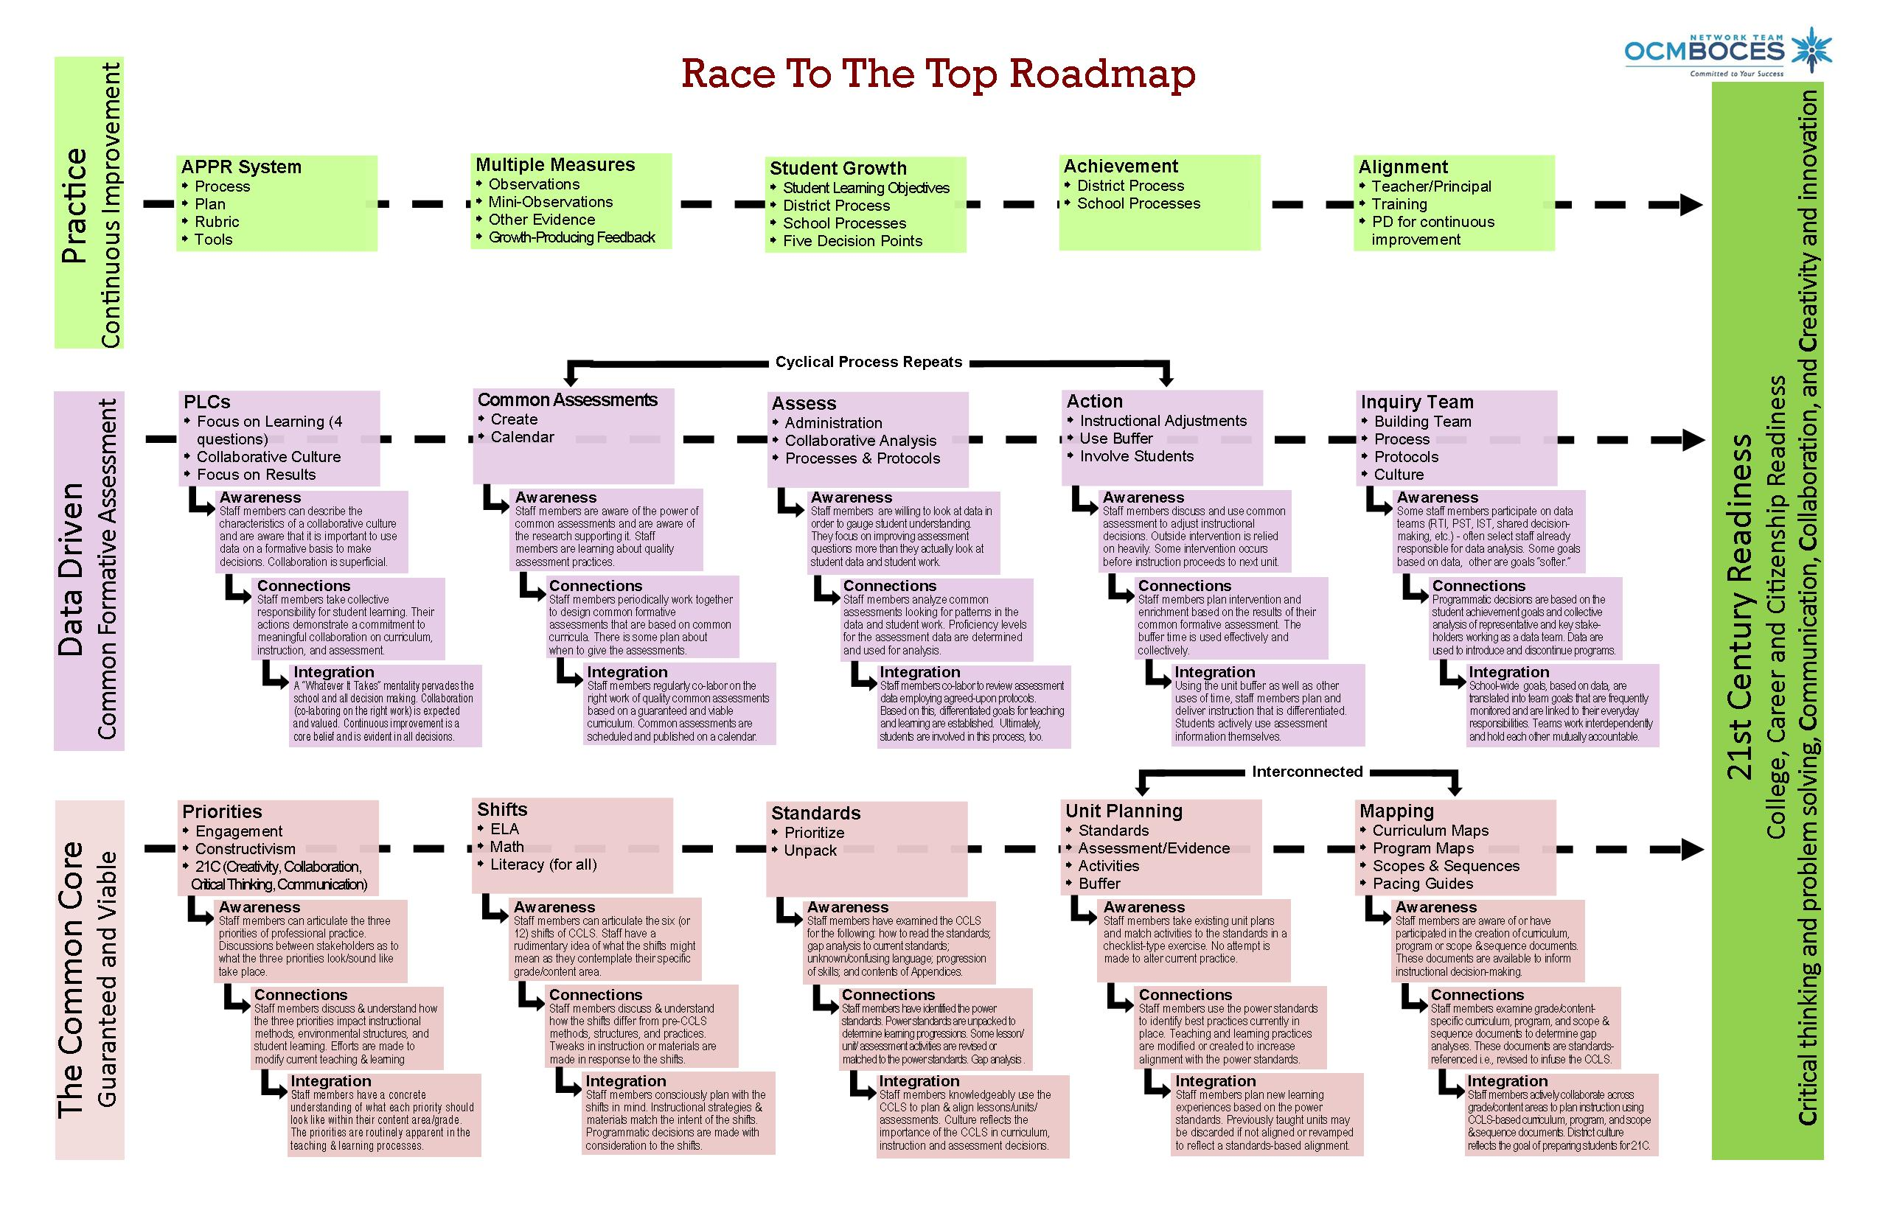
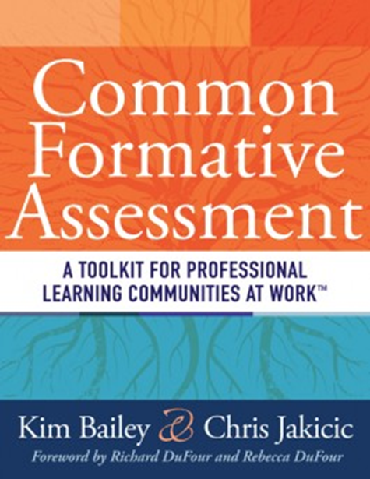
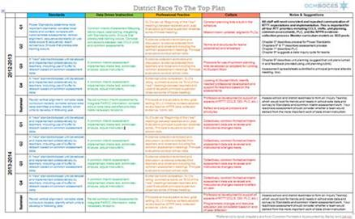
Another Way To Look at the Work
RTTT Road Map
RTTT “textbook”

Slide 44
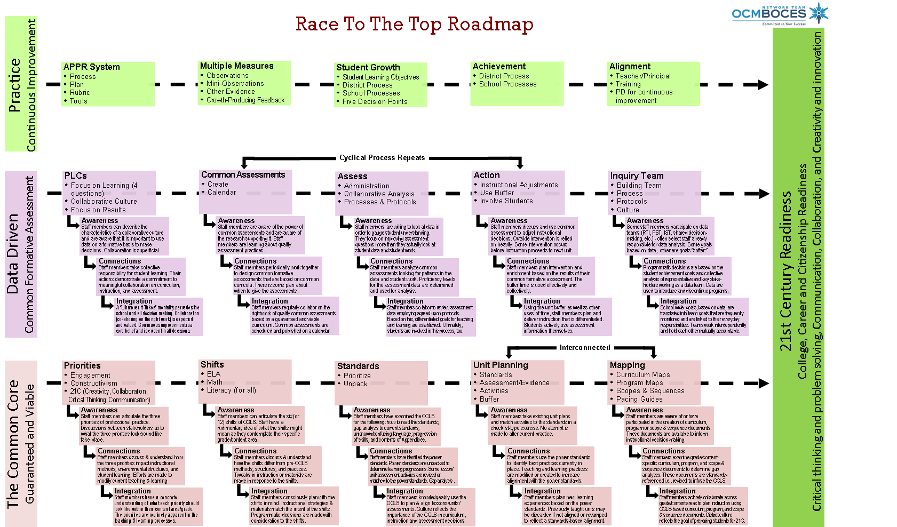
Race To The Top Road Map
Where are
you now?
Notes:
NOTES

Slide 45
Introducing the “textbook”

Slide 46


Introducing the “textbook”
Intro to PLC
DuFour
Hattie
Deming

Slide 47
Introducing the “textbook”
Intro to PLC

Slide 48
Introducing the “textbook”
Intro to PLC

Slide 49
Introducing the “textbook”
Assessment Overview
DuFour
Stiggins
Wiliam

Slide 50
Introducing the “textbook”
What’s Most Important
Marzano
Ainsworth

Slide 51
Introducing the “textbook”
Unpacking
Marzano
Wiggins
McTighe
Ainsworth

Slide 52
Introducing the “textbook”
Assessment Design
Reeves
Ainsworth
Marzano
Stiggins
Popham

Slide 53
Introducing the “textbook”
Unit Planning & Mapping
Covey
Wiggins
McTighe
p21

Slide 54
Introducing the “textbook”
Data-Based Action
Schmoker
DuFour
Wellman
Lipton

Slide 55
Introducing the “textbook”
Involving Students
Popham
Wiliam
Brookhart
Hattie

Slide 56
Introducing the “textbook”
Sustaining the Effort
DuFour
Newmann
Deming

Slide 57
Remember that Plate?

Slide 58

But how is it adding too much to our plates to…

Slide 59
Be clear about what we expect children to learn…

Slide 60
Use assessment and data to nurture and guide learning…

Slide 61
Try to become a better teacher or leader…

Slide 62
Work collaboratively to prepare students for their future?

Slide 63
Are we adding to our plates or is this the way we should already be doing business?

Slide 64

School can be a jungle…
Notes:
Take a break after the video

Slide 65

Professional Practice

Slide 66


Imagine you are in the classroom of a highly effective teacher:
  What would you see?
  What would you hear?
  What would the students be doing or saying?
Individually, write one idea per post-it note.
Notes:
NOTES

Slide 67
As a group, arrange the sticky notes in a way that makes sense, grouping similar ideas together.
Notes:
Need for a common languages. Even thought we had a convergent sense of what should be occurring in a classroom, we all have different descriptors and ways of talking about it

Slide 68
Draw the pie on chart paper.
Label the slices.
Now stick the sticky notes in the slice of the pie in which they belong
Standard 7
Professional Growth
Notes:
NOTES

Slide 69
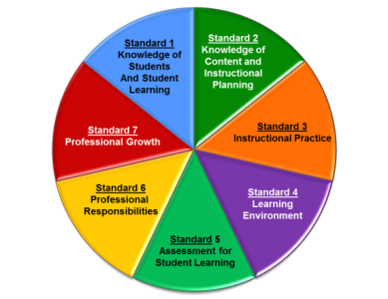
Standard 1: Knowledge of Students & Student Learning
  Knowledge of child development
  Knowledge of research…
  Knowledge of diverse learning needs
  Knowledge of individual students
  Knowledge of economic, social
  Knowledge of technological literacy…
Notes:
NOTES

Slide 70
Standard 2: Knowledge of Content & Instructional Planning
  Knowledge of content…
  Connect concepts across disciplines…
  Uses a broad range of instructional strategies
  Establishes goals & expectations
  Designs instruction
  Evaluate / utilize resources
Notes:
NOTES

Slide 71
Standard 3: Instructional Practice
  Research-based practices
  Communicates clearly…
  High expectations…
  Variety of instructional… to engage student
  Engage students in multi-disciplinary skills
  Monitor and assess progress
Notes:
NOTES

Slide 72
Standard 4: The Learning Environment
  Creates a respectful, safe and supportive environment
  Creates an intellectually stimulating environment
  Manages the learning environment
  Organize and utilize available resources (e.g. physical space, time, technology…)
Notes:
NOTES

Slide 73
Standard 5: Assessment for Student Learning
  Range of assessment tools
  Understand, analyze, use data for differentiation*
  Communicates assessment system*
  Reflect upon assessment system and adjust*
  Prepare students for assessments
  * - assessed through “multiple measures”
Notes:
NOTES

Slide 74
Standard 6: Professional Responsibilities
  Upholds standards and policies
  Collaborate with colleagues
  Communicate & collaborate with families
  Perform non-instructional duties
  Complies with laws and polices
Notes:
NOTES

Slide 75
Standard 7: Professional Growth
  Reflect on practice
  Set goals for professional development
  Communicate and collaborate to improve practice
  Remain current in knowledge of content and pedagogy
Notes:
NOTES

Slide 76
Using the placemat for the NYSED Teaching Framework, re-sort your table’s post-it notes as appropriate to the standard, element and indicator
Notes:
NOTES

Slide 77
Knowledge of Students & Student Learning
Element 1.1 Demonstrate knowledge of child and adolescent development including cognitive, language, social, emotional, and physical developmental levels.
A) Describes developmental characteristics of students
Standards
Summary statements
Elements
Indicators
With rubrics
Notes:
77
NOTES

Slide 78

There are three priorities in the Teaching Standards
Engagement
Constructivism
21st Century
Readiness
PRIORITIES
Notes:
NOTES

Slide 79
Engagement:
Cognitive
Zone of proximal development
Every student (ELLS, SWD, too)
ENGAGEMENT
Notes:
NOTES

Slide 80
Constructivism:
Making connections
Making meaning
Relate to world outside
Relate to personal future
CONSTRUCTIVISM
Notes:
NOTES

Slide 81
21C Readiness:
College
Career
Citizenship
Collaboration
Communication
Critical Thinking & Problem Solving
Creativity
21C READINESS
Notes:
NOTES

Slide 82
Observe what students are doing that shows evidence of engagement, constructing meaning, or 21C. Each triad member is responsible for one priority.
Collect evidence in a table, be prepared to share your evidence.
engagement
constructivism
21C
Notes:
Watch 15 minutes of a lesson. Use math “best deal” video? We have to make sure we chart these pieces of “evidence” for use later!!!

Slide 83
What did you observe in the video?
Evidence from the video
Notes:
We have to make sure we chart these pieces of “evidence” for use later!!!

Slide 84
In addition to the three priorities, other common themes of the Standards (and rubrics):
  Upholds standards and policies
  Equity
  Cultural competence
  High expectations
  Developmental appropriateness
  A focus on individuals, including those with special needs
  Appropriate use of technology
  Student assumption of responsibility
Notes:
NOTES

Slide 85
Learning by Adults and
Learning by Children

Slide 86
Conditions for Learning
Reflect on something you recently learned.
How did you learn it?
How do you know?
What conditions help you learned it?

Slide 87
Conditions for Learning
Reflect on something you recently learned.
How did you learn it?
How do you know?
What conditions help you learned it?
It’s hard to learn on your own without any feedback…

Slide 88
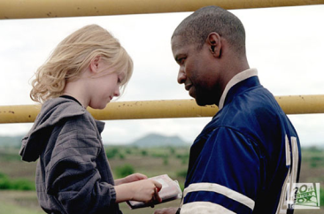
Effective Feedback
What were the qualities of the best feedback you have received?
What were the qualities of ineffective feedback?
Notes:
Click on picture to access video clips. Use in order.

Slide 89
Translating this to Evaluation…

Slide 90
Translating this to Evaluation…
adds Accountability…

Slide 91
Translating this to Evaluation…
adds Accountability…
for Teachers and Evaluators

Slide 92

Highly Effective
Effective
Developing
Ineffective
Notes:
NOTES

Slide 93
Ineffective – Teaching shows evidence of not understanding the concepts underlying the component - may represent practice that is harmful - requires intervention
Developing – Teaching shows evidence of knowledge and skills related to teaching - but inconsistent performance
Notes:
NOTES

Slide 94
This
Is
our focus!
Effective - Teaching shows evidence of thorough knowledge of all aspects of the profession. Students are engaged in learning. This is successful, accomplished, professional, and effective teaching.
Highly Effective – Classroom functions as a community of learners with student assumption of responsibility for learning.
Notes:
NOTES

Slide 95

H
E
D
I
Notes:
NOTES

Slide 96
H
E
D
I
?
Notes:
NOTES
As a table, think of a HEDI scale for an example other than swimming. Ask one or two tables to share.

Slide 97

A second look at a rubric:
Read the descriptors for Element III.4 of the rubric
Highlight the verbs / phrases that distinguish the differences among the levels of performance
Notes:
NOTES

Slide 98
An even closer look at the rubric:
Analyze your assigned element from the rubric (from Standard 3.1 – 3.6 or Standard 5.1)
On the left side of the chart paper, summarize your element
On the right side of your chart paper, describe what the students might be doing in the classroom that exemplifies that element
element summary
what students do
Notes:
NOTES

Slide 99

Gallery walk of the elements 3.1 – 3.6 and 5.1:
Docent at posters, answering questions only!
Carry two sticky notes with you: one with something you expected to see, one for something that surprised you
Place two notes on charts at the end of gallery
Something you expected to see
One thing that surprised you
Notes:
NOTES

Slide 100
The priorities of the framework are critically important to understanding the rubrics and the assessment of teaching practice. How might you respond to the following questions/statements (discuss at table):
  “We don’t have a lot of technology in our district so I don’t think we can hold teachers responsible for 21st Century skills.”
  “We have embraced direct instruction in our district so we can’t expect teachers to be highly effective because direct instruction doesn’t allow for students to take control of the classroom.”
  “How can students be cognitively engaged in something like PE?”
  “I don’t think these rubrics will work for all teachers.”
Notes:
NOTES

Slide 101

What shifts have to occur…
In teachers’ thinking?
In teachers’ actions?
Notes:
NOTES

Slide 102
What shifts have to occur…
In principals’ thinking?
In principals’ actions?
Notes:
NOTES

Slide 103
What shifts have to occur…
In the culture of the district?
In the culture of the school?
Notes:
NOTES

Slide 104
Agenda
Introductions
Objectives and Agenda Review
RTTT: The Big Picture (and resources)
Common Language in Schools
Priorities in the Teaching Standards
Engagement, Constructivism & 21C
Observing a lesson
Teacher Evaluation
Rubric Organization - Levels of Performance
Closure

Slide 105
Agenda Preview
Reconvene and regroup
Objectives and Agenda Review
Focusing on the learners
Teacher Evaluation
The nature of evaluation (feedback, evidence, bias)
Collecting Some Evidence
Getting It Done
Closure

Slide 106
Questions
Visiting the Parking Lot
+/∆
+
∆
Notes:
NOTES

Slide 107
Lead Evaluator Training
Day 1

