Slide 1
Lead Evaluator Training
2012-2013 Ongoing Training
Day 4

Slide 2
Agenda
Growth and Value-Added Update
21st Century Readiness and APPR
Evidence Collection
Inter-rater agreement and reliability
Growth-Producing Feedback
Comparing scaled scores
Teacher Improvement Plans
NEXT Year’s Plans
Notes:
Review the agenda.

Slide 3
Lead Evaluator Training
New York State Teaching Standards and Leadership Standards
Evidence-based observation
Application and use of Student Growth Percentile and VA Growth Model data
Application and use of the State-approved teacher or principal rubrics
Application and use of any assessment tools used to evaluate teachers and principals
Application and use of State-approved locally selected measures of student achievement
Use of the Statewide Instructional Reporting System
Scoring methodology used to evaluate teachers and principals
Specific considerations in evaluating teachers and principals of ELLs and students with disabilities
Notes:
These are the “nine” official goals of Lead Evaluator Training.

Slide 4
Lead Evaluator Training
From the Review Room: “Describe the process by which evaluators will be trained and the process for how the district will certify and re-certify lead evaluators. Describe the process for ensuring
inter-rater reliability. Describe the duration and nature of such training.”
Notes:
This is where ongoing training is mentioned in the Review Room.

Slide 5
Lead Evaluator Training
Continue to collect evidence
Use collected evidence to rate teachers on a rubric (with feedback)
Manage the new system
Employ growth-producing feedback to increase the quality of teaching
Implement the Reform Agenda (RTTT)
Notes:
Our local goals for Lead Evaluator Training, in addition to the required components.

Slide 6
Leadership for Readiness
What Boards Do | What Superintendents Do | What Principals Do
Educate the community on readiness and the changes needed Adopt policies that support the focus on college and career readiness Budget based on values and expectations of the community Protect human capital investments through professional development Evaluate the superintendent based on multiple measures, including student achievement, teacher & leader effectiveness Focus discussion at Board meetings on student achievement, teaching and learning Be knowledgeable about the Reform Agenda | Build principals’ capacity and hold them accountable for implementing: Standards Data-Driven Instruction Evidence Based Observation Foster the use of district-wide, common interim assessments Expect principals to be involved in the data-driven instruction process with teachers Implement effective & aligned professional development at all levels of the district Demand and protect principal time in classrooms | Build teacher understanding around the Shifts in Instruction demanded by adoption of the Common Core Protect teacher time to plan Standards-based units Have a laser-like focus on teaching and learning and build a culture of reflection and continuous improvement Spend as much time as possible in classrooms Engage in growth-producing conversations with teachers; build teacher capacity & hold them accountable Foster systems for test-in-hand analysis of interim assessment data
Notes:
Adapted from Commissioner King's Presentation at the NYSCOSS 2013 Winter Institute [NYSED]

Slide 7
Leadership for Readiness
What Boards Do | What Superintendents Do | What Principals Do
Educate the community on readiness and the changes needed Adopt policies that support the focus on college and career readiness Budget based on values and expectations of the community Protect human capital investments through professional development Evaluate the superintendent based on multiple measures, including student achievement, teacher & leader effectiveness Focus discussion at Board meetings on student achievement, teaching and learning Be knowledgeable about the Reform Agenda | Build principals’ capacity and hold them accountable for implementing: Standards Data-Driven Instruction Evidence Based Observation Foster the use of district-wide, common interim assessments Expect principals to be involved in the data-driven instruction process with teachers Implement effective & aligned professional development at all levels of the district Demand and protect principal time in classrooms | Build teacher understanding around the Shifts in Instruction demanded by adoption of the Common Core Protect teacher time to plan Standards-based units Have a laser-like focus on teaching and learning and build a culture of reflection and continuous improvement Spend as much time as possible in classrooms Engage in growth-producing conversations with teachers; build teacher capacity & hold them accountable Foster systems for test-in-hand analysis of interim assessment data
WHAT DO YOU THINK?
Notes:
Adapted from Commissioner King's Presentation at the NYSCOSS 2013 Winter Institute [NYSED]

Slide 8


Slide 9
Value-Added Update

Slide 10
Value-Added, or Not?
No Board of Regents agenda item yet
beta for high school principal VAM completed
Guidance does say that HS principals use SLO if no VAM(2B7)
???

Slide 11
Mini-lesson:
21st Century Skills

Slide 12


Slide 13
21C Scavenger Hunt
In the document provided at your table, look through it and highlight any references to
21st Century Skills
Communication
Collaboration
Critical Thinking
Creativity and Problem Solving

Slide 14
NYS Teaching Standards III.5
Teachers engage students in the development of multidisciplinary skills, such as communication, collaboration, critical thinking, and use of technology.
Students synthesize and express ideas both in written and oral formats.
Students work effectively with others, including those from diverse groups and with opposing points of view.
Students make decisions, solve problems, and take actions as appropriate.
Students solve problems and/or acquire new knowledge through creative and innovative approaches to learning.
Students utilize technologies and resources to solve real world problems.

Slide 15
NYS Teaching Standards III.5
Teachers engage students in the development of multidisciplinary skills, such as communication, collaboration, critical thinking, and use of technology.
Students synthesize and express ideas both in written and oral formats.
Students work effectively with others, including those from diverse groups and with opposing points of view.
Students make decisions, solve problems, and take actions as appropriate.
Students solve problems and/or acquire new knowledge through creative and innovative approaches to learning.
Students utilize technologies and resources to solve real world problems.
THESE ARE THE 4 Cs!

Slide 16
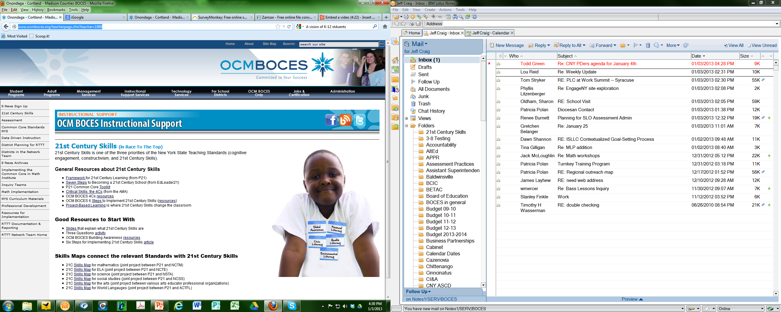
21C Resources

Slide 17
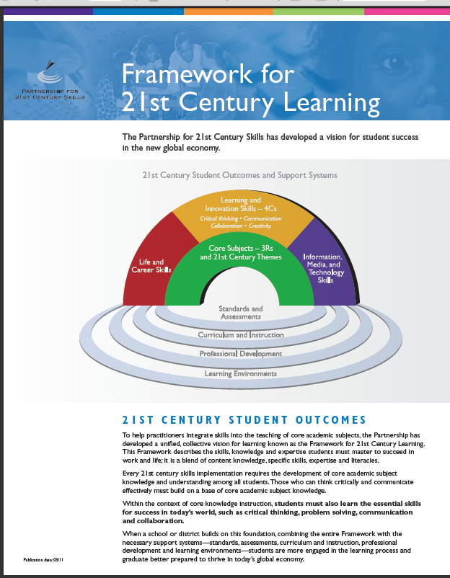
21C Resources

Slide 18
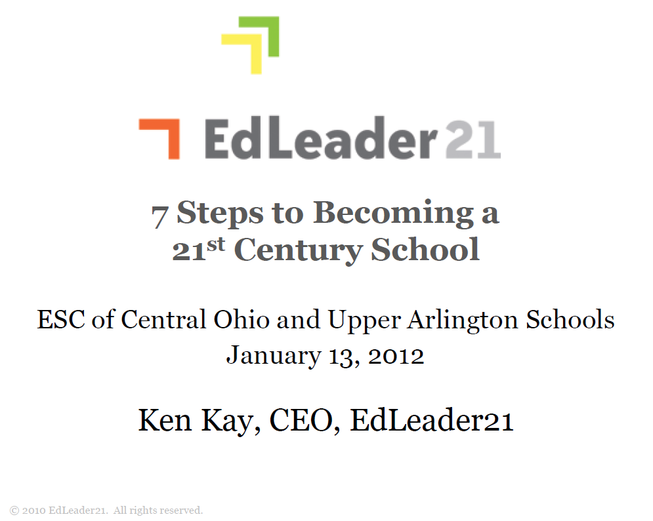
21C Resources

Slide 19

21C Resources

Slide 20
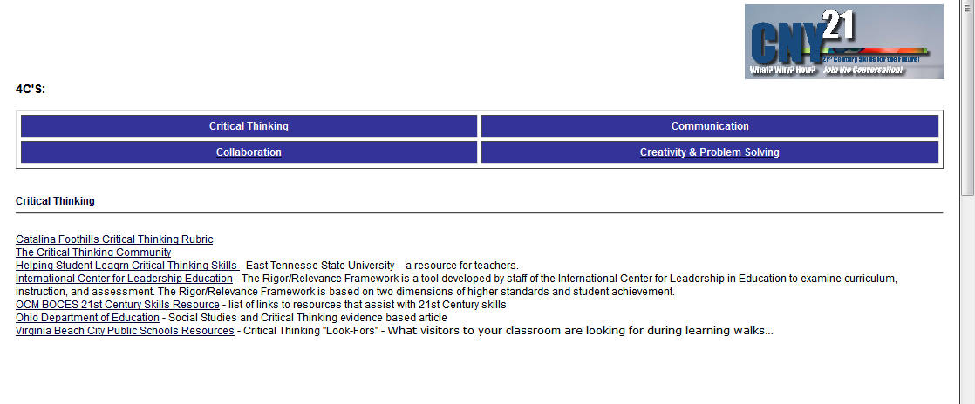
21C Resources

Slide 21
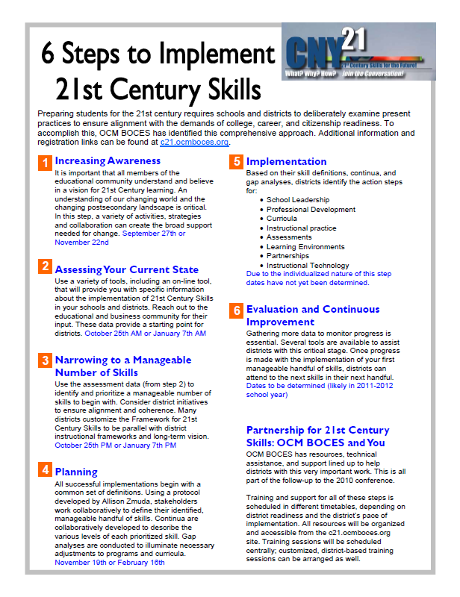
21C Resources

Slide 22

21C Resources

Slide 23
21C Resources

Slide 24
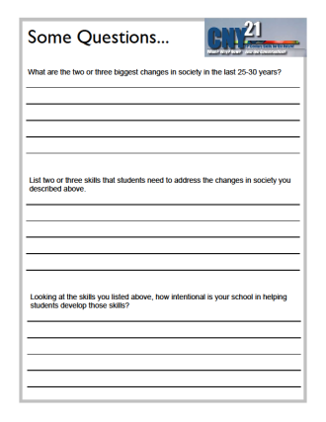
21C Resources

Slide 25
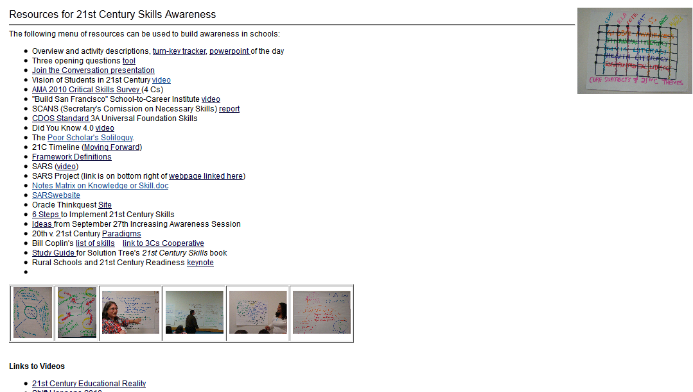
21C Resources

Slide 26
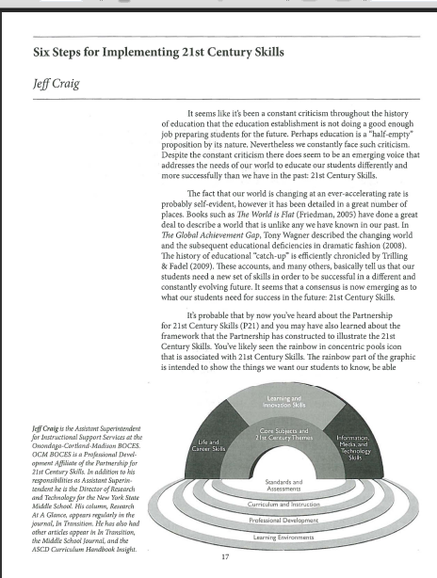
21C Resources

Slide 27

III.5 Mini-Observation

Slide 28

Quick break

Slide 29
Evidence Collection and
Growth-Producing Feedback

Slide 30
Evidence Collection
Watch the video
Collect evidence
Focus on instruction
  Standard III (Teaching Standards and NYSUT)
  Domain 3 (Danielson)

Slide 31
Evidence Collection
Label the evidence provided to you
Use Standards (or refer to Danielson)

Slide 32
Evidence Collection
Rate the teacher on Standard 3 (NYSUT).
As prompted in polleverywhere, text your rating
Where were you, compared to
  Others in the room
  (inter-rater agreement)
  The facilitator
  (inter-rater reliability)

Slide 33

Growth-Producing Feedback
With your neighbor, plan your conversation with the teacher

Slide 34
Using Scaled Scores in SLOs and LATs

Slide 35
Problems with Scaled Scores
Not comparable from year to year
Scale is changing ( from ≈400-800 to ≈100-200 or the like)

Slide 36
Problems with Scaled Scores
Not comparable from year to year
Scale is changing ( from ≈400-800 to ≈100-350 or the like)
So, how can you compare from year to year? Can you?

Slide 37
Comparing Scaled Scores
When this might come up?
  SLOs
  LATs
  RtI
  AIS identification
  Parent questions
  Other

Slide 38
Low, Mid, High Example
Choose a grade band to work with
For “old” scale scores:
  Divide 1 range into three sections (thirds)
  Repeat for 2, 3, 4
For “new” scale scores, work in the opposite direction

Slide 39
4x9 Example
Choose a grade band to work with
For “old” scale scores:
  Enter the low and high for each range in the spreadsheet
For “new” scale scores:
  Enter the low and high for each range in the spreadsheet
Compare old and new to see if growth

Slide 40
Teacher Improvement Plans

Slide 41


§30-2.10(a) and (b)
Teacher or Principal
Improvement Plans

Slide 42
C17 from Guidance
When/under what circumstances must a district or BOCES implement a teacher or principal improvement plan?
Upon rating a teacher or principal as Developing or Ineffective through an annual professional performance review, a school district or BOCES must formulate and commence implementation of a teacher or principal improvement plan (TIP and PIP, respectively) for that teacher or principal.

Slide 43
C17 from Guidance
When/under what circumstances must a district or BOCES implement a teacher or principal improvement plan?
The TIP or PIP must be developed locally through negotiations and implementation must begin no later than 10 school days from the opening of classes in the school year following the school year for which such teacher or principal’s performance is being measured.

Slide 44
C18 from Guidance
What are some potential elements of improvement plans?
An improvement plan defines specific standards-based goals that a teacher or principal must make progress toward attaining within a specific period of time, such as a 12-month period, and shall include the identification of areas that need improvement, a timeline for achieving improvement, the manner in which improvement will be assessed, and, where appropriate, differentiated activities to support improvement in these areas.

Slide 45
C18 from Guidance
What are some potential elements of improvement plans?
The plan should clearly describe the professional learning activities that the educator must complete. These activities should be connected directly to the areas needing improvement. The artifacts that the teacher or principal must produce that can serve as benchmarks of improvement and as evidence for the final stage of the improvement plan should be described, and could include items such as lesson plans and supporting materials, including student work.

Slide 46
C18 from Guidance
What are some potential elements of improvement plans?
The supervisor should clearly state in the plan the additional support and assistance that the educator will receive. In the final stage of the improvement plan, the teacher or principal should meet with his or her supervisor to review the plan, alongside any artifacts and evidence from evaluations, in order to determine if adequate improvement has been made in the required areas outlined within the plan for the teacher or principal.

Slide 47
Evidence Based TIPs
Look at rubric
(standard or element or indicator level?)
Prioritize based on district and building goals
Identify possible SUSTAINED actions that could be included
Go to your form; fill it out
What is YOUR plan?

Slide 48
Have a Go!
On YOUR form, get started!

Slide 49

Tips for TIPs
Think remediation
Think positive intentions
Think priorities
Think focus
Think coaching
Think differentiated
Think sustainability
Think ongoing

Slide 50
Tips for TIPs
Don’t think punishment
Don’t think compliance
Don’t think workshop alone
Don’t think buffet
Don’t think quick fix
Don’t think one size fits all

Slide 52
Looking to 2013-2014
Considering a different approach:
 | Cortland | Syracuse
AM | Danielson | NYSUT & Teaching Standards
PM | NYSUT & Teaching Standards | Danielson
What do you think? Feedback?

Slide 53
Looking to 2013-2014
What else would help?
Growth Producing Feedback, again?
Year One cohort, again?
Ongoing year 3 – roughly the same
schedule as this year? Other possibilities?

