Slide 1
Lead Evaluator Training
2015-2016 Ongoing Training
Day 3

Slide 2
Welcome to Day 3
Lead Evaluator Training
Agenda Review

Slide 3
Nine Required Components
3012-c
3012-d
New York State Teaching Standards and Leadership Standards
Evidence-based observation
Application and use of Student Growth Percentile and VA Growth Model data
Application and use of the State-approved teacher or principal rubrics
Application and use of any assessment tools used to evaluate teachers and principals
New York State Teaching Standards and Leadership Standards
Evidence-based observation
Application and use of Student Growth Percentile method
Application and use of the State-approved teacher or principal rubrics
Application of assessment tools the district employs

Slide 4
Nine Required Components
3012-c
3012-d
Application and use of State-approved locally selected measures of student achievement
Use of the Statewide Instructional Reporting System
Scoring methodology used to evaluate teachers and principals
Specific considerations in evaluating teachers and principals of ELLs and students with disabilities
Application and use of State-approved locally selected measures of student growth
Use of the Statewide Instructional Reporting System
Scoring methodology used by the state and the district
Specific considerations in evaluating teachers and principals of ELLs and students with disabilities

Slide 5
Our Components
Managing the APPR (especially in d)
Connecting it to Learning
Increasing the likelihood that it makes a difference

Slide 6
Agenda
Transition: §3012-c and §3012-d
Research: Widget Effect
Literature: Smorgasbord
Evidence Collection & Scoring (with feedback)
Summative Evaluation (in light of the changes)
Notes:
Review the agenda.

Slide 7
Warm Up Activity
At your table, outline what the “transition” means for your teachers, THIS YEAR.

Slide 8
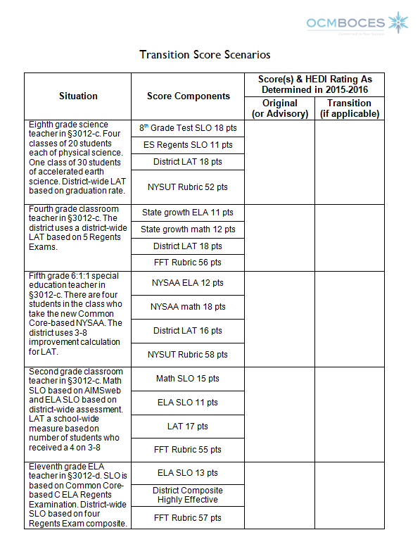
Warm Up Activity
Worksheet:
Review each of the transition score scenarios. Determine the score(s) and rating(s) for each teacher or principal.

Slide 9
Research:
Revising the Widget Effect

Slide 10
The Widget Effect
The New Teacher Project (2009) labeled the failure of systems to discriminate among teacher performance as “the Widget Effect.”
Less than 1% of teachers rated unsatisfactory
But 81% of administrators and 57% of teachers could identify a teacher in their school that was unsatisfactory

Slide 11
The Widget Effect
Findings led to changing evaluation practices
Influenced RTTT requirements
Many states changed their practices

Slide 12
The Widget Effect - REVISITED
2.7% rated below satisfactory
Evaluators estimate 27.8% below satisfactory
Evaluators expected fewer unsatisfactory ratings than were deserved going in

Slide 13
The Widget Effect - REVISITED
Reasons for inflation:
  Factoring in potential
  Personal discomfort
  It could be worse
  Skewed systems

Slide 14
The Widget Effect - REVISITED
Reasons for inflation:
  Factoring in potential
  Personal discomfort
  Lack of faith in the overall system
  Disagreement with foundation
  It could be worse
  Skewed district-determined scoring systems

Slide 15
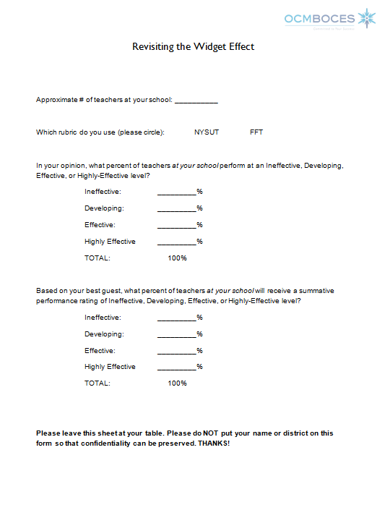
The Widget Effect - REVISITED
Local Research Project
  Please fill in information about your school or district and leave it behind.
  Anonymous survey

Slide 16

Three-Minute Pause

Slide 17
Literature:
Smorgasbord

Slide 18
Article Read & Share
Look the articles over
Choose one that interests you
Read it
Take turns discussing when all done

Slide 19
Article Read & Share
Identify the connection between the different article that your table read
?

Slide 20
Evidence Collection Practice

Slide 21
Evidence Collection Practice
ELA Lesson
Watch it (mini)
Collect evidence, clean it up, sort, etc.
Score on the provided rubric: Classroom environment focus
Check out inter-rater reliability

Slide 22
Standard IV: Learning Environment
Teachers work with all students to create a dynamic learning environment that supports achievement and growth.

Slide 23
Element IV.1
Teachers create a mutually respectful, safe, and supportive learning environment that is inclusive of every student.
Teachers are caring and respectful in their interactions with students.
Teachers embrace student diversity as an asset in the classroom.
Teachers recognize and reinforce positive interactions among students.
Teachers create a climate of acceptance and respect.
Teachers create an environment where students show responsibility to and for one another.

Slide 24
Element IV.2
Teachers create an intellectually challenging and stimulating learning environment.
Teachers encourage students to set high standards and expectations for their own performance.
Teachers motivate students to initiate their own learning and strive to achieve challenging learning goals.
Teachers promote students’ curiosity and enthusiasm for learning.
Students are actively engaged in learning.
Students openly express their ideas.
Students show pride in their work and accomplishments

Slide 25
Element IV.3
Teachers manage the learning environment for the effective operation of the classroom.
Teachers establish, communicate, and maintain clear standards and expectations for student behavior.
Teachers develop, implement, and adapt routines and procedures to manage activities and transitions.
Teachers facilitate instructional groupings to maximize student participation, cooperation, and learning.
Students exhibit respectful classroom interactions.

Slide 26
Element IV.4
Teachers organize and utilize available resources (e.g., physical space, time, people, technology) to create a safe and productive learning environment.
Teachers arrange and adapt the physical environment to accommodate individual and group learning needs and to celebrate student accomplishments.
Teachers ensure that all students have equitable access to available resources and technologies.
Teachers effectively use the services and skills of available volunteers and paraprofessionals.
Teachers know and implement policies and procedures to ensure student safety.

Slide 27

Evidence Collection Practice

Slide 28
Scoring
Compare your evidence
Look at the rubric, decide what you can score (probably not everything)
Determine a score for those items

Slide 29
Feedback
What kind of feedback would you provide this teacher?
Discuss at your table.
Plan, especially, your opening line.

Slide 30
Connect Back
Make a connection between the conversation you want to have with the teacher and one (or more) of the articles we read today.

Slide 31
Preparing for the
Summative Evaluation

Slide 32
Preparing for the
Summative Evaluation
TRANSITION

Slide 33
Summative Evaluation
SLO scoring conversion
LAT scoring conversion
Rubric scaling to 60 points
Total Score > HEDI scale
Growth-Producing Feedback
PD recommendations
Improvement Plan Requirements
TRANSITION

Slide 34
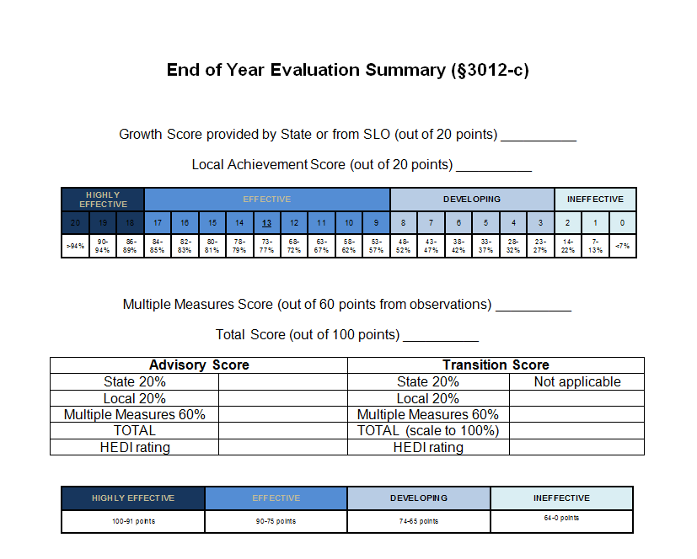
C in Transition

Slide 35
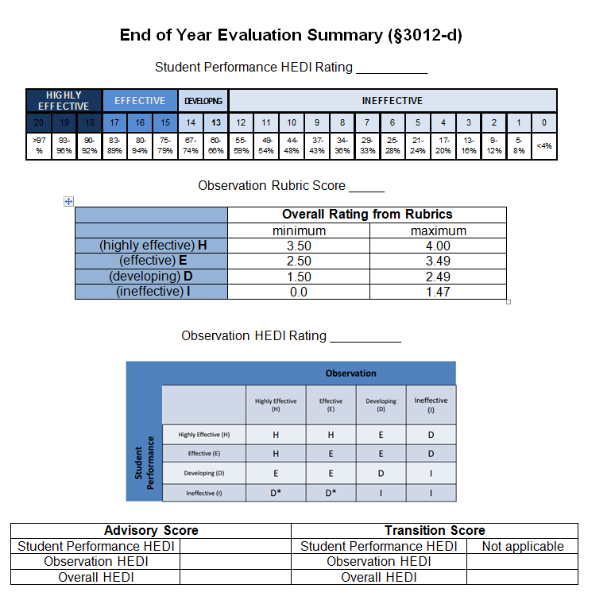
D in Transition

Slide 36
One Last Transition Practice
4th grade classroom teacher
Combined ELA and math growth score from state 13 pts
For LAT, 2/3 of students met the target on the 4th grade science test
Rubric score of 3.2 translates to 55 pts

Slide 37
Closure Activity

Slide 38
Next Year
Year One Cohort for New Administrators? Likely?
Ongoing Training (need your input)
  Likely 3 sessions
  Timing similar to last year?
  Four repeats to choose from?
  What else?

Slide 39
Closure: Next Year
On note paper, write a quick letter to Jeff about what you would like to see included in or changed for
Lead Evaluator Training,
NEXT YEAR.
Leave it at your table.
Dear Jeff:

Slide 40
Lead Evaluator Training
See you next year!

