Slide 1
Lead Evaluator Training
2014-2015 Ongoing Training
Day 3

Slide 2
Welcome Back!
[re]Orientation
Lead Evaluator Training Background
Agenda Review

Slide 3
Lead Evaluator Training
Year 1
New York State Teaching Standards and Leadership Standards
Evidence-based observation
Application and use of Student Growth Percentile and VA Growth Model data
Application and use of the State-approved teacher or principal rubrics
Application and use of any assessment tools used to evaluate teachers and principals
Application and use of State-approved locally selected measures of student achievement
Use of the Statewide Instructional Reporting System
Scoring methodology used to evaluate teachers and principals
Specific considerations in evaluating teachers and principals of ELLs and students with disabilities
Notes:
These are the “nine” official goals of Lead Evaluator Training.

Slide 4
Lead Evaluator Training
Ongoing
From the Review Room: “Describe the process by which evaluators will be trained and the process for how the district will certify and re-certify lead evaluators. Describe the process for ensuring inter-rater reliability. Describe the duration and nature of such training.”
Notes:
This is the language about ongoing Lead Evaluator Training.

Slide 5
Lead Evaluator Training
Ongoing
Continue to collect evidence
Use collected evidence to rate teachers on a rubric (with feedback)
Manage the new system
Employ growth-producing feedback to increase the quality of teaching
Implement the Reform Agenda (RTTT)
Notes:
Our local goals for Lead Evaluator Training.

Slide 6
Lead Evaluator Training
Ongoing
Or, to basically increase the likelihood that all of this can make a difference.
Notes:
Our local goals for Lead Evaluator Training.

Slide 7
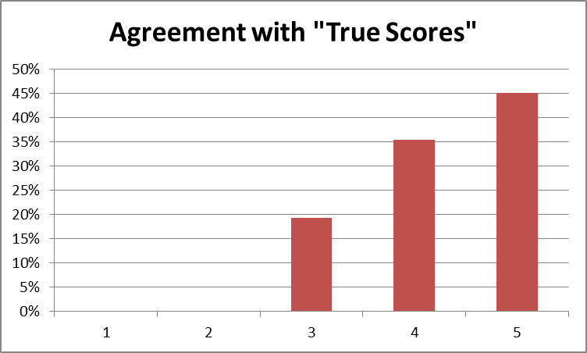
FFT Scorer Distribution

Slide 8
FFT Scorer Distribution
When a score was off from the “true score:”
4% scored lower
96% scored higher

Slide 9
NYSUT Scorer Distribution

Slide 10
NYSUT Scorer Distribution
When a score was off from the “true score:”
10% scored lower
90% scored higher

Slide 12
Agenda
Growth Mindset
Review of Artifacts
Summative Evaluations
End-of-the-year Meetings
Looking Ahead to Next Year
Notes:
Review the agenda.

Slide 13
Growth Mindset
Connecting with Research & Literature

Slide 14
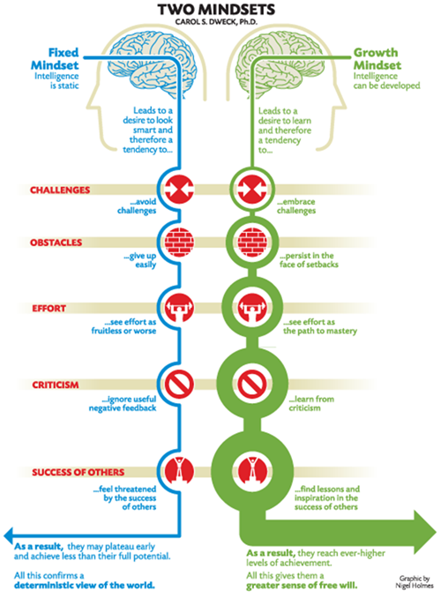

Slide 15
Growth Mindset
Read a recent article about mindset and teachers.
Think about your staff and the things you hear in your school.
Identify some things you could do to foster a Growth Mindset

Slide 16
1. Growth Mindset
Read a recent article about mindset and teachers.
Every few minutes you will be prompted to “say something” about what you’ve read so far to a partner.
This will repeat several times.

Slide 17
2. Growth Mindset
Think about your staff and the things you hear in your school.
Jot down on either side some of the things you’ve heard in your school about both mindsets (on the back side of the article).

Slide 18
3. Growth Mindset
Identify some things you could do to foster a Growth Mindset.
Talk at your table about some of the things you can do.
Record these at the bottom of the page.

Slide 19
Beginning of the Year

Slide 20
The Year at a Glance
Beginning of the Year
Ongoing
End of the Year
✓
Beginning of the year meeting
Standards I and II
SLO and local (LAT) target setting
Evidence Submission by Teacher
Evidence Collection
Sharing the evidence
Feedback Conversations
Evidence from the year collected
Compare collected evidence to the rubric
Summative score determination and communication
✓
✓

Slide 21
“Middle” part of the Year

Slide 22
The Year at a Glance
Beginning of the Year
Ongoing
End of the Year
Beginning of the year meeting
Standards I and II
SLO and local (LAT) target setting
✓
Evidence Submission by Teacher
Evidence Collection
Sharing the evidence
Feedback Conversations
Evidence from the year collected
Compare collected evidence to the rubric
Summative score determination and communication
✓
✓
✓

Slide 23
End-of-the-Year

Slide 24
The Year at a Glance
Beginning of the Year
Ongoing
End of the Year
Beginning of the year meeting
Standards I and II
SLO and local (LAT) target setting
Evidence Submission by Teacher
Evidence Collection
Sharing the evidence
Feedback Conversations
Evidence from the year collected
Compare collected evidence to the rubric
Summative score determination and communication

Slide 25
Artifacts
Examine some new artifacts. These artifacts are in the “end of the year” section, paper-clipped together. Take a look at them. Talk about them. Use the organizer.

Slide 26
Time Out: Taking Stock

Slide 27
Taking Stock
Reflect on the progress you have made this year:
LAST YEAR

Slide 28
Top Three Reflections
Think back on this year. What were the three “biggies” for your school this year:
Instructional:
Cultural:
Other:

Slide 29
Top Three Reflections
Look ahead to next year. What might be the three “biggies” for your school this year:
Instructional:
Cultural:
Other:

Slide 30
Summative Score
Calculate Mr. Greenburgh’s summative score for the year.
He received a “10” for his state growth score.
Use the roster to calculate his LAT score
Use the rubric score summary to determine his 60 points (using the methodology for your district)

Slide 31
PD Recommendations
What will be your PD recommendations for Mr. Greenburgh for next year?
Look at his artifacts
Look at his scores from the rubric
Think about your “biggies” for next year

Slide 33
Folder Organization
Please reorganize the folder:
Beginning of the Year section
Lesson section
End of the year section
Rubric (in order)

Slide 34
End-of-the-Year Meetings
Individual Meetings
and/or
Group Meetings

Slide 35
Meeting Plan (or Map*)
Yes, it is about summative requirements
But it is about more:
Reflection
School-wide reflection and progress toward goals
Setting the stage for next year
Notes:
Whether or not your APPR plan requires individual end-of-the-year meetings, you should do this with your staff. Use department meetings, grade-level meetings, or faculty meetings.

Slide 36
Preparing for the Meeting(s)
What will your agenda be for the individual or group end-of-the-year meetings?
Recall from the research we looked at last year that teachers report that uncertainty about process and expectations is a source of anxiety

Slide 37
Preparing for the Meeting(s)
Take a few moments to jot down what your end-of-the-year meeting agenda might look like

Slide 38
Growth-Producing Feedback
With your neighbor, plan your conversation with the teacher

Slide 39
Closure Activity

Slide 40
Next Year
Year One Cohort for New Administrators? Likely?
Ongoing Training (need your input)
Likely 3 sessions
Timing similar to last year?
Four repeats to choose from?
What else?

Slide 41
Closure: Next Year
On note paper, write a quick letter to Jeff about what you would like to see included in or changed for Lead Evaluator Training, NEXT YEAR.
Leave it at your table.
Dear Jeff:

